Slide 1
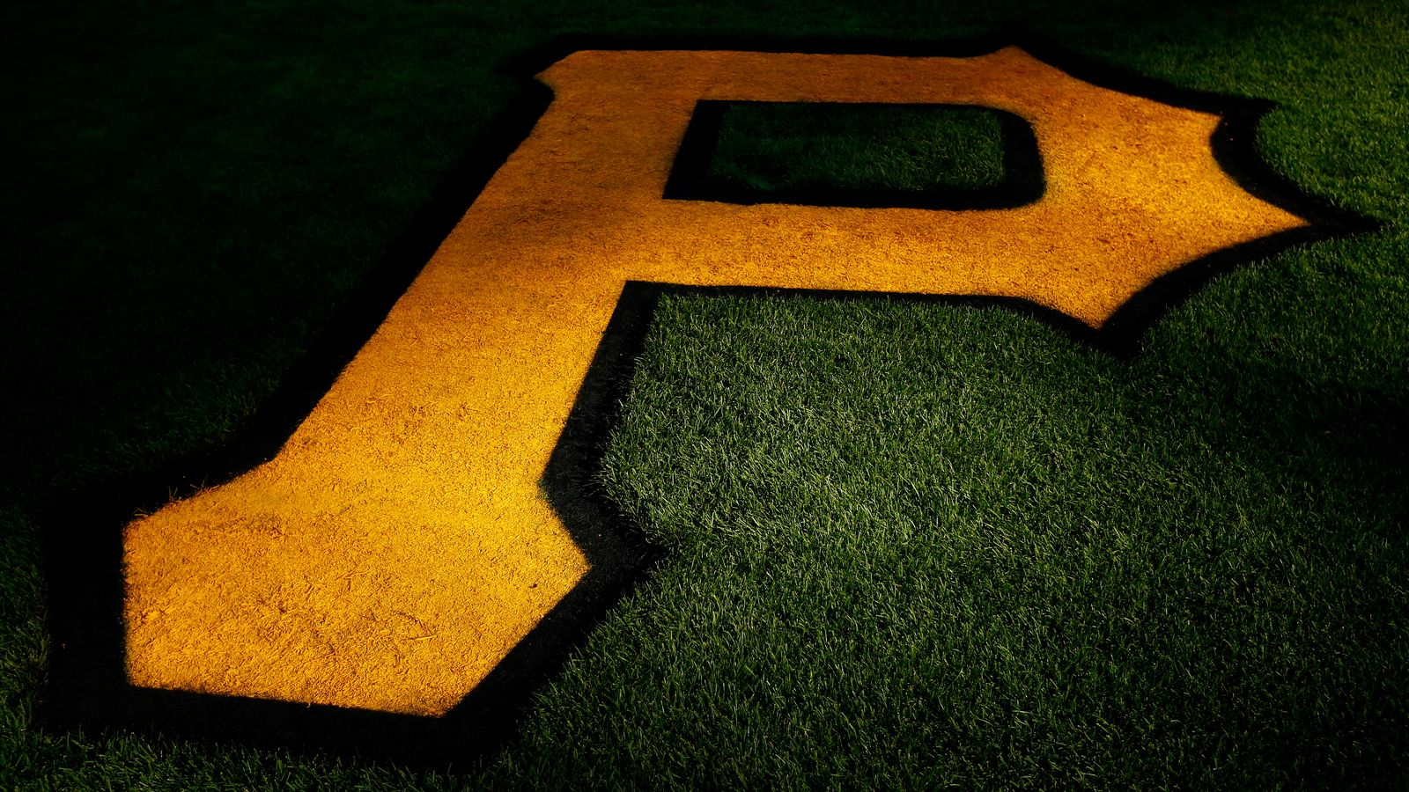
Pittsburgh Pirates Sport Marketing Plan
Kristen Swann

Slide 2
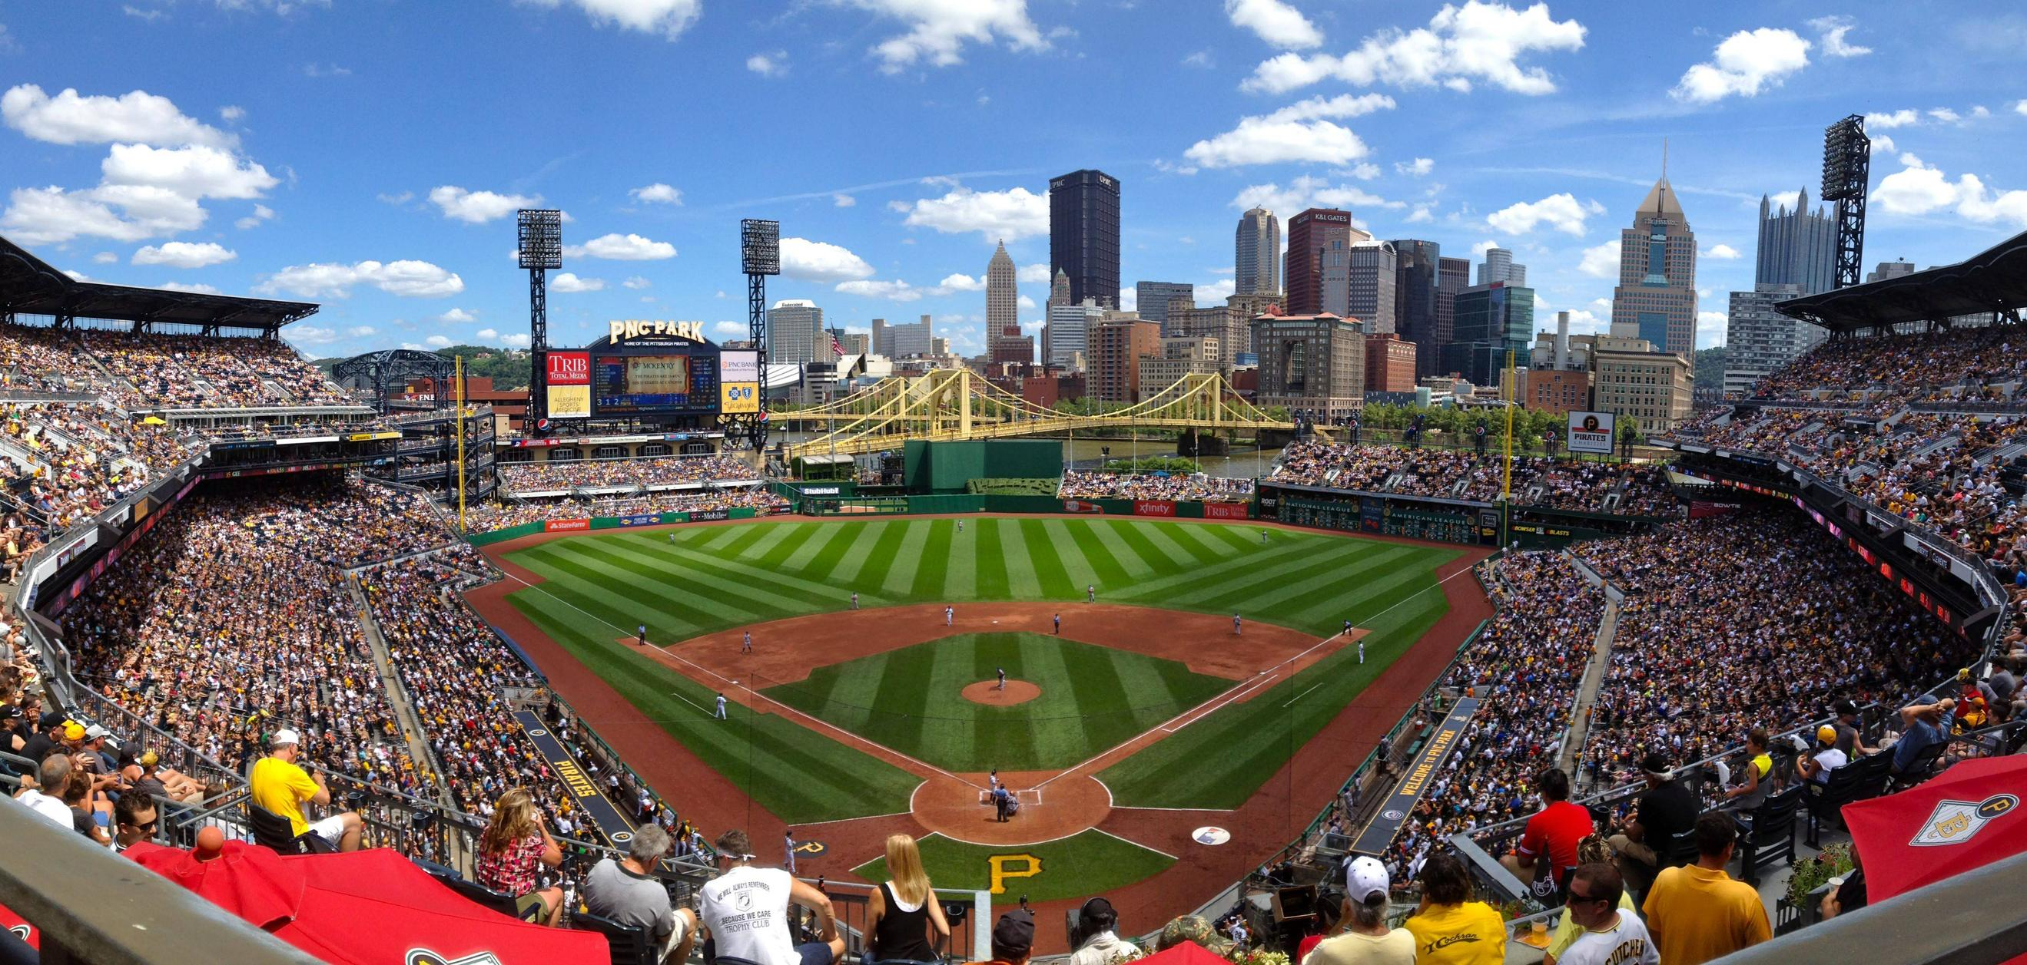
Introduction
MLB- National League
PNC Park
Owner- Robert Nutting
Manager- Clint Hurdle
General Manager- Neal Huntington

Slide 3
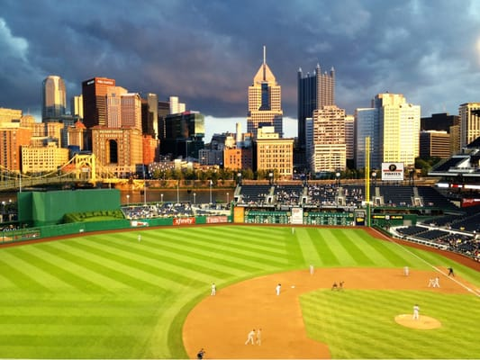
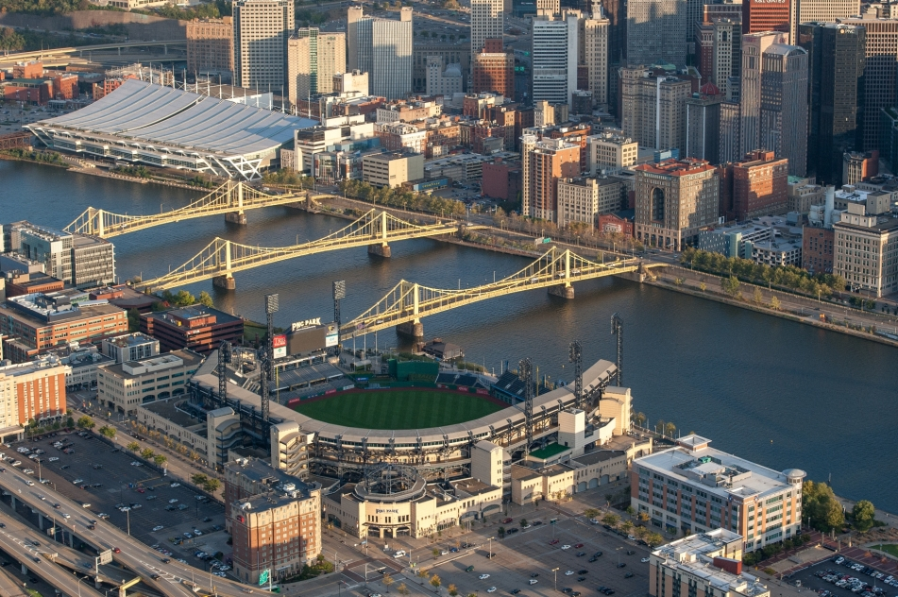
Facility Overview: PNC Park
Opened on March 31, 2001
115 Federal Street Pittsburgh, PA
Capacity- 38,362
$216 million to construct

Slide 4

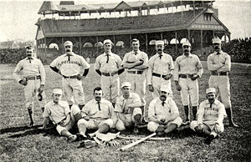
History
Founded in 1881 as Allegheny
Later the Pittsburgh Alleghenys, Pittsburg Pirates and now Pittsburgh Pirates
5 World Series Championships
Video

Slide 5
Organizational Value
Current overall franchise value- $975 million (18th in MLB)
Average MLB team value- $1.3 billion
Operating income- $35 million
Total revenue in 2016- $244 million

Slide 6






Sponsors

Slide 7
Mission Statement
“WE WILL”
Our goal is excellence in everything that we do both on and off the field. We are just as committed to excellence in how we interact with the community, our business partners and, most importantly, our fans. PNC Park is the Best Ballpark in America, and we will continue to look at ways to improve the fan experience to make it an even more inviting and fun place to visit.

Slide 8
Charities
Pirates Charities is committed to strengthening the community by supporting organizations and programs aimed at improving the lives of children and adults in the greater Pittsburgh region. Pirates Charities places a special emphasis on supporting youth programs focused on health, fitness, and education by developing partnerships with those who share in our mission.
video

Slide 9
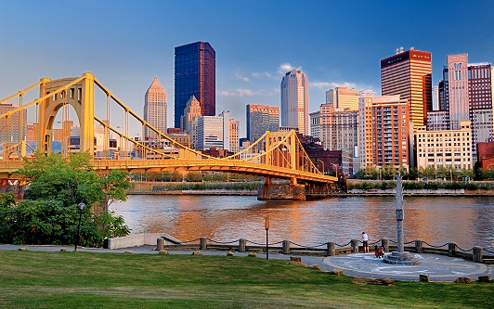
Pittsburgh Demographics
Population- 334,563
67% White, 27% African American, 3% Asian
47.56% male, 52.44% female
24% 20-34 years old

Slide 10

Fan Base of MLB
70% male, 30% female
26% 35-54 years old
83% White
32% $40-$75k income

Slide 11
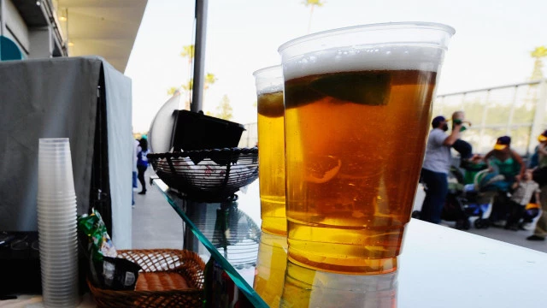
Prices
Pittsburgh Pirates
MLB Average
Average ticket price- $31
Hot dog- $4.37
Beer- $5.95
Parking- $15.89
Average Ticket price- $29.96
Hot dog- $1.63
Beer- $5.50
Parking- $15

Slide 12
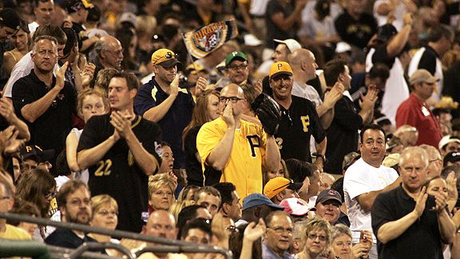
Target Audience
Women- only 30% of MLB fan base
Younger fans- children, 20-34 year olds
Minority groups
35-54 year old men- keeping loyal fans

Slide 13
SWOT Analysis
Strengths- Only MLB team in Western PA/NY, no other major sports during season, relatively low prices
Weaknesses- low budget, losing season in 2016
Opportunities- Andrew McCutchen, some success in recent years
Threats- Steelers, Penguins, Cleveland Indians

Slide 14
Marketing Objectives
28,112 average attendance in 2016
38,362 capacity of PNC Park
Objective: increase ticket sales
Bring in new fans from target market
    Women
    Children
    Increase diversity of fan base

Slide 15

Strategies
Ladies Night
  With purchase of ticket:
    Giveaways to women at gates
    Food and drink specials
    Happy Hour at centerfield prior to game
    Wine tasting throughout stadium
    Discounted women’s apparel

Slide 16
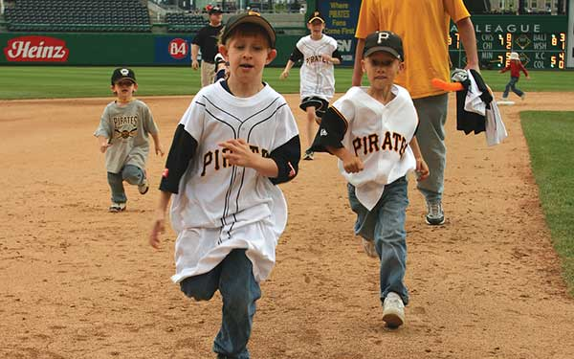
Strategies
  Kids Day
  Children 12 and under:
    Tee-shirt/jersey giveaway
    1 free food item
    Face painting
    Kids run the bases after game
    Bounce houses/kids zone
Video

Slide 17

Strategies
Student Night
  Pitt Themed
    Ticket discount with student ID
    Drink and food specials
    Limited edition Pirates/Pitt apparel
    Games with free ticket or food prizes

Slide 18

Strategies
Ethnic Nights
  Example: Korea Night
    Special ticket pricing for groups
    Jung Ho Kang Bobble Head Giveaway
    Korean Food Vendors
    Autograph signing with Jung Ho Kang

Slide 19
Summary
With this marketing plan, the Pirates organization will increase revenue and grow financially. The strategy includes continuing a strong relationship with loyal fans as well as creating a more diverse fan base. The fan experience will continue to improve and remain the top priority of the Pirates organization.

Slide 20
Sources
http://www.forbes.com/forbes/welcome/?toURL=http%3A//www.forbes.com/pictures/mlm45gdfgj/baseballs-most-valuable/&refURL=https%3A//www.google.com/&referrer=https%3A//www.google.com/
http://pittsburgh.pirates.mlb.com/pit/community/charities.jsp
http://pittsburgh.areaconnect.com/statistics.htm
http://opendorse.com/blog/2013-sports-fan-demographics/
https://www.statista.com/statistics/193673/average-ticket-price-in-the-mlb-by-team/
http://www.cbsnews.com/media/the-7-most-and-least-expensive-stadiums-to-watch-a-major-league-baseball-game/
https://www.gobankingrates.com/personal-finance/ranked-most-least-expensive-stadiums-mlb-fans-watch-baseball-game/

