Slide 1
Physical Fitness and Physical Activity in Older Adults
Mgr. Lenka Svobodova, Ph.D.
Incubator of Kinanthropology Research
Department of Gymnastics and Combatives

Slide 2
Physical activity in older adults
Goals
  Maintaining self-sufficiency (the ability to perform activities of daily living (ADL)
  Maintaining or improving the quality of life
  Slowing down aging processes and their manifestations

Slide 3
Older adults
Physical fitness
Physical activity

Slide 4
Components of Physical Fitness
Cardiorespiratory endurance
Musculoskeletal fitness
Body weight and body composition
Flexibility
Balance

Slide 5
Cardiorespiratory endurance
  ability to the heart, lungs, and circulatory system to supply oxygen and nutrients efficiently to work muscles.
  Assessment
    To measure the maximum oxygen consumption (V02max),
    or the rate of oxygen utilization of the muscles during aerobic exercise, in order to assess cardiorespiratory endurance and functional aerobic capacity. Physical fitness evaluations should include a test of cardiorespiratory function during rest and exercise. Graded exercise tests (GXTs) are used for this purpose.
    6-minute walking test (easy to use in practice)
    2-minute step test

Slide 6
The 6 minute walk test - 6MWD
6 Minute Walk Test Distance Conversion Table
Standard estimates from 6MWD (feet walked) to METs
Based on ACSM metabolic prediction equation formula for horizontal walking.*
Distance Distance MPH Meters
in feet in meters ∙min-1 VO2(ml∙kg-1∙min-1) METs
500 152 .94 25 6.04 1.73
510 155 .96 26 6.09 1.74
520 159 .98 26 6.14 1.75
530 162 1.00 27 6.19 1.77
540 165 1.02 27 6.24 1.78
550 168 1.04 28 6.29 1.80
560 171 1.06 28 6.35 1.81
570 174 1.08 29 6.39 1.83
580 177 1.10 29 6.45 1.84
590 180 1.11 30 6.50 1.86
600 183 1.13 30 6.55 1.87
610 186 1.15 31 6.59 1.89
620 189 1.17 32 6.65 1.90
630 192 1.19 32 6.70 1.91
640 195 1.21 33 6.75 1.93
650 198 1.23 33 6.80 1.94
The 6MWD is a sub-maximal exercise test used to assess aerobic capacity and endurance. The distance covered over a time of 6 minutes is used as the outcome by which to compare changes in performance capacity.

Slide 7
Musculoskeletal fitness assessment
The measurable variables are mass, strength and physical performance.
Variables Measurement techniques
Muscle mass Dual energy X-ray absorptiometry (DXA)
                Bioimpedance analysis (BIA)
Muscle strength Handgrip strength
                Arm Curl
                Knee flexion/extension
Physical performance Usual gait speed
        Chair stand
                Foot up and go

Slide 8
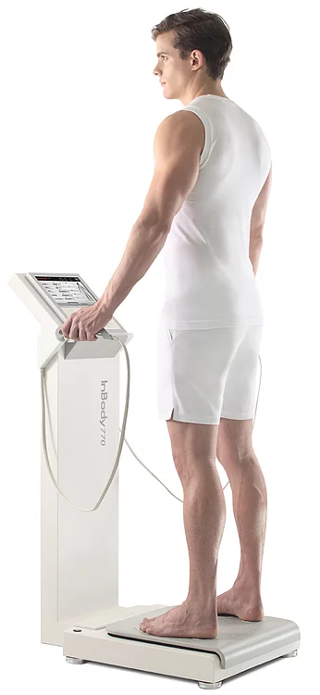
Muscle mass assessment
A wide range of techniques can be used to assess muscle mass. Cost, availability and ease of use can determine whether the techniques are better suited to clinical practice or are more useful for research.
Dual energy X-ray absorptiometry (DXA) is one of the methods for research and also clinical use to distinguish fat, bone mineral and lean tissues. This whole-body scan exposes the patient to minimal radiation. The main drawback is that the equipment is not portable, which may preclude its use in largescale epidemiological studies.
Bioimpedance analysis (BIA) estimates the volume of fat and lean body mass. The test itself is inexpensive, easy to use, readily reproducible and appropriate for both ambulatory and bedridden patients.

Slide 9
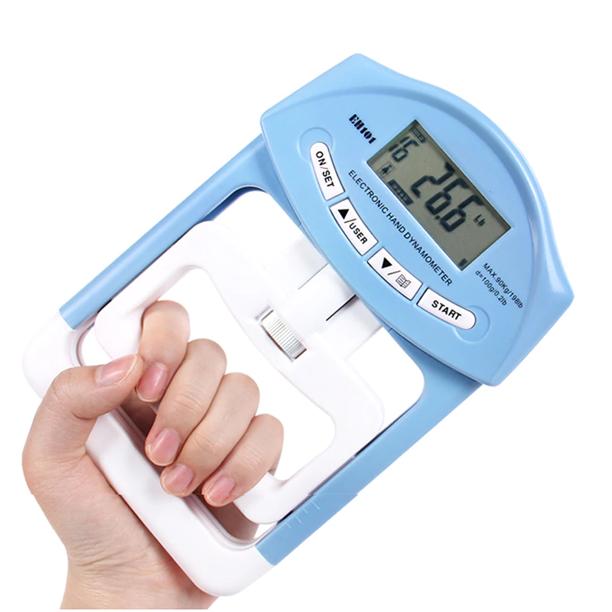
Muscle strength assessment
Hand grip strength test
Physical status according to the result given by the dynamometer (in kg)
Age Male Female
normal strong weak normal strong weak
Isometric hand grip strength is strongly related with lower extremity muscle power, knee extension torque and calf cross-sectional muscle area. Low handgrip strength is a clinical marker of poor mobility and a better predictor of clinical outcomes than low muscle mass. In practice, there is also a linear relationship between baseline handgrip strength and incident disability for activities of daily living (ADL).

Slide 10
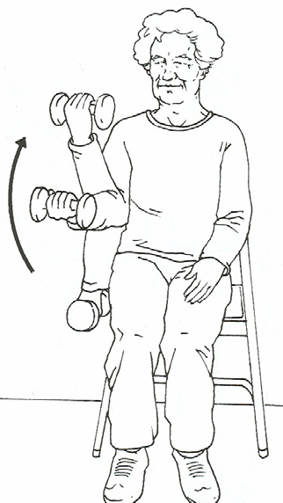
Muscle strength assessment
Senior fitness test – Arm Curl - To assess upper-body strenght
  Number of biceps curls that can be completed in 30 seconds
  holding and hand weight of 5 pounds (2.27 kg) for women;
  8 pounds (3.63 kg) for men
  # curls in 30 seconds
  Age Men Women
  60 – 64 19 17
  65 – 69 18 17
  70 – 74 17 16
  75 – 79 16 15
  80 – 84 15 14
  85 – 89 13 13
  90 + 11 11

Slide 11
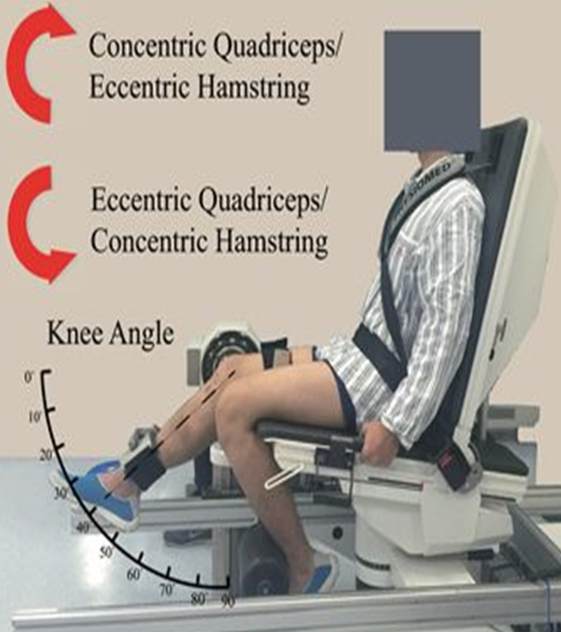
Muscle strength assessment
Isokinetic dynamometry
  Knee flexion/extension
Strength is about the magnitude of force generation, whereas power is about work rate (work done per unit time). In healthy older people, power is lost faster than strength. Both are important, but power is a better
predictor of certain functional activities.
Strength can be measured isometrically or isokinetically, the latter being a closer reflection of muscle function in everyday activity.
It is usually measured as the force applied to the ankle, with the subject seated in an adjustable straight-back chair, the lower leg unsupported and the knee flexed to 90°. Modern, commercial isokinetic dynamometers allow both isometric and isokinetic measurements of strength as concentric torque at various angular velocities. Measurement is feasible in frail older people.

Slide 12
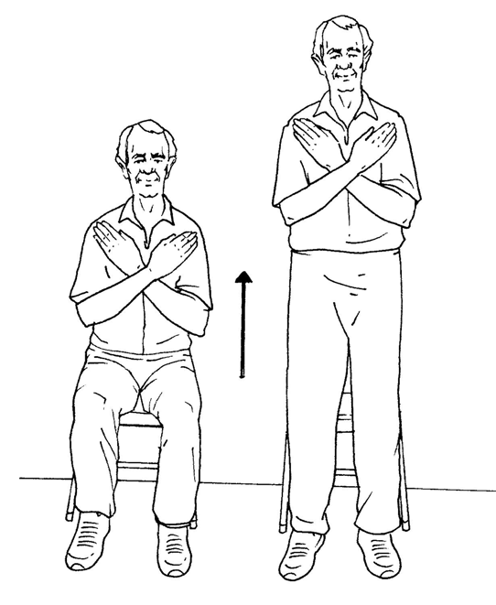
Physical performance assessment
Senior fitness test – Chair stand – To assess lower-body strenght
  Number of full stands that can be completed in 30 seconds with arms folded across chest
# stands in 30 seconds
Age Men Women
60 – 64 17 15
65 – 69 15 15
70 – 74 15 14
75 – 79 14 13
80 – 84 13 12
85 – 89 11 11
90 + 9 9

Slide 13
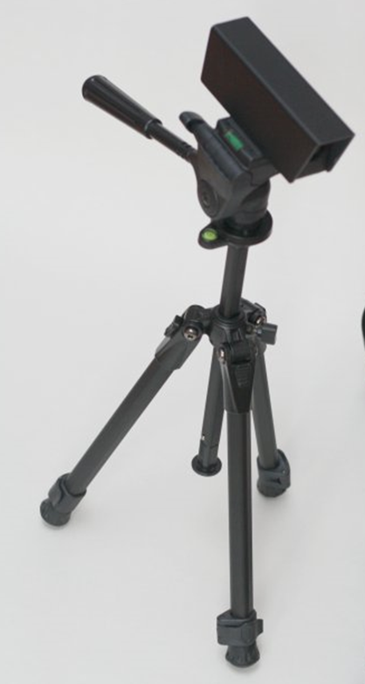
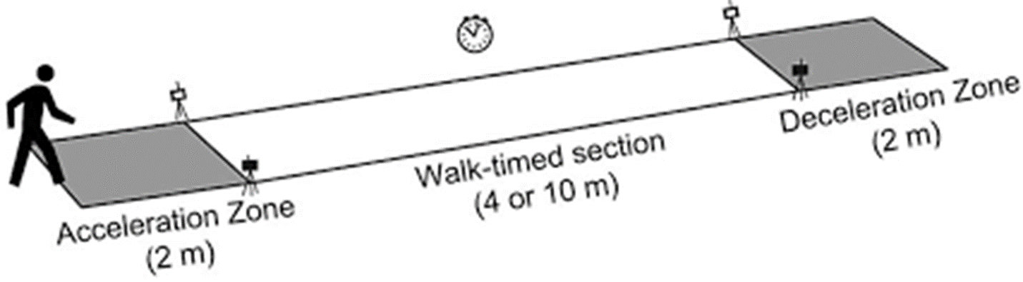
Physical performance assessment
Timed 10-Meter Walk Test
Normal comfortable speed or
maximum speed trials

Slide 14
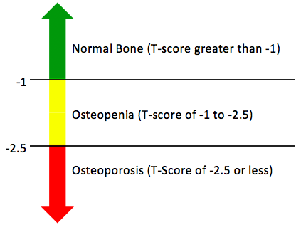
Bone strenght assessment
A bone density test uses X-rays to measure how many grams of calcium and other bone minerals are packed into a segment of bone. The bones that are most commonly tested are in the spine, hip and sometimes the forearm.
DEXA scores are reported as "T-scores" and "Z-scores." The T-score is a comparison of a person's bone density with that of a healthy 30-year-old of the same sex. The Z-score is a comparison of a person's bone density with that of an average person of the same age and sex.

Slide 15
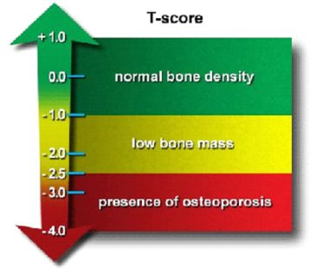
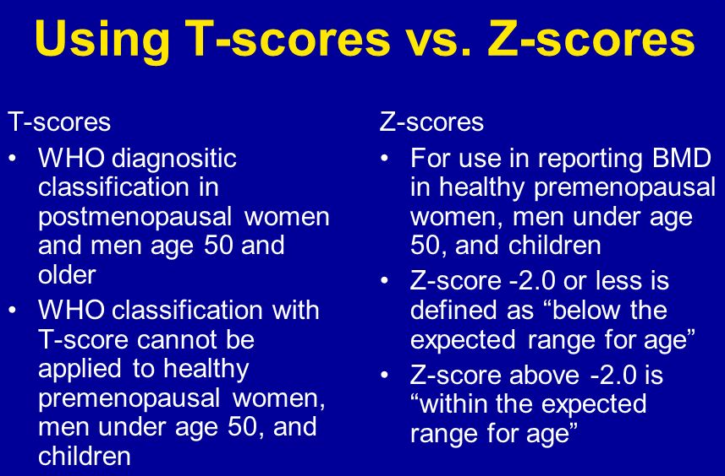
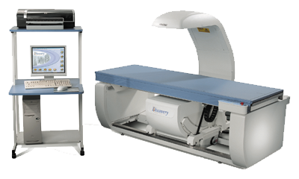
Bone Densitometry (DXA)

Slide 16
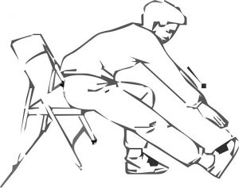
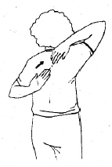
Flexibility
  the ability to move a joint or series of joints fluidly through the complete range of motion. Flexibility is limited by factors such as bony structure of the joint and the size and strength of muscles, ligaments, and other connective tissues.
  Assessment
  Senior fitness test (SFT) – Chair sit – and – reach test
  SFT – Back scratch test

Slide 17
Balance
  the ability to keep the body's center of gravity within the base of support when maintaining a static position, performing voluntary movements, or reacting to external disturbances.
  Functional balance refers to the ability to perform daily movement tasks requiring balance such as picking up an object from the floor dressing, and turning to look at something behind you.
Assessment
  Static balance
    Posturography
    The One-Legged Stance Test
  Dynamic balance
    The 3m backwards walk test
    Foot up and go test
    Reach test
There are inconsistencies in the terminology used - postural stability, postural control, postural responses, postural sway, postural balance, balance, balance ability, balance control, balance performance, dynamics of standing balance, and so on. We work with the following terminology - static balance and dynamic balance.

Slide 18
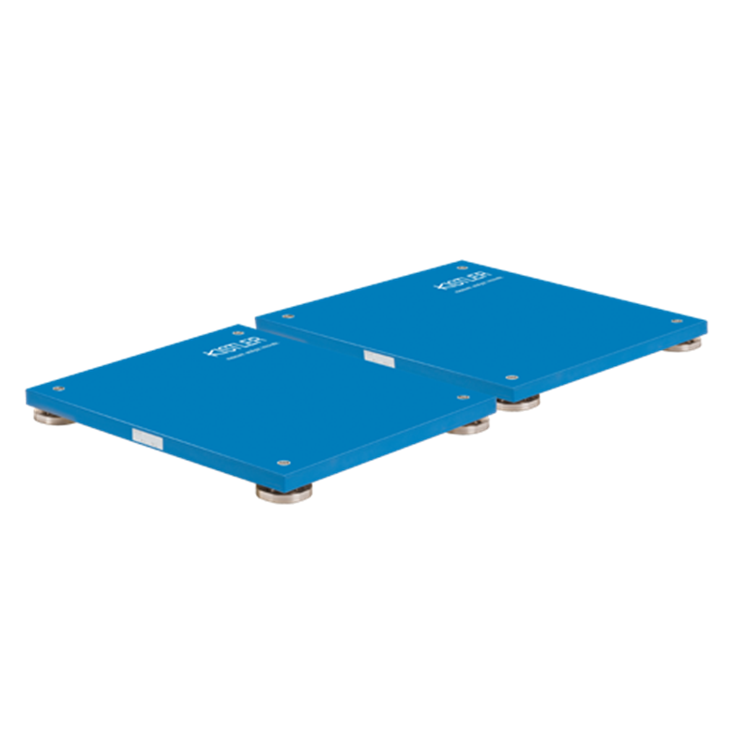
Static Balance - force plates
Posturography is the technique used to quantify postural control in upright stance in either static or dynamic conditions.
The trials were performed under both eyes closed (EC) and eyes open (EO) conditions in double leg stance and narrow. Most researchers conducted between 2 and 5 repetitions of postural sway recordings.
The possible effect of fatigue, especially in a population of balance impaired or otherwise pathologically affected elderly subjects, has to be considered when increasing the trial number or duration.
In studies was found higher overall reliability values under eyes closed conditions compared to open eyes.
Changing from a narrow- to a broad-based stance invokes a change in balance strategy from ankle to hip to the trunk and in the degree of control by stiffness.
The most common COP variable reported is the total sway path length, sway area, medial-lateral sway length, anterior-posterior sway length, and velocity.
Even though it has been shown that COP measures differ between age groups, these measures' reliability is not influenced by gender.
Resistance exercise interventions did not significantly change any of the variables in either eye open or closed conditions.

Slide 19
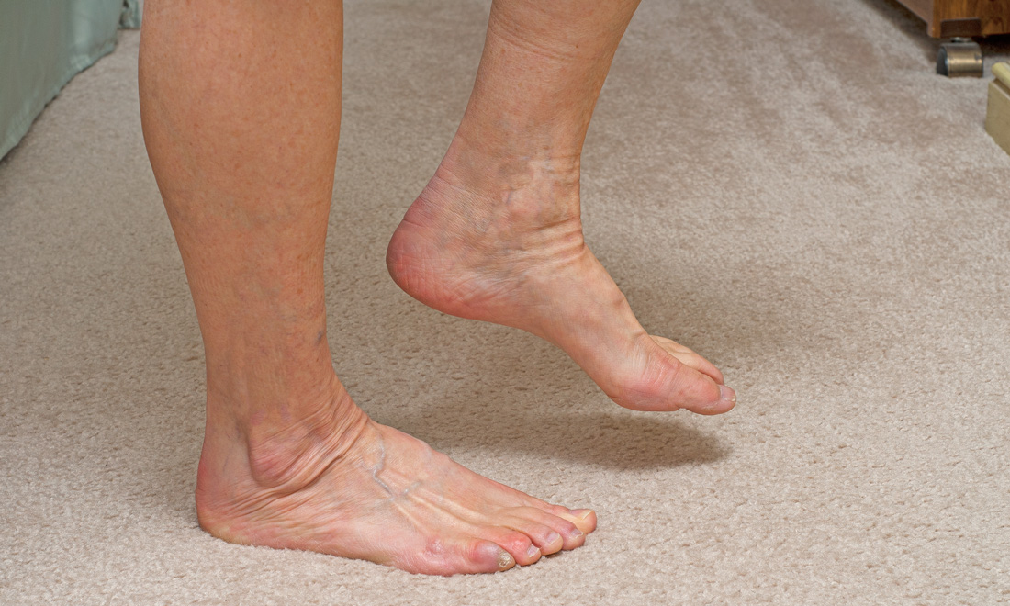
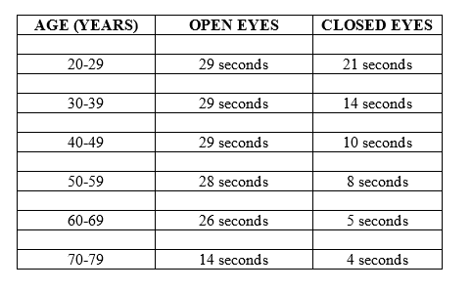
    The One-Legged Stance Test
    measures postural stability (i.e., balance) and is more difficult to perform due to the narrow base of support required to do the test. ... The patient is then instructed to close his eyes and maintain balance for up to 30 seconds.
Simple Balance Test

Slide 20
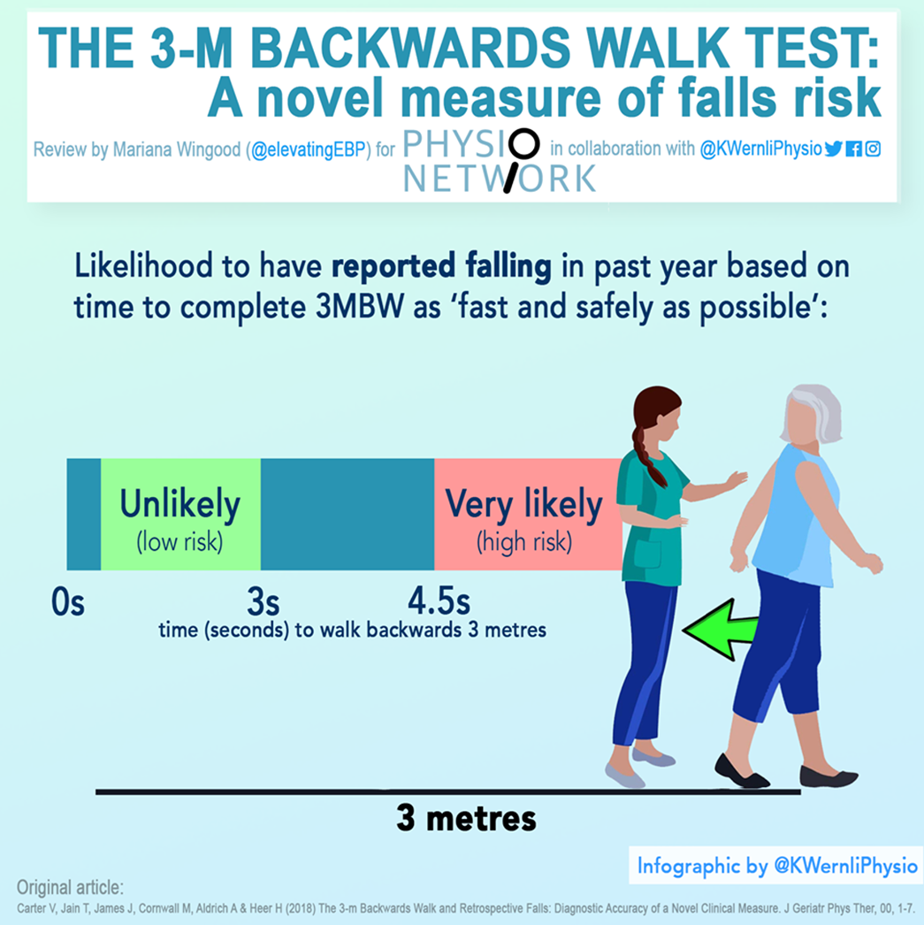
Dynamic balance ability – assessment
The 3-m backwards walk test
... Several measures of fall risk have been previously developed and include forward walking, turning, and stepping motions.
… recent research has demonstrated that backwards walking is more sensitive at identifying age-related changes in mobility and balance compared with forward walking…

Slide 21
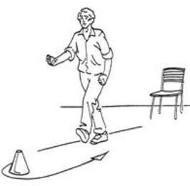
Dynamic balance ability assessment
Senior fitness test – 8 – Foot up and go
  Number of seconds required to get up from a seated position, walk 8 feet (2.44m), turn and return to seated position
  Seconds to complete task
  Age Men Women
  60 – 64 4.8 5.0
  65 – 69 5.1 5.3
  70 – 74 5.5 5.6
  75 – 79 5.9 6.0
  80 – 84 6.4 6.5
  85 – 89 7.1 7.1
  90 + 8.0 8.0

Slide 22
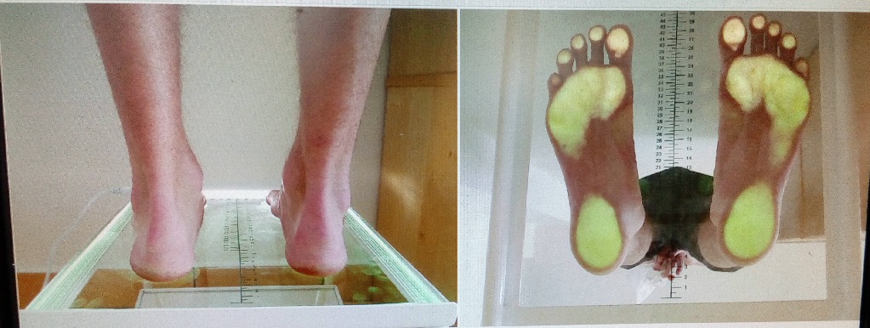
Podocam
Device showing arch shape (footprint)
To assess foot type

Slide 23
Research focus
The impact of different types of physical activity in older adults
Predictive model of fall prevention in older adults
Analysis of walking of selected age groups

Slide 24
Predictive model of fall prevention in older adults
MUNI/IGA/1643/2020
We found very important to develop predictive model prevention for falls in older adults to prevent injuries leading to mortality and morbidity. In praxis, only single tests related to falls risk are used. However, the complex set of tests would bring valuable variables, which lead to results that are more accurate.
The aim of this study
The predictive models based on measured variables will be created as a tool for assessing the physical fitness of older adults with regard to fall prevention. The models could bring innovative approach to prevention of falls in older adults.
Bringing the models, we would be able to predict the risk of falls in older adults, therefore to suggest appropriate targeted intervention fitness program or medical consultation

Slide 25
Predictive model of fall prevention in older adults
Methods:
Study design
It will be an observational cross-sectional study. Older adults will be tested and they will fill questionnaires at the Faculty of Sports Studies in Brno. Measured data will be processed by a statistical method of regression analysis. The predictive model based on the analysis will be created for fall prevention for older adults.
Participants
The study will involve about 250-300 older adults (age 65-84) who do not suffer from acute or chronic diseases that would make it impossible to complete testing.

Slide 26
Predictive model of fall prevention in older adults
Single tests and observed parameters
Anamnesis questionnaire – anamnesis will contain personal anamnesis, demographic data, medication, socioeconomic status, level of physical activity and nutrition.
Anthropometry – basic anthropometric data (weight, height, adipose and muscle tissue distribution) will be measured using Inbody 770.
6 minutes walking test – an exercise test used to assess aerobic capacity and endurance - 2-minute step test
Hand grip strength test – this test measures the maximum isometric strength of the hand and forearm muscles by dynamometer Takei 5401.
Chair stand test – this test measures leg strength. Chair stand test is part of the Senior Fitness Test Protocol and is designed to test the functional fitness of older adults.

Slide 27
Predictive model of fall prevention in older adults
Single tests and observed parameters
Timed Up and Go Test (TUG) – highly reliable screening test for dynamic stability and the ability to predict falls among older adults.
Functional Reach Test (FRT) – FRT is a outcome measurement and assessment tool for ascertaining dynamic balance.
Static balance – we will analyze center of pressure (COP) parameters using Kistler stabilometric platforms.
Fear of falling will be measured by questionnaire FES-I and by a fall risk assessment using the Downtownfall risk index
The Montreal Cognitive Assessment (MoCA) - is a brief cognitive screening tool for mild cognitive impairment.

Slide 28
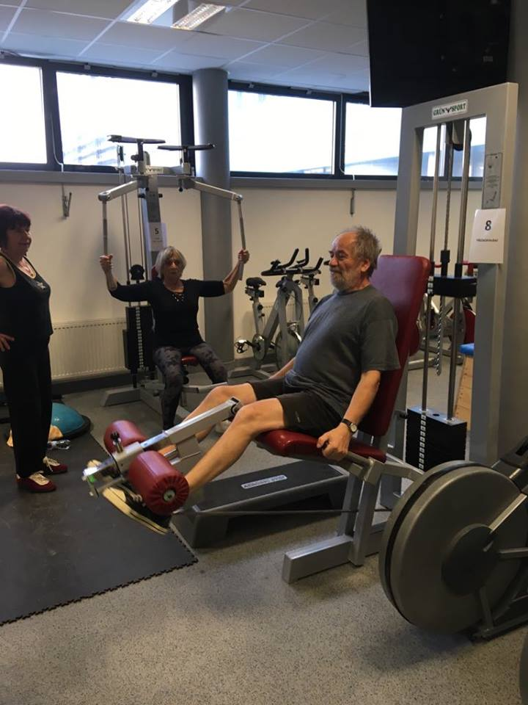
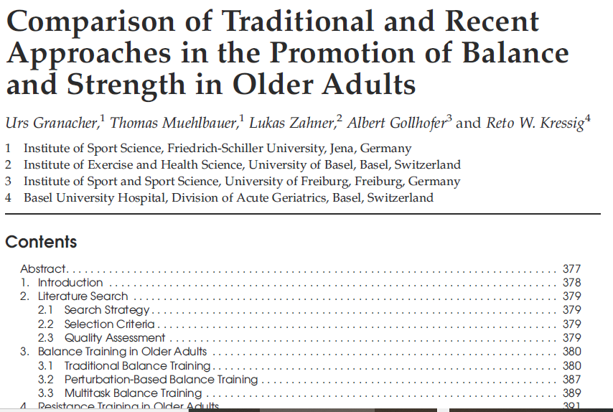
The impact of different types of physical activity in older adults

Slide 29
Resistance training
…increased amount of muscle mass can induce many health benefits and increase life quality (Barbalho et al., 2018)
New recommendation
2–3 sets of 1–2 multijoint exercises per major muscle group, achieving intensities of 70–85% of 1 repetition maximum (1RM), 2–3 times per week, including power exercises performed at higher velocities in concentric movements with moderate intensities (Fragala, 2019)
Our training
3 sets per exercise per muscle group, 8–12 repetitions, intensity 70–80% of 1RM, exercise selection 8–10 different exercises, modality free-weight or machine-based exercises.

Slide 30
Proprioceptive training
Postural stability, gait, and balance decrease with age (Baloh, RW, Ying, SH, and Jacobson, KM. 2003)
…dynamic balance improvement is associated with a decrease in risk of falls and fear of falling and improvement in quality of life (Matsumura, Ambrose, 2006)
Our training specific proprioceptive exercises in static and dynamic positions with the bosu and gym ball as unstable training tools. Training was progressively structured in 2 or 3 phases (Antonio Marti´nez-amat, 2013)

Slide 31
Endurance training
Nordic walking is one form of exercise that has gained a lot of interest among middle-aged and older adults.
…higher heart rate and oxygen consumption and energy expenditure than walking without poles (Parkatti, Perttunen, and Wacker, 2012; Schiffer et al., 2006; Hansen & Smith 2009; Saunders, Hipp, Wenos, & Deaton, 2008).
Our training trainer taught the Nordic walking technique to the participants following the guidelines. The intervention included exercise in the surrounding forest. During the training, participants were instructed to walk as fast as it was comfortable. Training intensity was based on the subjective perception of exertion.

Slide 32
Parkour Concepts for Healthy Aging
1426/2020
Background
Falls of the elderly are the third most common cause of death due to injury. Therefore, we are looking for ways to eliminate the risk of falling. We were inspired by the American physiotherapist Ben Musholt, who sees great potential in Parkour for seniors.
The aim of the exercise is to teach seniors to evaluate obstacles of various types, to overcome them as effectively as possible and to learn to fall safely.
The benefit of this type of exercise is the accumulation of self-confidence, which in itself will improve the daily life of a senior and allow him to run hobby activities.

Slide 33
Single tests and observed parameters
Timed Up and Go Test (TUG) – highly reliable screening test for dynamic stability and the ability to predict falls among older adults.
Functional Reach Test (FRT) – FRT is a outcome measurement and assessment tool for ascertaining dynamic balance.
Static balance – we will analyze center of pressure (COP) parameters using Kistler stabilometric platforms.
Fear of falling will be measured by questionnaire FES-I and by a fall risk assessment using the Downtownfall risk index
Five point test - a Test of Nonverbal Fluency
  Figural (or nonverbal) fluency is the ability of executive functions to provide information about divergent reasoning, divided attention, planning and mental flexibility.
  https://www.csnn.eu/en/journals/czech-and-slovak-neurology-and-neurosurgery/2014-6-3/the-five-point-test-a-test-of-nonverbal-fluency-normative-data-for-adults-50230

Slide 34
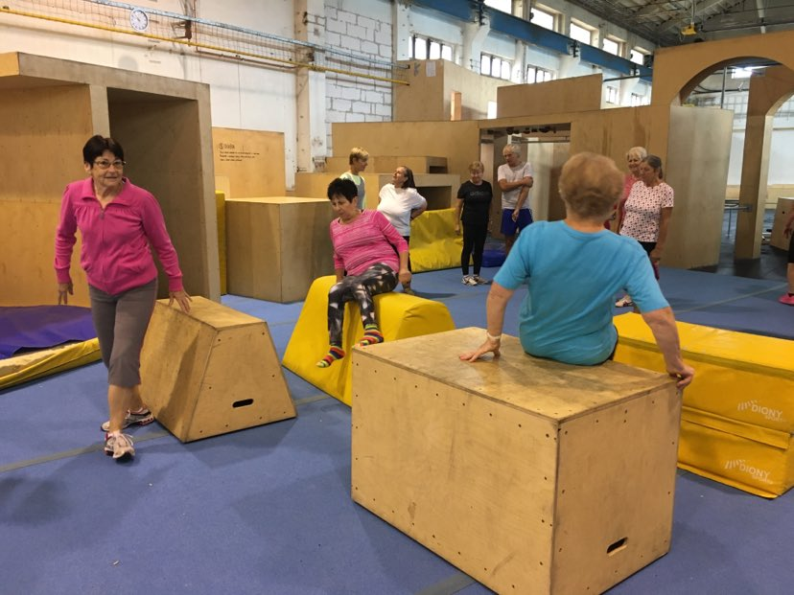

Slide 35
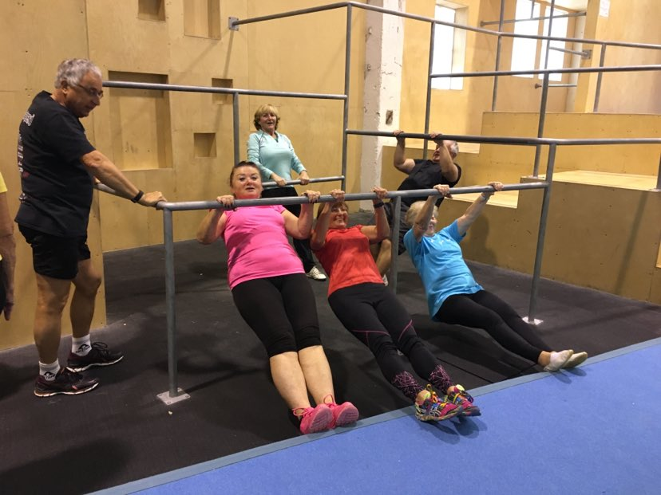

Slide 36
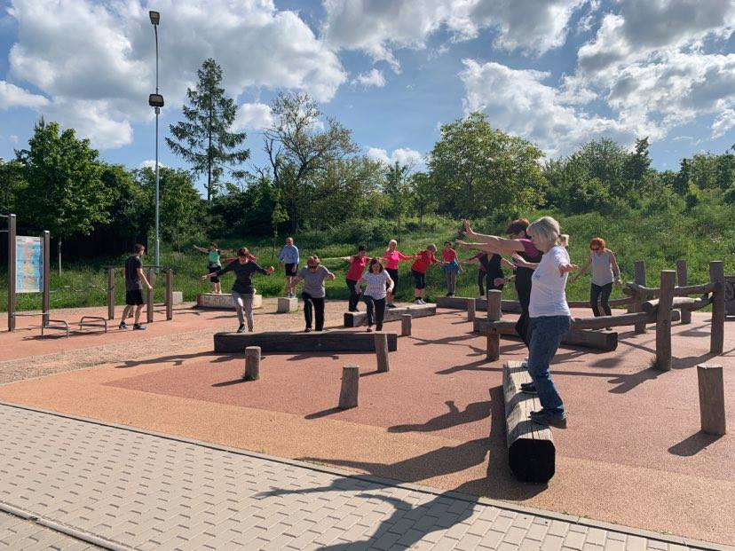

Slide 37
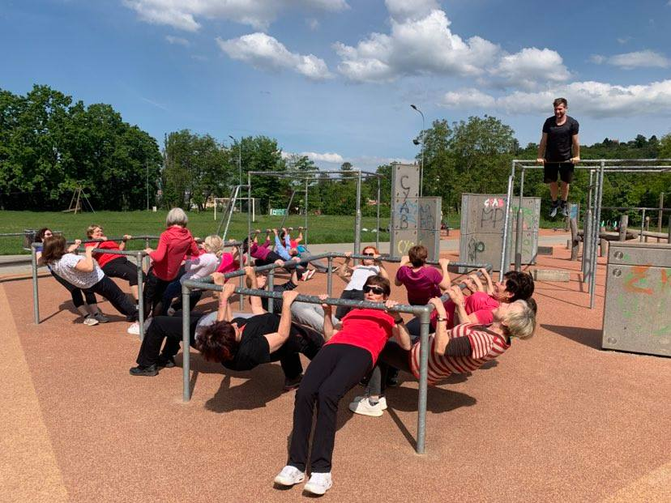

Slide 38
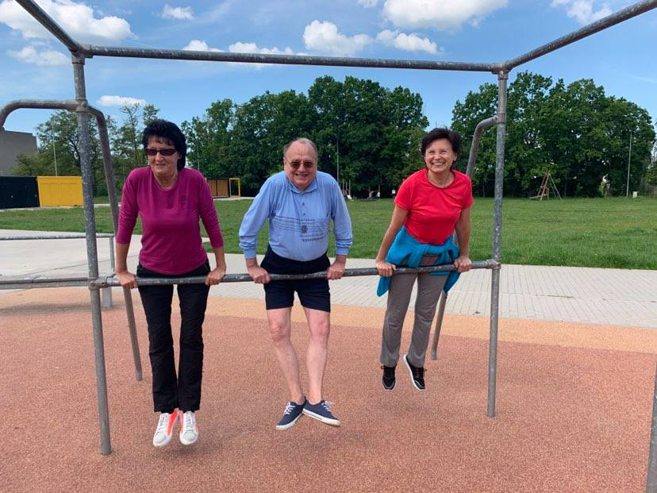

Slide 39
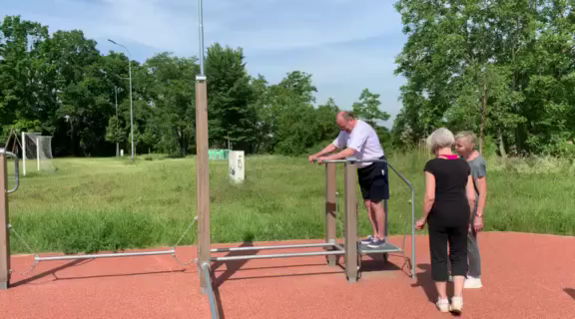

Slide 40
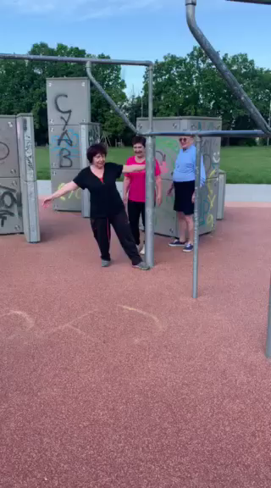

Slide 41
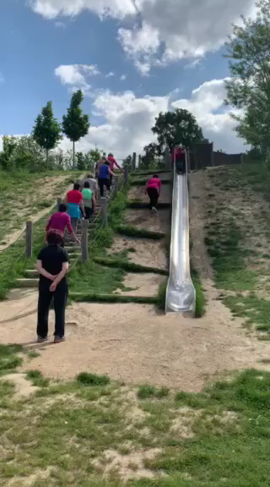

Slide 42
Analysis of walking of selected age groups
1708/2020
The project is focused on the issue of the condition of the foot arch, balance abilities and the spatiotemporal parameters of walking in seniors.
The relationship between spatio-temporal parameters of gait and adverse health conditions in the elderly is part of many scientific studies (Rodríguez-Molinero, et al., 2019; Ansai, Andrade, et al., 2019; Hollman, et al., 2011).
The condition of the arch of the foot, the length and width of the stride, the walking cadence and its speed are considered markers for the prediction of falls, cardiovascular and neurodegenerative diseases in the senior population.

Slide 43
Analysis of walking of selected age groups
1708/2020
Participants
Older adults living in their own home (n = 50) and seniors living in a home for the elderly with the ability to self-service (n = 50). A comparison between groups of seniors living in their dwellings and in institutional facilities is planned.
…the project follows on from last year's project
had measured 204 older adults

Slide 44
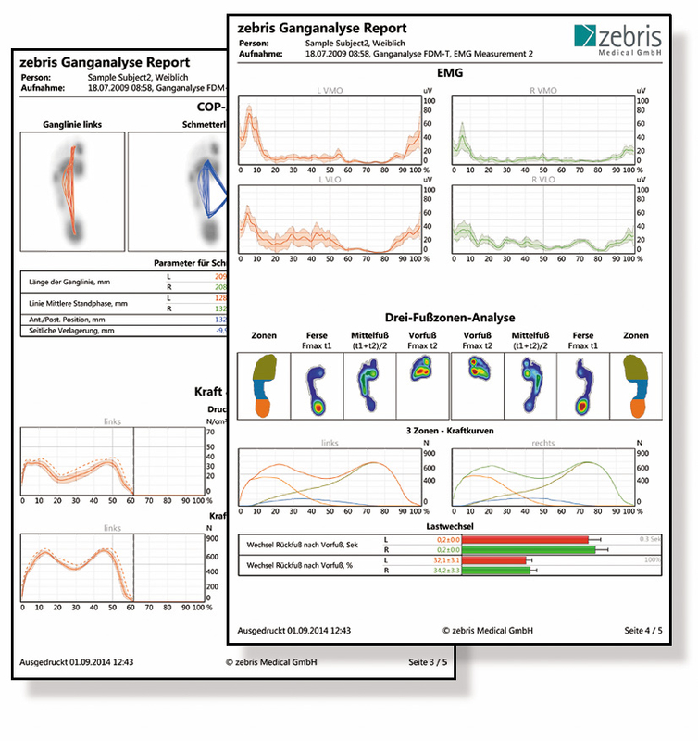
Conclusion
Walking/gait - a vital everyday movement
Walking/gait - diagnostic method
The reduction in gait speed is frequently used as a marker of frailty.
The spatial parameters of gait and their association with falls, functional decline and death in older adults.
A stride length shorter than half of the height is a sensitive risk marker for functional loss and falls.
(Rodríguez-Molinero, Herrero-Larrea, Miñarro, Narvaiza, Gálvez-Barrón, et al., 2019; Ansai, Andrade, Masse, Gonçalves, Takahashi, et al., 2019; Hollman, McDade, Petersen, 2011).

Slide 45
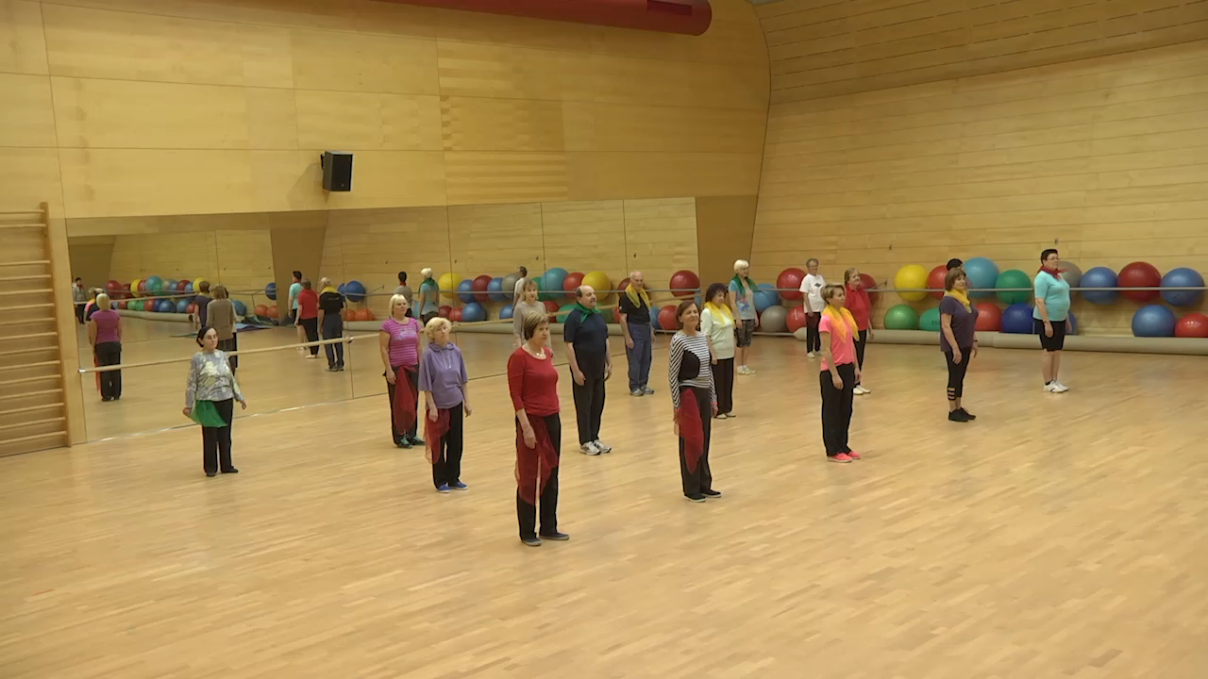

Slide 46
e057 Physical Activity in Older Adults
9:00 – 9:50 B11/236
14:00-14:50 Gym 118
September B11/236 9:00 – 9:50 theoretical basis (oral lecture)
October 14:00-14:50 Gym 118 physical fitness assessment (practical lesson)
November – attending exercise lessons for seniors
December - data processing, analysis and interpretation
  (last meeting December 8, 2021)

