Slide 1
FanExperience

Slide 2
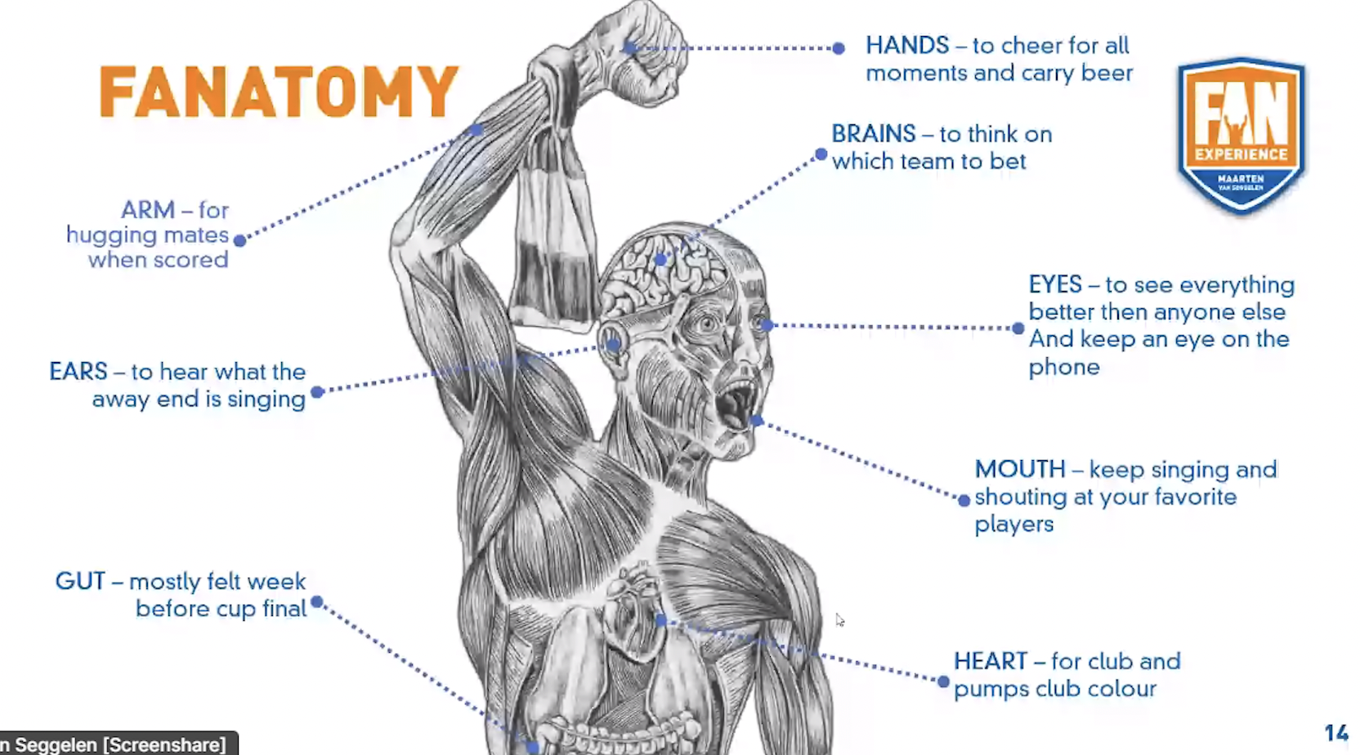

Slide 3
