Slide 1
Does image of Japanese martial arts in Euro-American pop-culture fits true budo?
Cinematography examples
Zdenko Reguli
Masaryk University, Czech Republic

Slide 2
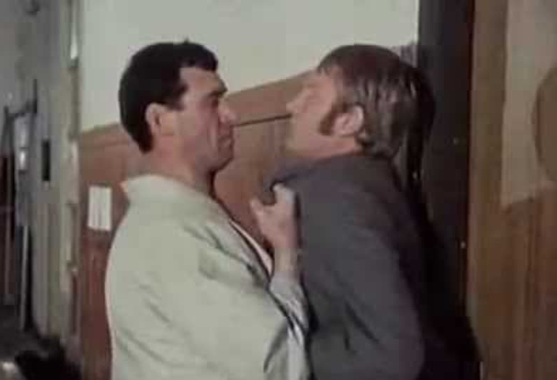
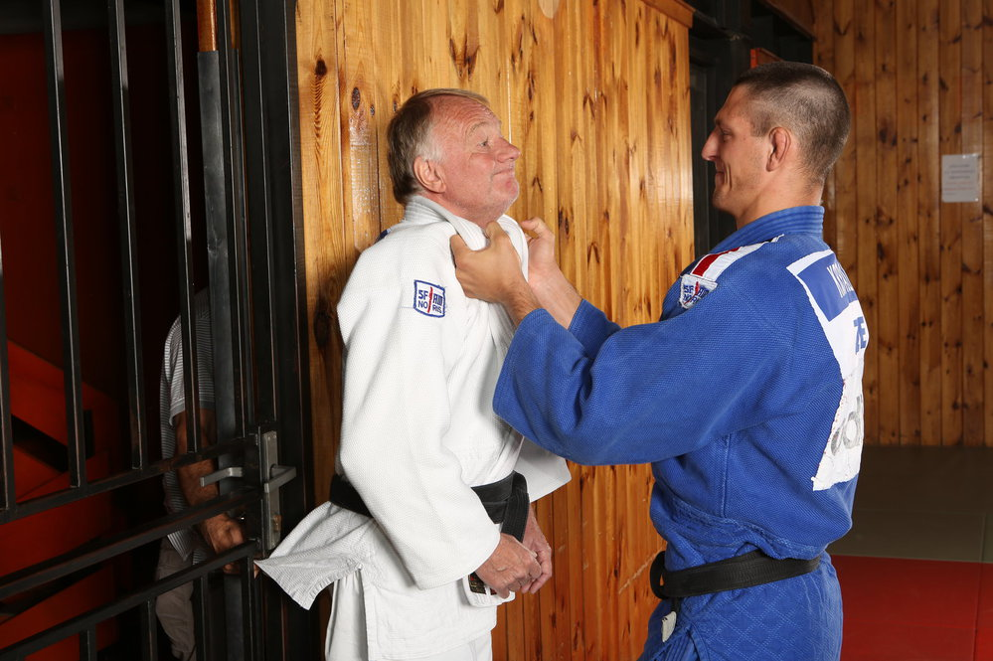
Joachim, Put It in the Machine (1974)

Slide 3
Martial arts cinema in different cultures
Film (an piece of art) and movie (commercial entertainment)
Most known martial arts movies genres:
  Japanese jidaigeki and chanbara
  Kung-fu movies (Hong Kong movies)
  Western action movies (Hollywood)
  Indian cinema (desi, or Bollywood films)

Slide 4
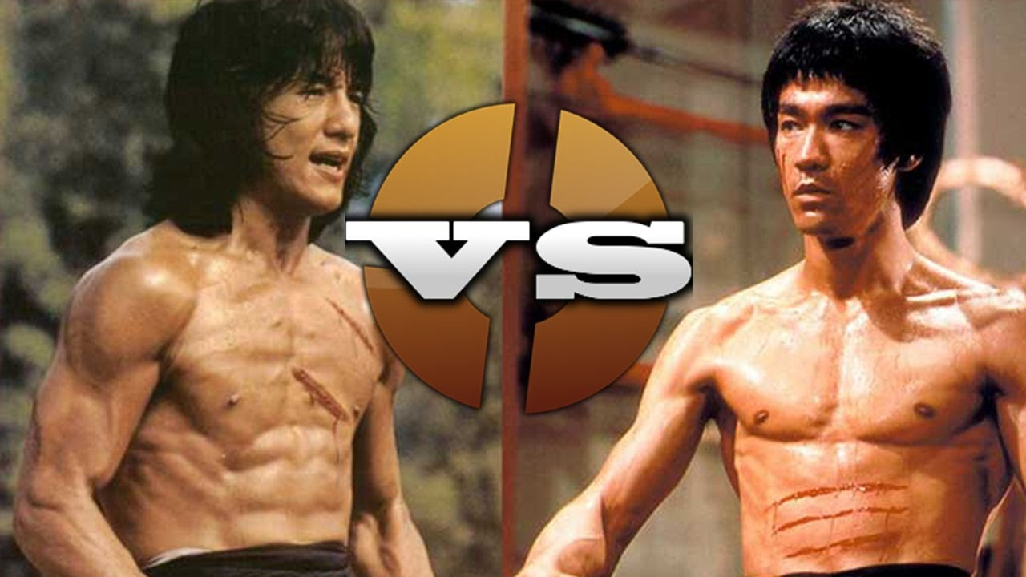
Kung-fu movies

Slide 5
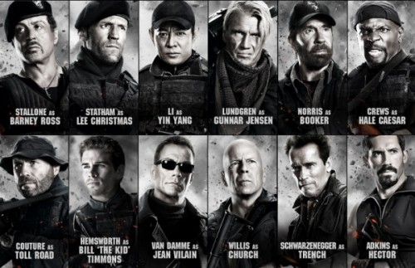
Western action movies

Slide 6
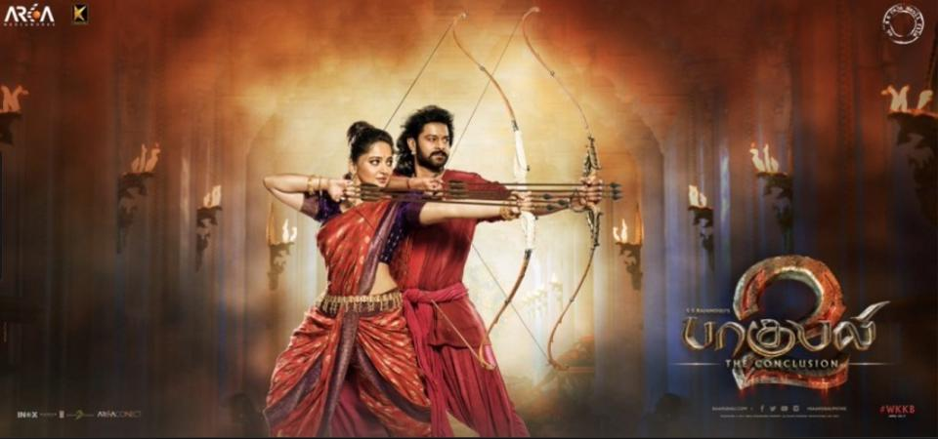
Indian cinema

Slide 7
Sword in Japanese popculture: jidaigeki films
Japanese „period drama“ often set to Edo period
Showing lives of samurai, craftsmen, farmer, and merchant
Using dramatic convetions:
  characteristics of heroes and villains
  using a high degree of formality and frequent archaisms in the language together with catch phrases
  ritualised sword fight, little blood, and often do not even cut through clothing

Slide 8
Sword in Japanese popculture: chanbara
Sword fighting movies similar to western cowboy, swashbuckler, or sword and sandals movies
Violence is stylized
Lot of blood (geysers ang buckets of blood)
Dismemberment and decapitation

Slide 9
Western movies influenced by chanbara
Western remakes of Japanese movies
Yojimbo (1961) – Fistful of dollars (1964)
Seven Samurai (1954, Shichinin no samurai) – The Magnificent Seven (1966)
Rashomon (1950) – The Outrage (1964)
Steel Edge of Revenge (1969, Goyokin) – The Master Gunfighter (1975)
Zatoichi – Blind Fury (1989)
Using the basic ideas
The hidden fortress (1958, Kakushitoride no sanakunin) – Key inspiration for Star Wars (1977)
Reverse remakes
Unforgiven (1992) – Unforgiven (2013, Yurusarezaru mono)

Slide 10
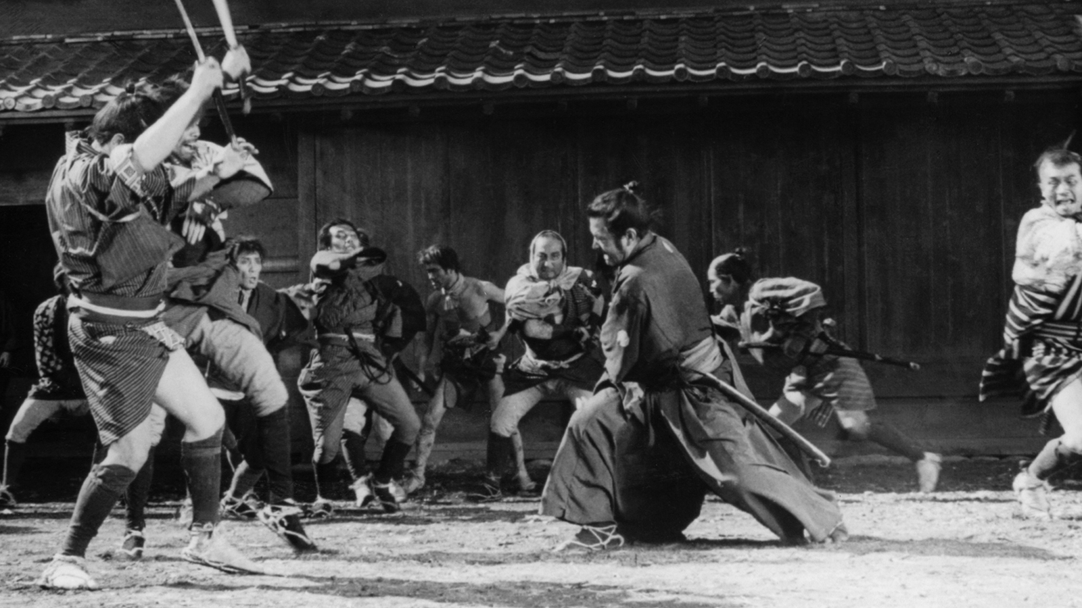
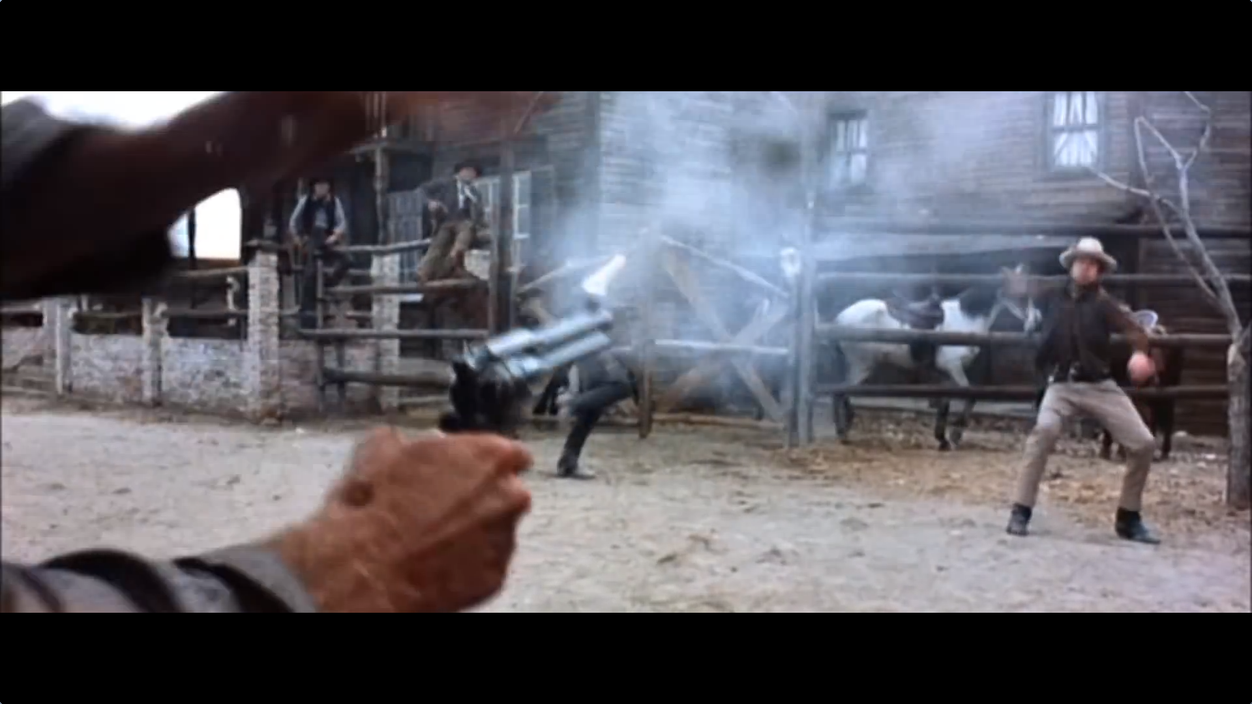
Yojimbo (1961) – Fistful of dollars (1964)

Slide 11
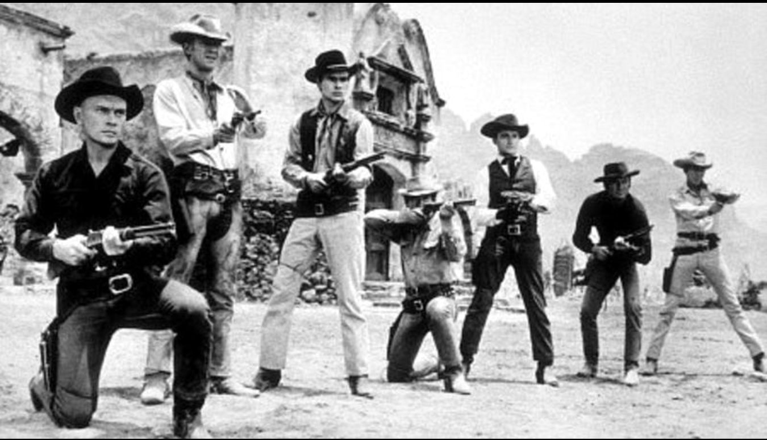
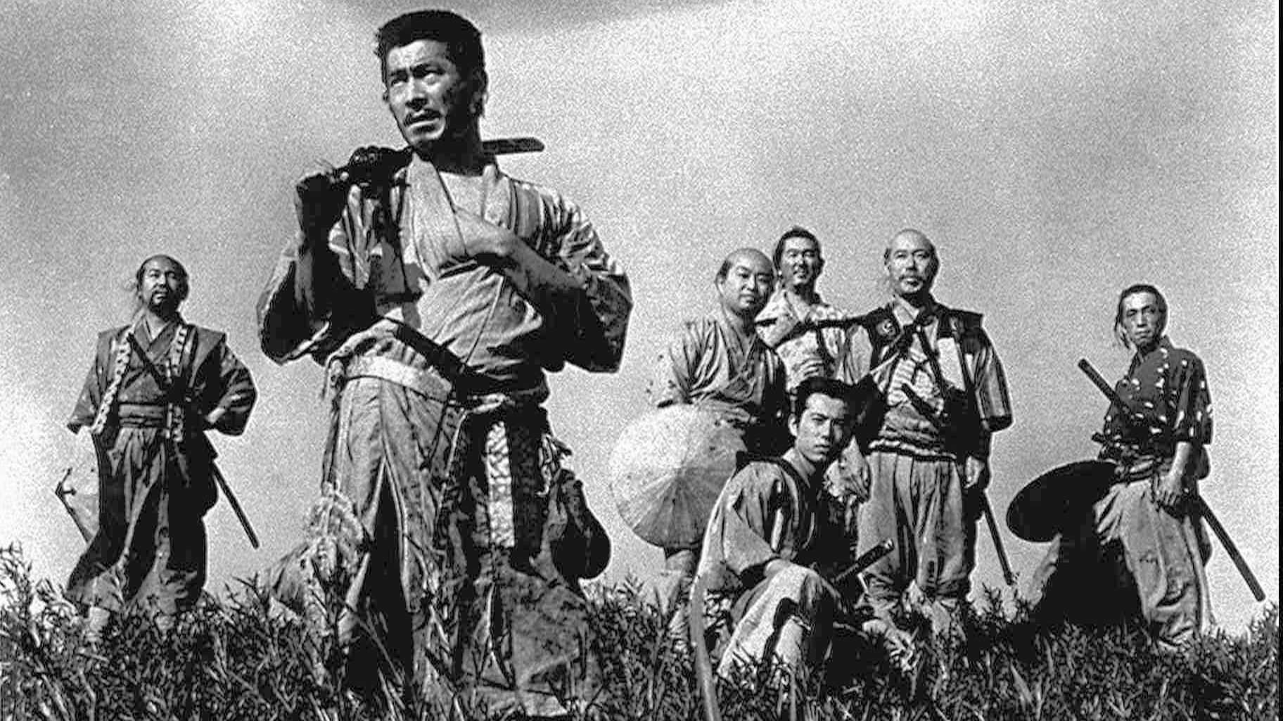
Seven Samurai (1954, Shichinin no samurai) – The Magnificent Seven (1966)

Slide 12
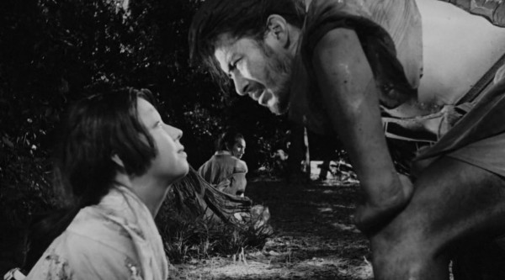
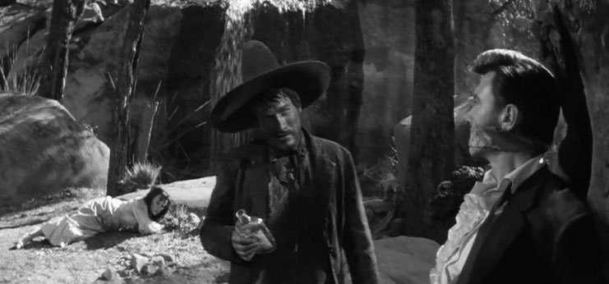
Rashomon (1950) – The Outrage (1964)

Slide 13
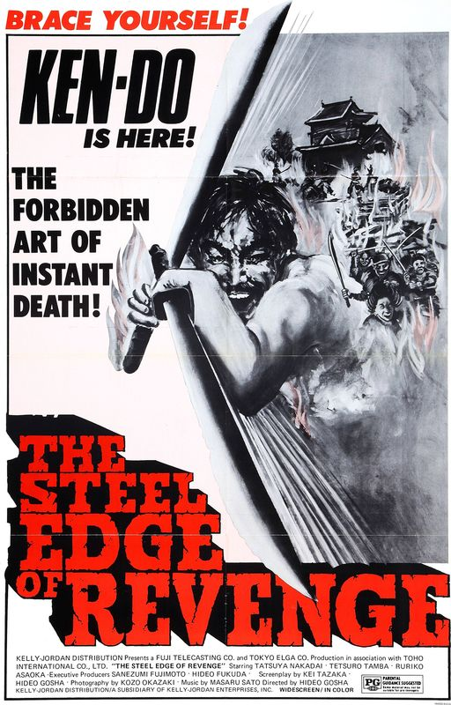
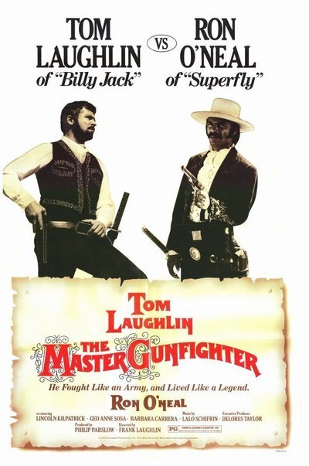
Steel Edge of Revenge (1969, Goyokin) – The Master Gunfighter (1975)

Slide 14
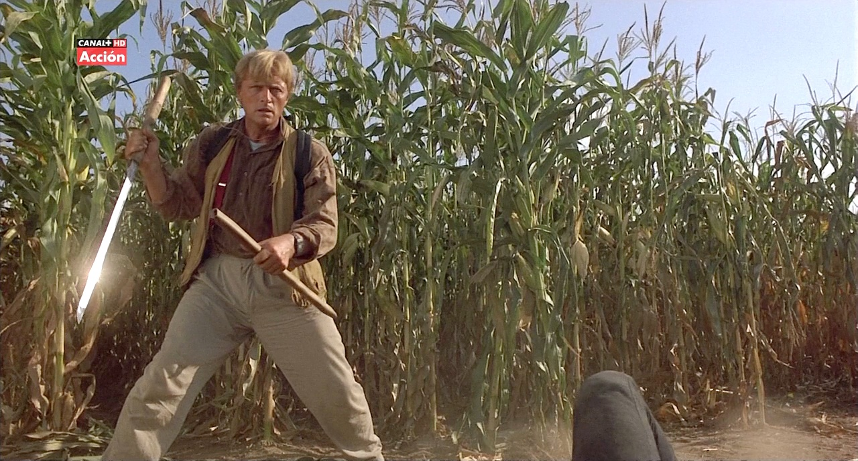
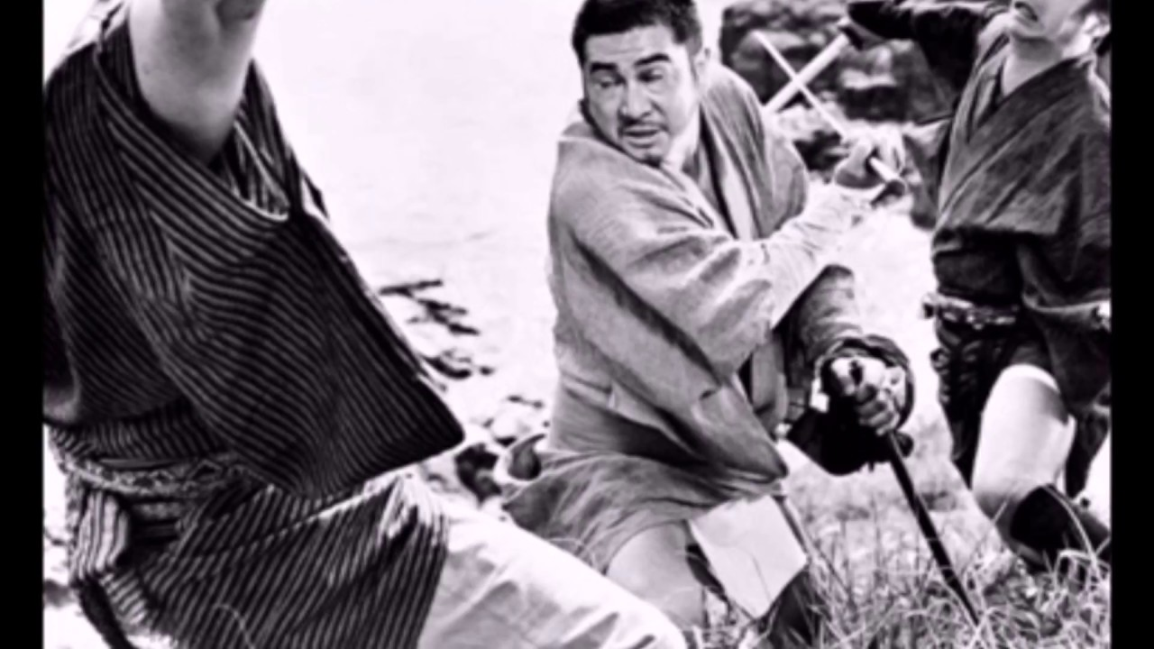
Zatoichi – Blind Fury (1989)

Slide 15
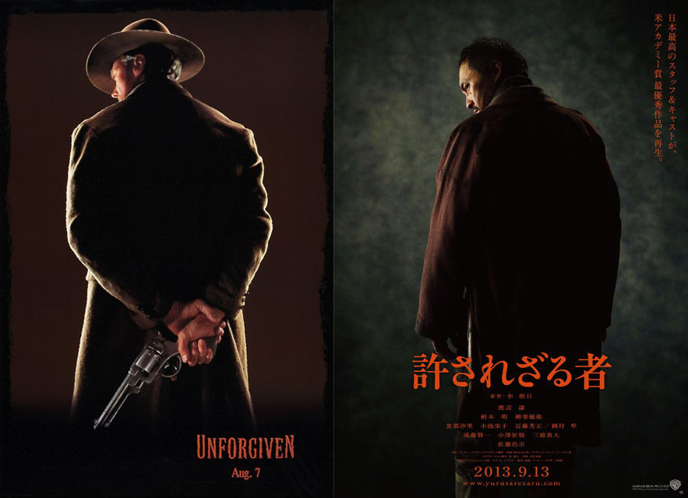
Unforgiven (1992) – Unforgiven (2013, Yurusarezaru mono)

Slide 16
Budo movies
Karate, the Hand of Death (1961)
The Challenge (1982)
The Karate Kid (1984)
No Retreat, No Surrender (1986)
DOA: Dead or Alive (2006)
The Sensei (2008)
Kickin' It (2011, TV Series)
Lot of movies played by martial artists

Slide 17
Budoka as an actor
Some claimed to be skilled in various martial arts: Chuck Norris, Bill „Superfoot“ Wallace, Benny „the Jet“ Urquides, Cynthia Rothrock
Steven Seagal (aikido)
Dolph Lundgren (kyoukushin karate)
Jean Claude van Damme (shotokan karate)
Wesley Snipes (shotokan karate)
Michael Jay White (shotokan and goju ryu karate, kobudo)
Matt Mullins (shorei ryu karate)
Scott Adkins (judo, karate, and others)
Richard Norton (Goju kai karate)
Jeff Speakman (goju ryu karate)
Jim Kelly (shorin ryu karate)

Slide 18
Fourfold model of acculturation
Assimilation. Adoption the cultural norms of a dominant or host culture, over their original culture. (El Mariachi, Star Wars, Kill Bill)
Separation. Rejection the dominant or host culture in favor of preserving culture of origin. (Showdown in Little Tokyo, The Last Samurai, Red Sun, James Bond)
Integration. Ability to adopt the cultural norms of the dominant or host culture while maintaining culture of origin. Seven Samurai (The Magnificent Seven), Yojimbo (A Fisful of Dollars)
Marginalization. Rejection both the culture of origin and the dominant host culture. (Peaceful Warrior)

Slide 19
Definition of budo
(The Japanese Budo Association)
Budō is a form of Japanese physical culture that has its origins in the ancient tradition of bushidō – literally, “the way of the warrior.” Practitioners of budō develop technical martial skills while striving to unify of mind, technique and body; to develop their character; to enhance their sense of morality; and to cultivate a respectful and courteous demeanour. Thus, budō serves as a path to self-perfection. Budō as a general term refers to the modern Japanese martial arts disciplines comprised of jūdō, kendō, kyūdo, sumō, karatedō, aikidō, shōrinji kempō, naginata, and jūkendō.

Slide 20
Can we see budo in movies?
Stylized fight: technics and tactics used in (The Sensei, 2008)
Using weapons and fighting skills as a symbol describing characters
Characteristics of hero and anti-hero
The goal of the training and using martial skills

Slide 21
What can audience take from martial arts movies?
Knowledge about martial arts
Motivation to start studying budo
Learn a bit about Japanese culture
Popularize budo
Movies are for entetainment
Budo is to be pracised

Slide 22
Thank you for attention
Zdenko Reguli
Masaryk University, Czech Republic
reguli@fsps.muni.cz

