Slide 1
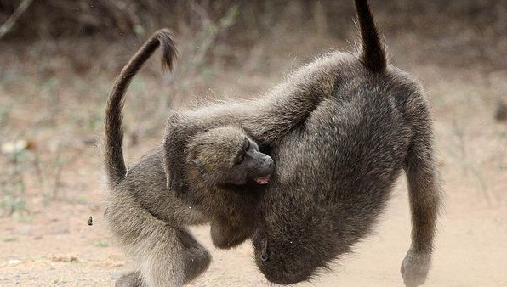
Performing under Pressure; on the Biology, Psychology and Sociology of stress in high-performance professions
II - On the physiology of stress

Slide 2
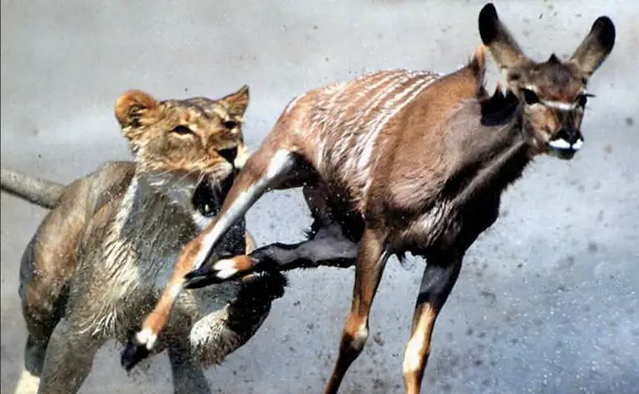

Slide 3
Nature selects for speed
Speed over accuracy
It matter less where you run than that you run as quickly as possible
Limited time frame (5 min)
Most negatives effects of stress are the result of turning on the system for way longer than the approximately 5 minutes it usually takes.
Sapolsky, R. M. (2004). Why zebras don’t get ulcers: A guide to stress, stress related diseases, and coping. In Natural History. https://doi.org/10.1002/cir.3880060119
Heitz, R. P. (2014). The speed-accuracy tradeoff: History, physiology, methodology, and behavior. Frontiers in Neuroscience, 8(8 JUN), 1–19. https://doi.org/10.3389/fnins.2014.00150

Slide 4
Both the lion and the gazelle need the same acute processes to survive
Transport energy (fuel + oxygen) to those parts of the body that you need to survive
Legs
Upper body
Hyper cognitive focus on the task at hand (fight or flight)
Down-regulation of non-essential processes

Slide 5
Energy
Oxygen in-take and transport to the relevant muscle groups
Increased respiration rate
Increased blood pressure / increased heart rate
Release of glucose from glycogen stores and transport to the relevant muscle groups
Cortisol
Increased blood glucose levels
Increased blood pressure / increased heart rate

Slide 6
Important cognitive changes
Mild stress
Enhanced cognitive function; implicit memory & declarative tasks
Enhanced task oriented focus
High acute or chronic stress
Impairs the formation of complex memories: enhances implicit memory
Repetitive tasks
Sandi, C. (2013). Stress and cognition. WIREs Cogn Sci, 4(June). https://doi.org/10.1002/wcs.1222

Slide 7
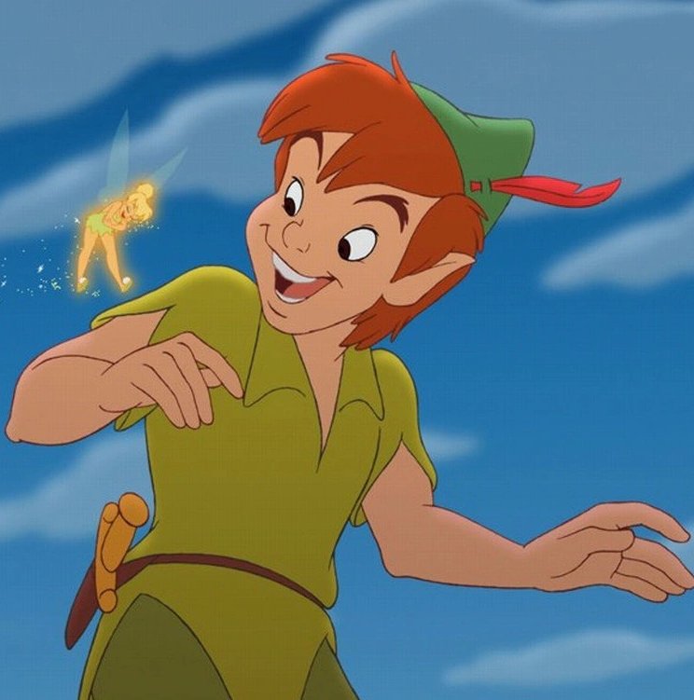
Downregulated functions
Growth
Reproduction
Digestion
Yamamora, D. L. R., & Reid, R. L. (1990). Psychological stress and the reproductive system. Seminars in Reproductive Endocrinology, 8(1), 65–72. https://doi.org/10.1055/s-2007-1021424
Toyoda, A., Iio, W., Matsukawa, N., & Tsukahara, T. (2015). Influence of chronic social defeat stress on digestive system functioning in rats. Journal of Nutritional Science and Vitaminology, 61(3), 280–284. https://doi.org/10.3177/jnsv.61.280
Oroian, B. A., Ciobica, A., Timofte, D., Stefanescu, C., & Serban, I. L. (2021). New Metabolic, Digestive, and Oxidative Stress-Related Manifestations Associated with Posttraumatic Stress Disorder. Oxidative Medicine and Cellular Longevity, 2021. https://doi.org/10.1155/2021/5599265

Slide 8
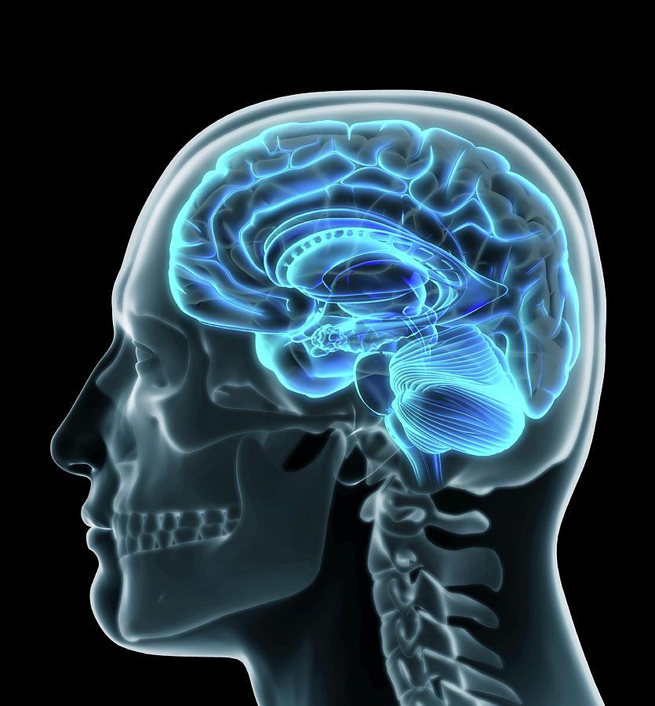
Processing stimuli; the hardware
A stimulus is detected by one of our senses
The amygdala relays signals if the stimulus is threatening
Locus coeruleus (Norepinephrine)
Hypothalamic adrenal axis (Cortisol)
Ventral tegmental area (Dopamine)
Medial prefrontal cortex (is this really a problem?)

Slide 9
Autonomic nervous system
Sympathetic nervous system
Parasympathetic nervous system

Slide 10
(nor-)adrenaline / (nor-)epinephrine
Setting the system up for movement
Blood pressure / heart-rate
Respiration rate
Task related focus and memory
Heightened alertness & stressor related memory
Three behavioural stages of nor-adrenaline
Movement
Erratic movement (panic)
Shutdown
Ross, J. A., & Van Bockstaele, E. J. (2021). The Locus Coeruleus- Norepinephrine System in Stress and Arousal: Unraveling Historical, Current, and Future Perspectives. Frontiers in Psychiatry, 11(January), 1–23. https://doi.org/10.3389/fpsyt.2020.601519

Slide 11
Cortisol
Release glucose (fuel) from glycogen stores
Highest in the morning
Nightmares
Interaction with nutrition
Suppress inflammation
Blood pressure

Slide 12
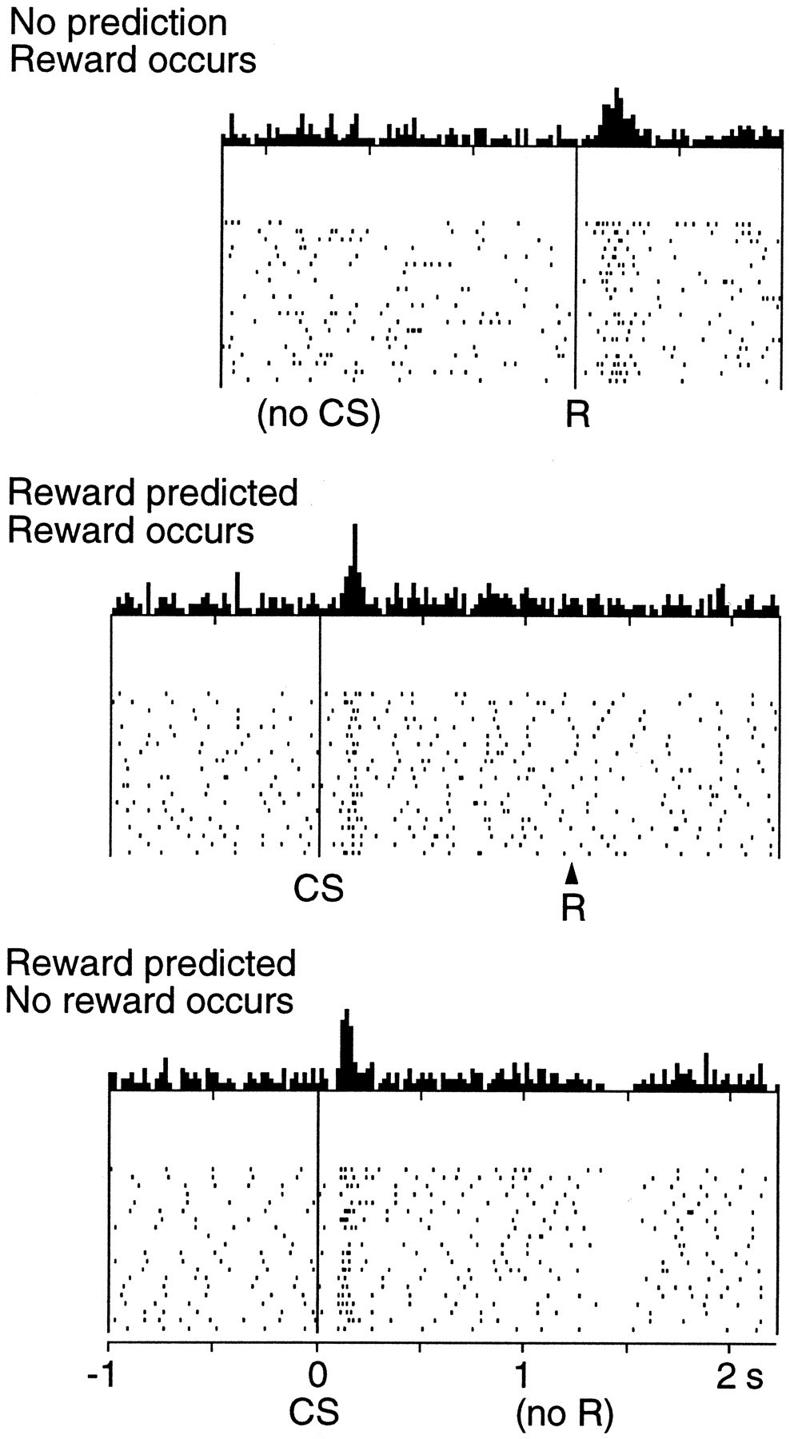
What does dopamine do to the stress response
Dopamine: the great motivator (NO, it does not do reward!!)
Training
Uncertainty
Schultz, W. (2002). Getting formal with dopamine and reward. Neuron, 36(2), 241–263. https://doi.org/10.1016/S0896-6273(02)00967-4

