Slide 1
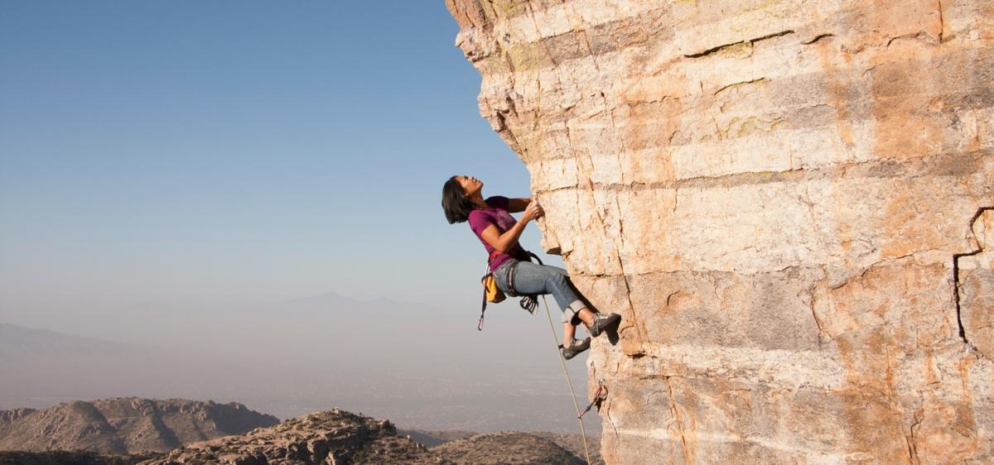
Performing under Pressure; on the Biology, Psychology and Sociology of stress in high-performance professions
VII – Performance under stress

Slide 2
How do you utilise the stress response to facilitate optimal performance?
Prepare the system for stress (See lecture 6)
Managing the acute stress response
Optimising the acute stress response
Increase dopamine
Increase feelings of control

Slide 3
Almost all of the most effective mechanisms to reduce or control the acute stress response involve feedback loops
It is hard to control
Thoughts
Emotions
Physiological states
Behaviour is much easier and that will alter all the above
Stress often requires an expression to movement (be that physiological or psychological – behaviour is the key!)

Slide 4
Managing the acute stress response

Slide 5
Feedback loops as a means to manipulate the stress system
Neurotropic substances
Benzodiazepams
Behavioural manipulations
Breath work
Visual system control
Visualisation

Slide 6
Breath work
Double sigh
Off load much more carbon dioxide
Respiratory sinus arrhythmia
Inhales: diaphragm moves down, more space for the heart, brain sends a signal to speed up to keep blood pressure steady.
Basis for Heart Rave Variability (HRV)
Feldman JL. Neurobiology of breathing control. Where to look and what to look for.. Advances in experimental medicine and biology, 1995.

Slide 7
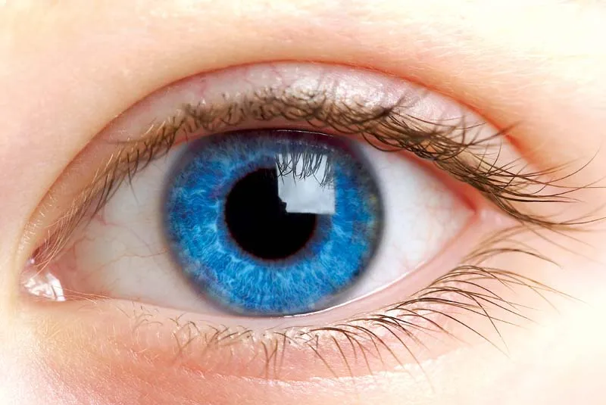
Visual control: Can you use the eyes to control stress?
Eyes – 2 functions
Detecting shapes, colours, etc. (vision)
Communicate to the brain – active or inactive (Cues about time of day, stressors, etc.) (YES! Another feedback loop!!)
Relaxed (panoramic vision)
Stressed (focussed vision)

Slide 8
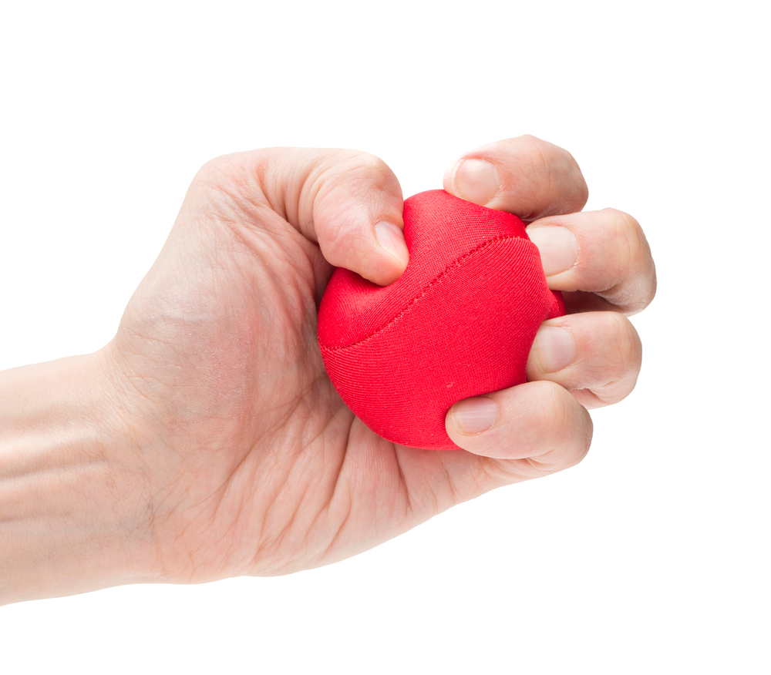
Left-brain / right brain cross talk
Over activity in the left side of the brain may lead to overthinking
Activity with the left hand, which cross talks to the right hemisphere, leads to an overall downregulation of brain activity
Mesagno, C., Beckmann, J., Wergin, V. V., & Gröpel, P. (2019). Primed to perform: Comparing different pre-performance routine interventions to improve accuracy in closed, self-paced motor tasks. Psychology of Sport and Exercise, 43(January), 73–81. https://doi.org/10.1016/j.psychsport.2019.01.001
Mesagno, C., & Beckmann, J. (2017). Choking under pressure: theoretical models and interventions. Current Opinion in Psychology, 16(June), 170–175. https://doi.org/10.1016/j.copsyc.2017.05.015

Slide 9
Optimising the acute stress response

Slide 10
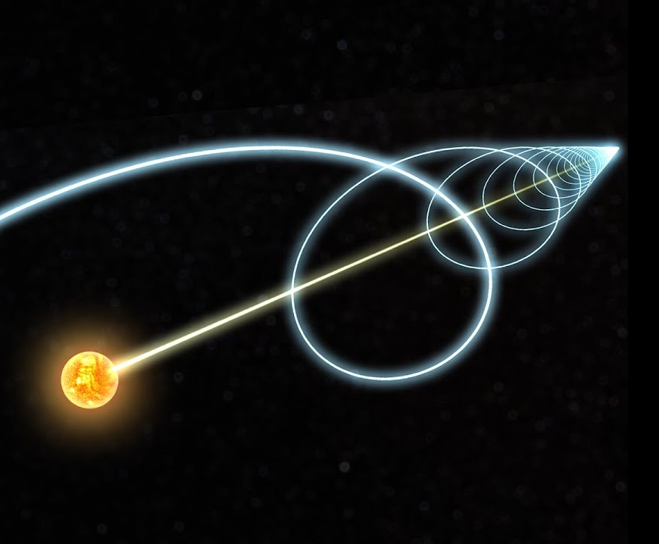
Forward movement: The nucleus reuniens
A small nucleus in the thalamus
Secretes dopamine in response to forward movement
Behaviour effects
In rats it increases willingness to fight harder
In people…
Zimmerman, E. C., & Grace, A. A. (2016). The nucleus reuniens of the midline thalamus gates prefrontal-hippocampal modulation of ventral tegmental area dopamine neuron activity. Journal of Neuroscience, 36(34), 8977–8984. https://doi.org/10.1523/JNEUROSCI.1402-16.2016

Slide 11
Nutrition
Certain foods stimulate the endorphin and dopamine systems.
Sugar
Alcohol
Cacao
Etc.
Careful! Many have a secondary detrimental effect.

Slide 12
Internal reward
External rewards seem to be transient and unreliable. There is significantly greater value in internal rewards
Slice time to fit your motivational needs
Connect reward to accomplishment not something you get upon finishing
Don’t engage in too many behaviours that release dopamine for little effort

Slide 13
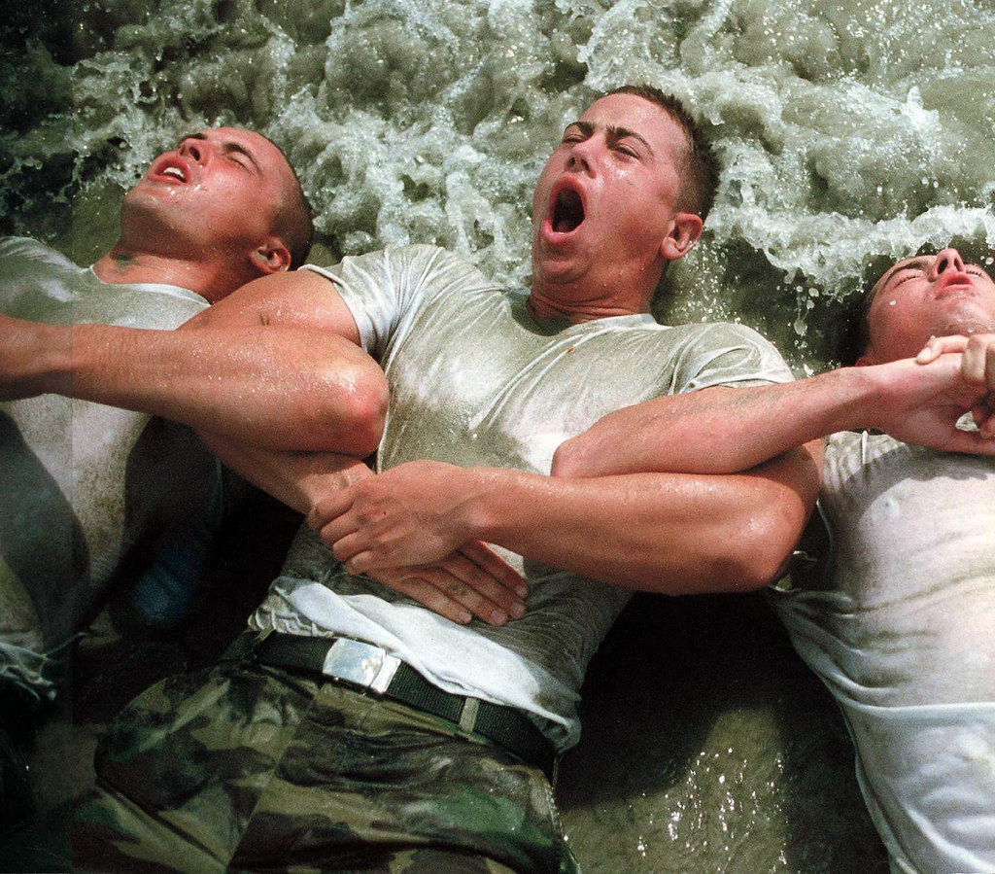
Altruism: just a strange observation
I have no data to support this, but there seems to be a strong link between resilience and altruism. Individuals who take up the responsibility to pull others through appear better at handling extreme stress
Special forces selection procedures

