Slide 1
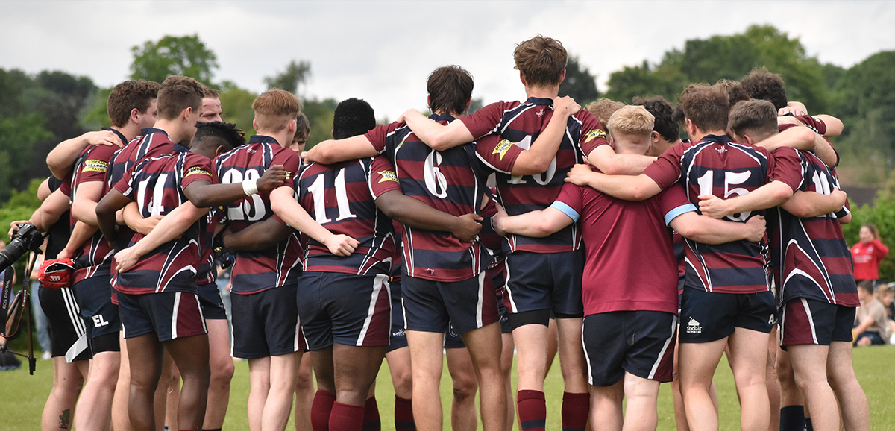
Performing under Pressure; on the Biology, Psychology and Sociology of stress in high-performance professions
VIII – Team-performance under stress

Slide 2
Completion between individuals vs completion between groups

Slide 3

Competition between individuals
Internal struggle between individuals within the group
Struggle over excess to mates, recourses and position in the social hierarchy
In its core, egocentricity
  Testosterone (its not aggression!!)

Slide 4
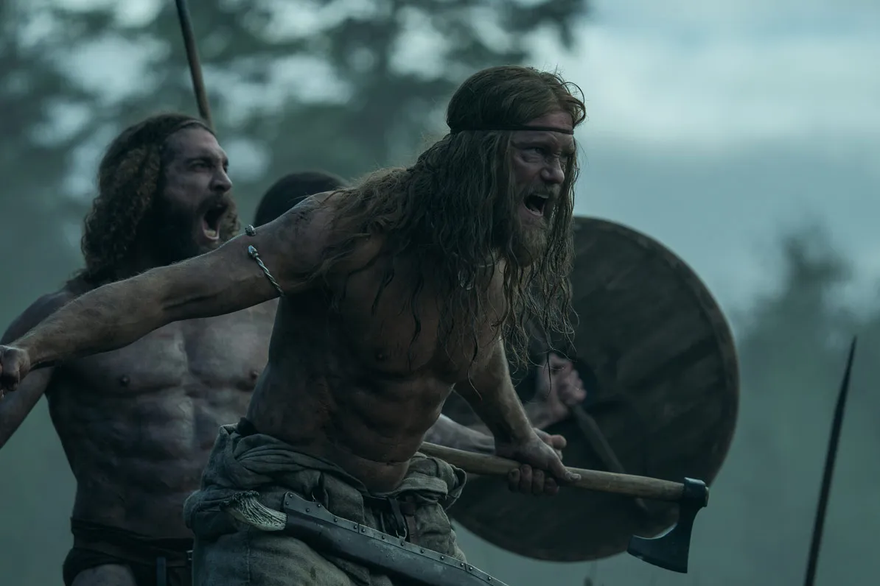
Testosterone & interpersonal competition
Non-linearity
Testosterone & competition, rather than aggression
Low levels associated with lower position on the social hierarchy
Posturing
Crespi, B. J. (2016). Oxytocin, testosterone, and human social cognition. Biological Reviews, 91(2), 390–408. https://doi.org/10.1111/brv.12175
Boksem, M. A. S., Mehta, P. H., Van den Bergh, B., van Son, V., Trautmann, S. T., Roelofs, K., … Sanfey, A. G. (2013). Testosterone Inhibits Trust but Promotes Reciprocity. Psychological Science, 24(11), 2306–2314. https://doi.org/10.1177/0956797613495063
Edwards, D. A. (2006). Competition and testosterone. Hormones and Behavior, 50(5), 681–683. https://doi.org/10.1016/j.yhbeh.2006.09.005
Sapolsky, R., & Balt, S. (1996). Reductionism and variability in data: a meta-analysis. Perspectives in Biology and Medicine, 39(2).

Slide 5
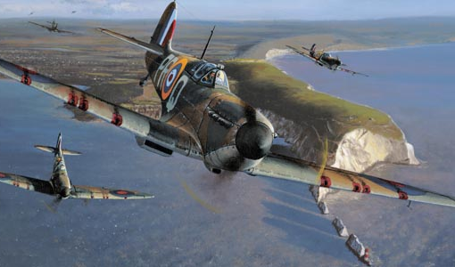
Intra-group conflict as a backdrop for inter-group competition
Inter-group competition can, and often does, involve efforts to outdo one another in the extend to which victories are gained against otherwise anonymous members of targeted outgroups.

Slide 6

Intra-group competition
In-group coordination
  Teamwork
  Cooperation
  Leadership
  Group-identity

Slide 7
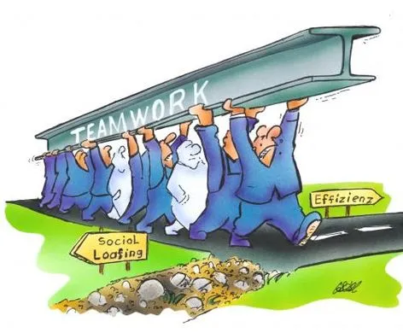
Costly signalling and the free rider problem
Humans are extremely vulnerable alone but united, we dominate almost any environment we enter.
  Teamwork serves the group
  But abstaining from cooperation, while reaping the benefits of the team effort serves the individual most
  Groups need to control for free riding
    Costly signalling
      Hard to fake
Sosis, R., & Bressler, E. R. (2003). Signaling Theory of Religion. CrossCultural Research, 37(2), 211–239. https://doi.org/10.1177/1069397103251426
Dunbar, R., Barrett, L., & Lycett, J. (2007). Evolutionary Psychology.
Sun, S., Johanis, M., & Rychtář, J. (2020). Costly signalling theory and dishonest signalling. Theoretical Ecology, 13(1), 85–92. https://doi.org/10.1007/s12080-019-0429-0

Slide 8
Lying and deceit as an attempt to fake cooperation and health
Stigmatisation
  Health cues: Infection, parasites, etc.
  Social cues: willingness to invest in the collective
We are NOT naturally truthful!!!!
  Ad hoc cost / benefit analysis
Levine, T. R. (2014). Truth-Default Theory (TDT): A Theory of Human Deception and Deception Detection. Journal of Language and Social Psychology, 33(4), 378–392. https://doi.org/10.1177/0261927X14535916
Verschuere, B., & Shalvi, S. (2014). The Truth Comes Naturally! Does It? Journal of Language and Social Psychology, 33(4), 417–423. https://doi.org/10.1177/0261927X14535394
McCornack, S. A., Morrison, K., Paik, J. E., Wisner, A. M., & Zhu, X. (2014). Information Manipulation Theory 2: A Propositional Theory of Deceptive Discourse Production. Journal of Language and Social Psychology, 33(4), 348–377. https://doi.org/10.1177/0261927X14534656

Slide 9
Leadership, the great undefinable !
A minimum of 66 different theories on leadership in the expert literature
Massive methodological issues in the field
The main problem
  Philosophical reflection upon phenomenological observations of behaviour in search of universal tendencies
    Ethics?
    Transformation?
    Service?
Alvesson, M., & Kärreman, D. (2016). Intellectual Failure and Ideological Success in Organization Studies: The Case of Transformational Leadership. Journal of Management Inquiry, 25(2), 139–152. https://doi.org/10.1177/1056492615589974
Atwater, L. E., Mumford, M. D., Schriesheim, C. A., & Yammarino, F. J. (2014). Retraction of leadership articles: Causes and prevention. Leadership Quarterly, 25(6), 1174–1180. https://doi.org/10.1016/j.leaqua.2014.10.006

Slide 10
Leadership: an evolved behavioural solution to a specific problem
Coordinated action
  Leadership can only exist, where there is a problem to be solved, i.e. a stressor.
  Leadership effectively modulates stress reactions
The range of human crises, which require communal action, is so large, that it is not feasible that one behavioural action can produce effective leadership in all cases.
  Observable behavioural and physiological changes in followers
  Context related behavioural and physiological changes in leaders

Slide 11
Leadership as an evolutionary tool
A means for coordinating action amongst individuals. For people this is extremely important for survival
Leadership occurs in all human, and some non-human cultures.
  Follow the first to move
  Follow the dominant male
  Follow context related competence
King, A. J., Johnson, D. D. P., & Van Vugt, M. (2009). The Origins and Evolution of Leadership. Current Biology, 19(19), R911–R916. https://doi.org/10.1016/j.cub.2009.07.027

Slide 12
Three levels of analysis
The leader
The followers
Context
Slides 12-16 are based on ongoing research at the Czech University of Defence. For any further information, contact me directly.

Slide 13
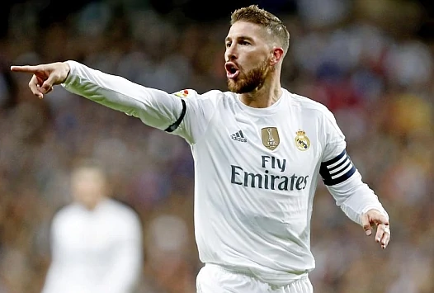
The leader
Perceived relevant competences
Perceived ressillience (if stress is an issue)
Perceived value to followers
  Care
  Reputation
Position in the hyrarchy
  Endorsment by higher authority
  Convention
  Previous experience

Slide 14
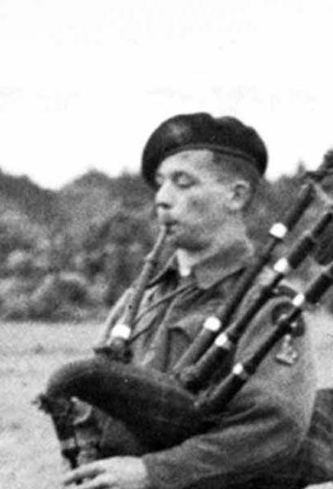
The followers
Can be more or less anyone, but must be willing to, temporarily, suspend their individual initiative, in favour of that of the leader.
  Downregulation of critical faculties
  Partially passive coping mechanisms
  A perceived benefit of doing so for the follower, which cannot be achieved as easily in other ways.

Slide 15
Context
Culture
  Meaningful symbols, behaviours and competences may be meaningless within other cultural contexts.
Immediate context
  What is the immediate issue that is being addressed.
Perceived risk
  What are risk-levels involved in the activity at hand and how do followers perceive the behaviour of the leader in response to them.

Slide 16
The main attributes of leadership
Competence
Resilience
Leadership techniques

