Slide 1
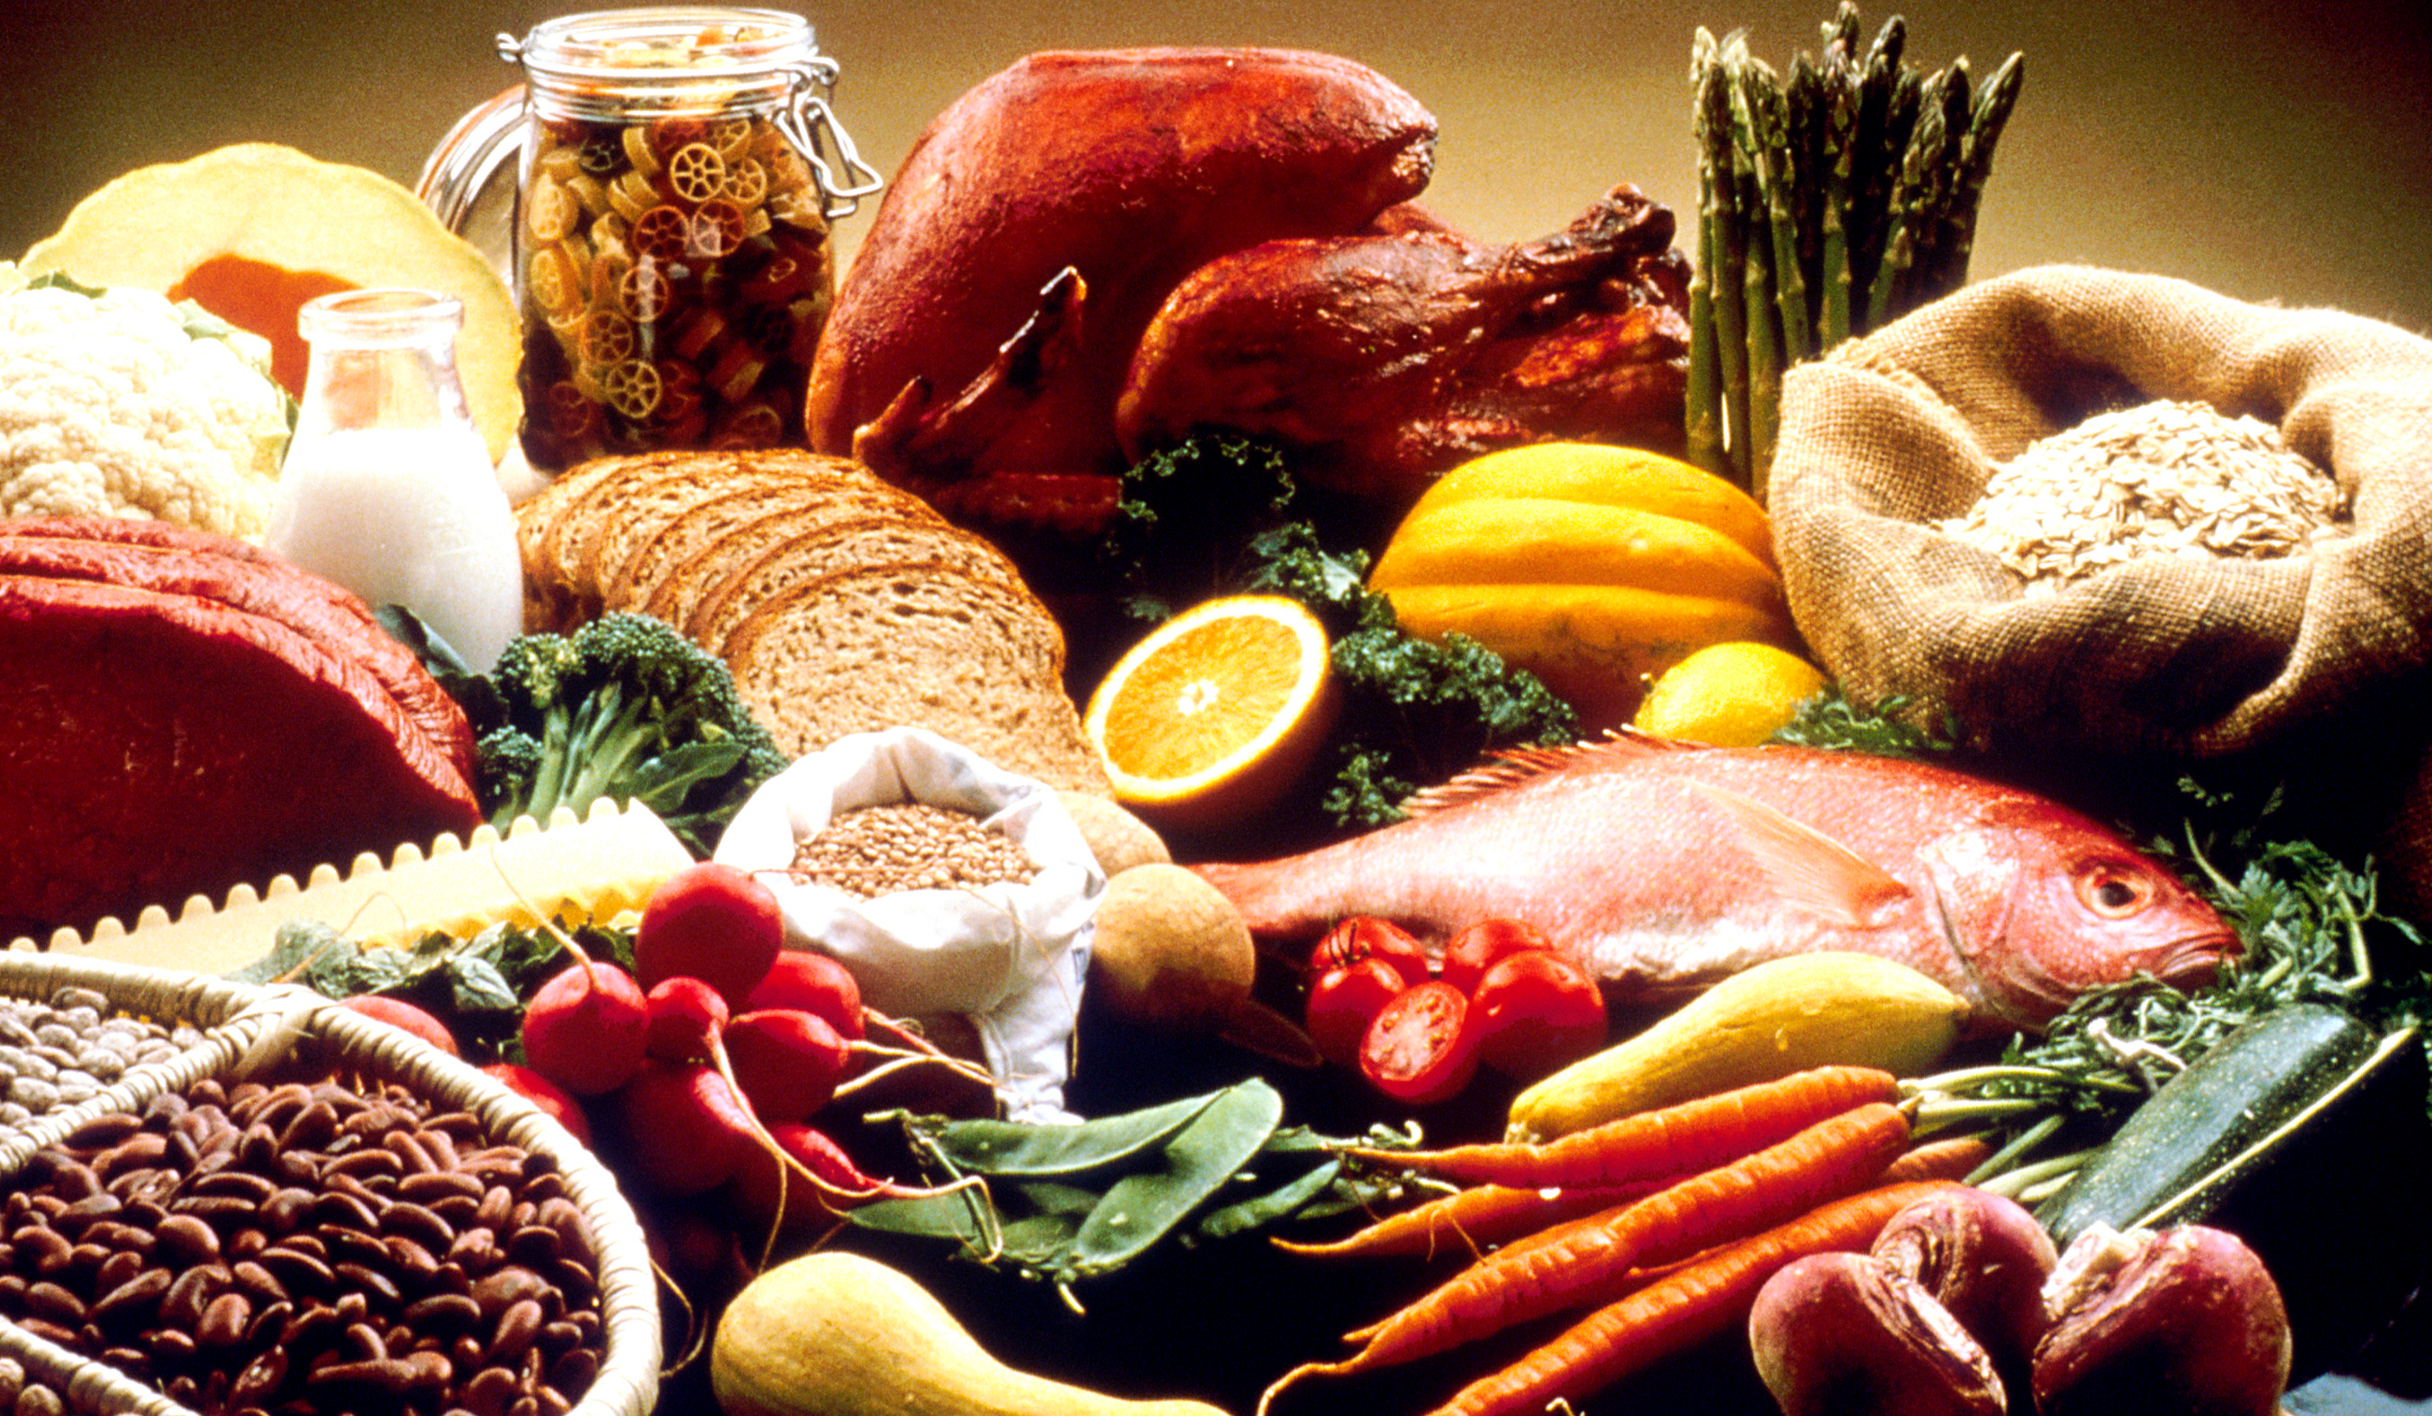
Performing under Pressure; on the Biology, Psychology and Sociology of stress in high-performance professions
IX – Nutrition, stress and performance

Slide 2
On the chaos that is Nutrition Science
Everyone has their favourite diet and tests it against the standard American diet (MacDonald’s, Burger king and worse).
Very few randomised trails
Extremely complicated to get people to follow a diet
Animal studies usually do not translate well
Mostly self-report data (highly unreliable)
Mostly aimed at the treatment of disease rather than optimum function
Heart disease, obesity, diabetes
With the exception of sport’s science, longevity research

Slide 3
The first question to ask:What are you aims?
Nutrition is probably not a question of ‘optimal’ function, but of optimisation for a specific outcome.
Longevity
Peak performance
Psychological stability
Stress resilience and peak performance?

Slide 4
The second question: what else are you doing/willing to do?
Nutrition does not exist in a vacuum.
Physical exercise
Link with carbohydrate consumption
Sleep
Affects leptin levels, amongst other endocrine and neuroendocrine systems.
Mental health
Your mental state may influence metabolism and vice versa.

Slide 5
The natural starting point: What did we evolve to eat?

Slide 6
How far back do we go?
Which ancestral species?
The further back you go the more fruit and leaves based diet gets (humans are believed to have first appeared between 300 and 500 thousand years ago).
After the advent of meat eating (at least 2.6 million years ago)
Energy surplus
After the advent of cooking (300 000 – 2 million years ago)
Energy surplus + gut-size reduction
After the agricultural revolution (+/- 11 700 years ago)
Rise in population, organisation and culture
Wrangham, R. (2009). Catching Fire: How Cooking Made Us Human. New York: Basic Books.
Thompson, J. C., Carvalho, S., Marean, C. W., & Alemseged, Z. (2019). Origins of the human predatory pattern: The transition to large-animal exploitation by early hominins. Current Anthropology, 60(1), 1–23. https://doi.org/10.1086/701477
Diamond, J. (2003). Guns, Germs, and Steel in 2003. Antipode, 35(4), 829–831. https://doi.org/10.1046/j.1467-8330.2003.00357.x

Slide 7
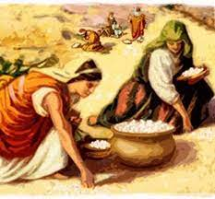
Changes in the food supply
Many of the foods of the time do no longer exist
Selective breeding of food stuffs
All year round access
Climate change & the disappearance of species

Slide 8
Changes in consumption culture
3 meals a day with snacks
Throughout most of pre-agricultural history people went often through short periods (a few days) of food deprivation, but rarely through starvation.
Non-stop availability
Obesity and diabetes
High levels of food-processing
Excess levels of salt, sugar and unhealthy fats

Slide 9
What do we actually know about prehistoric diet?
Atkins, paleo, raw, vegan, carnivore, keto … ????
We actually know surprisingly little
Generalist (all types of food stuffs)
An aim at digestibility (cooking)
But!!!! This diet was consumed in a highly physically active context!

Slide 10
Start of meat eating
Climate change: more grass lands.
Hunting is dangerous and hard. How do you start eating meat?
Scavenging (also rather dangerous but….. BONE MARROW!!!!)
Remains fresh for a few days because its encaged in a handy little box (bone)
Doesn’t take complicated tools (a stone)
High in fat
Thompson, J. C., Carvalho, S., Marean, C. W., & Alemseged, Z. (2019). Origins of the human predatory pattern: The transition to large-animal exploitation by early hominins. Current Anthropology, 60(1), 1–23. https://doi.org/10.1086/701477
Thompson, J. C., McPherron, S. P., Bobe, R., Reed, D., Barr, W. A., Wynn, J. G., … Alemseged, Z. (2015). Taphonomy of fossils from the hominin-bearing deposits at Dikika, Ethiopia. Journal of Human Evolution, 86, 112–135. https://doi.org/10.1016/j.jhevol.2015.06.013

Slide 11
Hunting & endurance running
Big game overheats quicker
If you can cool more easily, hunting becomes easy.
No need for sophisticated tools
No need for extreme physical output
Pickering, T. R., & Bunn, H. T. (2007). The endurance running hypothesis and hunting and scavenging in savanna-woodlands. Journal of Human Evolution, 53, 434–437. https://doi.org/10.1016/j.jhevol.2007.01.012

Slide 12
Key nutrients
Macronutrients
Carbohydrates (4cal/gram)
Protein (4cal/gram)*
Fat (9cal/gram)*
Micronutrients
Vitamins
Minerals

Slide 13
Micronutrients
Deficiencies, and in some cases excess, of a micronutrient may affect both the stress response and resilience. Regular bloodwork should tell you if you are deficient in anything.
Common deficiencies
Iodine
Calcium
Magnesium
Vitamins A, B12, D
Iron
Others to pay attention to:
Omega 3 fatty acids (anti-inflammatory)
Antioxidants

Slide 14
Macronutrients
The main sources of fuel and building materials
Fat and protein are essential
We can survive without carbohydrates
Endogenous production of glucose for the brain

Slide 15
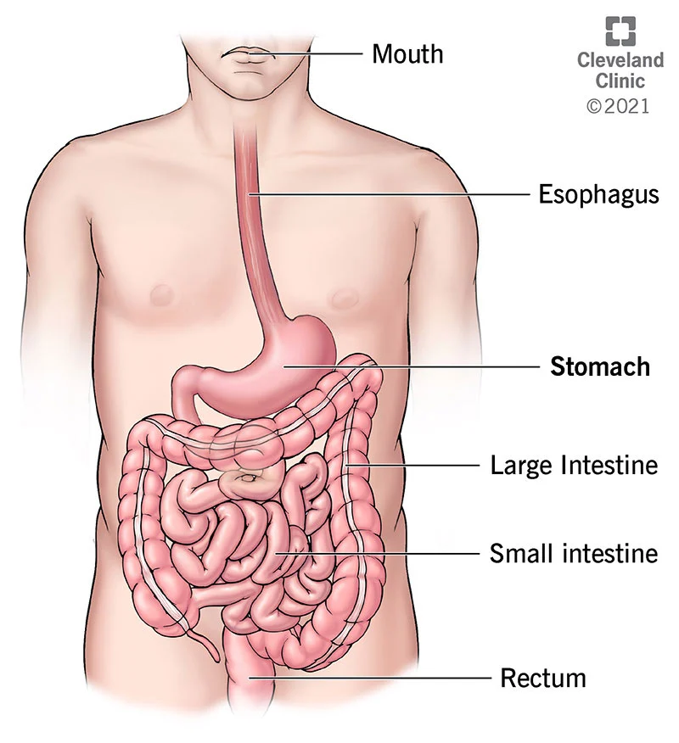
The digestive system has specific sensors for different nutrients
Sugars
We like sweet things even if you numb taste buds
Stimulates endorphin secretion
Amino acids (building blocks of protein)
We will eat until we have enough, not until we are full
L-tyrocine (dopamine precursor)
Chicken, turkey, fish, milk, yoghurt and almonds
Tryptophan (serotonin precursor)
Fats (lipids)

Slide 16
The system simplified
What you do not use, you store. But, not all macronutrients are stored the same way.
Insulin
Fat metabolism
Stress releases stored energy
Cortisol
Stress for no real reason
You dump a lot of energy on the system, remove it, dump it back in, remove it, etc.

Slide 17
Serotonin: the relax neuromodulator
Carbohydrates stimulate serotonin secretion
Rest and digest – relax
SSRIs – Common anti-depressants but serious side-effects
Blunted emotions
Diminished motivation
Diminished hunger
Diminished sex-drive

Slide 18
Fasting
Autophagy
ketosis
Longevity
Regulation of insulin levels
Neurogenesis
Mattson, M. P., Longo, V. D., & Harvie, M. (2017). Impact of intermittent fasting on health and disease processes. Ageing Research Reviews, 39, 46–58. https://doi.org/10.1016/j.arr.2016.10.005
Longo, V. D., Mitteldorf, J., & Skulachev, V. P. (2005). Opinion: Programmed and altruistic ageing. Nature Reviews Genetics, 6(11), 866–872. https://doi.org/10.1038/nrg1706

