Slide 1
QUIZ
Which theory says that we have a sample for every letter and its orientation in our memory? What are the disadvantages of the theory?
What is the difference between bottom-up and top-down perception? Can you give examples?
What are some of the features that Anne Treisman names in her theory?
What are functions of attention?
Can you provide at least two theories of attention? ( and describe the difference between them?)

Slide 2


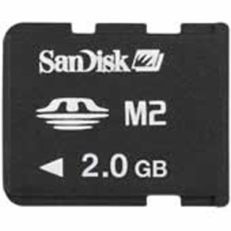
Memory
Michaela Porubanova

Slide 3

Memory
1. mental capacity to store information
2. information stored in our memory
3. recall of information that I am trying to utillize at the moment
4. dynamic processes used in the retention and recall/ recognition of information

Slide 4
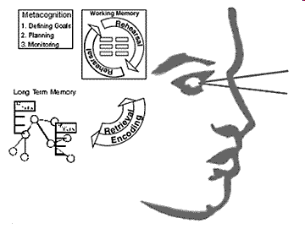
3 basics mechanisms of memory
Encoding
Storage
Retrieval

Slide 5

Our sense of self and personal history arises from our experiences – but we only know of these experiences through our recollections.
Are we, then, just a product of our memories?

Slide 6

Everyday memory
Memory is selective.
Recovering a memory is not playing a videotape
  Memory involves inferences that fill in gaps in recall.
  We are often unaware we have made such inferences.
Source Amnesia: The inability to distinguish what you originally experienced from what you heard or were told later about an event.

Slide 7

Confabulation
Confabulation: Confusion of an event that happened to someone else with one that happened to you, or a belief that you remember something when it never actually happened.
Confabulation is most likely when:
  You have thought about the event many times
  The image of the event contains many details
  The event is easy to imagine
  You focus on emotional reactions to the event rather than what actually happened.

Slide 8
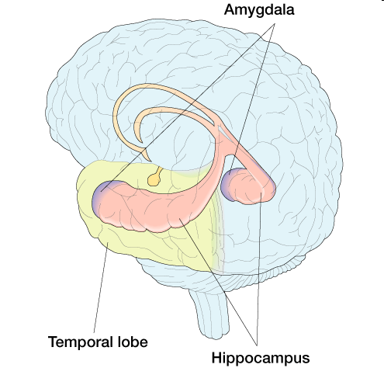
Patient H.M.
Brain surgery for epilepsy in 1953
• Parts of medial temporal region removed
• Including the hippocampus (and more)
• Specific anterograde amnesia (and some
retrograde amnesia for 3 previous years)
his working memory and procedural memory were intact, he could not commit new events to long-term memory
• No problem in perception, reasoning, etc
• Died, November 2008.

Slide 9
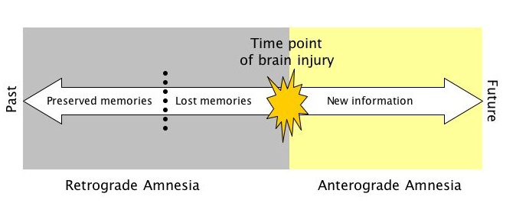
Amnesias
Memories for recent and remote events involve different structures.
• Retrograde Amnesia – loss of memory for events preceding the lesion.
• Anterograde Amnesia – loss of memory for events following the lesion.

Slide 10
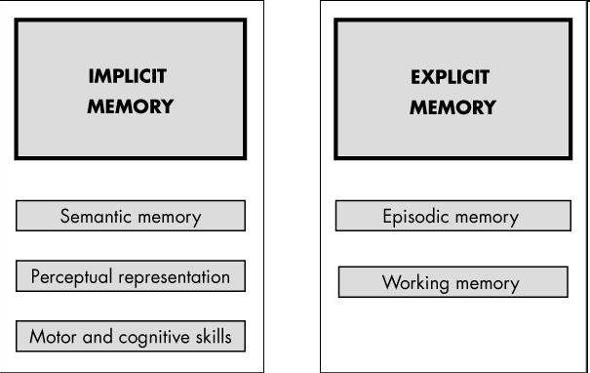
Types of memory I
Explicit Memory: Conscious, intentional recollection of an event or of an item of information.
Implicit Memory: Unconscious retention in memory, as evidenced by the effect of a previous experience or previously encountered information on current thoughts or actions.

Slide 11
Explicit Memory
Recall: The ability to retrieve and reproduce from memory previously encountered material.
Recognition: The ability to identify previously encountered material.

Slide 12
Black Grape Horse School Fish Student Bird Yellow Kiwi Blue Green Chair Mango Desk Bookcase Bed Teacher Table Homework Class Apple Dog Banana Orange Cat

Slide 13
Horse Brown Notebook Dog Pear Bird Orange Yellow Blue Purple Black Table Chair Desk Bookshelf Teacher School Pupil Homework Classroom Banana Kiwi Grape Bed

Slide 14
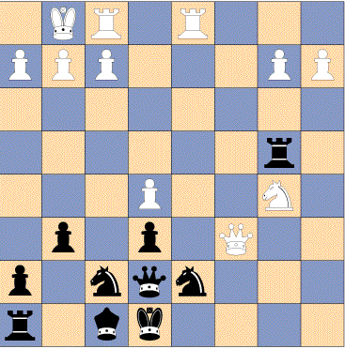
You have 5 seconds to memorize as much as you can
Then, draw an empty chess board and reproduce the arrangement of pieces

Slide 15
Chunking?
(Chunk: A meaningful unit of information; it may be composed of smaller units.)
Confusion?
Recall or recognition?

Slide 16
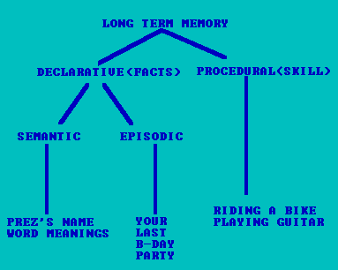
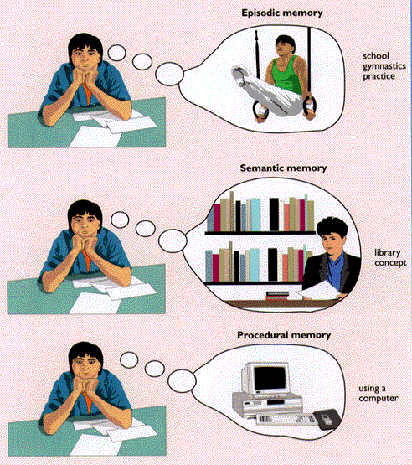
Types of memory
(Remembering that.... vs remembering how to ...)

Slide 17
What is Memory?
Memory for facts:
New York is located in the USA.
Declarative memory... what other kind could there be?
.... Remembering how to tie your shoelaces
.... Remembering how to ride a horse
Declarative vs Procedural Memory
(Remembering that.... vs remembering how to ....)

Slide 18
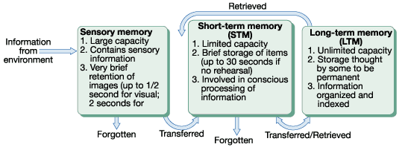
Three-storage Model of Memory
Sensory Memory: Fleeting Impressions
Short-term Memory: Memory’s Scratch Pad
Long-term Memory: Final Destination

Slide 19
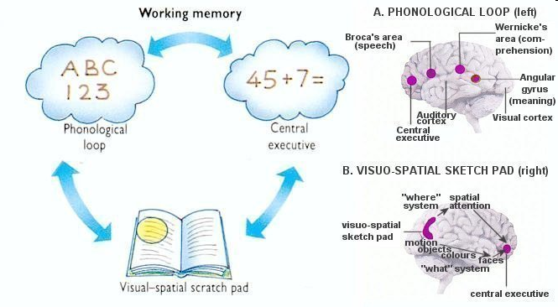
Short Term Memory/Working Memory
Theorists differ a lot here
•WM acts as an active area in which items are kept at the forefront of attention
• Preserved by rehearsal
• An old theory due to George Miller
suggested a capacity of 7 +/- 2 ‘items’

Slide 20
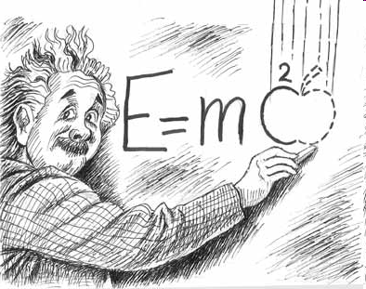
Rehearsal
Maintenance Rehearsal: Rote repetition of material in order to maintain its availability in memory.
Elaborative Rehearsal: Association of new information with already stored knowledge and analysis of the new information to make it memorable.

Slide 21
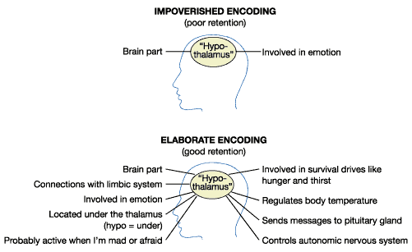
rehearsal

Slide 22
Memory techniques- mnemonics
http://www.youtube.com/watch?v=V8S8V9VEFyI&feature=related

Slide 23
Theories of forgetting
Decay
Interference
Cue-dependent forgetting

Slide 24
Decay
Decay Theory: The theory that information in memory eventually vanishes if it is not accessed (it is valid more to short-term than to long-term memory)
Notes:
Psychology 101 On Line
Norris Edwards, Chapter 1, Wade01.ppt, Page 24

Slide 25
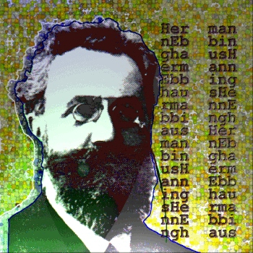
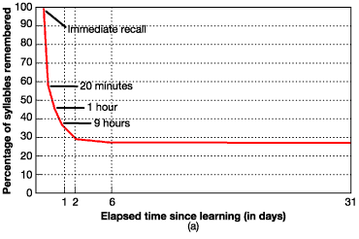
Forgetting Curve
Herman Ebbinghaus tested his own memory for nonsense syllables.
Forgetting was rapid at first and then slowly stagnated
Notes:
Psychology 101 On Line
Norris Edwards, Chapter 1, Wade01.ppt, Page 25

Slide 26
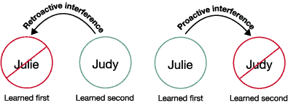
Interference
Retroactive Interference: Forgetting that occurs when recently learned material interferes with the ability to remember similar material stored previously.
Proactive Interference: Forgetting that occurs when previously stored material interferes with the ability to remember similar, more recently learned material.
Notes:
Psychology 101 On Line
Norris Edwards, Chapter 1, Wade01.ppt, Page 26

Slide 27
Cue-dependent Forgetting
Cue-Dependent Forgetting: The inability to retrieve information stored in memory because of insufficient cues for recall.
„searching for a book in a library without the reference number, title, author or even subject „
State-Dependent Memory: The tendency to remember something when the person is in the same physical or mental state as during the original learning or experience.
Notes:
Psychology 101 On Line
Norris Edwards, Chapter 1, Wade01.ppt, Page 27

Slide 28
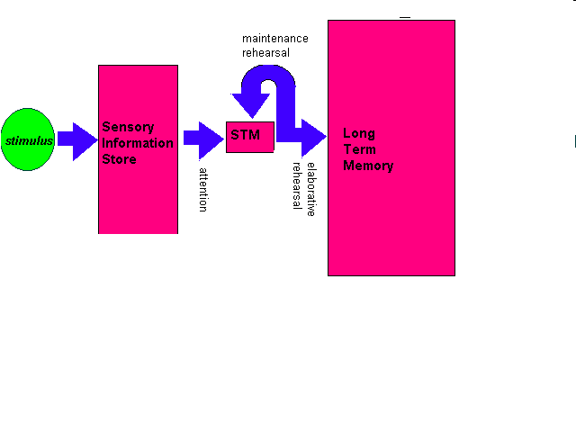
Atkinson and Shiffrin

Slide 29
Sensory memory
Great capacity
Time limitation
2 sec
Attention necessary for further processing
Fast decay of information

Slide 30
Sensory memory (iconic memory)
Research of George Sperling
Latency :50ms
A | M | X | C
V | K | O | M
N | R | Y | J

Slide 31
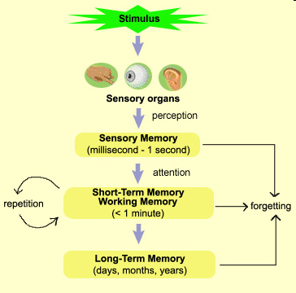
Transfer of info from SM to STM
attention= “ a gate” between SM and STM
Relevance of information
Selectivity of attention

Slide 32
Selectivity of attention
http://www.youtube.com/watch?v=IGQmdoK_ZfY

Slide 33
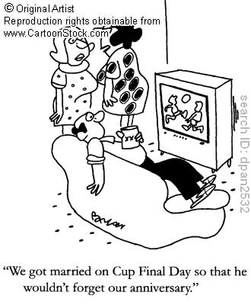
Short-term memory
Information flowing constantly
How to retain info?
Attention but alsomaintanence rehearsal
If information is not processed it vanishes after 15-30 s

Slide 34

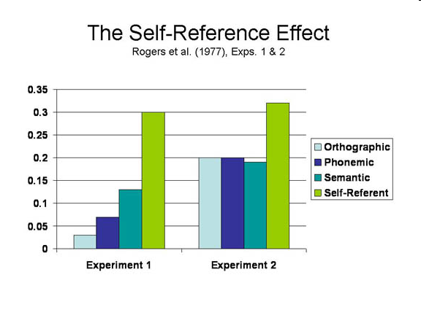
Self-reference effect
http://www.psych.uni.edu/psychexps/exps/Self_Reference/selfref99.htm

Slide 35
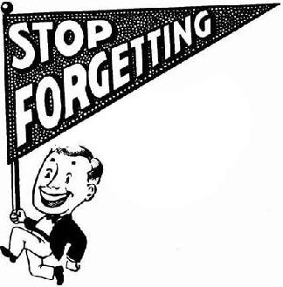

Long-term memory
“relatively” unlimited (time and space-wise)

Slide 36
Document about memory
http://www.youtube.com/watch?v=4sWnkBf5V7s&feature=related

Slide 37
Long-term memory loss
http://www.youtube.com/watch?v=WmzU47i2xgw&feature=related

Slide 38
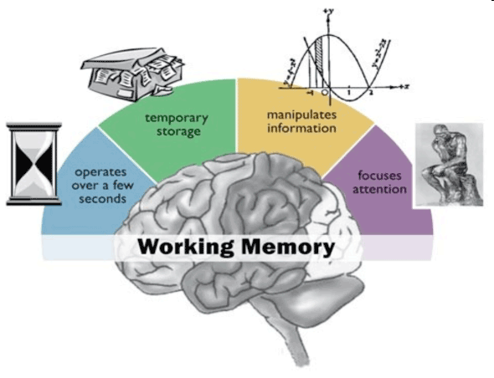
Baddeley- working memory

Slide 39
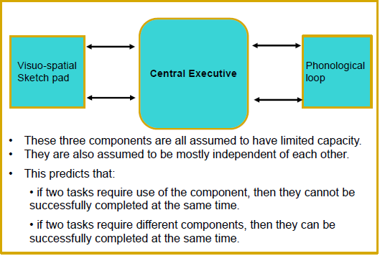
Working memory: Alan Baddeley

Slide 40
Baddeley- working memory
Central Executive: meters out attention
Phonological loop: sub-vocal rehearsal
Visuo-spatial sketchpad: non-verbal information
(visual, movement, etc)

Slide 41
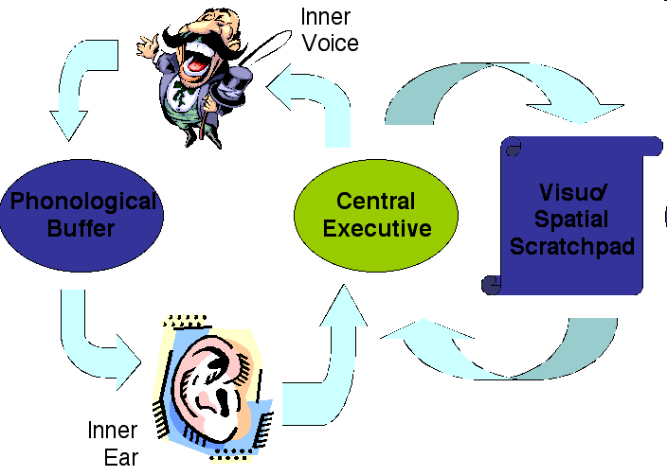
Central Executive/ „supervisor“
binding information from a number of sources into
coherent episodes
coordination of the slave systems
shifting between tasks or retrieval strategies
selective attention and inhibition

Slide 42
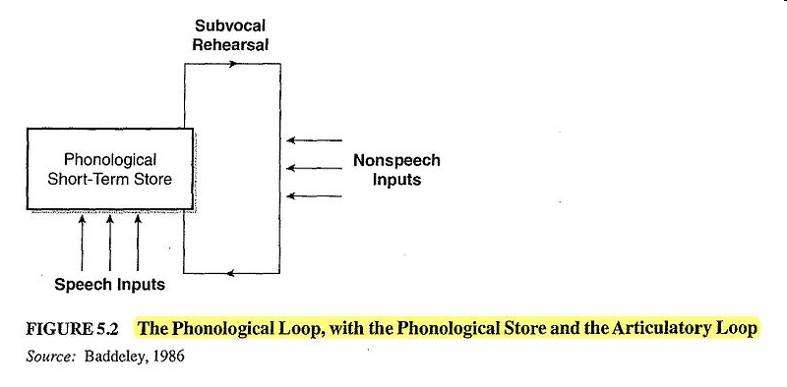
Phonological Loop
Processes sound or phonological information
phonological store and articulatory rehearsal component /loop

Slide 43
Phonological Loop
- Mental Rehearsal
Which list is easier to retain in memory?
Z L Q T N K S R
P B G V C T D E
cup hat ball tree fork top door pin
refrigerator hippopotamus encyclopedia.....

Slide 44
Phonological Loop
Items which sound similar are more easily to be confused because storage of information is based on the sound of the item (sub-vocal rehearsal)
Longer words take up more ‘space’: they exert WM, so less information is remembered

Slide 45
Visuospatial sketchpad
hold information about what we see = visual information
manipulation of spatial and visual information

Slide 46
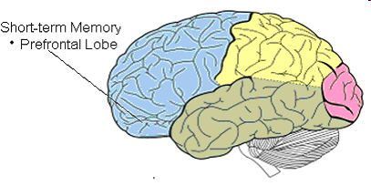
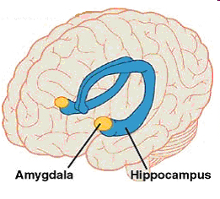
STM/WM vs LTM
Short Term Memory is: Time-limited
(max ca 30 sec)
Content limited
prefrontal cortex
dial a phone number someone just told you
Long Term Memory is:
Of Indefinite Duration
Virtually unlimited
even permanently on the basis of meaning and importance

Slide 47
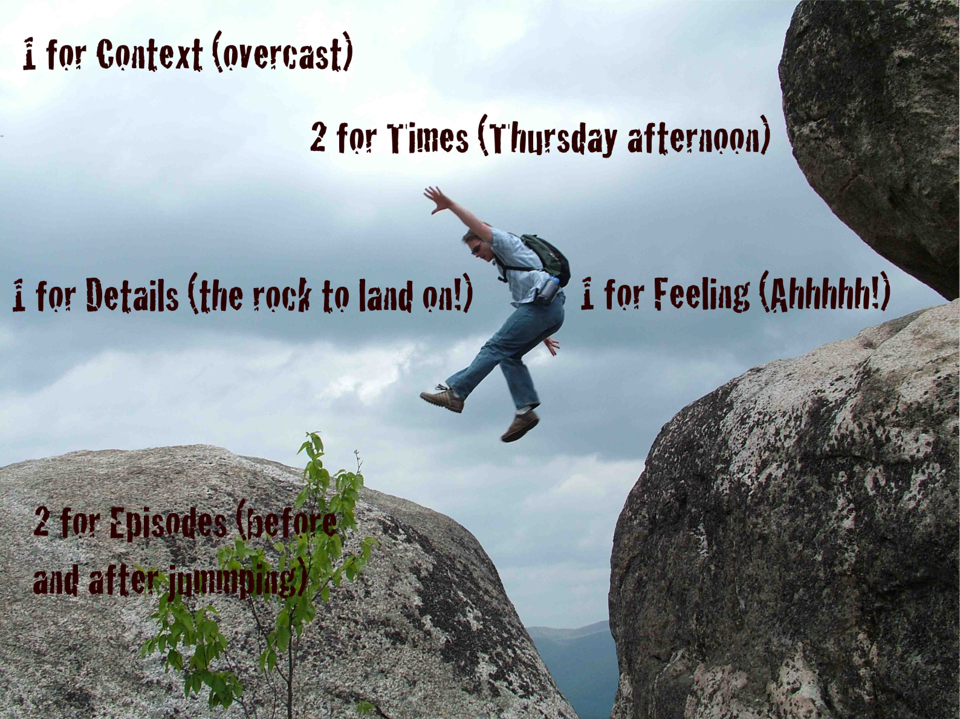
Autobiographical Memory

Slide 48

Autobiographical Memory
The reminiscence bump: people recall a disproportionatelylarge number of autobiographical memories of events that happened when they were about 15-25 years of age.
WHY?
memories linked to self-identity
biological/ maturational account
the cognitive account – novel experience

Slide 49
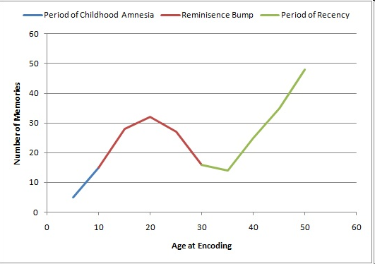
Autobiographical Memory

Slide 50
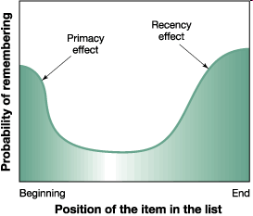
Autobiographical Memory
A period of recency: people recall more autobiographicalmemories of events that happened more recently in their lives.
Recall Ebbinghaus

Slide 51
