Slide 1
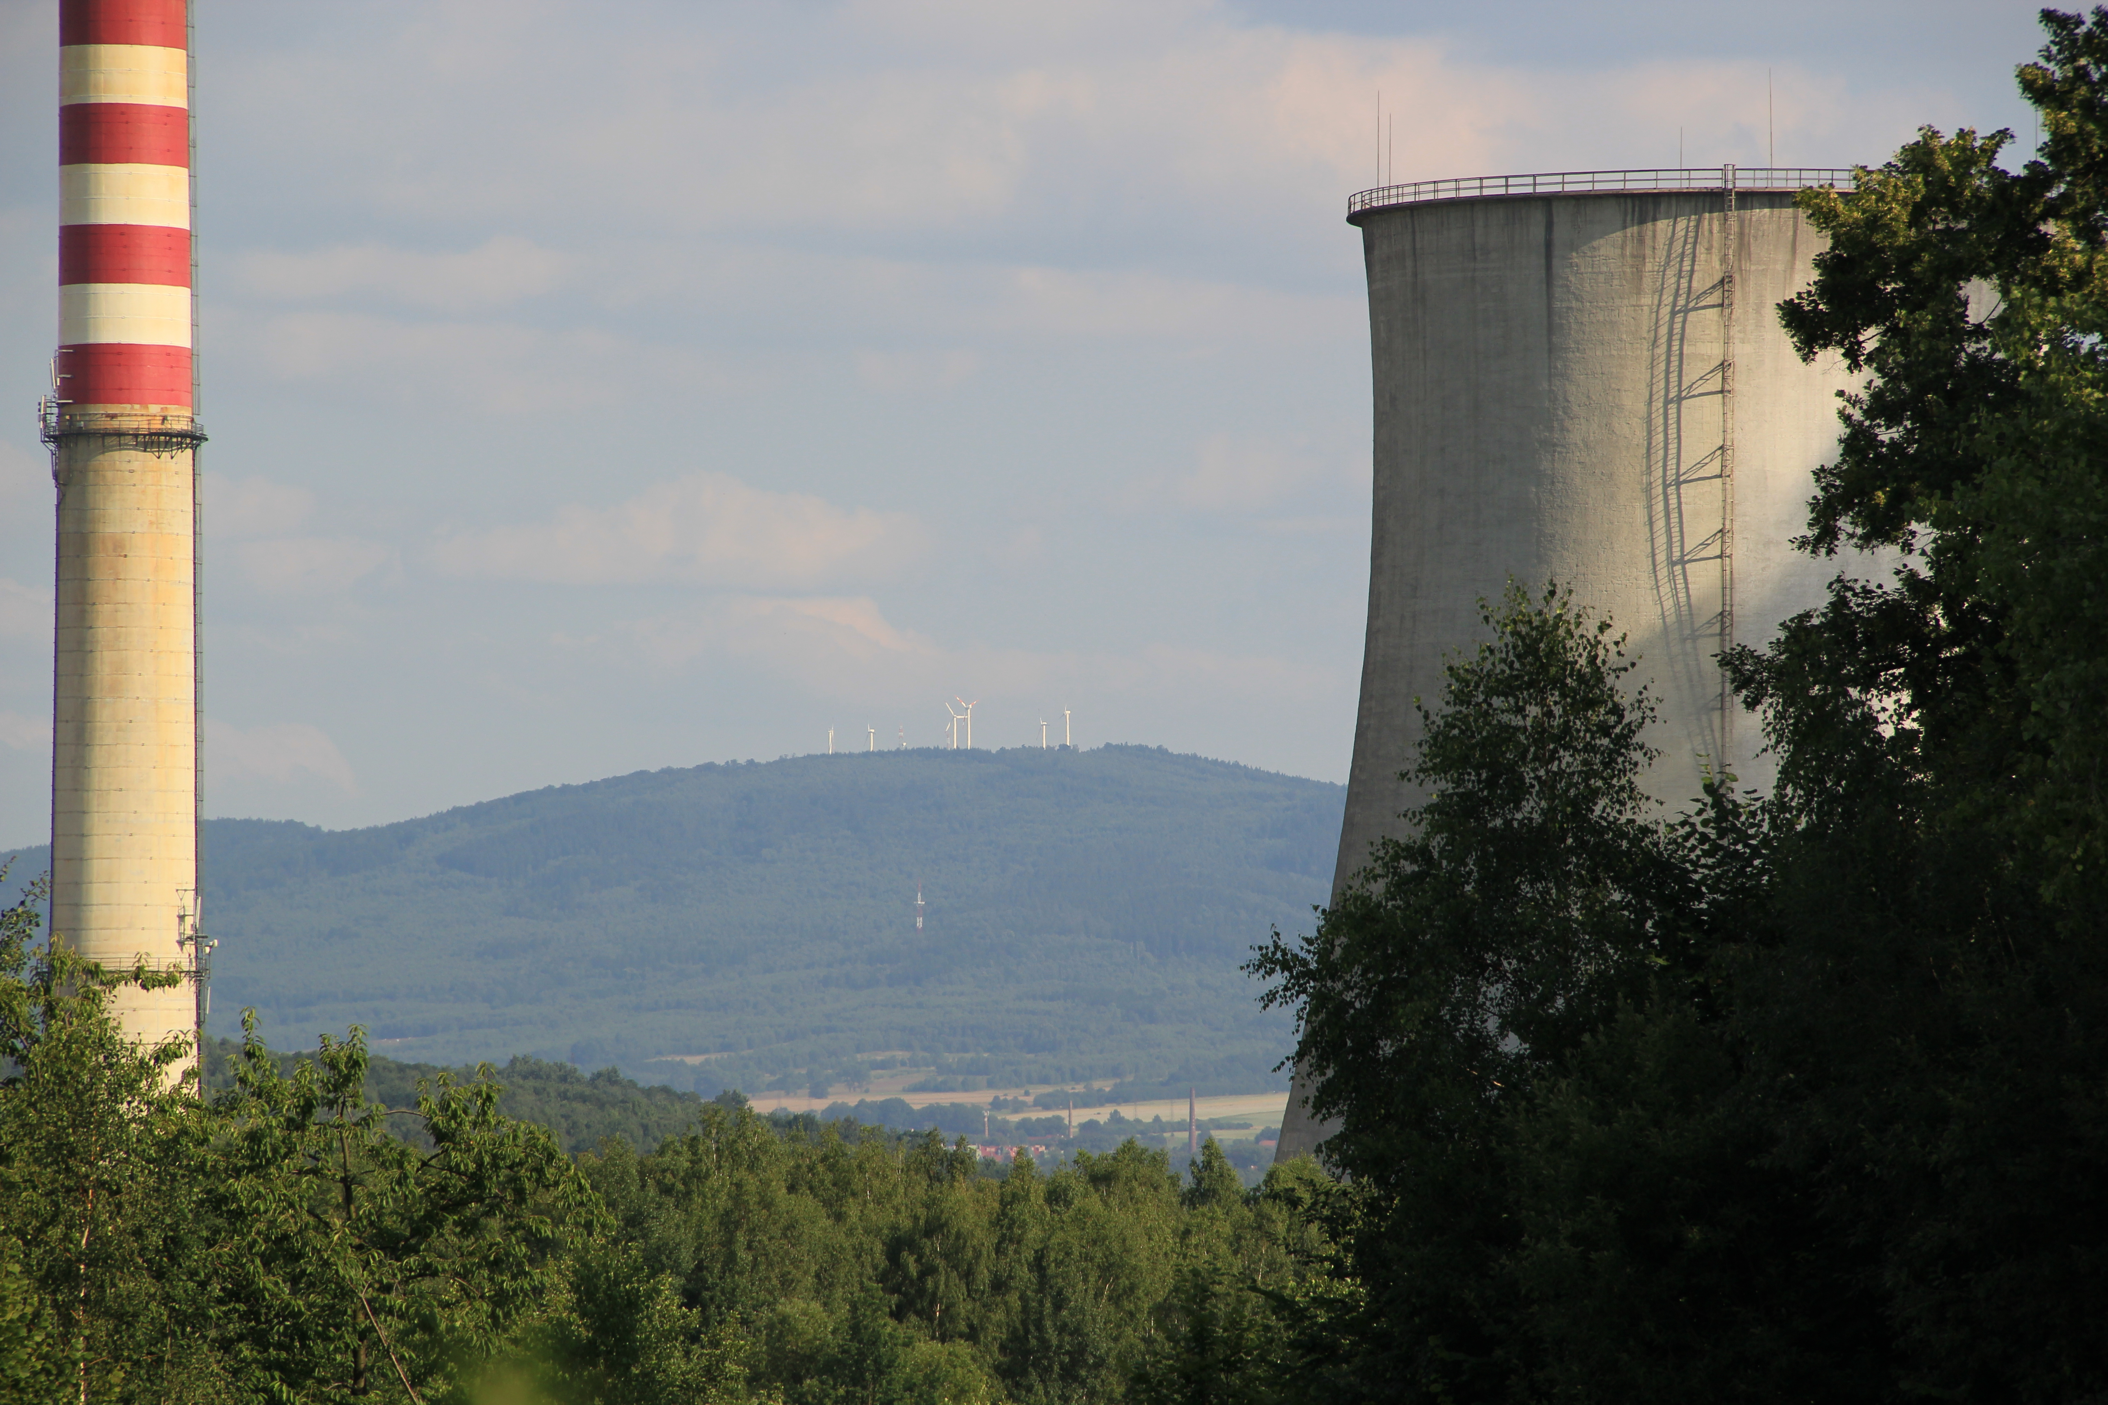

www.bankwatch.org
LOW-EMISSION STRATEGY - POLAND 2050
Brno, 04.09.2013
Notes:
1

Slide 2

Scope
Context
About the project
Key findings
Key messages
www.bankwatch.org

Slide 3

Context
www.bankwatch.org

Slide 4
POLAND – Climate protection facts
Between 1988 and 2011 GHG emissions fell down by 29% – Kyoto goal for Poland is 6% emission reduction
GDP between 1991 – 2012 has more than doubled
Polish society not only profited but also paid for the changes
www.bankwatch.org

Slide 5
What is the state of the climate policy debate in Poland?
Open questioning of our civilization's responsibility for climate change
Three vetoes of Poland to EU climate targets, a resolution of the Polish Parliament (October 2012),
Strong energy sector and mining lobby are slowing down the development of RES and energy efficiency technologies (they are orphans) but shortages of electricity are coming.
The role of the coal is under discussion. Difficult times for lignite (strong social opposition and a necessity to open new lignite deposits) and the Polish hard coal is increasingly too expansive.
Two new opportunities ??? - Shale gas –the hype is down in recent months and nuclear power stations – the debate about costs and a suitable localization
Almost technological state of the art in the Polish heavy industry: chemical and petrochemical, steel and non-iron mills, glass and paper
Communal waste in Poland is one of the biggest problems with waste in EU
Notes:
Polski rząd pod wpływem lobby węglowo-energetycznego ale i także części przemysłu nie chce się zgodzić na bardziej ostrą politykę klimatyczną dlatego trzy razy w ostatnim okresie czasu użył weta. 1 Podniesienie progu redukcji emisji przez UE z 20% do 25%; Mapa Drogowa 2050 gospodarki niskowęglowej, Mapa Drogowa 2050 energetyki. Skostniała polska energetyka nie chce dopuścić do zasadniczych zmian strukturalnych budowanie energetyki rozproszonej widząc w tym utratę swoich interesów i wpływów politycznych.

Slide 6
Is climate policy too risky for Poland? II
Transport almost dead end street
Agriculture and forestry today do not play the important role in climate protection
Overuse of the argument that the risk of carbon leakage is too large.
Lack of integration between the climate and economy policies as well as strong center for long-term strategic planning
BUT
In 2009, 73% of Poles recognized climate problems as severe or very severe
In 2011, GHG emissions per capita were at the level of 10,5 tones CO₂eq – 5 times more than the estimated amount needed globally to stabilize the climate
www.bankwatch.org

Slide 7
The choice
Poland can chose between one of the two development paths:
  Limited development scenario that keeps the current status quo ante with respect to the reform agenda;
  Modernization scenario in which future development is based on three pillars:
    High quality institutions and regulations
    Innovation
    Resource efficiency;
www.bankwatch.org

Slide 8
Two development paths
Source: IBS BAU
Limited development scenario – the reference tool for report analysis.
Modernization scenario – scenario that incorporates many reforms and takes into account the green growth agenda.
www.bankwatch.org

Slide 9
About the project
www.bankwatch.org

Slide 10

Towards 2050 - project objectives
The project’s goal is to show the relationship between development and the low-emission economy:
  benefits of choosing the path of modernization based on resource efficiency and innovation;
  positive impact of the economic modernization on the sustainable development and its implementation;
  the consequences of reducing CO₂ emissions and development (low-emission policy does not hamper the development but drives it in).
www.bankwatch.org

Slide 11
Goals – the journey to 2050
The main goal of the project is to lead the public discourse about the greenhouse effect reduction and transformation towards low-emission economy in Poland.
Use „solid”, substantive arguments for the GHG mitigation and the attempt to change the attitude of politicians and business towards low-emission policy.
www.bankwatch.org

Slide 12
Goals – the journey to 2050
To show the relationship between development and the low-emission economy:
  benefits of choosing the path of modernization based on resource efficiency and innovation;
  the consequences of reducing CO₂ emissions and development (low-emission policy does not hamper the development but drives it in);
  positive impact of the economic modernization on the sustainable development and its implementation.
www.bankwatch.org

Slide 13
Scope of the work
BAU scenario
Assessment of the technological potential to reduce GHG up to 2050
Cost analyzes of the technological potential on the micro level (including micro-MAC, scenario building etc)
Alternative scenarios for GHG emission reduction up to 2050
Macroeconomic simulations of the scenarios (macro-MAC - MEMO 2)
Neutral narrative stemming from the well documented information
Some others types of research (eco-innovation, financing, climate policy) – 4 discussion papers
www.bankwatch.org

Slide 14
Forum of Experts
The results of the study have been consulted with a group of 50 experts from the scientific community, social activist, politicians and members of the central administration and local authorities.
The full list of the involved parties can be consulted here:
http://np2050.pl/pl/forum-ekspertow

Slide 15
Key findings
www.bankwatch.org

Slide 16
Sectoral perspective – buildings
Key sector for energy efficiency improvements – in the modernization scenario the total energy saved up to 2050 can satisfy Poland’s energy needs for 8 years.
Even conservative scenario for deeper retrofit and technologies implementation leads to substantial energy savings and GHG reductions -40% in comparison to BAU and by 25% comparing to the current GHG level
Total reduction and net costs depend on developments in energy sector (i.e. low emission energy → increased savings in appliances, but higher costs of fuel switch to electricity).

Slide 17

Energy and emissions
The energy sector in the reference scenario (BAU) maintains the current structure based on the traditional coal power plants.
Improvements in the energy intensity of the economy and the gradual reduction of emissions per unit from electricity production due to the use of more effective modern coal technologies are not able to offset the effects of a fast growth of the Polish economy and the gradual increase of the role of electricity in the energy mix.
In the BAU scenario the emissions grow and in the 2010-2050 period reach 8830MtCO2e compared to 50-60% less in the modernization scenarios.
Electricity production will reach 320-330 TWh in 2050 and heat production 58-96 TWh (compared to 155TWh and 96TWh at present)

Slide 18
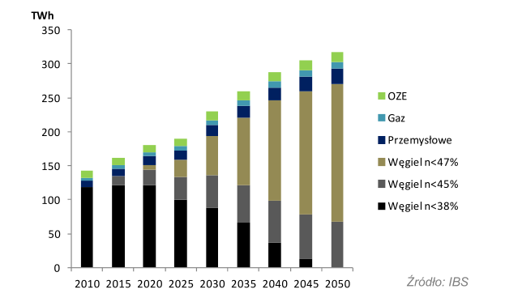
Reference scenario BAU for the energy sector
Currently 30,5 GW of electricity generated on the basis of coal (9,7 GW lignite and 20,8GW hard coal). In the BAU reference scenario the demand for coal for the energy sector will go up by 35% (approx. 35 million tones) in 2030 and by 50% (approx. 50 million tones in 2050).

Slide 19
Sectoral perspective – energy I
The general philosophy of scenarios
 |  | Openness allowing (or not) net import from the EU
 |  | Autarky | Integrated EU energy market
Power sector structure affecting network costs and competitive pressure on coal | Large-scale power generation | BAU French model Low Emission Coal | The Balanced Path Switch to gas
 | Distributed generation | Distributed generation | European scenario

Slide 20
Sectoral perspective – energy II
Reduction relative to 1990
94% | 95% | 94% | 93% | 93% | 91% | -21%
Source: IBS
Several different low-emission paths are possible. Coal is not a must.
2050 perspective allows for gradual evolution, but it should start now to avoid lock-ins.
Costs increase, but are not prohibitive. Investing in distributed generation and European energy market needed to avoid being left behind in case of tech breakthroughs.

Slide 21
Sectoral perspective – energy III
CO₂ price impact
Source: IBS
Price of GHG allowances rising to 45 euro in 2050 → some scenarios cost less than BAU after 2030. For scenarios based on CCS coal/gas this price does not fully cover costs of CO₂ capture. Reduction from the current 400MtCO2e to 171MtCO2e in modernization scenarios compared to 525MtCO2e in BAU.

Slide 22
Sectoral perspective - industry and waste
Source: IBS
Iron and steel – industry expects benefits (demand for new materials) from transition in other sectors
Oil and gas – without CCS only marginal reductions achievable
Chemicals – ethylene cracking significant, but costly lever
Skepticism of the industry towards CCS (especially oil and gas)

Slide 23
Sectoral perspective – industry
Chances/benefits
resource and energy efficiency
indirect effect of the transition – increase in demand for some products (low-emission investments, e.g. steel for wind farms, innovative materials for energy efficient buildings)
Risks/costs
High initial capital expenditure, returns depend on volatile fuel prices
CCS: decrease in energy efficiency, technological and environmental uncertainty, high costs

Slide 24
Energy savings
Source: IBS
Energy efficiency push in buildings and transport, as well as other sectors, can lead to full decoupling of economic growth and energy consumption.
Poland has already shown that it is capable of rapid improvements in production sectors. In next decades the consumption choices (buildings, transport) will be more important.

Slide 25
Emission reduction
Source: IBS
Poland can achieve both dynamic economic growth and significant GHG emission reduction through beneficial energy savings and affordable energy sector decarbonization (additional 1% of GDP in 2050*)
Technological and organizational breakthroughs in cheap low-emission power generation with additional subsequent fuel switch can lead to 80% GHG reduction.
Notes:
* The calculation does not include the effect that the boost of innovation could cause. If the innovations are coupled with the low-emissions transformation the GDP growth is of 3,5% out of which 1,5% is due to the increases in energy efficiency and 2% on the innovation related with the energy efficiency and green generation technologies.

Slide 26
Additional actions
Analyzed package allows to reach 55% emission reduction in 2050 including 30% for „free” with net profit.
However, broad range of other measures is available:
additional fuel switch in buildings (electricity supplemented by gas)
widely used electric vehicles (-85% GHG relative to BAU vehicle)
fuel switch in industry to low emission electricity and biomass; ½ of mix in light and ¼ in heavy industry
decline in mining and fuels (75% decline due to reduced demand for fossil fuels)
high cost agriculture (implementing 1/3 of costly measures)
Additional measures allow to reach 80% reduction of GHG emissions in 2050 relative to 1990.
These actions mostly depend on major (and uncertain) technological advances in low emission electric power generation (e.g. energy storage). Thus, it is difficult to provide reliable cost estimates for them.

Slide 27
Key messages

Slide 28
Key messages (1)
Active modernization agenda can transform Poland from a middle to a high income developed economy in 40 years
      Limited development = Poland as 3rd Iberian country
      Modernization = Poland as a 5th Scandinavian country
Certain effort in the reform implementation phase is necessary but the improvements in energy and fuel efficiency constitute an attractive, low hanging fruit to be picked up.

Slide 29
Key messages (2)
Emissions will fall significantly as a
  byproduct of the modernization agenda and
  desired policy choice made by a transforming society.
Overall impact on the economy will be unequivocally positive – costs will be smaller than benefits
Wisely designed policy is a key factor if the window of opportunity is to be successfully used before it is closed

Slide 30
Key messages (3)
Putting Poland on the low-emission path is wise and beneficial choice for coming decades.
Interim, achievable targets (i.e. for 2020 and 2030) are important to keep the pace of transition and provide incentive for economic improvements in the next decades.
Despite technological uncertainties it is worth investing in both low-hanging fruits of energy efficiency and innovative methods of power supply.

Slide 31
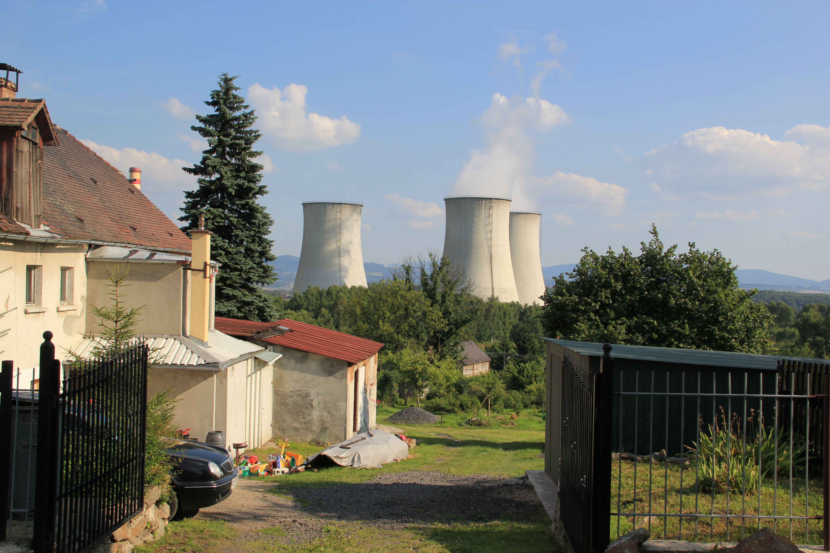
„Anything that is good for the industry is good for Poland”
www.bankwatch.org
Notes:
31
EC Bydgoszcz II kotły 1-4 = 746 MW; kotły 1 i 2 nielegalnie
PGE Górnictwo i Energetyka Konwencjonalna S.A. z siedzibą w Bełchatowie / Elektrociepłownia II (dawniej EC Bydgoszcz II) – IPPC do 31.12.1015
Podobnie jak w przypadku ZEDO Dolna Odra kocioł 3 i 4, dla kotłow 1 i 2 EC Bydgoszcz II funkcjonowanie w okresie po 31.12.2015 jest niezgodne z dyrektywa LCP i ich wpisanie do Przejściowego Planu Krajowego jest niezgodne z prawem unijnym.

Slide 32
And what are the developments in Poland?
The Renewable energy directive has yet to be fully transposed.
For now the new energy law makes it easier for the so-called prosumers (producers and consumers of energy) to sell the energy they produce to the grid and they receive 80% of the average energy price from the previous year.
Poland has yet to transpose the EU ETS directive, Industrial Emission Directive, Energy Performance for Building Directive and 5 other energy related directives.

Slide 33
Renewable energy in Poland
The latest analysis “Optimal energy mix for Poland until 2060 – DAS Model” stresses that according to Polish Transmission System Operator (PSE Operator) as much as 6,2 GW of wind power can be received by the Polish energy electricity grid in 2020 with a slight increase to 7,6 GW in 2025.
That is compared to 2,8GW as of 30.06.2013.
Lack of willingness to support the RES above the minimum 2020 EU obligations – 15% of final energy, 19,2% of electricity.

Slide 34
Co-firing of biomass with coal
In 2012 7TWh from co-firing constituting 48% of the green energy produced in Poland.
Estimates for 2013 suggest 5TWh due to the sharp fall in the prices of green certificates in Poland.
Currently there is 9TWh of oversupply in the Polish green certificate system due to the unrestricted growth of the co-firing that has caused most of new renewable energy investments to be shelved or frozen.

Slide 35
Security of supply concerns in 2015-2017 period
The recently published report by the Polish Ministry of Economy warns of the security of supply threat due to the necessity to retire old coal units from the Polish energy system at the end of 2015 (IED requirements).
The analysis states that approx. 95 MW of power may be missing from the energy system in 2015, 800 MW in 2016 and 1100 MW in 2017.
The peak uncovered summer demand in 2016 may reach approximately 520 MW to reach 680 MW in 2017.
Meanwhile all the new big coal investments apart from the 1000MWe unit in Kozienice will be operational at the earliest at the end of 2018.

Slide 36
Thank you for your attention!
For more information visit:
www.np2050.pl
Kuba Gogolewski
kuba.gogolewski@bankwatch.org
CEE Bankwatch Network
Raszyńska 32/44 Street flat 140
02-026 Warszawa
Poland
www.bankwatch.org
Notes:
36

Slide 37
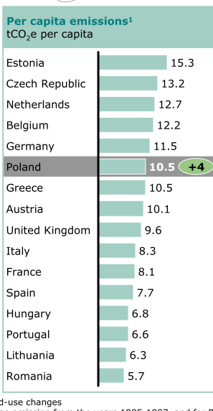

Slide 38
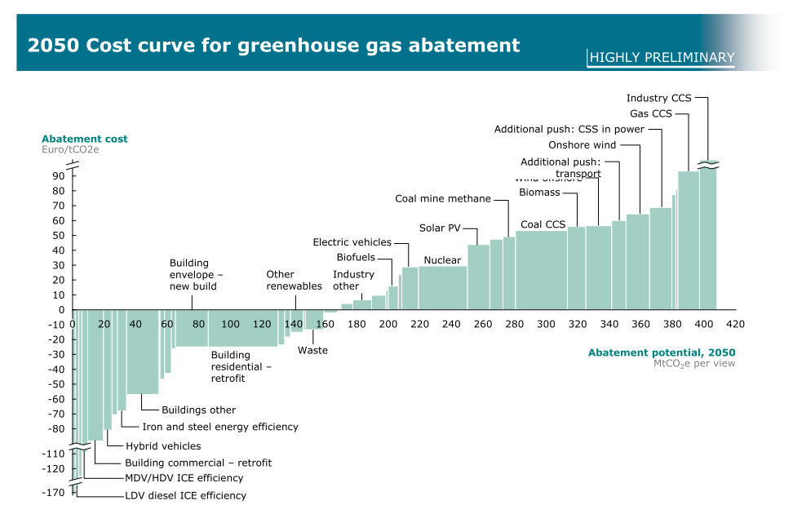

Slide 39
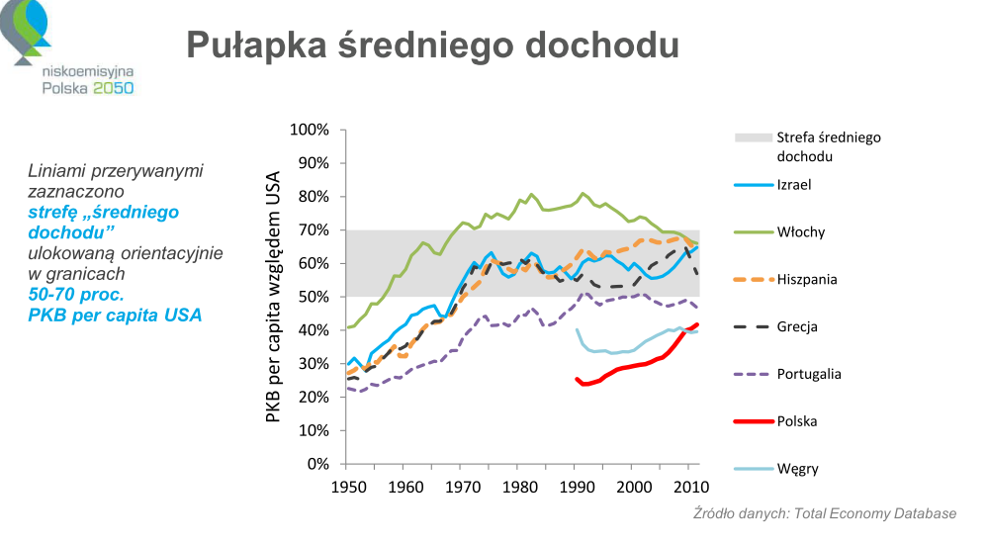

Slide 40
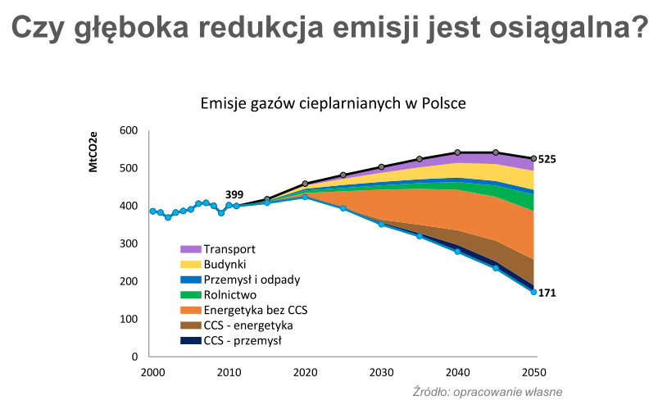

Slide 41
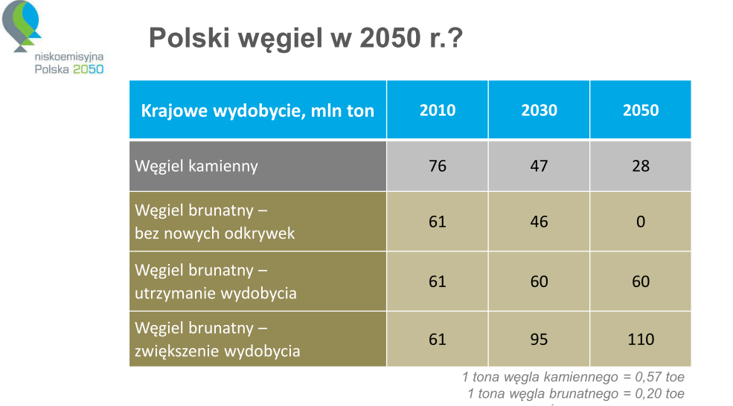

Slide 42
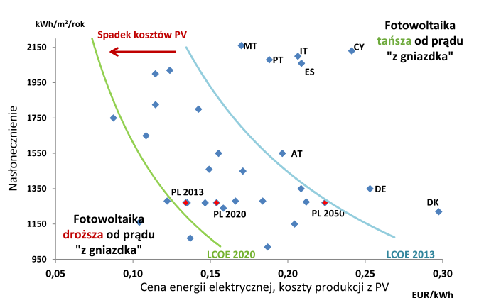

Slide 43
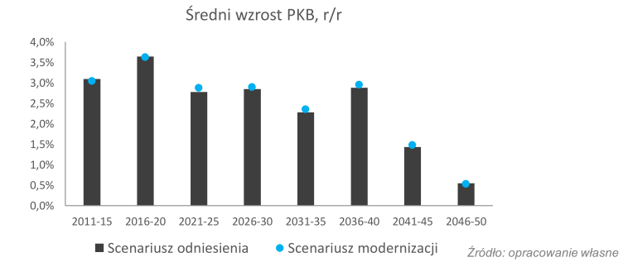

Slide 44
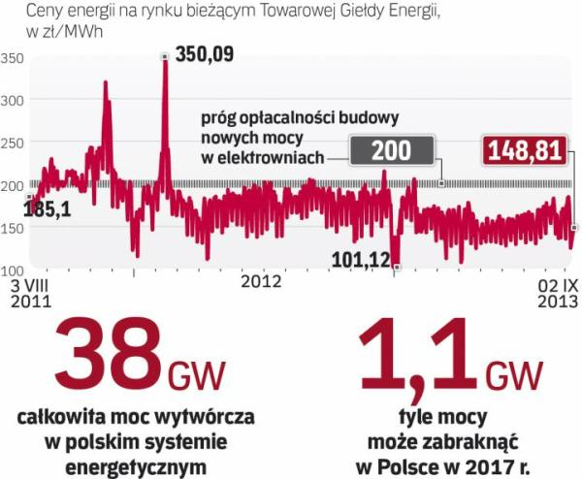
Source: ”Rzeczpospolita” http://www.ekonomia.rp.pl/galeria/532088,2,1044323.html

