Slide 1
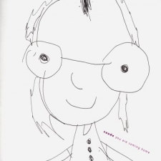
Learning Disorders
MKN: F81

Slide 2
Learning Disorders
Insufficiently developed learning skills
Affects acquiring educational skills
Etiology:
It is easier to say, what is NOT the cause.
Learning disorders are not a simple consequence of:
lack of learning opportunities
mental retardation
injury
brain disease
disabilities
→ Multidimensional causes
Occurrence:
Czech Ministry of Education: 3-4 % of children in average classroom.

Slide 3
Learning Disorders
Types of learning disabilities:
dyslexia
dysortographia
dysgraphia
dyscalculia
dysmusia
dyspinxia
dyspraxia
affects
reading and reading comprehension
orthography
writing
counting and work with mathematical symbols
musical skills
drawings level
dexterity
Therapy:
long-term process
specific reeducation
use of special-pedagogical methods
regularity of reeducation
strengthening the positive motivation

Slide 4
Learning Disorders
Who I love the most in the world.
I love, most of the world mrs teacher, that made me not to be a jerk.

Slide 5
Learning Disorders
Sources:
Mezinárodní klasifikace nemocí. 10. revize. Duševní poruchy a poruchy chování. Popisy klinických příznaků a diagnostická vodítka. (1992) Praha: Psychiatrické centrum.
Pokorná, V.: Teorie, diagnostika a náprava specifických poruch učení. Portál, Praha 1997

