Slide 1
The early perspectives on subcultures
Reading Park & Cressey

Slide 2
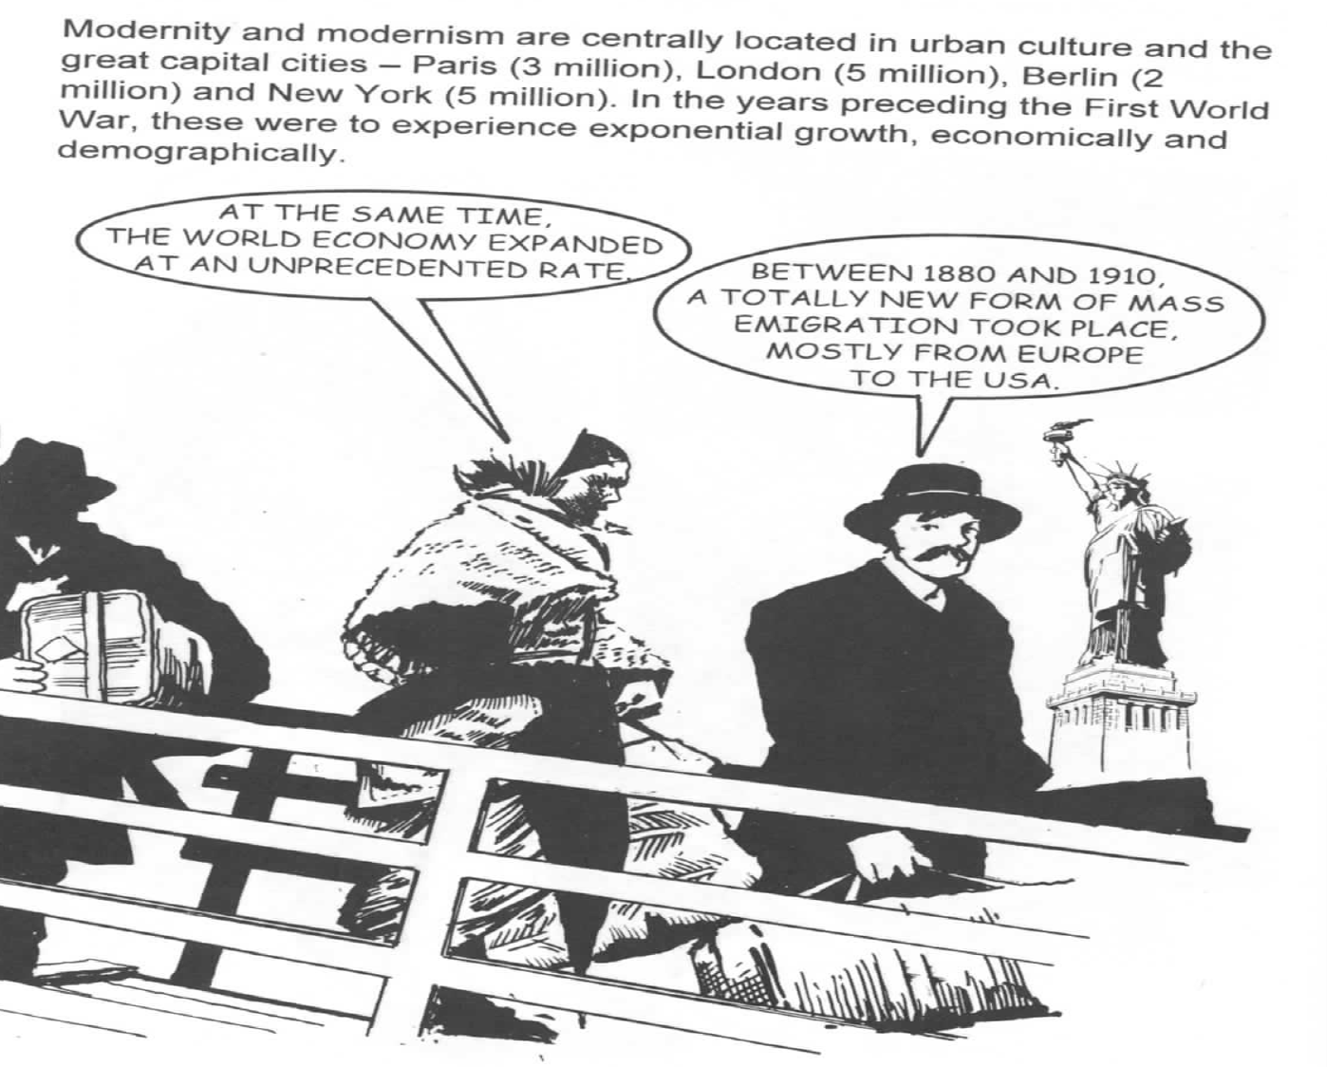
The city as a modern phenomenon

Slide 3
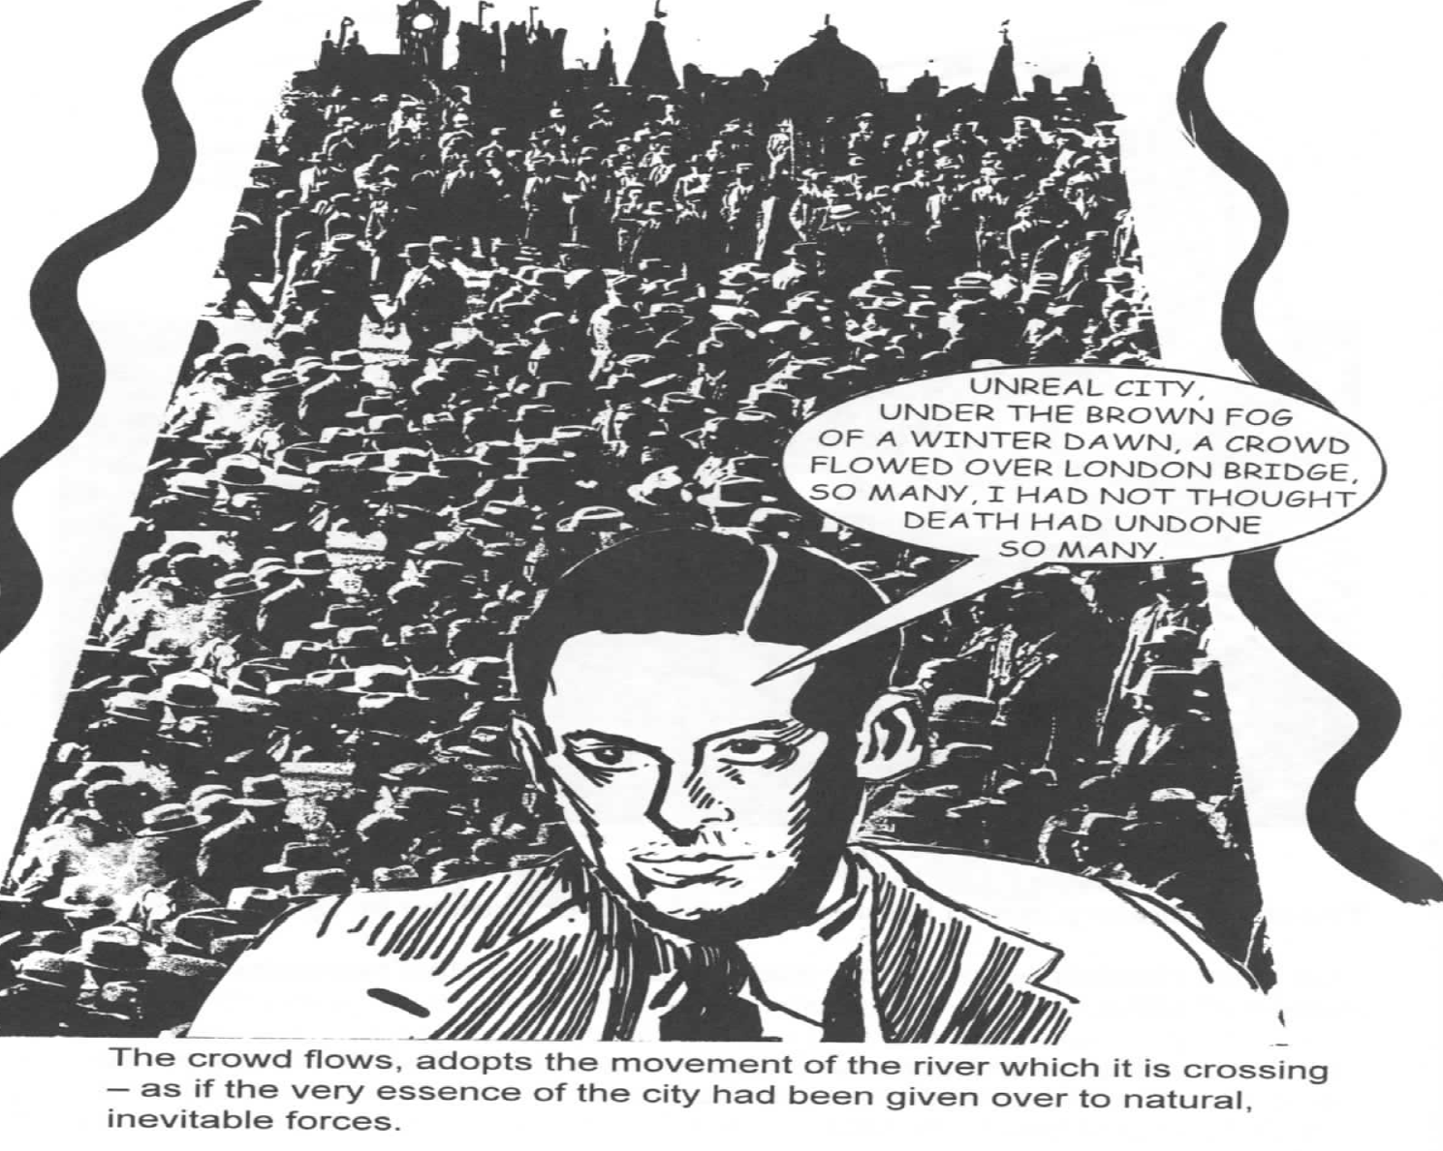
The quest for new metaphors/concepts

Slide 4
Points raised by Park’s treatise on
The City I.
Can we think of the city as a living organism?
Rather than ‘urban jungle’, it could be perceived through the trope of ‘urban ecology’ – the city has a system/an order of its own, a set of patterns that can be recognized and described by sociologists.

Slide 5
Points raised by Park’s treatise on
The City II.
The city produced variety of observers who studied the city – dandies, detectives… and sociologists!
Getting first-hand information about the city (other than journalists, educators/social workers, writers, lawyers, criminal investigators) – employing the method of their own: urban ethnography

Slide 6
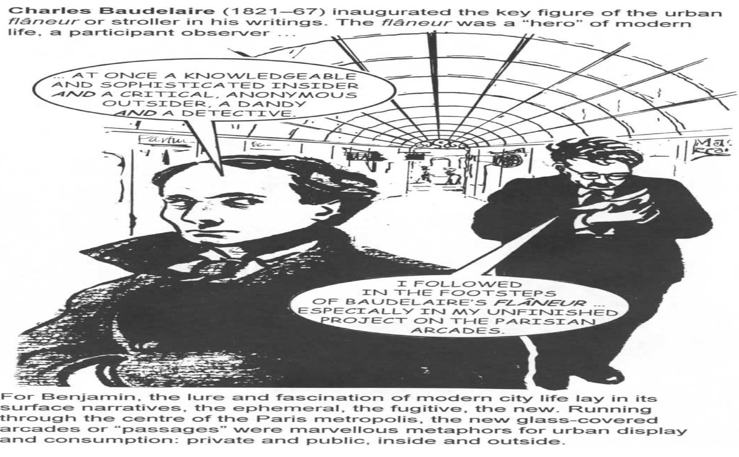

Slide 7
Points raised by Park’s treatise on
The City III.
Which paradoxes characterize the city life?
Proximity/segregation, ghettoization/mobility, norm/exception. The focus on deviance!

Slide 8
The deviants I.
“What lends special importance to the segregation of the poor, the vicious, the criminal, and exceptional persons generally, which is so characteristic a feature of city life, is the fact that social contagion tends to stimulate in divergent types the common temperamental differences, and to suppress characters which unite them with the normal types about them.” (Park, p.33)

Slide 9
The deviants II.
“Association with others of their own ilk provides also not merely a stimulus, but a moral support for the traits they have in common which they would not find in a less select society.” (Park, p.33)

Slide 10
The deviants III.
“In the great city the poor, the vicious, and the delinquent, crushed together in an unhealthful and contagious intimacy, breed in and in, soul and body, so that it has often occurred to me that those long genealogies of [deviant families] would not show such a persistent and distressing uniformity of vice, crime, and poverty unless they were peculiarly fit for the environment in which they are condemned to exist.” (Park, p.33)

Slide 11
The deviants IV.
“We must then accept these ‘moral regions’ and the more or less eccentric and exceptional people who inhabit them, in a sense, at least, as part of the natural, if not the normal, life of a city.” (Park, p.33)
Back to the ‘urban ecology’ trope – some social groups are seen as human mosquitoes [sorry!]… still, they belong to the city and are inevitable.
Their behavior, although deviant, is still subsumed under ‘human nature’ and should be tolerated.

Slide 12
The notion of ‘human nature’ I.
“The city […] shows the good and evil in human nature in excess[…]; [it is] a laboratory or clinic in which human nature and social processes may be conveniently studied.” (Park, p.34)
Such a project is not far from that of e.g. Émile Zola. In his novels, he aspired to study „le ventre de Paris“ to document the life of entire families of alcoholics and criminals and social types such as prostitutes.

Slide 13
The notion of ‘human nature’ II.
The question of a method:
Zola kept files on individual cases (as a lawyer, a doctor... or a sociologist would keep) and proceeded through a meticulous description (often offensively detailed)...
To capture the raw matter of life, analyze it and provide an unbiased observation of the human nature.
P.S.: consider also the influences of Freud and Darwin!

Slide 14
Gendering the deviant
The marginal, the unassimilated, the delinquent, the recent migrant, the gang member, the ‘hobo’…
Consider gender… and ethnicity, ‘race’ and age… How does Cressey contribute to the study of the city? Think sociological categories, as well as his method, style and the overall approach!

