Slide 1
Subcultures as symptoms of the new dimension of class conflict
Reading Cohen (1972) and ‘Resistance through Rituals’ (1976)

Slide 2
Problematic changes – task 1
Instead of improving the living conditions of the working class, the set of changes presented as ‘modernization’ caused number of problems.
Put down a list of problems as suggested in Cohen’s text.
You can proceed by filling in a provisional table of two columns: CHANGES => PROBLEMS

Slide 3
What went wrong? – task 2
P.87-88 “If someone should ask why the plan to ‘modernize’ the pattern of East End life should have been such a disaster […] the reasons are complex. They are political in so far as the system does not allow for any effective participation by local working-class community in the decision-making process at any stage or level of planning.”

Slide 4
What went wrong? – task 2
P.88 “[…] the plans are unconsciously modelled on the structure of the middle-class environment [..]”
What difference does Cohen draw between the middle-class and the working-class way of living?
Why should these two distinct life styles be in conflict? (see RTR p.11-13)

Slide 5
Between cultures
What is the meaning of the ‘dominant culture’ and the ‘parent culture’? (consult RTR p.10-12, Cohen p.89-90)
Observe some of the influential ideas on so-called ‘mass culture’ (RTR p.18-19, see quotes!)
Finally, consider how are young working-class boys positioned vis-à-vis the dominant/parent and mass culture.

Slide 6
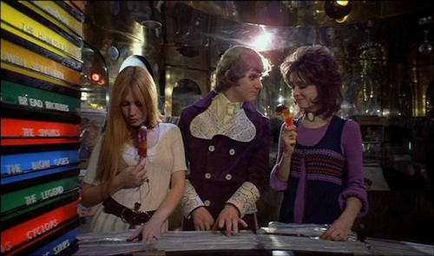
Youth Culture as a threat

Slide 7
Youth Culture as a portent of a more just society?
“the persistent and insistent ‘never had it so good’ ideology” (RTR p.22)
OR
“the affluence-consensus-embourgeoisement thesis” (RTR p.31)
How do you understand these terms? How does Cohen’s study problematize them?

Slide 8
Understanding subcultures
Find in Cohen’s text potential definitions of subcultures (p.89-91)!
Let’s clarify these propositions and link them into a coherent explanation – What is the meaning of subcultures for Cohen? How do they emerge? What solutions do they propose? Why are they seen as imperfect solutions? Etc.

Slide 9
Beyond understanding… analysis and critique
Concept-theory-argument-discussion…
Locate weak points in Cohen’s understanding of subcultures!
Think of examples that prove his explanation wrong… Show inconsistencies in his reasoning… What are the limits of his subculture theory? Etc.

Slide 10
Youth Culture – a threat or promise?
Exercise in interpretation
https://www.youtube.com/watch?v=8LvCe38CsVU
Offer an interpretation of this video – or rather couple of interpretations: 1) you may think in line with ‘mass culture’ critiques, 2) argue as a proponent of subcultural resistance (winning the space, staging an underlying conflict with hegemonic forces, using mass cultural items creatively…), 3) or ?

