Slide 1
Considering gender in studies of subcultures
From ‘Girls and Subcultures’ (1976) to ‘Riot Grrrl is…’ (1998)

Slide 2
Group work: ‘10 preparation + ‘10 presentation
Group 1: Describe the difficulties of research on subcultures that McRobbie and Garber identified. Why are young women absent from the literature? If they are present, how are they portrayed?
Group 2: If women were present, why and how were they marginal to most of the activities?
Group3: Where should we look to find girls negotiating spaces for collective activities, how do they organize their cultural life?

Slide 3
Feminist approaches to (sub)cultural research
McRobbie and Garber in ‘Girls & Subcultures’:
Provided critical commentaries to the existing scholarship and showed that categories of research contain gender bias
Examined the underlying mechanisms of power in scholarship, media, culture
Provided corrective versions of the concept as well as opened new fields of research

Slide 4
Teddy Boys – as figures of symbolic resistance

Slide 5
Identification with the research subject
“Paradoxically, the exclusion of women was as characteristic of the new ‘radical’ or sceptical theories of deviance as it had been of traditional criminology. […] the ‘new deviancy theory’ often amounted to “a celebration rather than analysis of the deviant form with which the deviant theorist could vicariously identify – an identification by powerless intellectuals with deviants who appeared more successful in controlling events” […].”
(McRobbie&Garber 1976 p.212)

Slide 6
Teddy Boys & Girls – recognizing women’s participation (towards equal access, visibility and sharing)

Slide 7
Teddy Girls – finding girls on their own (towards autonomous cultures)

Slide 8
New Teddy Girls – provoking feminist interventions

Slide 9
Where is gender in all this?
Are subcultures/popular culture/youth gendered terms?
Ehm what does it mean a „gendered term“?
Well... what is gender?
A fancier term for women.
It means both men and women but it mainly studies women and LGBT groups.
A category of analysis which functions similar to class, ethnicity, age or ‘race’ – it allows for representations of our social worlds.

Slide 10
From women to femininity I. (p.214-5)

Slide 11
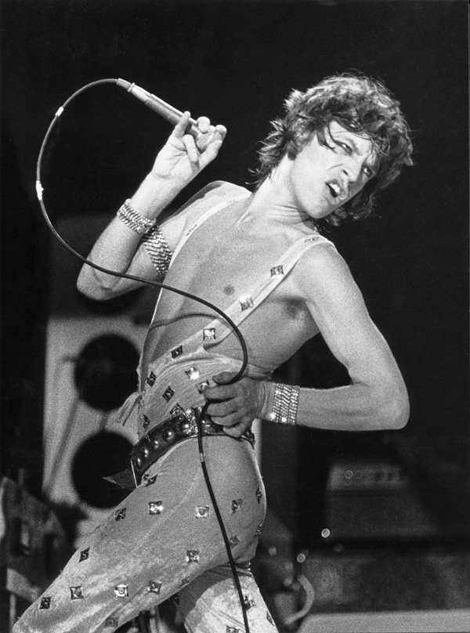
From women to femininity II. (p.215)

Slide 12
Intersecting categories: gender & class (p.215)

Slide 13
New femininities and masculinities performed (plurality of gendered styles)
“The feminising of the male image may in no way signal the complementary liberation of the female from the constraints of the feminine image. […] despite these surface shifts in the provided culture, the root attitudes towards the position of girls in the sub-cultures may not have changed all that much in two decades [‘50s – ’70s].”
(McRobbie & Garber p.215)

Slide 14
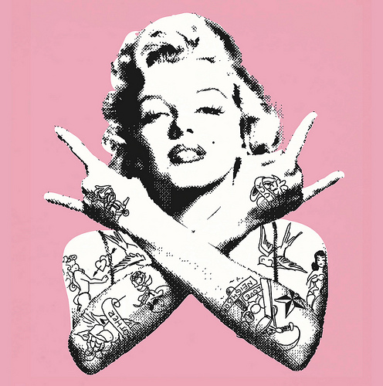
From women in subcultures to feminist subcultures

Slide 15
‘Riot Grrrl is…’
In what way does the manifesto incorporate feminist inspirations?
What is feminist and what is punk about it?
How do RG use the tools of punk in service of crafting a liberated identity for women?
Which problematic points of contact with the ‘mainstream’ are mentioned?
What is RG’s ultimate goal?

Slide 16
Gender as analytical category in the study of subcultures
Gender tends to speak through the hierarchically ordered binaries: performers/audience, subculture/mainstream
Gender and subcultural figures: nerds, geeks, otaku, collectors… How is subcultural expertise gendered?
[your example of gender analysis in the field of pop, youth and sub-cultures]

