Slide 1
External dimension of the EEP – III. part
16.4.2014

Slide 2
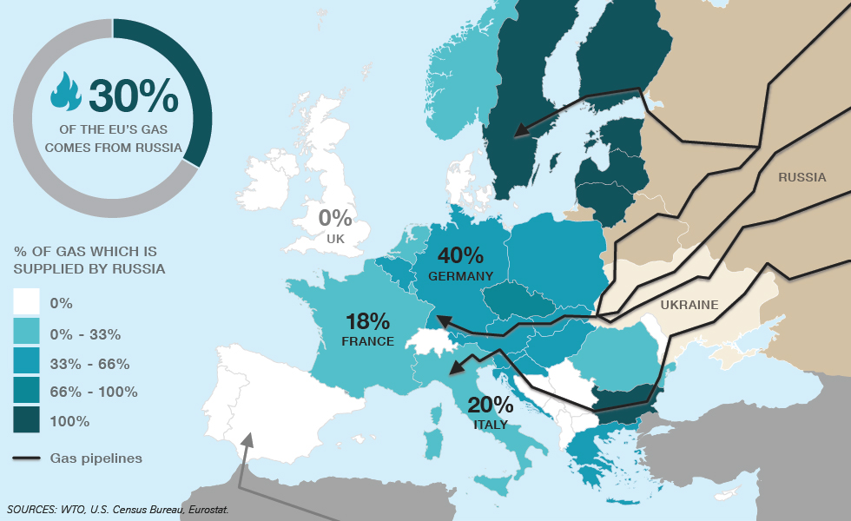
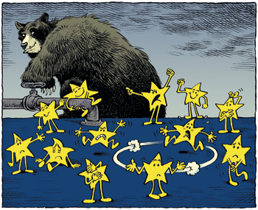
EU – Russia Energy Relations– A short historical overview

Slide 3
Legal basis for EU – Rusia energy cooperation
Partnership and Co-operation Agreement (PCA)
Energy Charter Treaty (ECT)
Partnership for Modernisation
Energy dialogue divided into three thematic groups
EU acquis communautaire

Slide 4
Approaches of the EU member states towards Russia
Is energy the most important factor?
Mark Leonard & Nicu Popescu (A Power Audit of EU-Russia Relations):
„Trojan horses“ (Cyprus, Greece)
„Strategic Partners“ (France, Germany, Italy, Spain)
„Friendly Pragmatists“ (Austria, Belgium, Bulgaria, Finland, Hungary, Luxembourg, Malta, Portugal, Slovakia and Slovenia)
„Frosty Pragmatists’“ (Czech Republic, Denmark, Estonia, Ireland, Latvia, the Netherlands, Romania, Sweden and the United Kingdom)
„New Cold Warriors“ (Lithuania, Poland)

Slide 5
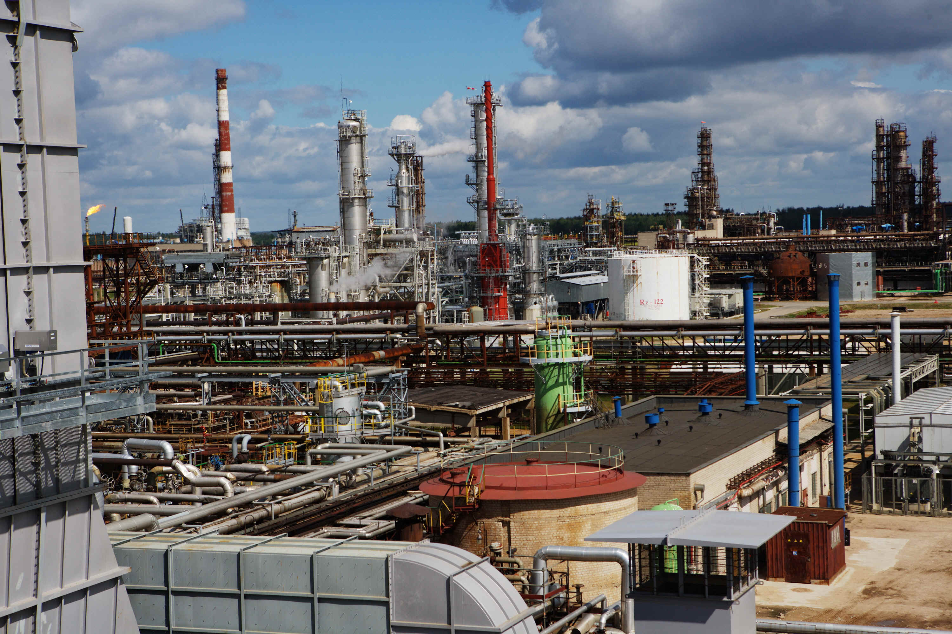
The Problematic Russian activities in the EU
Russian Companies vs EU Companies
Mažeikių Nafta (ORLEN Lietuva ) case
MOL case

Slide 6
Thank you for your attention
Veronika Zapletalova
zapletal@fss.muni.cz

