Slide 1
Sustainable Food
and Food Security
Masaryk University, Brno, April 21st – 24th 2015
Session 1 – Introduction
Dr Daniel Keech
Countryside and Community Research Institute
University of Gloucestershire, UK
dkeech@glos.ac.uk

Slide 2
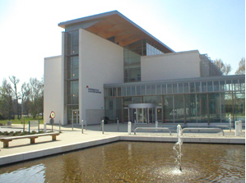
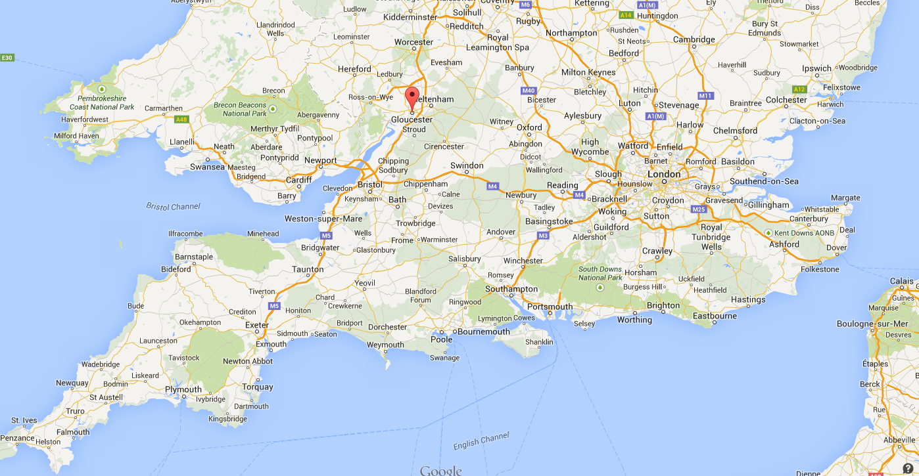
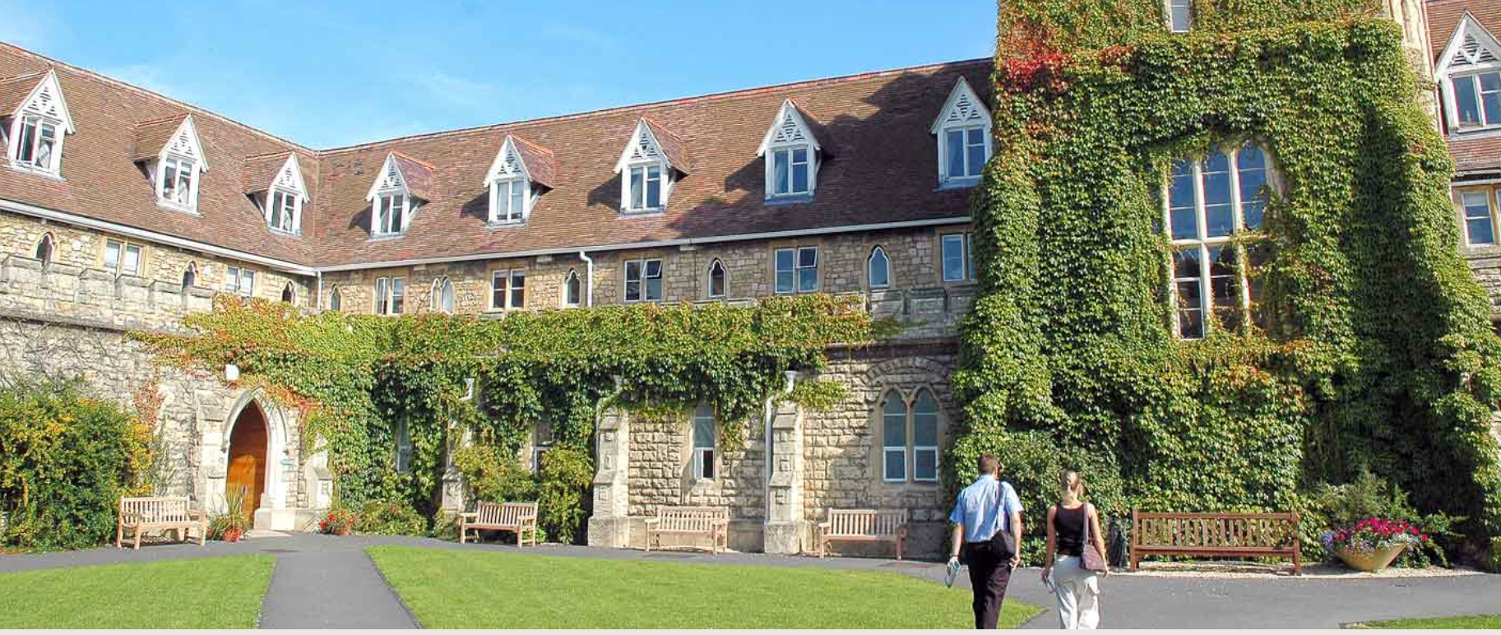
University of Gloucestershire
Small university in SW England
Originally est. in 1847
9000 students, 1000 PG, 55%W
Specialisms: fine arts, applied/social sciences, sport, business, education
Four campuses in two adjacent towns
CCRI
Est. 1986, one of UK’s largest rural research centres. Now more broadly based around social innovation, food, sustainability and renewables.
Masters teaching and PhD
Most research within EU partnerships

Slide 3
Introductions
Your name
Previous/other study areas
Areas of interest in this module
Involvement in food networks?

Slide 4
Overview of the week
Together we will:
Explore the changing role of food over the last 2-3 decades.
Critically consider some public, scientific and policy debates around food supply, production and consumption, including the complexities and inter-connectedness of local and non-local food.
Briefly trace multi-disciplinary methodological approaches which can help us, as researchers, make sense of these difficult issues.
Examine ‘alternative’ and community food provision models.
Carry out independent research which aims to help students demonstrate and communicate their grasp of the issues covered.
Notes:
4

Slide 5
Course progression (1)
Session 1: Tues 21st April (M117)
Introductions, overview, research exercise.
Session 2: Wed 22nd April 8.00 (U41)
Dynamic narratives: debates about sustainability and security
Session 3: Wed 22nd April 9.45 (Aula)
Responses from civil society: Community Supported Agriculture
Notes:
5

Slide 6
Course progression (2)
Session 4 – Thurs 23rd April 8.00 (U42)
Farmers’ Markets (in the UK) – Rural regeneration or urban niche?
Session 5 – Fri 24th April 8.00 (M117)
Traditional orchards in Germany – environmental social enterprise
Session 6 – Fri 24th April 9.45 (U35)
Student presentations of food diary.
Notes:
6

Slide 7
Working together
Small group: allows flexibility and informality; but relies on attendance and adequate preparation.
We have a course structure, but please feel free to ask questions as they arise; discussions may develop and be pursued where time allows.
I appreciate that English is not your first language and that my examples are from UK/Germany.
Please ask for clarifications where necessary. If there are problems talk to me, or to your course leader.
Are you happy? If not, don’t suffer in silence.
Notes:
7

Slide 8
Research exercise
(feedback in session 6)
Keep a diary keep of what you eat from Monday 20th April until Thursday 23rd April (I hope this has started). When you are buying food and eating, what things do you look for, which contexts inform your actions?
The table shows some examples of considerations:
Preference | Reason | Indicator
I buy ready-meals. | I don’t enjoy cooking. | Cooking instructions
I buy the cheapest food available. | I am a student with not much money. | Price
I try to buy organic food. | I believe it’s better for your health. | Certification label
Notes:
The purpose of this exercise is to get students to reflect on what social, cultural, political, ethical… values they attach to food in theory. On Friday we will recall this exercise when students present their diaries.
8

Slide 9
Research exercise
Buying: What decisions were involved in making your purchases? Did you make any compromises or trade-offs?
Menu: What did you cook and eat and what decisions were linked to this?
Consequences: consider the sustainability issues of your meals and purchasing in this period (food chains; human and non-human actors; areas of tension etc…).
Changes: What would you change? What would you need to achieve that? Did local food help with any of these issues?
Notes:
9

Slide 10
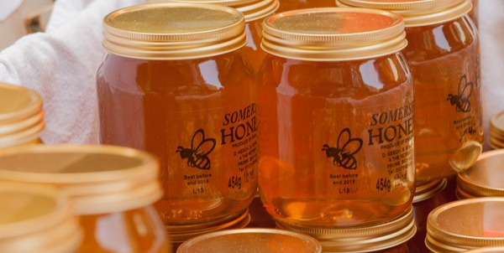
Example of food diary record
Friday 6th Mar
Breakfast – Toast and honey, tea.
Lunch – Vegetarian meal from university canteen: potato salad and cheese sandwich. Chocolate bar.
Evening meal – Frozen pizza and frozen potato chips from the supermarket.
Comments – Always buy fair-trade tea. Am a vegetarian. Just can’t resist chocolate! Quick evening meal, I am going out with friends tonight. Afternoon coffee plus apple cake at new local produce café run by people I know.
Notes:
The exercise is intended to reveal a number of influences on food intakes and purchasing decisions. In this case, fair-trade coffee displays ethical concern for distant commodity farmers; evening meal is likely to be high in fat and suggests familiarity with Italian foods (see lunch). Vegetarianism may be a political choice.
Chocolate cake may carry guilt associations, unlike the coffee. Support for acquaintances shows social structures in some market situations. Tues is not a day for food hedonism, or perhaps reflects work-life balance issues.
10

Slide 11
Food diary verbal report
This is based on your diary in the form of an oral presentation to the rest of the group. Work in groups of 3-4 people.
Can be a simple verbal presentation, power-point, video, excel sheet… all this is fine. But draw out critical questions or dilemmas which you have encountered or find interesting. For example:
Health: do labels help?
Environment: did you throw lots of food away?
Ethics: fair-trade is an apology for neo-liberalism…
Social: no fresh fruit and veg in my neighbourhood
Economic: sustainable food seems to cost more
Be honest – this is auto-ethnographic data collection

Slide 12
Food diary oral presentation
Don’t just describe what you bought/ate. Draw out critical reflections based on what we have discussed, for example:
What social, ethical, economic, health, environmental factors inform your decisions?
What are you trying to achieve, if anything (say if not)?
Any narratives from academic literatures we covered?
Who are the people affected by your decisions?
Possible conflicts and dilemmas you faced
What needs to change to affect your behaviour? To what extent do you control behaviour-change?
Local foods – how do they feature (if at all)?
You don’t have to cover everything!! 5-10 mins present’n
Concluding summary remarks

Slide 13
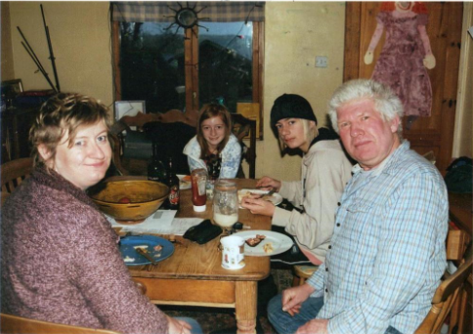
Any questions so far?
Happy?
What you expected?
See you after breakfast - 08.00 in U41
Notes:
13

