Slide 1

Sustainable Food
and Food Security
Session 2 – Concepts and narratives
around sustainable food
Dr Daniel Keech
Countryside and Community Research Institute
University of Gloucestershire, UK
dkeech@glos.ac.uk
Masaryk University, Brno, April 21st – 24th 2015

Slide 2
Plenty, healthy, quality?
Some generalised key developments post 1945:
Marshall Plan, ‘Green revolution’, self-sufficiency, surplus for trade and aid
Oil dependency highlighted in oil crisis of early 1970s (see Jones, A. (2001) Eating Oil. Sustain, London; and AEA (2005) The Validity of Food Miles as an indicator of Sustainability.)
CAP production subsidies until 2003 ⟹ surpluses, global dumping, falling food prices for consumers. Supermarket dominance and foreign direct investment (FDI) (see Neil Wrigley).
CAP reform in 2003 ⟹ decoupling of subsidy from production and link to environmental stewardship
Notes:
2

Slide 3
Plenty, healthy, quality? (2)
More-or-less falling consumer prices until 2000s
Environmental degradation (Carson 1966), food safety scares, growth of organic movement from 1990s (see Julie Guthman 2002 and Gill Seyfang 2006…)
‘Quality turn’ and shift from public to individualised concerns in 2000s – health, lifestyle, ‘alternative hedonism’ (Soper 2004)
Obesity/famine paradox, the rise of social food co-ops in the absence of policy (e.g. see work by Elizabeth Dowler and Martin Caraher et al. 2001 onwards)
Notes:
3

Slide 4
Food in the public arena
Public health concerns around dietary intake affected by structural and social changes:
Fewer people work in agriculture, industrial settings, traditional family structures. Post-modern cities and working arrangements. ‘On the hoof ‘ eating, convenience shopping.
Move in 1980s (in UK) away from institutionalised public catering to consumer choice, lowest price tendering and de-skilling kitchen labour. School cooks ⟹ food assembly (Morgan and Sonnino 2008).
State abrogates public health to the private domain.
Notes:
4

Slide 5
Food and social exclusion
Increased awareness of spatial health inequalities:
Jubilee line Westminster to Canning Town – a year less of life expectancy as you travel east nine stops. In other words, your average life expectancy in Westminster is 73/6 or 64/67 in Canning Town. DIET IS A CONTRIBUTORY FACTOR.
This led in the early 2000s to the establishment of food distribution co-ops. Opens up debates about physical access, right to a healthy diet, the attractiveness of poor areas to supermarkets and the stigmatisation of food co-ops.
In 2013 new research (Oxfam 2013) links food poverty and the rise of food donation projects (often church-led) to welfare reform. Rise in food banks.
Notes:
5

Slide 6
Is food in crisis?
Agriculture in the ‘global north’ depends on fossil fuels and accounts for 40% of CO2 emissions, produces fewer calories than it consumes and depletes biodiversity.
C. 1bn people are starving while another 1bn suffer from diet-related ill-health (acquired diabetes, CHD…) and obesity.
Peak oil, gas, phosphorous, water, price volatility and social unrest linked to price increases… (Garnett 2011, Ambler-Edwards et al. 2009)
Population increases and urbanisation/rural migration.
Notes:
6

Slide 7
Some theories linked to sustainable food - sociology
Anthony Giddens | Reflexivity Speed of change and profundity of consequences is unprecedented. Work out solutions together.
Thomas Lyson | Social structuration Scale and structure of farms affects social structure of settlements.
Manuel Castells | Social movements Typography of civil groups; use of new communications to organise.
Notes:
7

Slide 8
Some theories linked to sustainable food - economics
Leyshon et al., Gibson-Graham | Alternative and feminist economics Change from the margins; experimental models can be expanded; role of women as reproducers of social life.
Jackson | Limits to growth Current model of capitalist growth assumes endless natural resources. (‘One planet living’ – nef).
Beddington, Royal Society, Foresight Report | Sustainable intensification Mobilisation of technology and resource efficiency to feed growing and urbanising world.
Notes:
8

Slide 9
Some theories linked to sustainable food - geography
Van den Ploeg, Marsden et al. | Local as rural development Articulating values embedded in local foods and releasing value to farmers.
Winter; Edward-Jones; Garnett; Born and Purcell | Critiques of food miles Defensive localism; CO2 fetish; contexts of environmental performance metrics; the ‘local trap’.
Morgan | Politics of care Local green and global fair – cosmopolitan, mixed food systems build around city-regions.
Notes:
9

Slide 10
What do we mean by sustainable food?
Sustainable food is associated with well-being, environmental sustainability, social justice and resilience. (nef, 2007)*
In other words sustainable food is healthy, green, fair (Morgan 2010) and able to withstand shocks.
*Sumberg, J. (2009) Reframing the Great Food Debate: the case for sustainable food. New Economics Foundation, London.
Notes:
10

Slide 11
A quick pause
Any questions? Everyone OK?
Will now move on to problematise sustainable food
Notes:
11

Slide 12
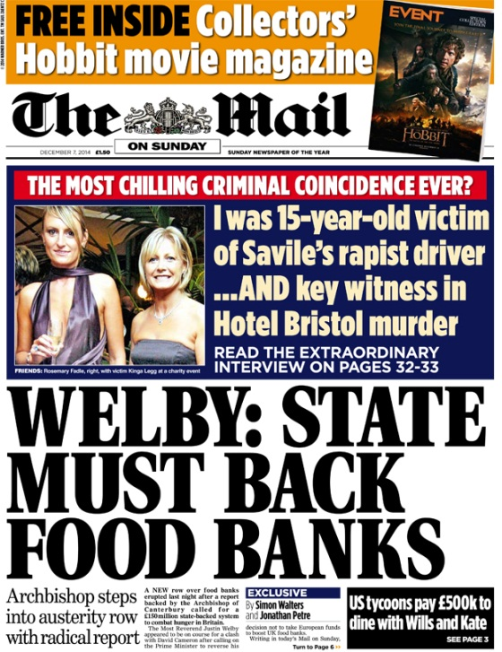
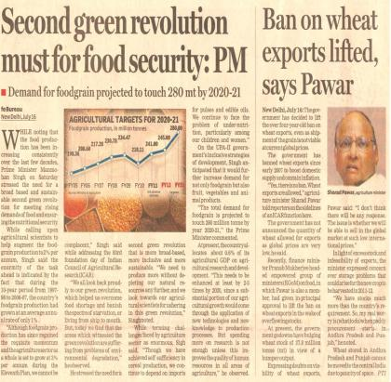
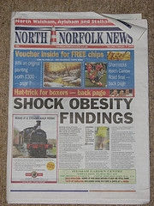
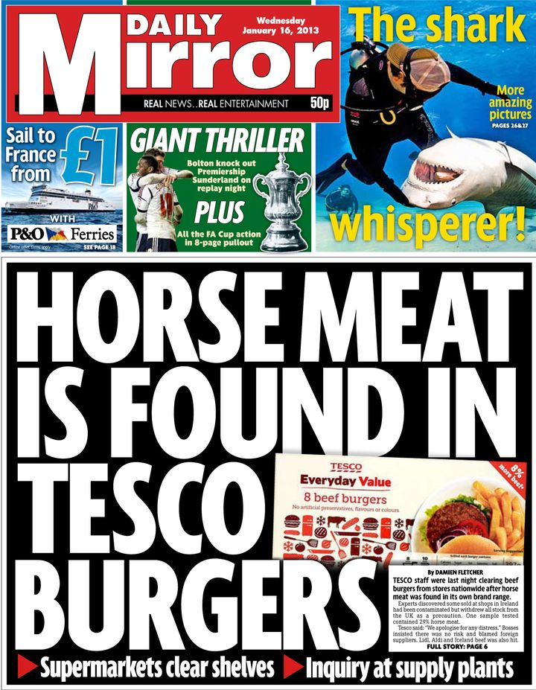
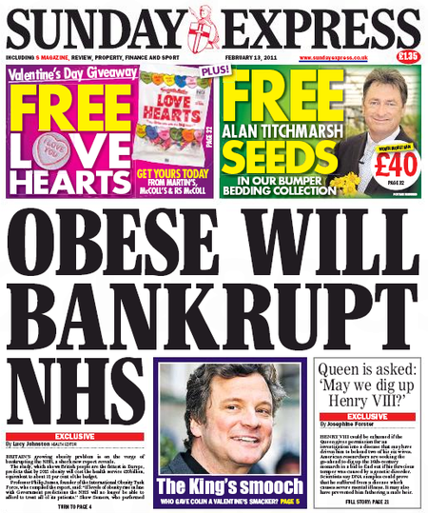
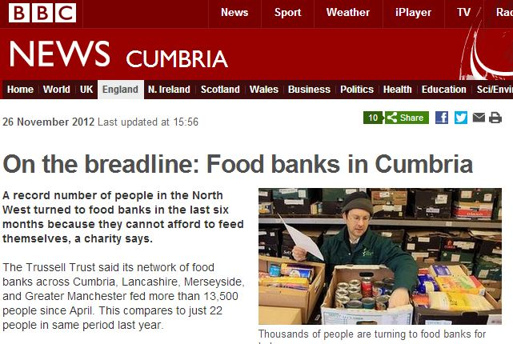
Notes:
Here’s just a collection of recent ‘food crisis’ newspaper reports and media coverage…

Slide 13
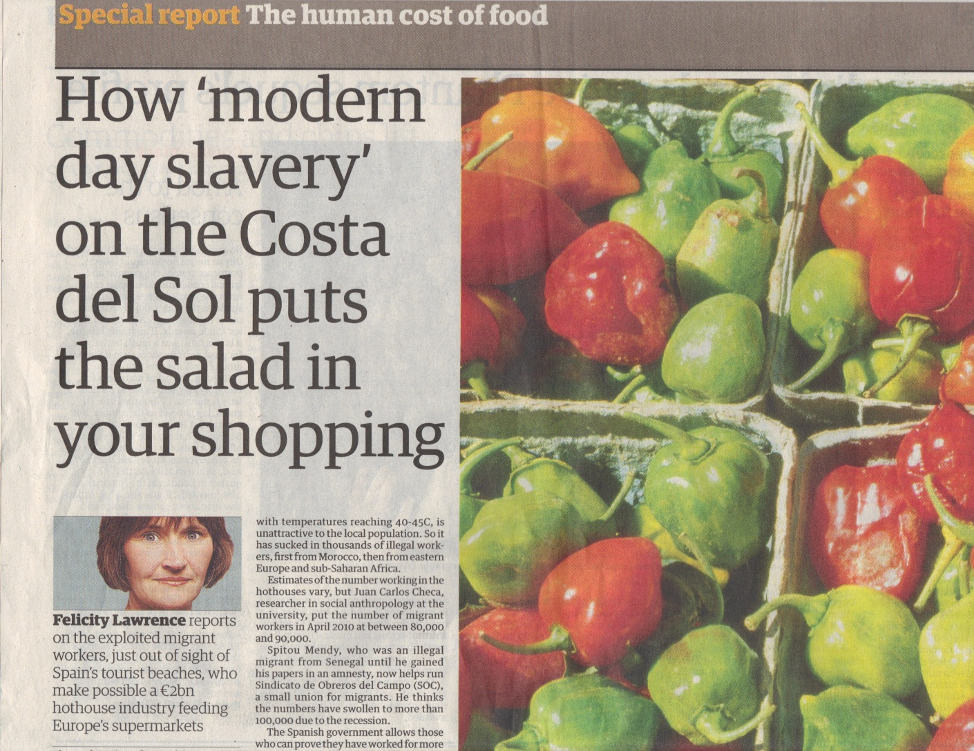
CO2 vs. social justice
Source: The Guardian 8th Feb ‘11
Notes:
13

Slide 14
The interdependence of food system and food culture
Notes:
14

Slide 15
Food system issues
Sustainable Food
Well-being | Social justice | Environ. Sust. | Resilience
Impact of pesticides on nearby residents | Poor labour conditions Dependence on gang-masters | Degradation (soil, water, over-fishing) Habitat destruct’n | Highly energy intensive Dependence on migrant labour
More processing = harder to control salt fat sugar consumption |  |  | Dependence on global trade
Road intensive = noise, pollution, traffic | Power balance against producers | Carbon intensive | Fuel cost
Junk food adverts target children | Power balance against small or indep. shops |  | Consolidation of retail sector
 |  | High levels of waste & packing
Production
Processing &
manufacture
Distribution
Advertising &
marketing
Disposal
Notes:
15

Slide 16
Food culture issues
Sustainable Food
Well-being | Social justice | Environ. Sust. | Resilience
 | Poor avail. of healthy food in disadvantaged areas Low income = inadequate for healthy diet | Expectation of year-round avail. of all products
Time poverty = more consumption of prepared foods |  |  | Falling levels of food ‘literacy’
Loss of eating together |  |  | Fuel cost
Disconnection to rural and farming issues |  |  | Homogenisation of food & places
Shopping
Cooking
Eating
Meaning
Notes:
16

Slide 17
Changing narrative - resilience?
Defra Narrative 2004 | Defra Narrative 2010
‘National self-sufficiency is neither necessary nor desirable.’ (Ministerial letter) | ‘Our food system needs to be prepared for shocks and to be able to manage risk.’ (Food 2030: How we get there, Defra 2010.)
Notes:
17

Slide 18
Key beliefs in local and sustainable food
It is better (healthier) to eat a more rather than a less diversified diet
It is better (healthier) to eat fresh food rather than preserved/prepared food
It is better (less environ. damaging, & food chain more transparent) to eat food produced closer to rather than further from the point of consumption
It is better (healthier, and less environmentally damaging) to eat food produced with a minimum of pesticides
It is better (less environmentally damaging) to eat food produced with a minimum of inorganic fertilisers
It is better (more socially just) to eat food produced, processed and/or marketed by smaller-local rather than larger-international operations
(Sustain: the alliance for better food and farming, London.)
Notes:
18

Slide 19
Readings
Did you all get a chance to read the two papers I sent?
What issues of sustainability to they raise?
Do you agree/disagree with what is suggested? Why is that?
How do you relate some of the issues raised to what is going on in Brno/Czech Republic/EU today?
Notes:
19

Slide 20
NGO and market innovations in the UK
Farmers’ markets
Hyperbolic organic sales (mainstreaming) (until 2008)
Box schemes
CSA and buying groups (growth since 2008: MLFW/LFF)
Food Links UK/Alimenterra
Public food procurement (FFL, SFT, free school meals)
Food access co-ops
NGOs as civil society agitators → under-paid market innovators?
Notes:
20

Slide 21
Possible questions emerging
How can the ethical motivations of the alternative food movement underpin, the development of a greener, fairer and healthier system/culture? Who decides?
How can the claims made for local food be substantiated? What implications have they got for a serious move to carbon-reduced and ‘cellular economy’ (Hardin Tibbs, BRASS 2011)?
What (infra-)structures are needed to make sustainable food viable? (distribution, finance, governance…)
Can the demand for ethical food be the basis for global solidarity, rather than nationalism, protectionism and stale local vs. global arguments?
Notes:
21

Slide 22
Changing narratives
Policy: Self-sufficiency ⟹ surplus ⟹ food security
Politics: Sufficiency/price ⟹ environmentalism/common concerns ⟹ quality/personal concerns (e.g. health and taste)
Retail power: Supermarkets as progressive ⟹ oppressive ⟹ appropriators
Third sector: Oppositional ⟹ entrepreneurial ⟹ technical specialists

Slide 23
Dominant themes
Nutritional transition:
  Rising demand for ‘western’ diets
  Obesity
  Nutritional composition of foods (salt/fat/sugar)
Food security:
  Increasingly a national concern; rising inequality
  Technological innovation
  Oppositional alternatives
  Collaborative stakeholder approaches
Environment/climate change
  GHG emissions
  Meat consumption
  Biodiversity/habitat loss
  Embedded resource/water use
Notes:
23

Slide 24
In summary…
Food is complex – farming, nutrition, education, consumption, industry, diet, culture, shopping, politics, income, planning, waste, political activism…
"...the concept of a base-line sustainability standard is non-sense, as sustainability is an aspirational open-ended agenda involving trade-offs and a range of potentially conflicting priorities...” Smith, B. (2008) Developing Sustainable Food Supply Chains. Philosophical Transactions of the Royal Society for Biological Sciences. 363, pp. 849-861.
Organic, fresh, seasonal, local, fair-trade, affordable, safe…
How do we choose?
Notes:
24

Slide 25





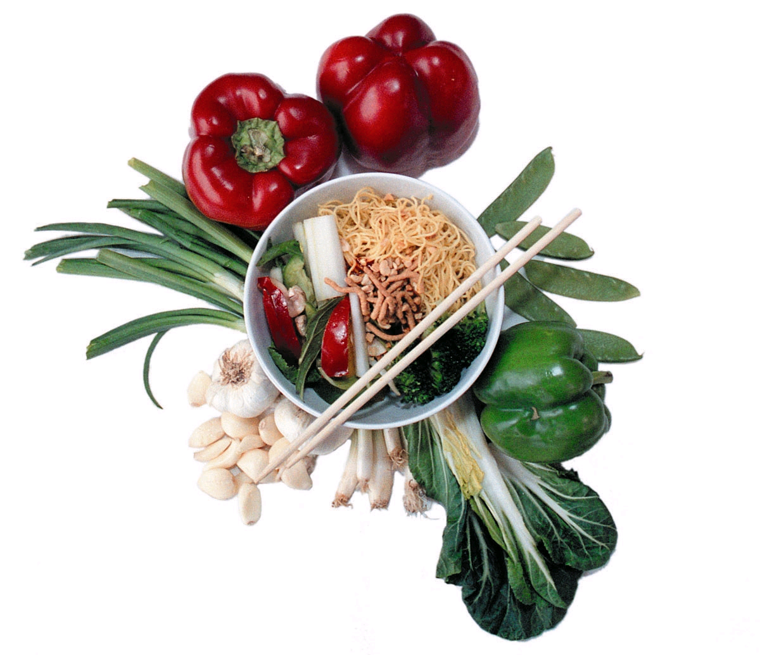





Slide 26
Questions?
Next session:
Tues 22nd April 9.45 (Aula)
Community supported agriculture

