Slide 1
Sustainable Food and Food Security
Session 4 – Farmers’ markets: rural development or urban niche?
Masaryk University, Brno, 23rd April 2015
Dan Keech, CCRI
University of Gloucestershire
dkeech@glos.ac.uk
Notes:
1

Slide 2
In this session we will
Look again at alternative food initiatives, this time at examples of the emergence as farmers’ markets as a civil society response to concerns linked to de-spatialised, industrialised agriculture.
Perceived benefits of FMs include:
Economic: farmers realise the retail price of the food they grow; money recirculation aids rural/regional development.
Social: interacting with farmers to understand food qualities, farming methods, ‘food with a face’. Enjoying the shopping experience, which can include dining.
Environmental: farmers provide information in literature, discussion and certifications about their environmental credentials – arguably more than labels.
Notes:
2

Slide 3
In this session we will also:
Use farmers’ markets as a way to briefly illustrate a quantitative research tool used in local development.
Watch another short film which introduces a farmers’ market through the voices of the organisers and the farmers.
Notes:
3

Slide 4
Reminder: policy and industry
Policy of neo-liberal global trade but substantial production subsidy (CAP reform productivism → multifunctionality)
Insistence by politicians/industry that food is safe despite a run of food safety scandals – salmonella in eggs, BSE in cattle, foot & mouth disease. Farmers blamed for some of these.
Retailers become market ‘gatekeepers’ during BSE in 1996 (Wales et al. 2006).
Upswing in public sympathy for farmers after FMD in 2001
Notes:
4

Slide 5
Why are FMs a civil society response?
Instituted by an alliance of the mainstream farmers’ union, the main organic certification body and the farm retail association. These groups formed NAFM (now FARMA – see www.farma.org.uk).
They link consumers directly with producers.
They challenge the power balances in the food chain, currently dominated by retailers.
Replication not growth – spatial rather than commercial ubiquity (compare supermarket spend)
FMs, (along with CSAs and public procurement) ‘still represent the main profile of the food relocalisation movement in the UK’ (Goodman et al 2011).

Slide 6
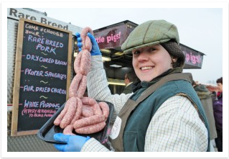
State of the nation(s)
First FM set up in Bath in 1997
FARMA (Farmers’ Retail and Marketing Association) www.farma.org is a co-op of 500 businesses who promote direct retailing by producers.
FARMA certifies about 500 of the 700 UK FMs.
(Other FM networks also exist, some with different regulations, e.g. about exotics, non-food, secondary traders.)
In US around 5,000 FMs but represent 0.8% of direct food sales.
France? Italy? Anywhere…. Anglo-Saxon?
Notes:
6

Slide 7
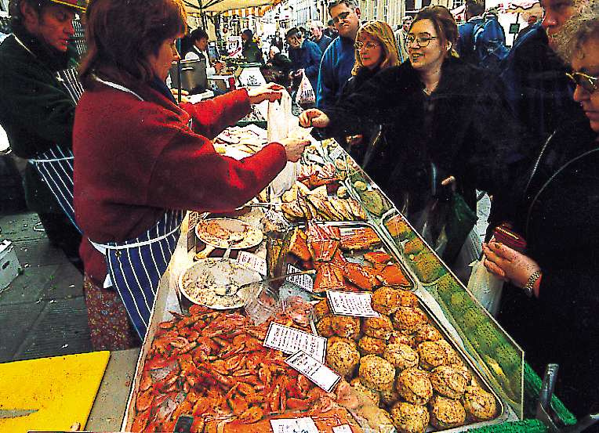
Notes:
7

Slide 8
Farmers’ market principles
Three basic principles:
retail relationship between producer and customer is direct
the distance between the farm and the market is prescribed
the producer must sell only what s/he makes
Notes:
8

Slide 9
Benefits for consumers and producers
Producers | Consumers
Low-cost operation and entry Full retail price return Contact (and possibly trade) with other local producers Face-to-face contact with customers Admin and marketing support from network/market manager | Attractive and convivial retail environment Seasonally changing produce Ability to question producers Unusual, high quality or rare breed foods Perception of ‘civic agriculture*’
(*Murdoch & Miele 1999, ‘Back to Nature’, Sociologia Ruralis 39, 4, 465-83.)
Notes:
9

Slide 10
Farmers’ Market models
…are varied:
Producer owned businesses or co-operatives (Somerset, Thames Valley, Hampshire)
Private companies (London, Stroud)
Council-run (Waverley Borough, North Lincolnshire District – some emerged from LA21)
Community Voluntary Groups (Deddington, Moseley)
NGO – (Hadleigh Salvation Army, Maidenhead Friends of the Earth)
Again: range of approaches linked to local contexts, in contrast with plc or Ltd models of conventional retailing
Notes:
10

Slide 11
The leaky bucket
NEF* proposed that local investment often leaves the area via:
Central taxation
Multi-national corporations
Non-local services.
*www.neweconomics.org
Notes:
11

Slide 12
LM3
Instead local businesses and services can recycle local investment, creating more local growth and preventing the leaking away of reinvestment opportunities.
LM3 is a way to calculate the local multiplier over 3 rounds of reinvestment: initial spend by consumers; the re-use of that money by companies buying supplies; and (in this case study) the spend of the wages of the workers of the company.
Research by nef and by Thatcher and Sharp (2008) using LM3 reveals a larger local multiplier when using local goods and services in the public sector and in food shops.
Notes:
12

Slide 13
Bristol farmers’ market
Bristol was England’s second farmers’ market, opened in 1998 with 20 stall holders selling meat, fish, fruit and vegetables, bread. There are now 35 stalls. Stallholders must come from within 40 (c.75km) miles of Bristol.
In 2008, Bristol City council decided to carry out LM3 research in the farmers’ market.
The council wanted to know what contribution the farmers’ market made to the regional economy (ie. Bristol + 75km)
Notes:
13

Slide 14
For the market of 35 stalls
Income Spent locally Spent locally by stall holders/staff
£304,500 + £241,164 + £59,669
----------------------------------------------------------------------------------------- = 1.99 LM3
Income
£304,500
This can also be done per stall holder:
Income Spent locally Spent locally by stall holders/staff
£8,700 + £6,890.40 + £1,704.85
----------------------------------------------------------------------------------------- = 1.99 LM3
Income
£8,700

Slide 15
LM3 results
In other words, in the case of Bristol farmers’ market, the LM3 calculation showed that, at that time, every £1 spent at the market by shoppers was worth almost £2 to the regional economy.
(Does this matter? Cf. last session: key beliefs about benefits of local food.)

Slide 16
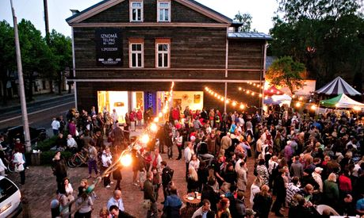
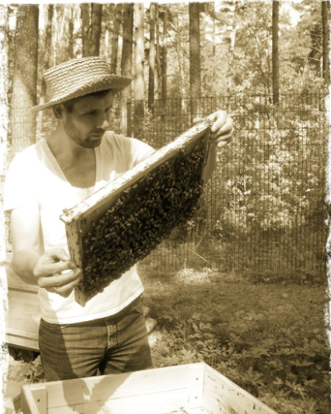
Other potentials for FMs
Urban regeneration: Southwark in London, St Nicholas in Bristol, Kalciema Quarter in Riga are promoted as ‘market quarters’ and have become very trendy.
From Growing Communities we heard how FMs can also support box schemes and other supply routes as part of a portfolio of retail arrangements.
FMs are their own supply chain – links to public and private catering are possible, local food wholesaling.

Slide 17
The farmer speaks: note the trajectory
And then out of the blue we had a phone call from X Farmers’ Market who were setting up. ‘Would you like to come and try and sell your juice?’ We had a VW camper van at the time and put 10 cases in. I’d sold out by half-past ten in the morning. And that was on a day where it was just stair rods of rain all day. So I spent the rest of the day standing round, but I had £100 in my pocket, which was more liquid money than I’d had in my pocket for several years.
So that was fortnightly, it went weekly, and we’ve been doing that ever since for about the last 12-13 years. Y then started up, again it was fortnightly, alternate Saturdays, and then there was Z on other alternate Saturdays and A did one on a Friday and B did one and at one point we were doing all of these markets and were running ourselves into the ground. And one year we actually sold out of everything we had by about the end of June. The danger was that if you weren’t on one of the pitches you’d lose your pitch at the farmers’ market.
We’d flogged ourselves into the ground and sold everything we had and we thought, actually we don’t need to be doing this. So we concentrated on a smaller number of markets obviously the best ones were the more local ones. It’s easy to forget that each day of the farmers’ market is a day of preparing, loading and all of the things that go with it. So if we were doing four markets a week, which was the case sometimes, that was actually eight days a week of preparation [and marketing] which doesn’t add up.

Slide 18
Short film
Winchester Farmers’ Market
http://www.youtube.com/watch?v=A3NYMkN6Mbo

Slide 19
Critical reflections
FMs have become important dimensions in a largely ‘place-less’ food market (Holloway and Kneafsey 2000).
FMs are elitist and set apart from ‘ordinary’ street markets, often charging much more for their produce than the latter. (BBC News 2012 http://www.bbc.co.uk/news/business-18522656 ).
‘Buying a £15 chicken is no more a challenge to the supermarkets than buying a Chanel handbag is a challenge to Primark. It’s a status symbol.’ (Daily Mail on-line 18th March 2015)
FMs are many things – alternative, reactionary, esoteric, social, convivial and people interact (‘perform’) on different levels (Spiller, in Fuller, Jonas and Lee (Eds.) 2012)
The local food–direct connection story has been appropriated in the food industry (traceabilty, farmer images, breeds/origins…)
Notes:
19

Slide 20
Some more reading
Kirwan, J. (2004) Alternative strategies in the UK agro-food system: interrogating the alterity of farmers' markets. Sociologia Ruralis 44 (4) pp. 395- 415.
Murdoch & Miele (1999) Back to Nature. Sociologia Ruralis Vol. 39, Iss. 4, pp. 465-83.
Stephenson, G., Lev, L. & Brewer, L. (July 2008) When things don’t work: some insights into why farmers’ markets close. Special report 1073-E. Oregon State University Extension Service.
Thatcher, J. and Sharp, L. (2008) Measuring the local economic impact of National Health Service procurement in the UK: an evaluation of the Cornwall Food Programme and LM3. Local Environment, Volume 13, No 3, April 2008 , pp. 253-270.

