Slide 1
Always positive? The consequences of candidate selection
Peter Spáč
16.3.2015

Slide 2
Candidate selection
A process taking place inside political parties
May include broader masses than just party members
Possible consequences may affect:
The political party itself
Events following the candidate selection
Politics in general

Slide 4
Consequences
Participation
Representation
Competitiveness
Cohesion of parties
Quality of candidates

Slide 5
A test for citizens
If you want to vote, please select the correct answers:
1. Who is the head of state in our country?
a) Prime Minister
b) President
c) Head of Constitutional court
2. How many MPs there are in our parliament?
a) 350
b) 500
c) 180

Slide 6
1. Participation
Active approach of those who may select
In general the idea of democracy:
Maximum inclusiveness – the universal suffrage
Question of quantity, not quality
Decreasing membership as a challenge for parties partly solved by raising inclusiveness in candidate selection

Slide 7
Participation
Inclusiveness vs. turnout
Inclusiveness:
The amount of people who may take part in selection
All members of party elite
Turnout:
The share of people allowed to select who actually took part and selected
Members of party elite who met and selected

Slide 8
Participation
Raising inclusiveness of the selectorate allows more people to decide, but does not automatically guarantee higher turnout
Application of Olsonian logic:
Higher incentives to participate in smaller groups
And vice versa
The more included people, the lesser weight of each person’s vote

Slide 9
Participation
A general trend – raising inclusiveness of selectorate increases absolute number of people allowed to participate, but lowers turnout
Typically a shift from party delegates to primaries
The main logic – when all are included, also the non-active are

Slide 10
Participation
Empirical findings:
Turnout of members – around 50 %
Turnout of delegates – 70 – 90 %
Influencing factors:
The relation between selection and election
The predictability of results of the selection
Technical issues

Slide 11
Participation - cases
Likud (ISR) - turnout:
Primaries – around 50 %
Central committee – around 90 %
British parties:
Conservatives – delegates – 70 – 90 %
Liberals – primaries - 34 %
Czech Republic

Slide 12
Quantity vs. quality
Increase of participation as a democratization tool
Is there a point where negatives outweigh the positives?
Risks of opening the gates to membership:
Mass registration of members
Uninformed members
Penalizing previous activity of members

Slide 13
Mass registration
Typical impact of including members to participate
Strong increase of membership before candidate selection and quick fall after the process
Canada – 60 – 300 %
Israel – similar findings
Iceland – more participants on primaries than voters

Slide 14
Mass registration
Important note – mass registration is not connected only to primaries
Similar effects may be present even when more exclusive selectorates have the real power
Organized hiring of instant members
Many cases also in Czech Republic (ODS, CSSD, etc.)

Slide 15
Mass registration
Example:
Candidates are selected by regional delegate conventions
Each region consists of several counties
Main rule – each county can nominate one delegate for each 500 members
Is there an incentive to hire instant members?
What can be done to prevent it or at least weaken incentives to do so?

Slide 16
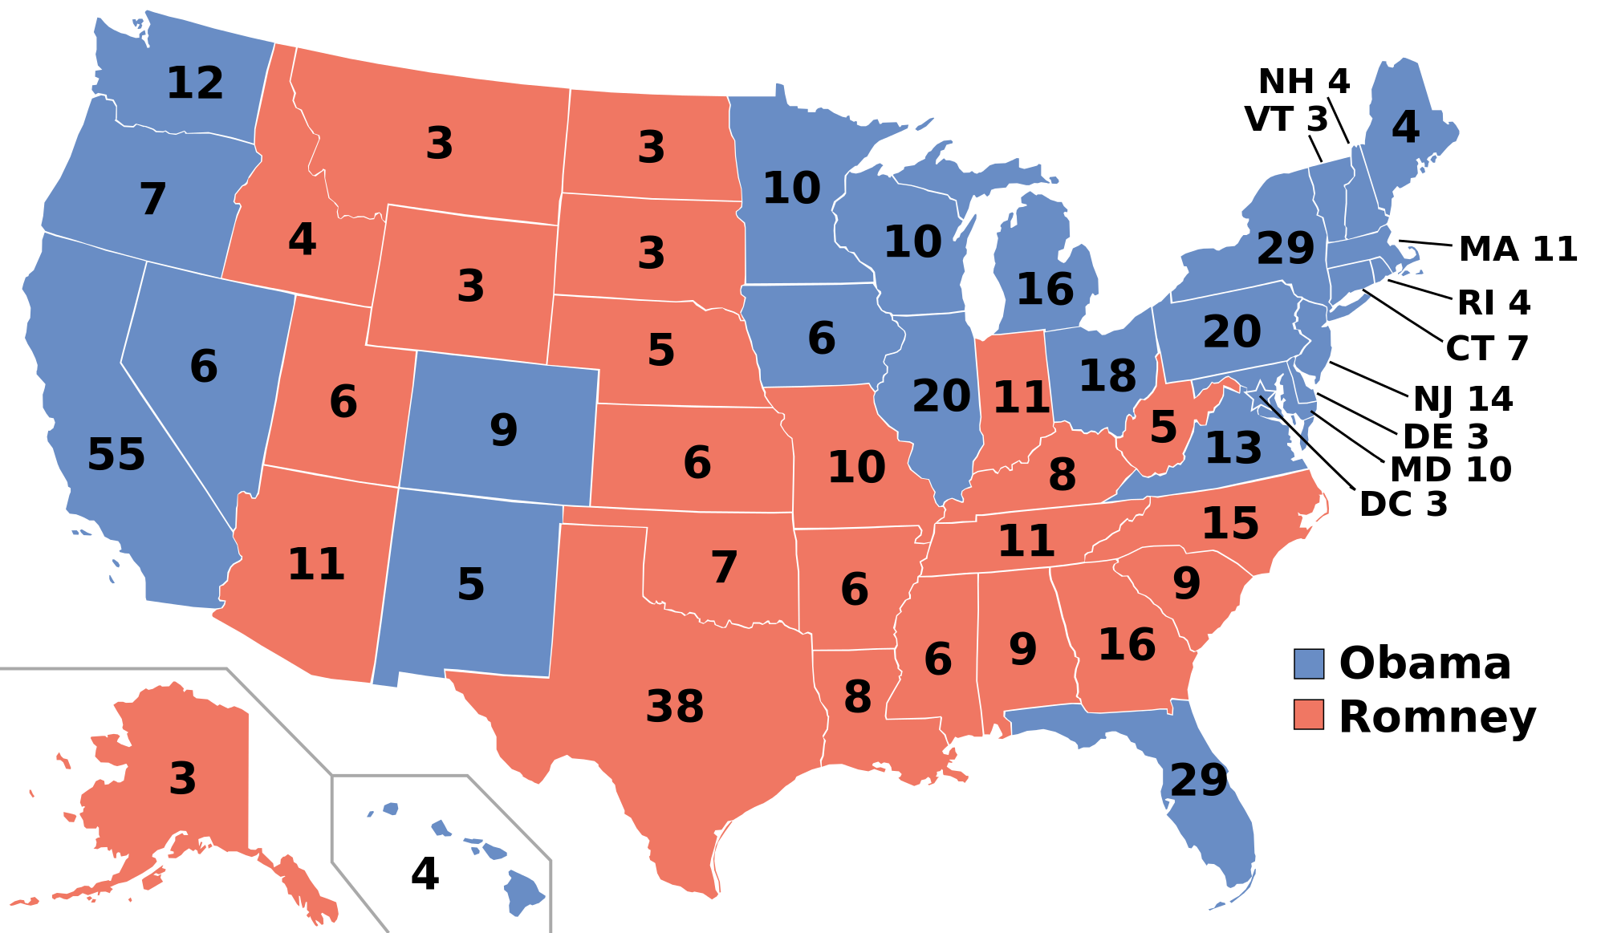

Slide 17
Mass registration
Preventing the risks:
Freezing the membership
Higher requirements for members to participate (which ones?)
Change of rules of candidate selection
Modification of creation of the selectorates

Slide 18
2. Representation
Who / what will the candidates represent?
Representation of ideas:
Candidates share the party’s ideology
Representation of presence:
Composition of candidates reflects the demographic structure of society (women, employers, young etc.)

Slide 19
Representation of presence
Easier to analyze than representation of ideas
Data from candidate lists vs. data for individual candidates
A mutual influence?
Women (young people) may have lesser interest in being candidates
This may be due to lower chances they have in candidate selection

Slide 20
Impact of candidacy
Higher requirements decrease representation:
Age → older aspirants
Monetary deposit → lower social groups, women
Previous experience → younger aspirants
Lower requirements may improve representation, but the party has weaker control on the process
Who may benefit from no requirements on candidates?

Slide 21
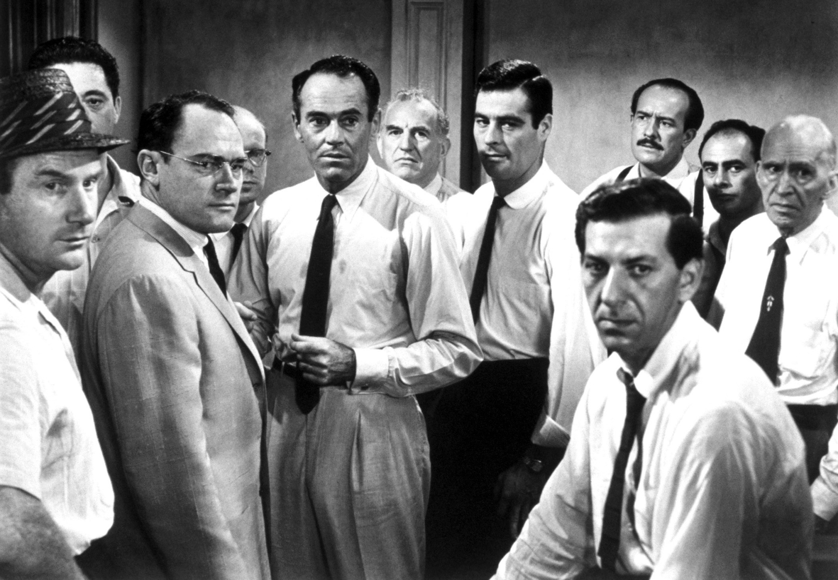
Impact of selectorate

Slide 22
Impact of selectorate
More exclusive selectorate improves representation:
Smaller group with ability to find and agreement through discussion
Composition of candidates is made via coordination and cooperation
Balancing the final selection in ideological and social aspects

Slide 23
Impact of selectorate
Inclusive selectorate:
Undermines representation
Mostly without ability to coordinate and cooperate
Numerous masses support uniformity
Western Europe – increasing inclusiveness of selectorate in parallel with adding quotas
D66 – primaries are preceded by screening process
A coincidence?

Slide 24
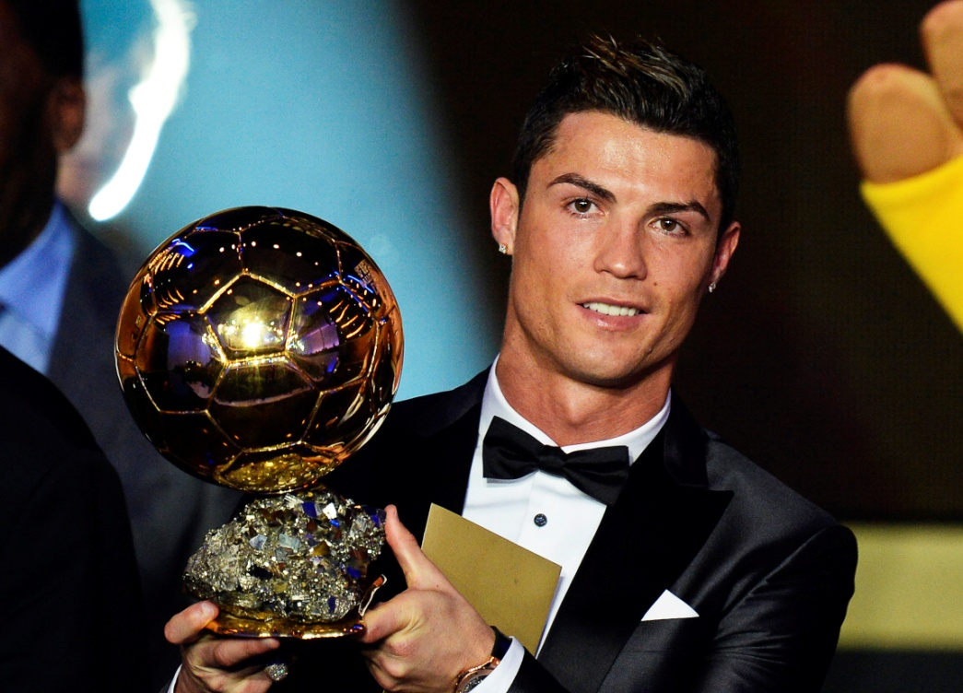
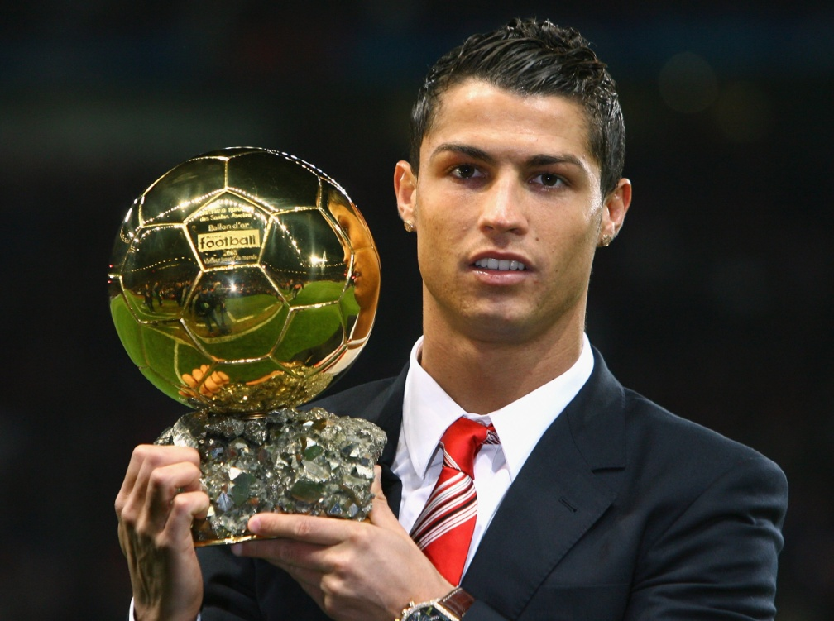
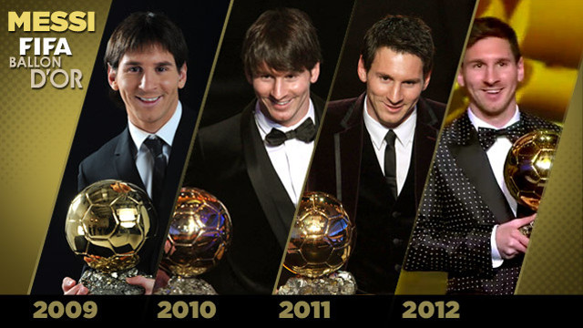

Slide 25
Impact of decentralization
Ensuring both territorial and social representation may be mutually exclusive (FPTP as prime example)
Selection on non-national level:
Ensures territorial representation, but harms social representation
Social representation (f.e. women) is better achieved in more centralized selection
Quotas:
Help the social representation
Small quotas – may help a specific person instead of the whole group

Slide 26
Impact of appointment/voting
Strongly connected to impact of selectorate
More exclusive selectorate appoint
More inclusive selectorate vote
Various effects of applied voting systems:
FPTP, Two round, STV, List PR
Different chances for coordination and balancing

Slide 27
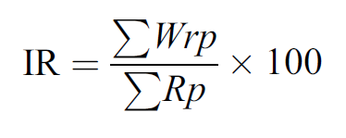
Measuring representation
Many ways how to operationalize representation
Index of representation (IR):
Percentage share of candidates of the respective group (women) among all candidates

Slide 28
Measuring representation
Weighted index of representation (WIR):
Share of candidates of the respective group (women) on realistic positions taking account to value of these positions

Slide 29
Weighted index of representation
Example:
7 realistic positions
Women got positions 3, 6 and 7
Values – position seven (1 point), position six (2 points), … position one (7 points)

Slide 30
Weighted index of representation
Position | Value
1 | 7
2 | 6
3 | 5
4 | 4
5 | 3
6 | 2
7 | 1
Sum of all values:
7 + 6 + 5 + 4 + 3 + 2 + 1 = 28
Sum of women’s positions:
5 + 2 + 1 = 8
WIR:
8 / 28 * 100 = 28,6 %

Slide 31
Weighted index of representation
Position | Value
1 | 7
2 | 6
3 | 5
4 | 4
5 | 3
6 | 2
7 | 1
Sum of all values:
7 + 6 + 5 + 4 + 3 + 2 + 1 = 28
Sum of women’s positions:
7 + 6 + 5 = 18
WIR:
18 / 28 * 100 = 64,3 %

Slide 32
Weighted index of representation
What if there are more selection events?
14 in Czech Republic (each district individually)
Each selection is calculated separately
Each selection has a weight equal to its realistic positions
Example:
Selection one – 7 seats, WIR = 28,6
Selection two – 3 seats, WIR = 60
WIR for both = (28,6*7 + 60*3) / 10 = 38
Pure average of 28,6 and 60 would be 44,3

Slide 33
Region | Weight (ODS) | WIR (ODS)
Prague | 8 | 0,19 | 1,52
Central Bohemia | 8 | 0 | 0
South Bohemia | 6 | 0 | 0
Plzen | 6 | 0,1 | 0,6
Karlovy Vary | 4 | 0 | 0
Usti nad Labem | 6 | 0,24 | 1,44
Liberec | 4 | 0 | 0
Hradec Kralove | 6 | 0,05 | 0,3
Pardubice | 4 | 0 | 0
Vysocina | 4 | 0,05 | 2
South Moravia | 8 | 0,11 | 0,88
Olomouc | 6 | 0 | 0
Zlin | 6 | 0 | 0
Moravia-Silesia | 8 | 0,28 | 2,24
 | 84 | 0,11 | 8,98

Slide 34
3. Competition
Is the process a real competition?
Is it a challenge for the incumbents?
No competition:
Number of aspirants equals number of candidates (on realistic positions)
Typically – FPTP with just one aspirant
In multi member districts even equality of aspirants and realistic positions may include some competition

Slide 35
Impacts on competition
Candidacy:
Higher / lower requirements put on incumbents may affect their chances
Automatic or easier reselection
Age restrictions, maximum amount of served terms

Slide 36
Impacts on competition
Selectorate:
Party elite - lowest competition
High support for incumbents
Preventing intraparty conflicts by making only little changes
Primaries - middle competition
Support of incumbents – better known to members
Obstacles for newcomers - needed support of numerous groups → campaign
Delegates – highest competition

Slide 37
Impacts on competition
Decentralization:
High territorial decentralization lowers competition:
USA – only 2 % of incumbents lost in primaries
Similar findings in Ireland or Israel
Germany – lower turnovers in SMD than in regions
Quotas:
Effect strongly depends on the „previous“ situation
Typically adopted after women already gained seats

Slide 38
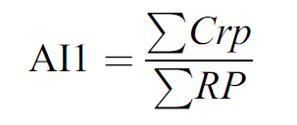
Measuring competition
Aspirant index 1:
Crp – candidates competing for realistic positions
RP – number of realistic position
26 candidates competing for 4 seats = 26 / 4 = 6,5
13 candidates competing for 11 seats = 13 / 11 = 1,2

Slide 39
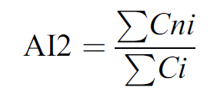
Measuring competition
Aspirant index 2:
Cni – non-incumbents competing for realistic positions
Ci – incumbents competing for realistic positions
26 candidates are competing out of which 17 are non-incumbents = 17 / 9 = 1,89

Slide 40
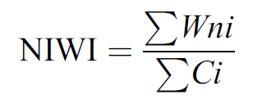
Measuring competition
Non-incumbents winning index (NIWI):
Wni – non-incumbents who won a position that is equal or higher than number of incumbents
Ci – number of competing incumbents
7 incumbents are competing and won positions 1, 2, 4, 6 and 7 → 2 / 7 = 0,29

Slide 41
Position | Incumbent
1
2
3
4
5
6
7
8
9
10
6 incumbents on the list
Positions of incumbents :
1, 2, 4, 6, 7, 9
Positions of newcomers:
3, 5, 8, 10
2 newcomers in positions 1-6
NIWI = 2 / 6 = 0,33

Slide 42
Other consequences
Cohesion of parties:
Candidates respond to those who can select them
Applying more inclusive selectorates reduces cohesion:
Higher importance of candidates and their profiles
Lesser importance of party’s profile as a whole
Allowing non-members to participate even supports these trends

Slide 43
Democracy at its best?
Selectorate | Inclusiveness | Representation | Competition | Cohesion
Elite / Committee | Low | High | Low | High
Party delegates | Medium | Medium | High | Medium
Party members | High | Low | Medium | Lower

