Slide 1
How to (not) Study Candidate Selection 1
Peter Spáč
2.3.2015

Slide 2
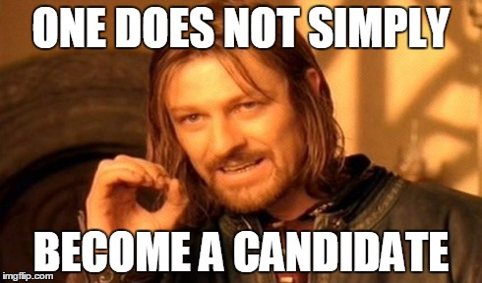

Slide 3
Candidate selection as topic
Not a mainstream in political science
Rising influence in recent periods
Unfinished discussions about theoretical framework and methodology
Key question – How to study candidate selection?

Slide 4
A possible shortcut?
Ability to predict which candidate selection methods will political parties apply
Data from studies (Lundell 2004) indicate that such attitude is not fully reliable
The same counts for changes in rules of candidate selection (Barnea and Rahat 2007)
Important outcome – each political party has to be studied individually

Slide 5
Existing research
Many empirical and less theoretical works
Various areas – what type of candidates to choose, what type of selection is the best etc.
Candidate selection as independent variable, dependent variable or both
Israel – most important area for methodological approach of candidate selection

Slide 6
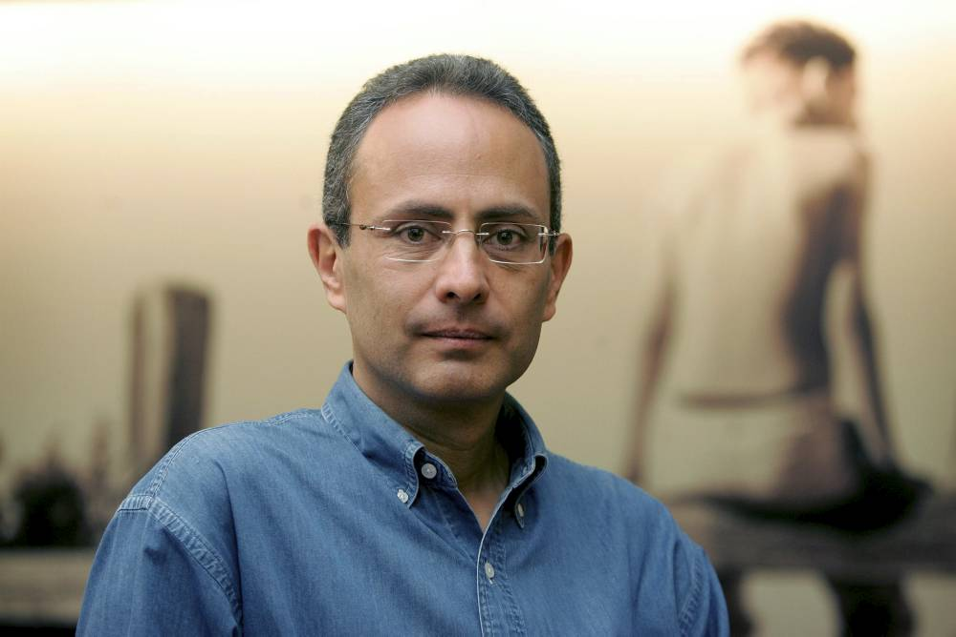
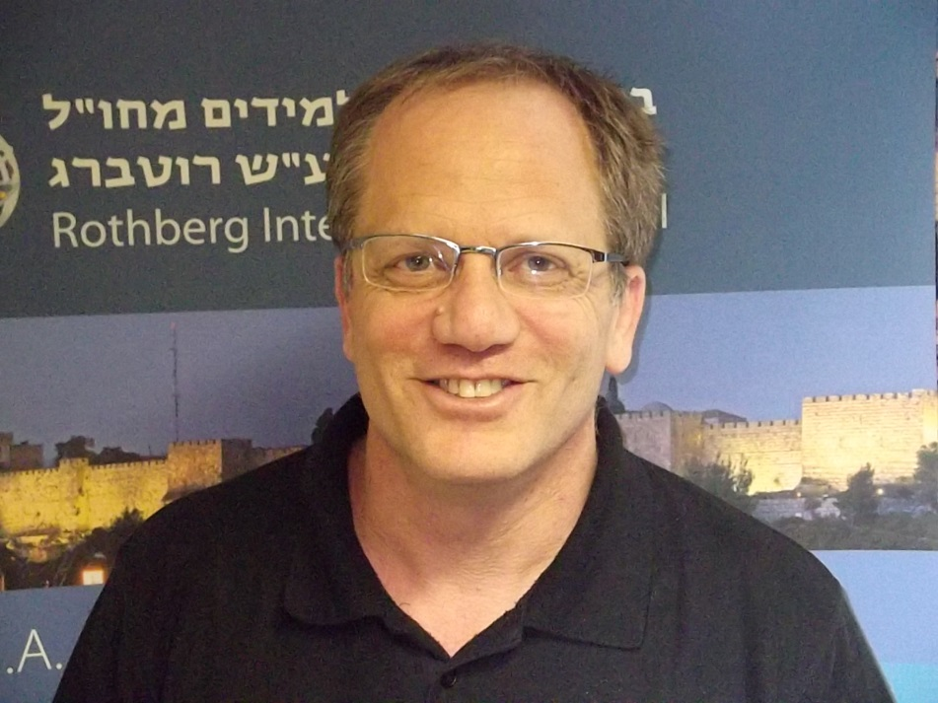
Reuven Y. Hazan
Gideon Rahat

Slide 7
Hazan and Rahat
Most prominent researchers in area of candidate selection
Democracy within parties. Candidate Selection Methods and their Political Consequences. (2010)
A complex framework based on 4 dimensions:
Candidacy
Selectorate
Decentralization
Appointment and voting systems

Slide 8
1. Candidacy
Who can be selected?
Describes the potential group out of which candidates may emerge
Most simple dimension for analysis
Possibly the most harsh dimension, as it may eliminate nearly everyone from being a candidate

Slide 9
Candidacy
An inclusive – exclusive continuum

Slide 10
Candidacy
All voters:
All eligible citizens may become candidates
US parties
Members:
Restriction to party members only
Plenty of examples including some Czech parties
Members + other requirements:
Most exclusive category
Members have to fulfill special conditions

Slide 11
Belgian socialists (in the past)
Who could be a candidate:
Member of the party, trade union or insurance association for at least 5 years
Who made minimum purchases from co-operative association
Was a subscriber of the party’s newspaper
Had children in state rather than in catholic school
And his family (wife, children) participated in the „proper“ women or youth organization

Slide 12
Candidacy
Why more inclusive?
Legal restrictions
Opening the gates to people
Why more exclusive?
Control over the candidate selection
Ensuring homogeneity of party
Resistance to corrupt practices
Candidacy requirements as reward for active and loyal members or as a motivation for proper behavior

Slide 13
Candidacy requirements
Important division of requirements:
Stated by the law
Stated by political parties
Legal system:
Delineates the ends of the continuum – citizenship, age, residence, incompatibility with other offices
Constitution, laws, regulations
Political parties may operate only within these positions and may not go beyond

Slide 14
Parties’ requirements
Age:
Mostly the upper level (the lower is stated by law)
Restrictions to long-term politicians
An effective way how to ensure access of younger candidates
Moral issue?
Belgian parties (maximum 65 years) → which Czech party in elections 2013 could not impose such restriction?

Slide 15
Parties’ requirements
Membership:
Status quo – being a members on a certain date
Lasting for some time – 1 year, 2 years, 5 years etc.
(Partly) effective way how to avoid corrupt practices based on hiring instant members
Opposite tactics:
Encouraging non-members to become candidates
Slovak party OLaNO, Dutch PVV
Any Czech case?

Slide 16
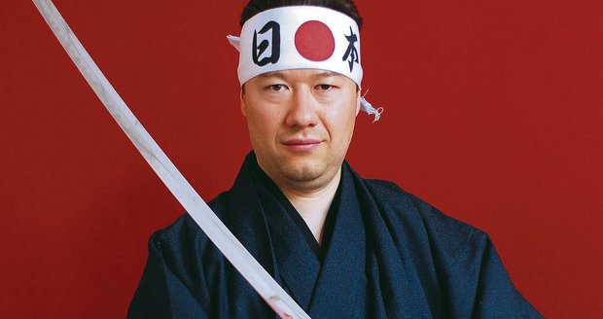

Slide 17
Parties’ requirements
Plenty of others:
Monetary deposit – „on the campaign“
Recommendation – by other members, authorities
Specific abilities – foreign languages
Previous political experience – mayor, party official
Symbolic requirements – honesty, reputation
Problematic:
Contracts of loyalty between parties and candidates
Unenforceable by the law

Slide 18
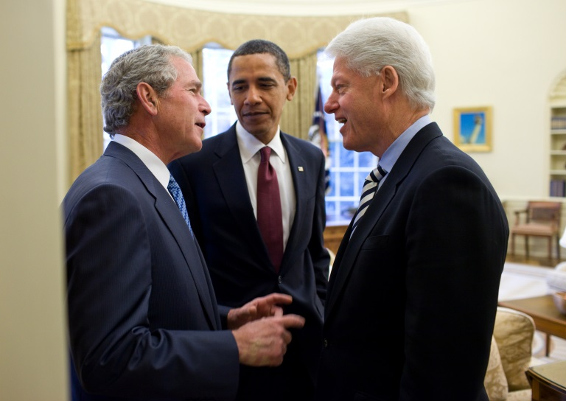
Incumbents
Automatic reselection – any guess?
Advantages:
No need to fulfil requirements as other candidates
Selected if not decided otherwise
Disadvantages:
Need of higher support in the party
Worse starting position on the final list

Slide 19
2. Selectorate
Who is selecting?
The party body (or bodies) that select the candidates from the pool of aspirants
The most important dimension of all with crucial effects on the whole process

Slide 20
Selectorate
An inclusive – exclusive continuum

Slide 21
Selectorate
Voters:
Entire electorate eligible to vote
Different types of primaries – non-partisan, blanket, open, semi-closed, (American) closed
Members:
Party membership in European meaning (not just registered voters)
Closed primaries

Slide 22
Selectorate
Party delegates:
Representatives selected by party members
Agency, congress, convention
Party elite:
Indirectly selected or non-selected bodies usually composing of small number of officials
Special selection committees
Party leader:
A single entity

Slide 23
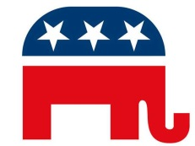
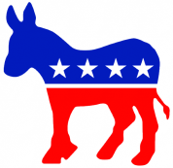
Selectorate
Measuring the selectorate:
Highly exclusive – Kadima (0), Forza Italia (2)
Middle sector – German parties (12)
Highly inclusive - Icelandic parties (22), US parties (24)

Slide 24
Selectorate - complexities
A single selectorate is rather rare
Why?
a) parties have complex internal structures
b) parties just want to make it harder for students to study candidate selection
Assorted method:
Different candidates face different selectorates that differ in their inclusiveness
Some candidates are selected by members, other by delegates (Belgian parties)

Slide 25
Selectorate - complexities
Multistage method:
All candidates face more selectorates in more stages
A central committee filters aspirants and presents a shorter lists of persons out of which party delegates select candidates
Weighted method:
All candidates face more selectorates at the same stage
Votes of each selectorate are weighted together
Kuomintang – weighting votes of party delegates and party members

Slide 26
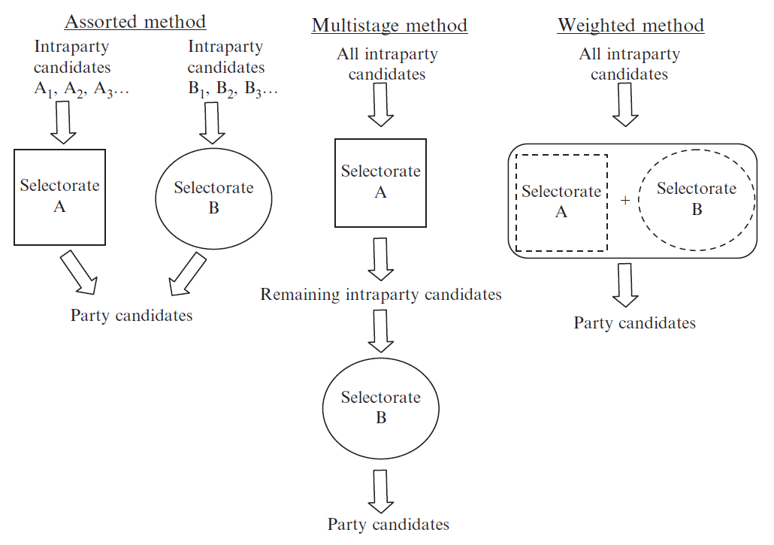

Slide 27
Selectorate - complexities
Public Affairs (VV) in 2010
Leaders of lists:
A central committee made a short list of aspirants
After that semi-closed primaries have chosen leaders
Other candidates:
Special selectorate composing of regional officials, local leaders and the list leader
Which complexities are present?

Slide 28
Selectorate - complexities
Public Affairs (VV) in 2010
Leaders of lists:
A central committee made a short list of aspirants
After that semi-closed primaries have chosen leaders
Other candidates:
Special selectorate composing of regional officials, local leaders and the list leader
Applied methods - multistage and assorted

Slide 29
Selectorate - complexities
How to deal with them?
Separate analysis of each selectorate and its impact
Excluding stages which are only formalities (in multistage method)
Calculation of relative impacts into an average value

Slide 30
Selectorate - complexities
Two selectorates:
Party members (18) and party delegates (12)
Both have equal impact
Final value is 15

Slide 31
Selectorate - complexities
Two selectorates:
Party members (18) and party elite (6)
Both have equal impact
Final value is 12

Slide 32
Selectorate - complexities
Potential problems:
Three or more selectorates
Selectorates are not close to each other
How to exactly measure their impact?
Results may not represent the reality
Necessary limitation of the framework

Slide 33
3. Decentralization
Whose interests are represented?
Extent to which national level influences the candidate selection as opposed to the weight of regional / local levels or social units
Aim – to ensure representation in territorial or social aspects

Slide 34
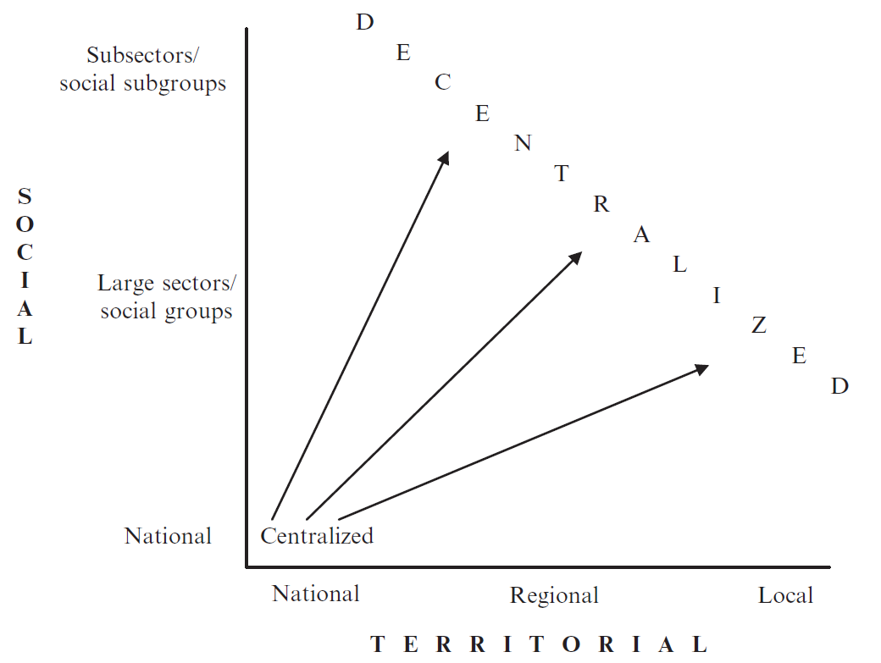

Slide 35
Mechanisms of decentralization
Establishment of non-national districts with their own selectorate:
Typical for territorial decentralization
Reserved positions (quotas):
Typical for social representation

Slide 36
Non-national districts
Regional or local branches have power to choose their candidates
Great influence of electoral system in general elections → strong role of electoral district level
FPTP usually leads to decentralized candidate selection while nationwide constituency works otherwise
Exemptions – parties in India, Netherlands

Slide 37
Reserved positions
Typically used for ensuring women representation
Other groups – young party members, members of trade unions, ethnic minorities
Quantitative share may not be enough – reserved positions should be competitive:
List PR systems – every third position of different gender
FPTP – reserved positions not only for lost districts
Quotas only for the selectorate may also be insufficient

Slide 38
Share of women on lists (Czech national election 2010)
Positions | ODS | CSSD | KSCM | SZ
1 – 6 | 10.5 | 10.5 | 29.8 | 35.1
7 – 12 | 15.8 | 29.8 | 21.1 | 40.4
13 – 18 | 31.6 | 22.8 | 31.6 | 36.8
19 – 24 | 28.1 | 31.6 | 29.8 | 33.3
25 – 30 | 21.1 | 31.6 | 31.6 | 31.6
31 - 36 | 12.3 | 25.5 | 36.8 | 30.9
Sum | 19.9 | 25.3 | 30.1 | 34.7

Slide 39
Share of women on lists (Czech national election 2010)
Positions | ODS | CSSD | KSCM | SZ
1 – 6 | 10.5 | 10.5 | 29.8 | 35.1
7 – 12 | 15.8 | 29.8 | 21.1 | 40.4
13 – 18 | 31.6 | 22.8 | 31.6 | 36.8
19 – 24 | 28.1 | 31.6 | 29.8 | 33.3
25 – 30 | 21.1 | 31.6 | 31.6 | 31.6
31 - 36 | 12.3 | 25.5 | 36.8 | 30.9
Sum | 19.9 | 25.3 | 30.1 | 34.7

Slide 40
Share of women on lists (Czech national election 2010)
Positions | ODS | CSSD | KSCM | SZ
1 – 6 | 10.5 | 10.5 | 29.8 | 35.1
7 – 12 | 15.8 | 29.8 | 21.1 | 40.4
13 – 18 | 31.6 | 22.8 | 31.6 | 36.8
19 – 24 | 28.1 | 31.6 | 29.8 | 33.3
25 – 30 | 21.1 | 31.6 | 31.6 | 31.6
31 - 36 | 12.3 | 25.5 | 36.8 | 30.9
Sum | 19.9 | 25.3 | 30.1 | 34.7

Slide 41
Important note
Decentralization
does not equal
democratization

Slide 42
Decentralization
Decentralization may be connected to democratization, but it is not a rule
These two dimensions should not be mixed
If the party leader used to choose candidates and now the party has decided to give this power to its local branches – is it democratization?

Slide 43
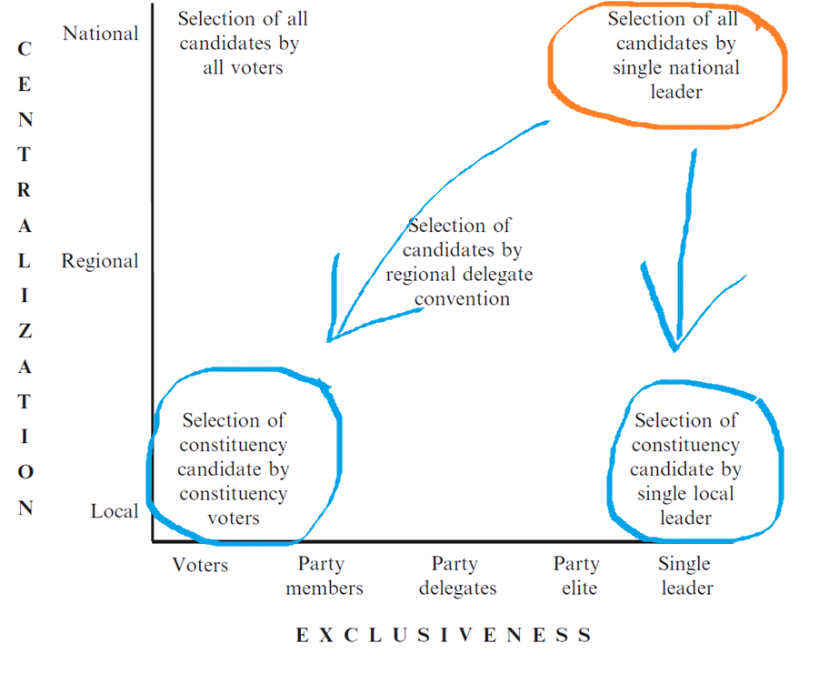

Slide 44
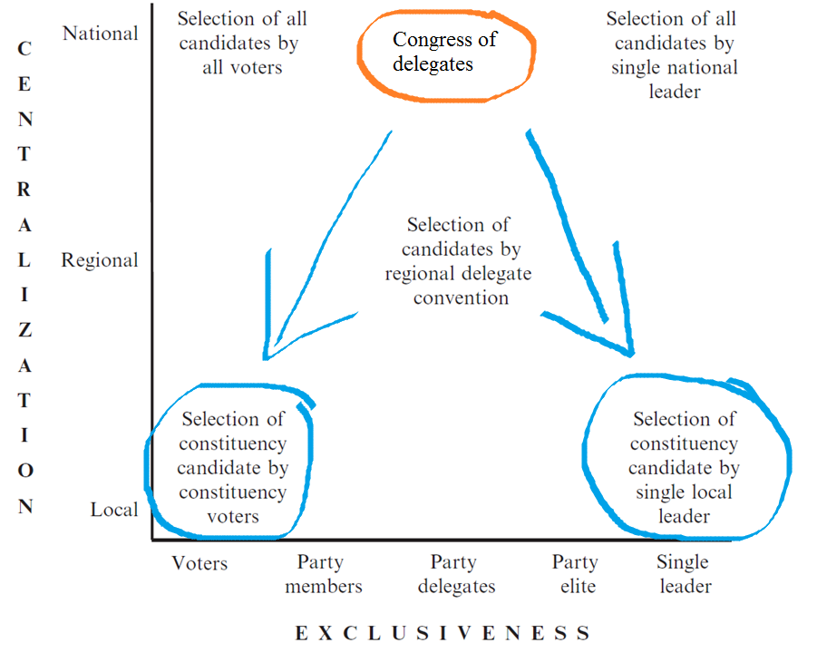

Slide 45
Appointment vs. Voting
How does the selectorate realize its decisions?
The technique of selecting the candidates
Appointment:
Usually connected to bodies of small number of people
Deliberation of members
Typically used for dialogue between factions

Slide 46
Appointment vs. Voting
Voting:
Usually used for large bodies of hundreds or thousands of participants (primaries, delegate conventions)
Effects of electoral systems as in regular elections
Important in respect to party unity or factionalism

Slide 47
Appointment vs. Voting
Combinations in multistage method or in a single selectorate
One body creates a proposal of candidates by appointment and another selectorate confirms this by a vote
The same is possible in a single selectorate where its more exclusive part makes the proposal
Example - Czech social democrats

Slide 48
Hazan and Rahat – 4 dimensions
Candidacy
Who can be selected?
Selectorate
Who is selecting?
Decentralization
Whose interests are represented?
Appointment vs. Voting
How does the selectorate realize its decisions?

