Slide 1
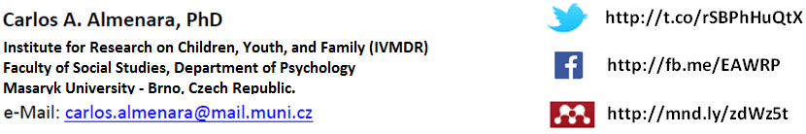
Online and Offline Resources in Psychological Assessment
PSY494P122 (2015-I)
Notes:
Carlos A. Almenara, PhD. Institute for Research on Children, Youth, and Family (IVMDR), Masaryk University, Brno – Czech Republic

Slide 2
COURSE INFORMATION

Slide 3
Course information
Classes are 2 academic hours long (45’ each one).
  First hour lecture
  Second hour: exercises
To access the final exam, it’s needed to attend at least 80% of the seminars (i.e. 10 out of 13 seminars in total).
Participate in classroom.
Read the assigned papers.

Slide 4
Course information
EVALUATION:
  40% mandatory assignments
  35% final exam (multichoice answer quiz with 20 questions)
  25% participation during classes

Slide 5
Course GOALS
  Give you the necessary skills and knowledge to:
    efficiently search,
    critically select,
    efficiently organize scientific information.
  Thus, to promote Information Literacy

Slide 6
ONLINE
RESOURCES

Slide 7

ONLINE RESOURCES
If you need basic information about a test, I encourage you to use:
  Educational Testing Service (ETS)
      It’s a FREE database of more than 25,000 tests and other measurement devices. Contains information about tests from the early 1900s to the present, and is considered the largest compilation of such materials in the world.
  http://www.ets.org/test_link/find_tests/

Slide 8

ONLINE RESOURCES
If you need bibliography about a test, I encourage you to use:
  Tests and Measures in the Social Sciences
      This FREE database contains information on about 14,000 measures available in 140 resources.
  http://libraries.uta.edu/TMdb

Slide 9
ONLINE RESOURCES
The largest databases on behavioral science and mental health:
  PsycINFO
  This database contains over 3 million abstracts of scholarly journal articles, book chapters, books, and dissertations.
  PsycARTICLES
  This database contains over 150 thousand full text articles of peer-reviewed scholarly journals.
  http://search.ebscohost.com/

Slide 10
OFFLINE
RESOURCES

Slide 11
Mental Measurements Yearbook
  Provides factual information, critical reviews, and comprehensive bibliographic references on the construction, use, and validity of all tests published in English.
MUNI FSS Library, Location: D2-732, Years: 1985-2010

Slide 12
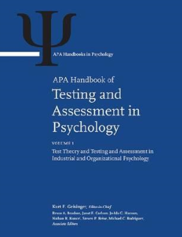
APA handbook of testing and assessment in psychology
This 3-volume handbook is a comprehensive presentation of the theory and application of tests in psychology and education.
Probably the most comprehensive reviews on the use of testing and assessment.
MUNI FSS Library (Barcode): 4240767206

Slide 13
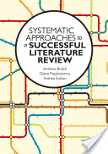
Systematic Approaches to a Successful Literature Review
This book takes you step-by-step through the process of a systematic review.
It includes examples, case studies, and exercises
MUNI FSS Library (Barcode): 4240771942

Slide 14
INFORMATION literacy

Slide 15
Information Literacy
American Library Aassociation - http://www.ala.org/acrl/files/standards/standards.pdf‎

Slide 16
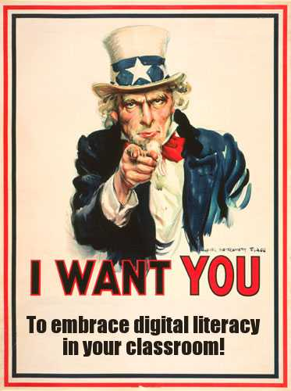
Information Literacy
National governments all around the globe
emphasize strong literacy as a
more-important-than-ever skill
in today’s knowledge-based societies
Bawden, D. (2008). Origins and concepts of digital literacy. In C. Lankshear & M. Knobel (Eds.), Digital literacies: Concepts, policies, and practices (pp. 17–32). New York, NY: Peter Lang Publishing.

Slide 17
SCIENTIFIC
INFORMATION

Slide 18
Scientific Information
Science:
  A method or process of evolving or developing an explanation of a phenomena or idea based on observation, identification, description, and experimental investigation using the best and most currently available information.
Collins, J W, O’Briend N P (2011). The Greenwoord dictionary of education (2nd ed.). Santa Barbara, CA: ABC-CLIO.

Slide 19
Scientific Information
Information can be conceptualized as:
  Process (i.e. the communication act)
  Knowledge (i.e. increase in understanding)
  Thing (i.e. an object that imparts information)
Buckland, M. (1991). Information and information systems. New York: Praeger.

Slide 20
EXERCISE

Slide 21

Scientific Information
EXERCISE (SOURCE CREDIBILITY):
  Perform a simple search for psychopharmacology on Google.
  How many of the results do you consider as “scientific information”?

Slide 22
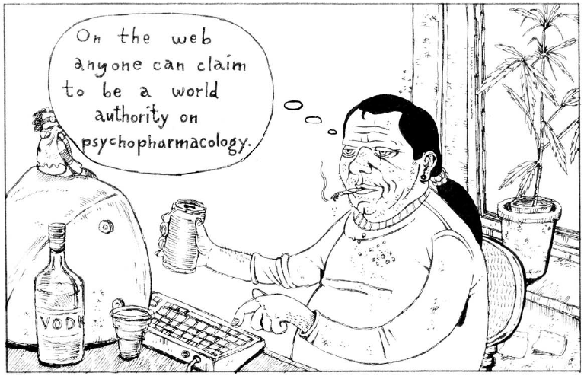
Scientific Information
Latto, J., & Latto, R. (2009). Study skills for psychology students. New York, NY: Open University Press.

Slide 23
Scientific Information
The most relevant sources of information are:
  Scientific books
  Articles in professional journals (peer-reviewed)
  Standard reference materials (e.g. encyclopedias)
  Research reports, dissertations and monographs
  Presentations at conferences, symposia and workshops
Fouché, C. B., & Delport, C. S. L. (2005). In-depth review of literature. In A. S. de Vos, H. Strydom, C. B. Fouché, & C. S. L. Delport (Eds.), Research at grass roots for the social sciences and human service professions (3rd ed., pp. 123–131). Pretoria: Van Schaik Publishers.

Slide 24
Scientific Information
Evaluating source credibility (skepticism):
  The reporting scientists and their respective institutions.
    Prior research
    Reputation within the field
    Prominence of the institution
  The publication or publisher of the reports.
    Peer-reviewed publication (extensive review process)
Nelson, D. E. (2011). Understanding and reporting the science. In C. F. Parvanta, D. E. Nelson, S. A. Parvanta, & R. N. Harner (Eds.), Essentials of public health communication (pp. 55–73). Sudbury, MA: Jones & Bartlett Learning.

Slide 25
Scientific Information
As can be deduced from the previous exercise:
  Scientific information is everywhere (online/offline), but the source must be evaluated.
  Scientific information is indexed in some way (e.g. library catalogues: keywords or internet metadata: tags)
  Some information is “invisible” for us (not indexed)

Slide 26
Scientific Information
Also deduced from the previous exercise:
  Pre-requisites to retrieve scientific information:
    It’s available in some way (library, bookstore, etc.)
    It’s indexed in some way (library’s catalogue, internet, etc.)

Slide 27
Scientific Information
Also deduced from the previous exercise:
  There are barriers to access scientific information:
    Language
    Cost
    Our own skills and knowledge

Slide 28
Readings for the Next Class:
(1) Finding a Research Problem (Joyner, Rouse, & Glatthorn, 2013)
(2) Hypothesis development [Part 1] (McBride, 2013)
(3) Health and biomedical information, Indexing, Research directions (Hersh, 2009)* [optional]
Assignment:
Formulate a research question.

