Slide 1
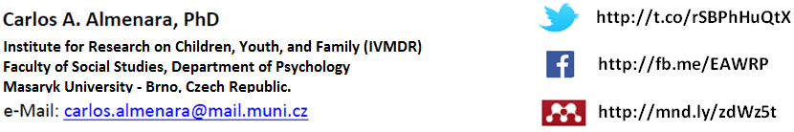
Online and Offline Resources in Psychological Assessment
PSY494P122 (2015-I)
Notes:
Carlos A. Almenara, PhD. Institute for Research on Children, Youth, and Family (IVMDR), Masaryk University, Brno – Czech Republic

Slide 2
The
BASICS of search

Slide 3

GOOGLE SCHOLAR

Slide 4
Google Scholar
Google Scholar provides a simple way to broadly search for scholarly literature.
You can search across many disciplines and sources:
  articles, theses, books, abstracts, from academic publishers, professional societies, online repositories, universities and other web sites.
http://scholar.google.com/

Slide 5
EXERCISE

Slide 6
Google Scholar
EXERCISE:
  Perform a simple search for psychopharmacology on Google Scholar
  How many of the results do you consider as “scientific information”?
http://scholar.google.com/

Slide 7
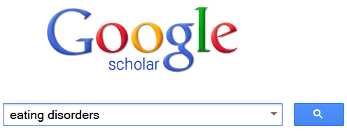
Google Scholar
Partial Match
  This is the kind of search we usually use by “default”

Slide 8
Google Scholar
PageRank
  It’s Google’s algorithm that assigns a numerical weighting to each element of a hyperlinked set of documents with the purpose of "measuring" its relative importance within the set.
  This is the reason why some documents appear first than others.

Slide 9
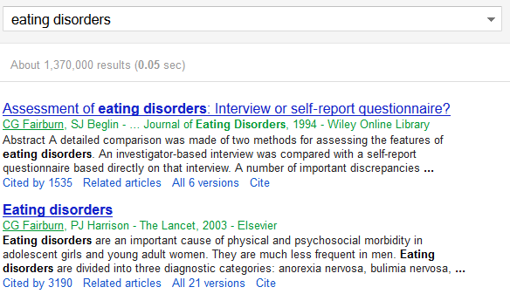
Google Scholar
PageRank

Slide 10
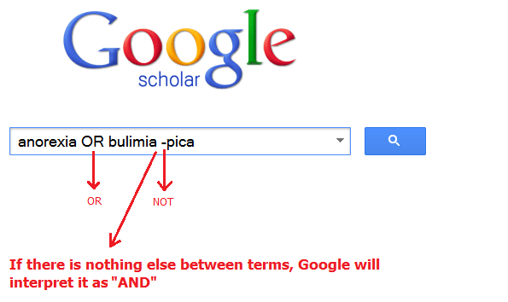
Google Scholar
Boolean Search
  A Boolean search uses “operators” (AND, OR , NOT)

Slide 11
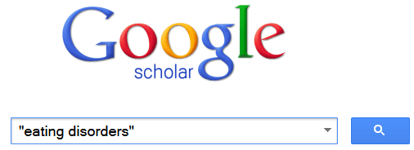
Google Scholar
Exact Match
  Use quotation marks to search for exact terms

Slide 12
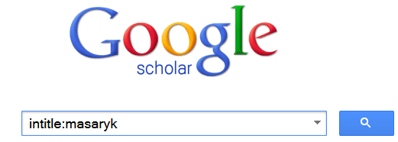
Google Scholar
Search the title of the document
  Use the operator intitle:

Slide 13
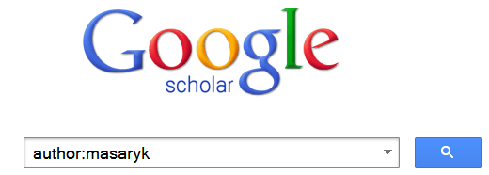
Google Scholar
Search by author
  Use the operator author:

Slide 14
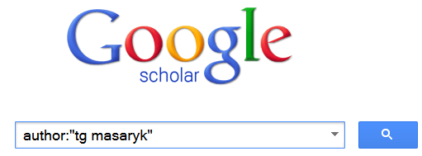
Google Scholar
Search by author (exact match)
  Combine the operator author with exact match:

Slide 15
Google Scholar
Search by author (exact match and Boolean operator)
  Combine the operator author with exact match and a Boolean operator:
  author:"tg masaryk" OR author:"Tomáš Garrigue Masaryk" OR author:"Tomáš Masaryk" OR author:"Tomáš G Masaryk"

Slide 16
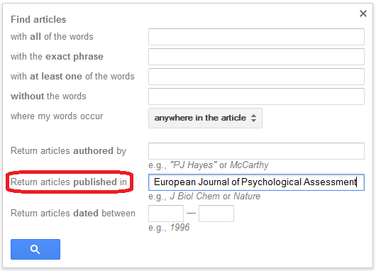
Google Scholar
Search by publication

Slide 17

Google Scholar
Search by publication
  NOTE: Google suggests you the journal’s abbreviated name

Slide 18
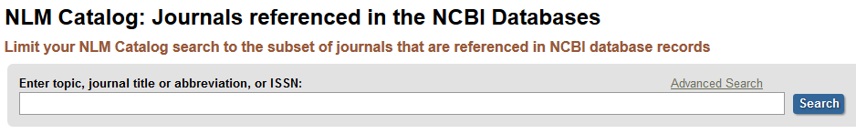

Google Scholar
Search by publication
  NOTE: You can search a journal’s abbreviation in the NLM Catalog
http://www.ncbi.nlm.nih.gov/nlmcatalog/journals

Slide 19

Google Scholar
Search by publication
  NOTE: Google scholar may also accept the journal’s ISSN
http://www.ncbi.nlm.nih.gov/nlmcatalog/journals

Slide 20
Google Scholar
Search by publication
  You might combine your search:
  OPTION 1:
  "European Journal of Psychological Assessment" OR "Europ J Psychol Assessm“
  OPTION 2:
  1015-5759 OR 2151-2426

Slide 21


Slide 22
Google Products
http://www.google.com/advanced_search
https://encrypted.google.com/advanced_search
http://images.google.com/advanced_search
http://groups.google.com/
http://news.google.com/
http://videos.google.com
http://translate.google.com/
http://www.google.com/preferences
http://www.google.com/publicdata/directory
http://www.google.com/trends
https://www.google.com/cse/manage/create
More: https://spreadsheets.google.com/pub?key=ty_BGDs9hnuBMRvj3AFeB2g&output=html
http://en.wikipedia.org/wiki/List_of_Google_products
Notes:
https://www.google.com/cse/publicurl?cx=010907764665242047998:2tmn5_bdyu8

Slide 23
Google
intitle, allintitle
inurl, allinurl
filetype, ext
allintext
site
link
inanchor
daterange
rphonebook
bphonebook
phonebook
stocks
define
cache
info
related
Date range uses Julian calendar days. You can calculate it online: http://www.onlineconversion.com/julian_date.htm
Stocks uses valid stock ticker symbol. You may search them on: http://www.macroaxis.com/invest/companyDirectory

Slide 24
Google Groups
Author
group
insubject
msgid
More: http://www.googleguide.com/advanced_operators.html

Slide 25
Google
“psychological assessment”
-psychiatry
~assessment
“psychological * assessment”
“psychological assessment” | “psychological measurement”

Slide 26
Google
site:.cz
filetype:pdf
ext:pdf
intitle:"psychological assessment"
allintext:MMPI appendix
link:http://www.apa.org
inurl:test
cache:http://knowledge.sagepub.com/view/using-test-data-in-clinical-practice/d200.xml

Slide 27
Google News
psychology location:"czech republic"
psychology source:"washington post"

Slide 28
Readings for the Next Class:
(1) Finding sources of information: Electronic databases (Lenburg, 2010)
(2) Finding the evidence (Wilczynski & McKibbon, 2013)
(3) Locating the best available research (Norcross, Hogan, & Koocher, 2008) (optional)
Assignment:
According to your research question, make a list of databases that you will use to find information.

