Slide 1
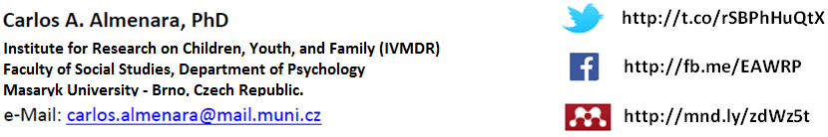
Online and Offline Resources in Psychological Assessment
PSY494P122 (2015-I)

Slide 2
DATABASES

Slide 3
DATABASES
There are thousands of databases.
They are usually available through:
  Data owners (institutions, publishers) or
  Third part companies (suppliers/retailers) or
  Third part institutions (libraries)

Slide 4
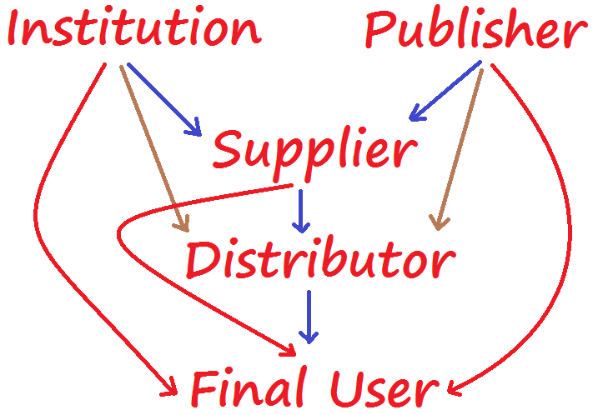
Notes:
By supplier I mean “retailers” such as EBSCO, ProQuest, etc.
By distributor I mean usually the library.

Slide 5
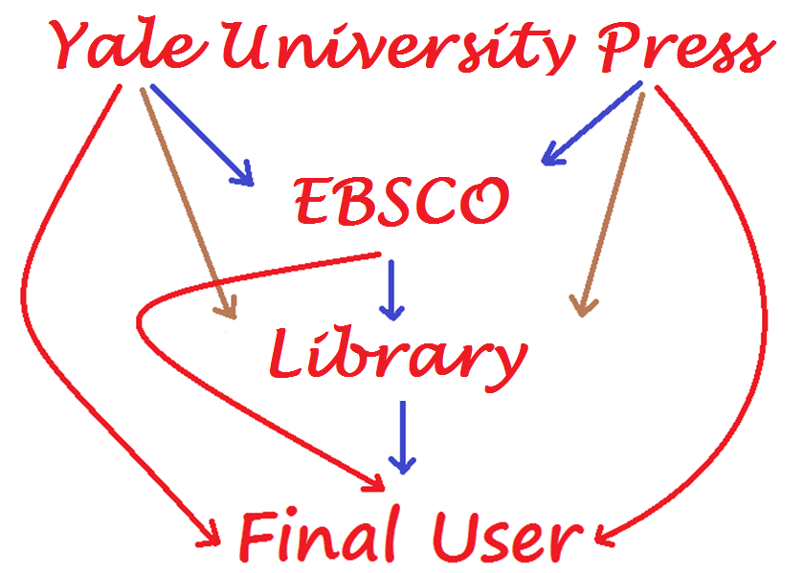
Notes:
By supplier I mean “retailers” such as EBSCO, ProQuest, etc.
By distributor I mean usually the library.

Slide 6
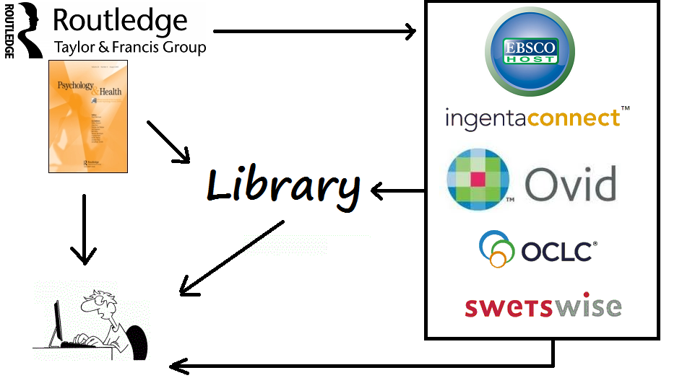

Slide 7
PUBLISHERS
(MOST RENOWNED)

Slide 8


Slide 9
SUPPLIERS
(MOST RENOWNED)

Slide 10
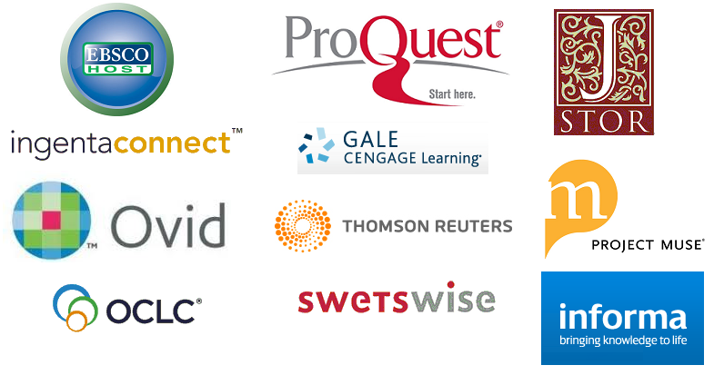

Slide 11
DATABASES
How to Select Them

Slide 12
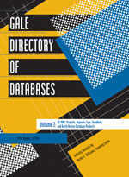
Gale Directory
Formed from the merger of 3 titles:
  Computer-Readable Databases
  Directory of Online Databases, and
  Directory of Portable Databases
Provides extensive coverage of more than 15,000 databases in all formats.
Volume 1: Is devoted to online databases
Volume 2: CD-ROM, DVD, diskette, magnetic tape, handheld, and batch access.
http://www.gale.cengage.com/servlet/ItemDetailServlet?region=9&imprint=000&titleCode=GDOD&cf=p&type=3&id=256122

Slide 13
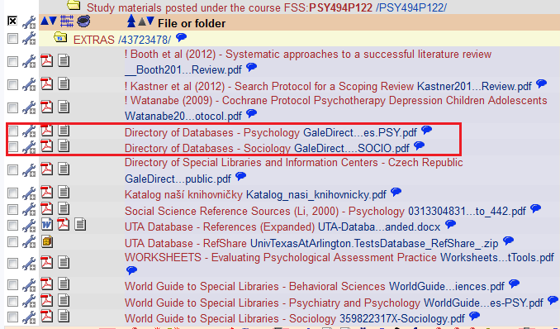

Slide 14
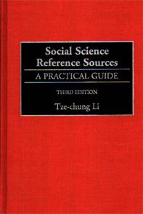
Social Science Reference Sources
Provides entries for roughly 1,600 reference sources in the social sciences, including:
  anthropology, business, economics, education, geography, history, law, political science, psychology, and sociology.
This 2nd edition gives special attention to electronic resources, including more than 200 web sites.
http://site.ebrary.com/lib/masaryk/docDetail.action?docID=10018032

Slide 15
DATABASES
OFFERED BY SUPPLIERS

Slide 16


Slide 17
EBSCO: About
EBSCO Information Services provides a complete and optimized research solution comprised of research databases, e-books and e-journals—all combined.
EBSCO offers more than 375 full-text and secondary research databases and over 515,000 e-books plus subscription management services for 360,000 e-journals and e-journal packages.
http://www.ebsco.com/about

Slide 18

ACADEMIC SEARCH™
For academic institutions: comprehensive multidisciplinary content
  Academic Search Elite.
  Academic Search Premier.
  Academic Search Complete.
http://ebscohost.com/academic
Notes:
e.g. anthropology, sociology, economics, etc.

Slide 19
ACADEMIC SEARCH™
Academic Search Elite:
  Over 13,600 Indexed and Abstracted Journals
  More than 2,300 Full-Text Journals
  Over 12,000 Peer-Reviewed, Abstracted and Indexed Journals
  More than 1,800 Peer-Reviewed, Full-Text Journals
http://www.ebscohost.com/academic/academic-search-elite

Slide 20
ACADEMIC SEARCH™
Academic Search Premier:
  More than 13,600 indexed and abstracted journals
  Full text for over 4,700 journals
  Over 12,000 peer-reviewed, indexed and abstracted journals
  More than 4,000 peer-reviewed, full-text journals
http://www.ebscohost.com/academic/academic-search-premier

Slide 21
ACADEMIC SEARCH™
Academic Search Complete:
  Over 13,690 indexed and abstracted journals
  Nearly 9,100 full-text journals
  Full text for more than 7,900 peer-reviewed journals
  PDF content dating back as far as 1887
  Searchable cited references provided for more than 1,450 journals
  Updated daily
http://www.ebscohost.com/academic/academic-search-complete

Slide 22

ACADEMIC SEARCH COMPLETE
http://search.ebscohost.com/

Slide 23


AGELINE®
Focuses exclusively on the population aged 50+ and issues of aging.
Premier source for the literature of social gerontology.
http://www.ebscohost.com/academic/ageline

Slide 24
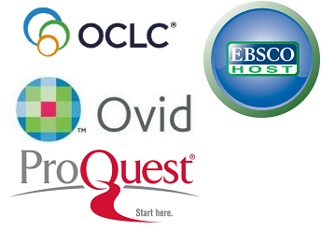
FRANCIS (INIST-CNRS)
Provides over 2.6 million records in humanities and social sciences dating back to 1972.
31% of the content is on psychology.
Source documents include journal articles, books, conference proceedings, dissertations, and reports.
http://www.inist.fr/?Francis-74&lang=en

Slide 25
PASCAL (INIST-CNRS)
More than 20 million records in 7 fields dating back to 1973. It includes fields like:
    Cognition: 272 titles and 200,000 references since 1984.
    Digital Communication and Information: 290 titles 800,000 references since 1984
Source documents include journal articles, books, conference proceedings, dissertations, patents, and reports, with special emphasis on European content.
http://www.inist.fr/?PASCAL-73&lang=en
http://pubpsych.eu
Notes:
Energy, Environmental issues, materials, nanoscience, safety, cognition, digital communication and information

Slide 26

Psychology & Behavioral Sciences Collection™
Covers information concerning topics in:
  Emotional and behavioral characteristics
  Psychiatry & psychology
  Mental processes
  Anthropology
  Observational & experimental methods.
>530 full-text journals.
http://www.ebscohost.com/academic/psychology-behavioral-sciences-collection

Slide 27


PsycINFO® (APA)
Is the largest resource devoted to peer-reviewed literature in behavioral science and mental health.
Abstracts from journals (99% peer-reviewed), book chapters, books, and dissertations.
Over 4 million records and summaries dating as far back as the 1600s
Ninety-nine percent of the covered material is peer-reviewed.
It’s indexed with controlled vocabulary from APA's Thesaurus of Psychological Index Terms®.
http://www.ebscohost.com/academic/psycinfo

Slide 28
PsycARTICLES® (APA)
A definitive source of full text, peer-reviewed scholarly and scientific articles in psychology.
More than 180,000 articles from > 100 journals published by the APA and allied organizations.
Coverage spans 1894 to present.
It’s indexed with controlled vocabulary from APA's Thesaurus of Psychological Index Terms®.
http://www.ebscohost.com/academic/psycarticles

Slide 29
PsycEXTRA® (APA)
Full-text companion to the scholarly PsycINFO® database with extensive coverage of gray literature.
Technical, annual and government reports, conference papers, newsletters, magazines, newspapers, consumer brochures and more.
Contains > 300,000 records that are not indexed in any other APA database.
It’s indexed with controlled vocabulary from APA's Thesaurus of Psychological Index Terms®.
http://www.ebscohost.com/academic/psycextra

Slide 30
PsycBOOKS® (APA)
Approximately 60,000 chapters in PDF from over 4000 books (some peer-reviewed) published by APA and other distinguished publishers.
Contains close to 3,000 classic books of landmark historical impact in psychology dating from the 1600s.
It’s indexed with controlled vocabulary from APA's Thesaurus of Psychological Index Terms®.
http://www.ebscohost.com/academic/psycbooks
http://psycnet.apa.org/index.cfm?fa=browsePB.home

Slide 31
PsycCRITIQUES® (APA)
Full-text book reviews featuring current scholarly and professional books in psychology.
Also contains reviews from a psychological perspective of popular films and trade books.
Approximately 41,000 reviews dating back to 1956
It’s indexed with controlled vocabulary from APA's Thesaurus of Psychological Index Terms®.
http://www.ebscohost.com/academic/psyccritiques

Slide 32
PsycTESTS® (APA)
Provides access to thousands of actual test instruments, most of which are available for immediate download and use.
Detailed test record including: a summary, background information, development history, purpose, reliability and validity data (when available), test format and the citation for the peer-reviewed source document.
Updated monthly. Coverage spans more than a century.
http://www.ebscohost.com/academic/psyctests

Slide 33

Mental Measurements Yearbook with tests in print
Produced by the Buros Institute of Mental Measurements (University of Nebraska)
Provides a comprehensive guide to over 3,500 contemporary testing instruments.
All yearbooks from the 1st edition (1938), through the 19th yearbook (2014) raise the total number of full-text reviews available on the product to over 10,000.
Test Reviews Online: http://buros.unl.edu/buros/jsp/search.jsp
Notes:
http://www.ebscohost.com/ACADEMIC/mental-measurements-yearbook-with-tests-in-print

Slide 34
Mental Measurements Yearbook ™ with tests in print (continued)
Comprehensive bibliography to all known commercially available tests that are currently in print in the English language.
Vital information: test purpose, test publisher, price, test acronym, intended test population, administration times, publication date(s), and test author(s). A score index permits users to identify what is being measured by each test.
Test Reviews Online: http://buros.unl.edu/buros/jsp/search.jsp

Slide 35
Health and Psychosocial Instruments (HaPI)
Produced by Behavioral Measurement Database Services (BMDS)
175,000 records, 80 unique instruments.
Instruments from Industrial/Organizational Behavior and Education are included.
Provides information on questionnaires, interview schedules, vignettes/scenarios, coding schemes, rating and other scales, checklists, indexes, tests, projective techniques, and more.
http://www.ebscohost.com/academic/health-and-psychosocial-instruments-hapi
Notes:
175,000 records, 80 unique instruments

Slide 36
PSYNDEX: Literature and Audiovisual
Media with PSYNDEX Tests
The most comprehensive abstract database of psychological literature, audiovisual media, intervention programs, and tests from the German-speaking countries (215,000 records, 30% translated in English)
Records of psychological publications from authors in the German-speaking countries, audiovisual media, and descriptions of intervention programs
Extensive descriptions of tests (5800 records back to 1945) in use in the German-speaking countries.
http://www.ebscohost.com/academic/psyndex-literature-and-audiovisual-media-with-psyndex-tests
http://pubpsych.eu

Slide 37

PEP Archive
Produced by Psychoanalytic Electronic Publishing, Inc. (PEP).
The most authoritative source from the field of psychoanalysis.
Offers the full text for 42 principal psychoanalytic journals and 58 classic psychoanalytic books dating as far back as 1871.
Encompass more than 1,360 volumes and a total of 613,000 printed pages, nearly 71,000 articles, book chapters, book reviews, letters and commentaries, and more than 8,700 figures and illustrations.
http://www.ebscohost.com/academic/pep-archive

Slide 38


Slide 39


ProQuest Central
The largest, multidisciplinary, full-text database available in the market today.
Provides access to 30 of ProQuest's most highly used databases with 21,000 periodicals.
Has a variety of content types across over 160 subjects, making this the broadest single research resource in the world.
http://www.proquest.com/libraries/academic/databases/ProQuest_Central.html

Slide 40

ProQuest Psychology Journals™
Provides abstracts and indexing for more than 1,000 titles, with over 690 titles available in full text.
Coverage: From 1971 to present.
Additionally, includes 4,000 full text dissertations spanning 2000 through 2006.
http://www.proquest.com/products-services/pq_psychology_journ.html

Slide 41
ProQuest Criminal Justice
Formerly ProQuest Criminal Justice Periodicals Index (CJPI)
Over 450 publications since 1969.
Authoritative information on criminology, addictions, alcoholism, gambling, child abuse.
http://www.proquest.com/products-services/pq_criminal_justice.html

Slide 42
ProQuest Education Journals
Covers not only the literature on primary, secondary, and higher education but also special education, home schooling, adult education, and hundreds of related topics.
Over 1020 titles (640 full text) since 1991.
http://www.proquest.com/products-services/pq_ed_journals.html

Slide 43

ProQuest Health and Medical Complete™
Combines the clinical research titles available in ProQuest Medical Library™ with hundreds of additional consumer and health administration titles.
Provides in-depth coverage from over 1,950 publications since 1986 with over 1,660 available in full text and of these, over 910 include MEDLINE® indexing.
http://www.proquest.com/products-services/pq_health_med_comp.html

Slide 44
ProQuest Nursing & Allied
Health Source
Provides users with reliable healthcare information since 1986 covering nursing, allied health, alternative and complementary medicine, and much more.
Provides abstracting and indexing for more than 1,070 titles, with over 890 titles in full-text, plus more than 12,300 full text dissertations representing the most rigorous scholarship in nursing and related fields.
http://www.proquest.com/products-services/pq_nursingahs_shtml.html

Slide 45
ProQuest Dissertations & Theses
With more than 3 million entries (since 1743), is the most comprehensive collection of dissertations and theses in the world.
Of the millions of graduate works listed, we offer over 1.5 million in full text format.
Right now, Google, Google Scholar and Google Books are indexing dissertations and theses published since 2007.
Open Access: http://pqdtopen.proquest.com/search.html
Limited view / Pay-per-view: http://dissexpress.umi.com/dxweb

Slide 46


Slide 47


Gale Virtual Reference
Offers more than 15000 full-text eBooks from Gale and other publishing partners.
100 Publishers including: SAGE, ABC-CLIO, Elsevier, Scribner, Macmillan, Greenwood, IGI Global, John Wiley & Sons, Kogan, Salem Press, etc.
http://www.gale.cengage.com/gvrl/

Slide 48
ACADEMIC ONE FILE
More than 14,000 titles, including more than 9,000 peer-reviewed journals and more than 6,000 in full text
Full text of The New York Times from 1985 to present
Links with JSTOR for archival access to periodicals
Thousands of podcasts and transcripts from NPR, CNN and CBC
Links to medical videos
http://www.gale.cengage.com/PeriodicalSolutions/academicOnefile.htm

Slide 49
Psychology Collection
Offers 300 full-text periodicals.
It also includes eBooks on psychology such as:
  Gale Encyclopedia of Psychology
  Encyclopedia of Children and Childhood: In History and Society
  Gale Encyclopedia of Mental Disorders
  Encyclopedia of Drugs, Alcohol and Addictive Behavior
http://solutions.cengage.com/Gale/Catalog/Fact-Sheets/it_psych.pdf

Slide 50
Book Review Index Online
The index includes more than 5 million reviews from 1965.
The plus version also includes more than 634,000 full-text reviews from InfoTrac OneFile and InfoTrac Expanded Academic, as well as full text via links to library holdings.
http://www.gale.cengage.com/BRIOnline

Slide 51


Slide 52


Web of Science
Information is carefully evaluated and selected.
Offers a true cited reference index, which is still the best tool for discovery.
12,000 of the highest impact journals
Includes the Book Citation Index (more than 50,000 books, and 160,000 conference proceedings)
Visualize the citations with Citation Maps, analyze them with Analyze Tool or integrate them with EndNote® Web.
http://wokinfo.com/products_tools/multidisciplinary/webofscience/

Slide 53

Journal Citation Reports (JCR)®
Offers a systematic, objective means to critically evaluate the world's leading journals, with quantifiable, statistical information based on citation data.
Measures research influence and impact at the journal and category levels, and shows the relationship between citing and cited journals.
http://wokinfo.com/products_tools/analytical/jcr/

Slide 54
Current Contents Connect
Provides access to:
  Complete tables of contents and abstracts from the most recently published issues of leading scholarly journals.
  More than 7,000 relevant, evaluated websites.
  Full, bibliographic information for selected electronic journals is also available pre-publication
http://wokinfo.com/training_support/training/current-contents-connect/

Slide 55
Data Citation Index
  Provides digital research that is discoverable, citable and linked to primary research literature.
  Coverage of nearly 2 million records from quality repositories from around the world.
http://wokinfo.com/media/pdf/dci_fs_en.pdf

Slide 56
Global Health from CABI
The definitive international public health database: captures key literature not covered by other databases.
Coverage of over 5,000 journals across the biological and medical sciences, from 158 countries in over 50 languages.
Includes journals, books, reports, conferences, patents, theses, and more.
Uses CAB Thesaurus and CABICODES
http://thomsonreuters.com/content/science/pdf/globalhealth_fs.pdf
http://www.cabdirect.org/advancedsearch.html

Slide 57


Slide 58

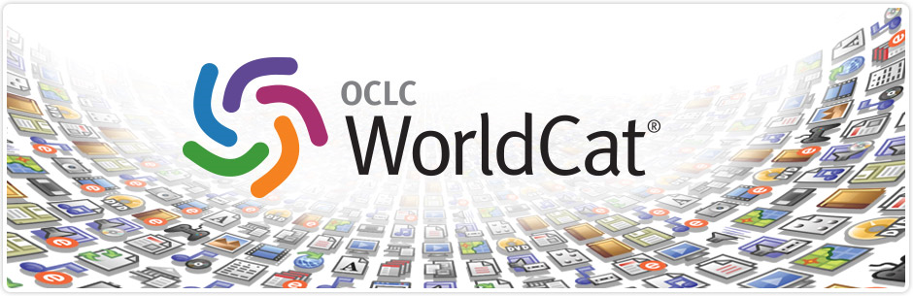
WorldCat
WorldCat is the world's largest network of library content and services.
Lets you search the collections of libraries in your community and thousands more around the world.
http://www.worldcat.org/whatis/default.jsp
http://www.worldcat.org/advancedsearch

Slide 59
WorldCat: eBooks
Includes the OCLC catalog of online electronic books available through libraries worldwide.
All online electronic books cataloged by OCLC member libraries, including all subjects.
Over 1.9 million books records in the database.
http://www.worldcat.org/advancedsearch

Slide 60
WorldCat: Dissertations & Theses
Fast and convenient access to the dissertations and theses available in OCLC member libraries.
Many of these are available electronically, at no charge, directly from the publishing institution.
Over 8 million records in the database
http://www.worldcat.org/advancedsearch

Slide 61

WorldCat: OAIster
OAIster is a union catalog of millions of records from open access collections worldwide.
OAIster includes more than 25 million records representing digital resources from more than 1,100 contributors.
http://oaister.worldcat.org/

Slide 62
WorldCat
http://www.worldcat.org/advancedsearch

Slide 63
DATABASES
(EVIDENCE-BASED)

Slide 64
Scientific Evidence
At the most basic level, evidence involves “the available body of facts or information indicating whether a belief or proposition is true or valid.”¹
For evidence-informed decision making
1 Brownson, R. C., Baker, E. A., Leet, T. L., Gillespie, K. N., & True, W. R. (2011). Evidence-based public health. New York, NY: Oxford University Press.

Slide 65
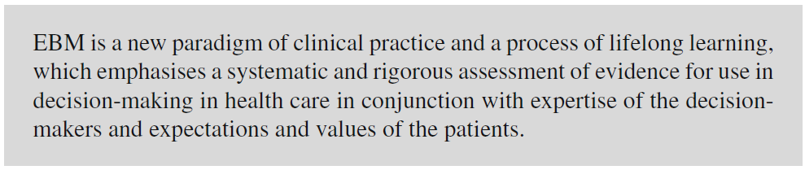
Evidence-based Medicine
Prasad, K. (2013). Fundamentals of evidence-based medicine (2nd ed.). New Delhi: Springer India.

Slide 66
Evidence-based Practice
“the conscientious, explicit and judicious use of current best evidence in making decisions about the care of individual patients”
Sackett , D. L. , Richardson , W. S. , Rosenberg , W. , & Haynes , R. B. (1997). Evidence-based medicine: How to practice and teach EBM . New York, NY : Churchill Livingstone . p. 2.

Slide 67
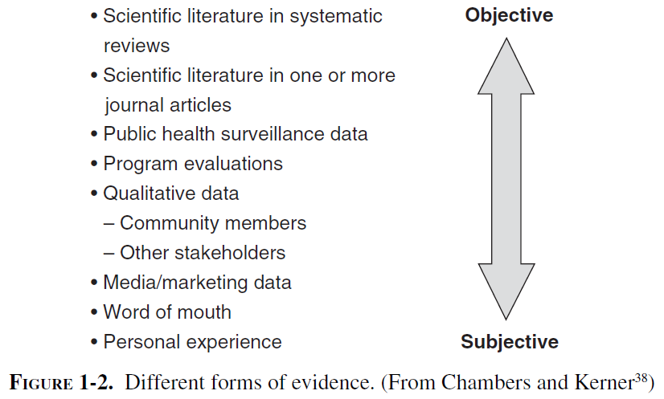
Scientific Evidence
Brownson, R. C., Baker, E. A., Leet, T. L., Gillespie, K. N., & True, W. R. (2011). Evidence-based public health. New York, NY: Oxford University Press.

Slide 68
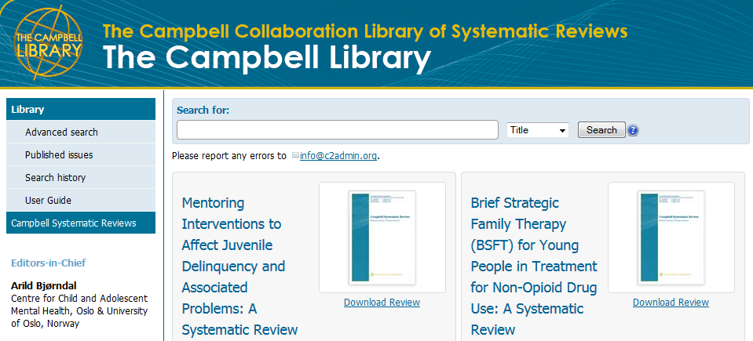
Campbell Library
http://www.campbellcollaboration.org/lib/

Slide 69



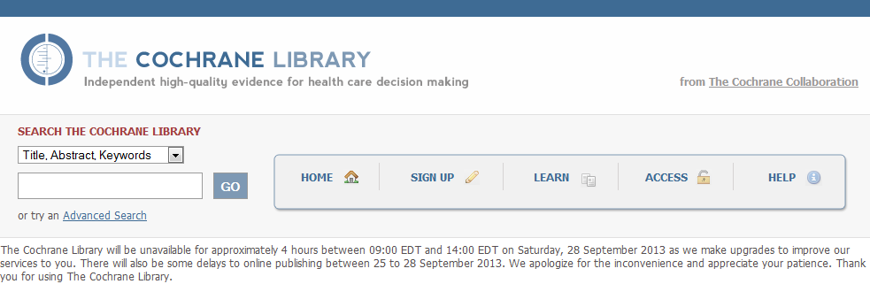
Cochrane Library
http://www.thecochranelibrary.com/

Slide 70
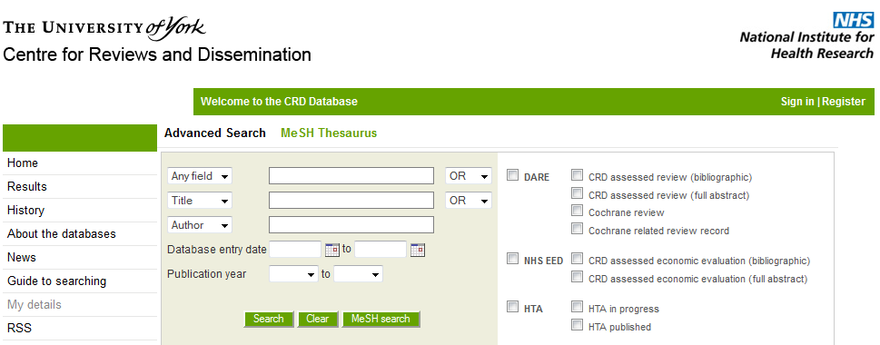
CRD Database (DARE)
http://www.crd.york.ac.uk/crdweb/SearchPage.asp

Slide 71
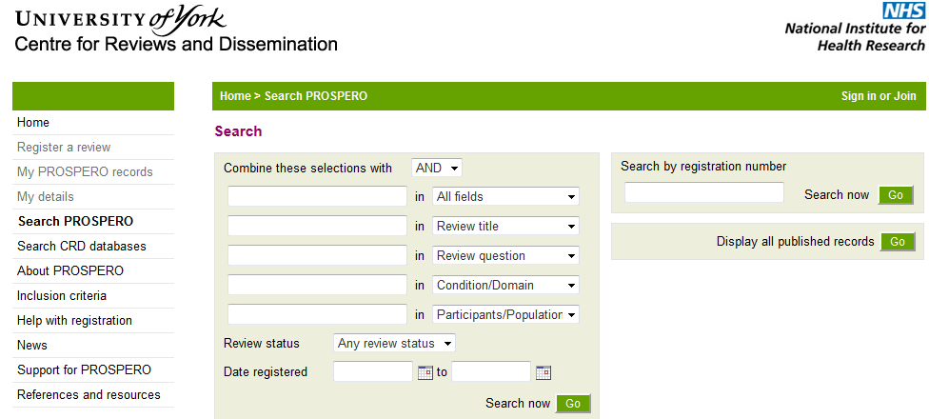
CRD Database (PROSPERO)
http://www.crd.york.ac.uk/PROSPERO/

Slide 72
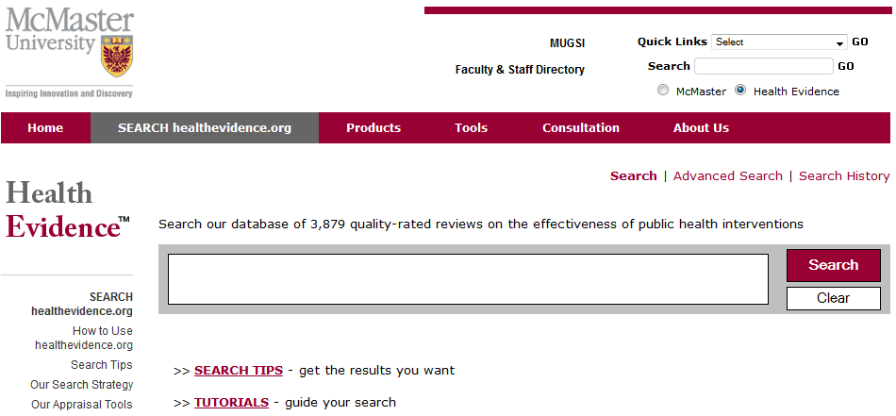
McMaster Health Evidence
http://www.healthevidence.org/search.aspx

Slide 73
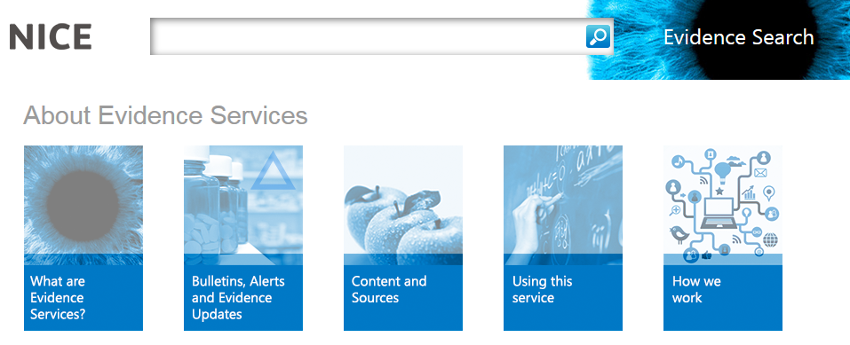
NICE (EBM Search Engine)
http://www.evidence.nhs.uk/search

Slide 74
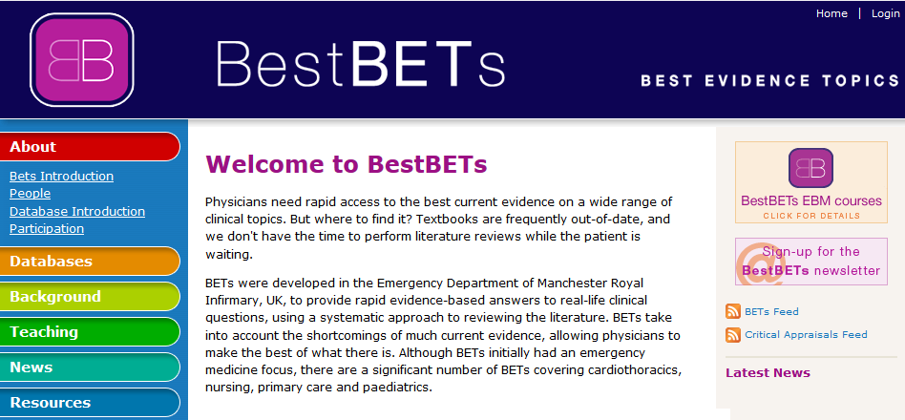
Best BETS
http://bestbets.org/index.php

Slide 75



Clinical Trials
http://clinicaltrials.gov/
http://www.controlled-trials.com/mrct/
http://public.ukcrn.org.uk/search/

Slide 76

EBM Journals
Evidence-based journals
  Mental Health
  Preventive Medicine
  Expert Opinion Journals *
* http://informahealthcare.com/page/eo

Slide 77
DATABASES
(TESTS)

Slide 78

Tests and Measures in the
Social Sciences
This database contains information on about 14,000 measures available in 140 compilation volumes.
There is a database version in RefShare.
http://libraries.uta.edu/TMdb

Slide 79

Educational Testing Service
Test Collection
The ETS Test Collection is a database of more than 25,000 tests and other measurement devices.
Contains information about tests from the early 1900s to the present, and is considered the largest compilation of such materials in the world.
Uses ERIC descriptors.
About: http://www.ets.org/test_link/about/
Database: http://1340.sydneyplus.com/ETS_Test_Collection/Portal.aspx

Slide 80

PROQOLID
Provides an overview of existing Patient Reported Outcome (PRO) instruments
Provides relevant and updated information on PRO instruments
Facilitates access to the instruments and their developers
Facilitates the choice of an appropriate PRO instrument
http://www.proqolid.org/about_proqolid

Slide 81

Know Mo
Prepared as part of a Systematic Review of Measures for the Measuring Addictions and Mental Health Problems in Alberta study.
Provides an index of diagnostic measures for addiction and mental health disorders.
Includes the major contributing literature and associated material summarizing the findings and uses of the measures.
http://www.knowmo.ca/Capacity/AddictionMeasures.aspx

Slide 82
DATABASES
(METASEARCH)

Slide 83

PubPsych
Includes: ERIC, ISOC-Psicología, MEDLINE, DANS, NORART, PASCAL, PSYNDEX.
http://www.pubpsych.eu/

Slide 84

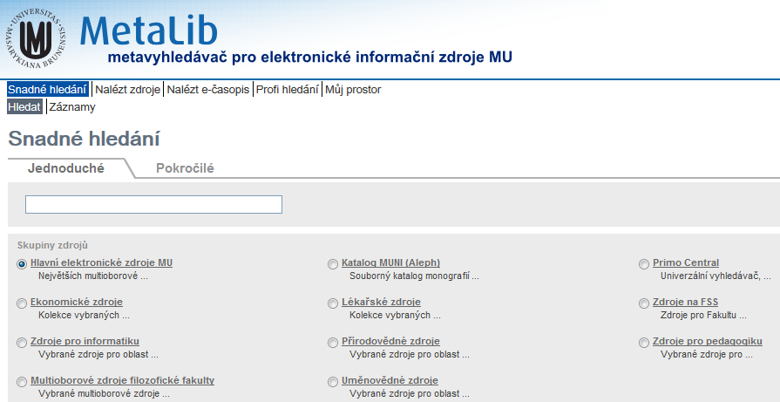
MUNI MetaLib
http://metalib.muni.cz/

Slide 85

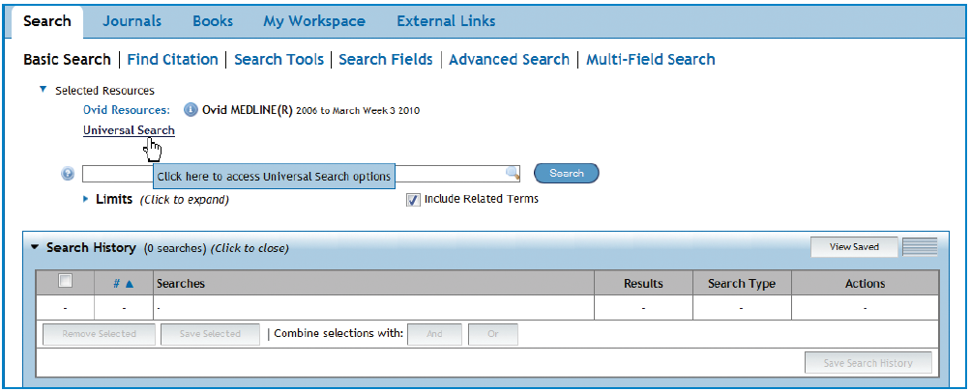
OVID Universal Search
http://resourcecenter.ovid.com/site/pdf/osp3/OvidUS_FS_0410.pdf

Slide 86

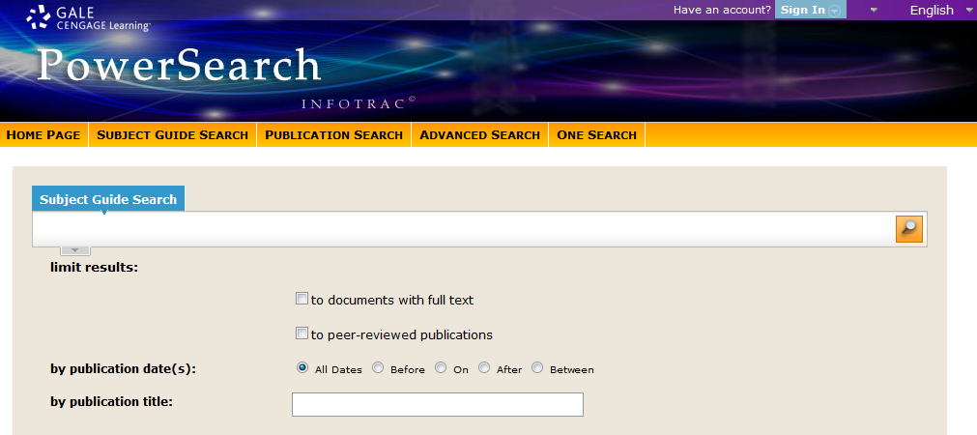
GALE PowerSearch
http://infotrac.galegroup.com/itweb/masaryk

Slide 87
Readings for the Next Class:
Saving citations (De Brún & Pearce-Smith, 2014; Chapter 10)
APA Citation Style (American Psychological Association, 2010)
Complementary Material:
  APA style guide to electronic references (APA, 2012)
  Citing Periodicals, Books, Other (Perrin, 2012)
  Sample paper (APA Style) (Schwartz, 2013)
Assignment:
The next class we’ll start our own Mendeley database.

