Slide 1
Dissertations & Theses;
JOURNALS;
ISI WEB OF KNOWLEDGE
Carlos A. Almenara, PhD
Online and Offline Resources In Psychological Assessment PSY494P122 (April 1, 2015)

Slide 2
DISSERTATIONS
&
THESES

Slide 3

ProQuest Dissertations & Theses
With more than 3 million entries (since 1743), is the most comprehensive collection of dissertations and theses in the world.
Of the millions of graduate works listed, they offer over 1.5 million in full text format.
Right now, Google, Google Scholar and Google Books are indexing dissertations and theses published since 2007.
Open Access: http://pqdtopen.proquest.com/search.html Limited: http://dissexpress.umi.com/dxweb

Slide 4
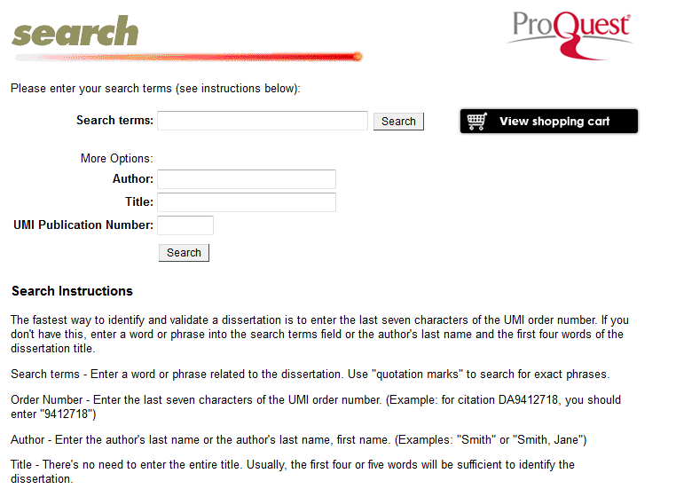
ProQuest Dissertations & Theses
Open Access: http://pqdtopen.proquest.com/search.html Limited: http://dissexpress.umi.com/dxweb

Slide 5
ProQuest Dissertations & Theses
This free version gives you access to the records only.
The results are limited to 40.
Open Access: http://pqdtopen.proquest.com/search.html Limited: http://dissexpress.umi.com/dxweb

Slide 6
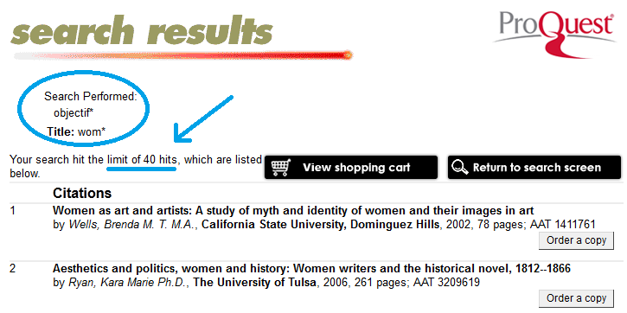
ProQuest Dissertations & Theses
Open Access: http://pqdtopen.proquest.com/search.html Limited: http://dissexpress.umi.com/dxweb

Slide 7

ProQuest Dissertations & Theses
Using Google:
  Limit your search to: site:gradworks.umi.com
Using Google Books (Advanced Search)
  Limit your search to: inpublisher:proquest
NOTE: It has limitations
Open Access: http://pqdtopen.proquest.com/search.html Limited: http://dissexpress.umi.com/dxweb

Slide 8
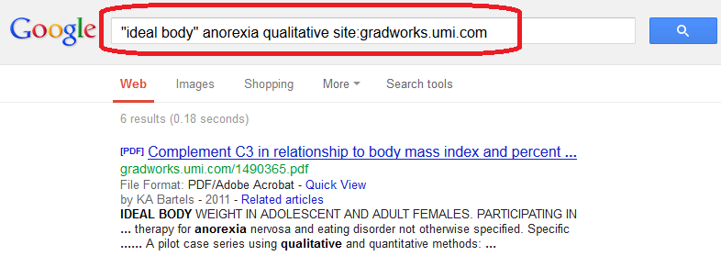
ProQuest Dissertations & Theses
In Google.com
http://www.google.com

Slide 9
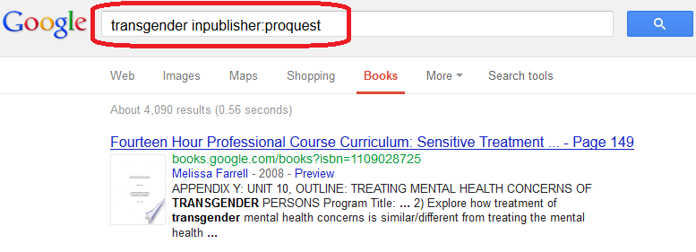
ProQuest Dissertations & Theses
In books.google.com
http://books.google.com/advanced_book_search

Slide 10
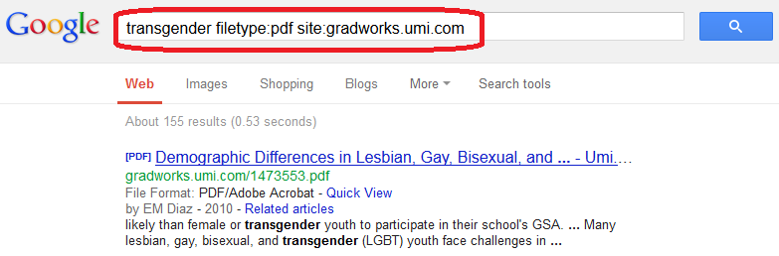
ProQuest Dissertations & Theses
PDF dissertations & theses in Google.com
http://www.google.com

Slide 11
ProQuest Dissertations & Theses
EXERCISE 1:
  Using PQDT *, find the most similar dissertation/thesis for your research.
  or
  Using Google or Google Books, find the most similar dissertation/thesis for your research.
* Open Access: http://pqdtopen.proquest.com/search.html Limited: http://dissexpress.umi.com/dxweb

Slide 12
JOURNALS
SEARCH ENGINES

Slide 14

CUFTS
Developed at the Simon Fraser University Library.
CUFTS is a free, open source (GPL) OpenURL link resolver and electronic resource management system designed for use by library consortia.
http://lib-code.lib.sfu.ca/projects/CUFTS/

Slide 15
CUFTS
The CUFTS public tools provide serials management services to libraries and people everywhere:
  Journal Search allows you to quickly find journal titles in over 475 different electronic collections listed in CUFTS.
  Search by journal title or ISSN to find out which collections include a journal, and what coverage dates are available.
http://lib-code.lib.sfu.ca/projects/CUFTS/wiki/CuftsTools

Slide 16
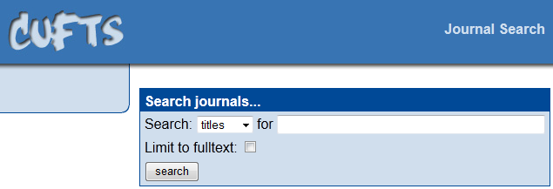
CUFTS
http://cufts2.lib.sfu.ca/MaintTool/public/search

Slide 17
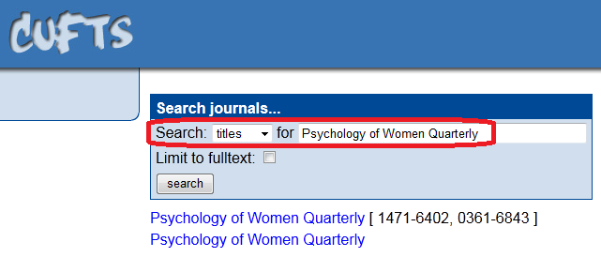
CUFTS
http://cufts2.lib.sfu.ca/MaintTool/public/search

Slide 18
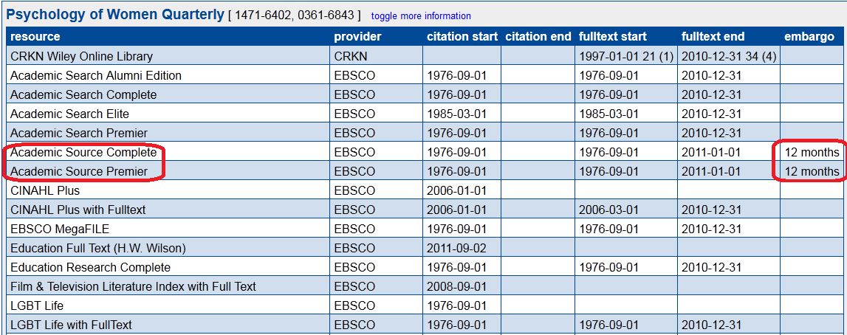
CUFTS
http://cufts2.lib.sfu.ca/MaintTool/public/search

Slide 19
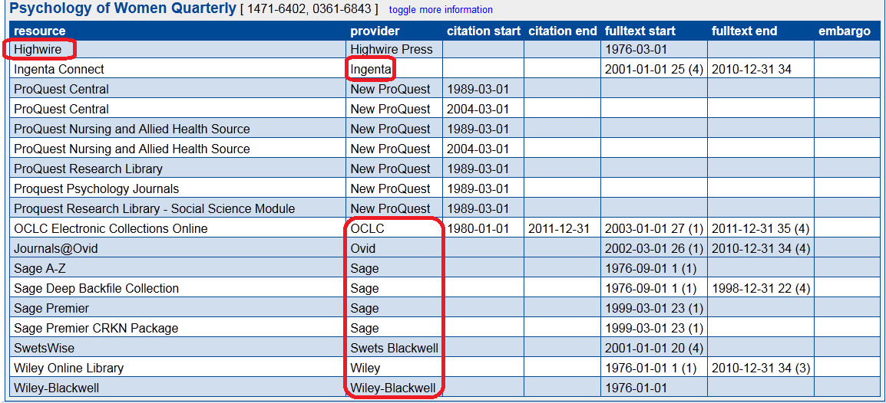
CUFTS
http://cufts2.lib.sfu.ca/MaintTool/public/search

Slide 20
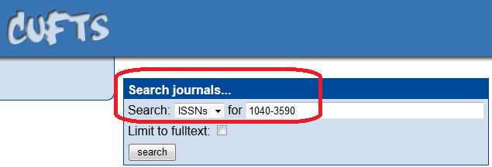
CUFTS
http://cufts2.lib.sfu.ca/MaintTool/public/search

Slide 21
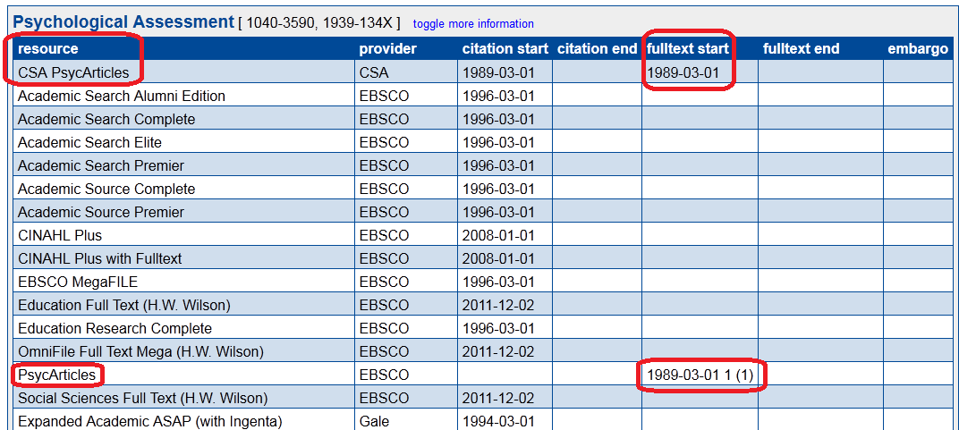
CUFTS
http://cufts2.lib.sfu.ca/MaintTool/public/search

Slide 23

JournalSeek
Is the largest completely categorized database of freely available journal information available on the internet.
Contains 102683 titles.
Journal information includes the description (aims and scope), journal abbreviation, journal homepage link, subject category and ISSN.
http://journalseek.net/

Slide 24
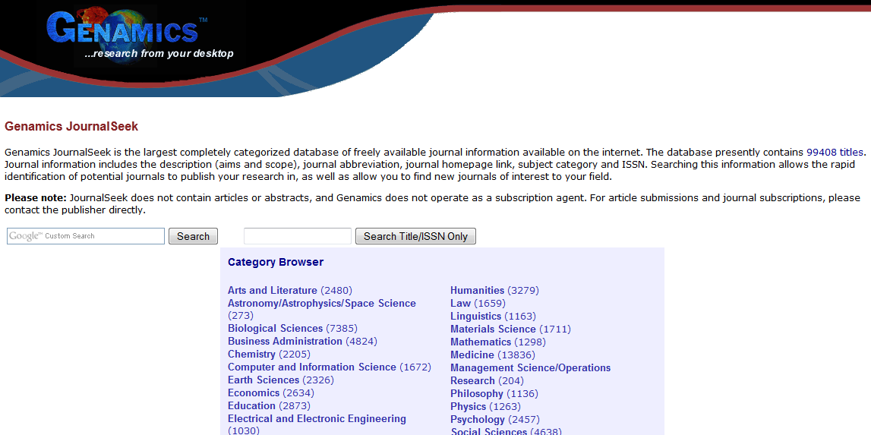
JournalSeek
http://journalseek.net/

Slide 25
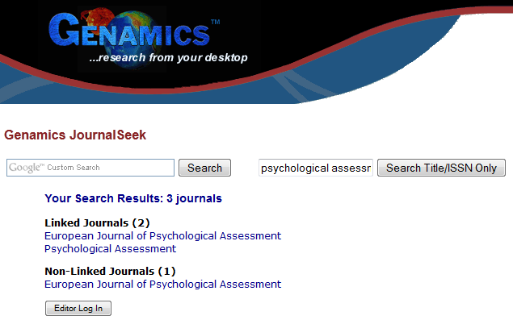
JournalSeek
http://journalseek.net/

Slide 26
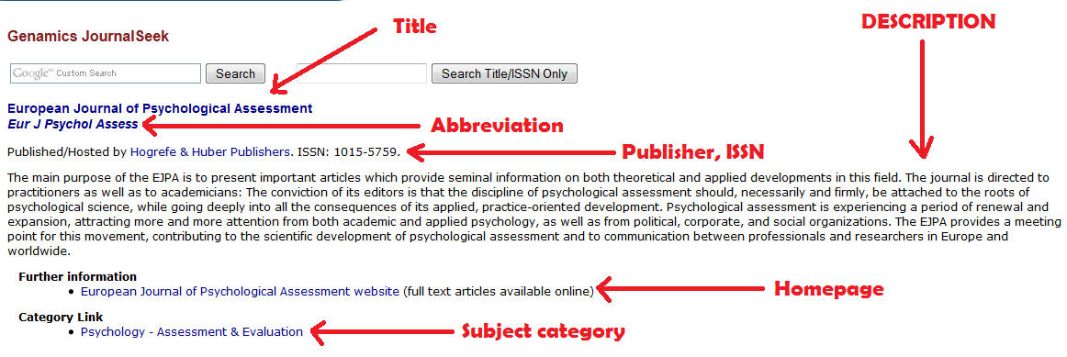
JournalSeek
http://journalseek.net/

Slide 28

Serials Solutions: SFX®
SFX ® is the most widely used OpenURL link resolver, with a customer base of over 2400 institutions in more than 50 countries.
MetaLib, integrated with SFX ®, provides users with a coherent and friendly environment for metasearching, and enables them to view retrieved results in a manageable, unified format.
http://www.exlibrisgroup.com/category/SFXOverview

Slide 29
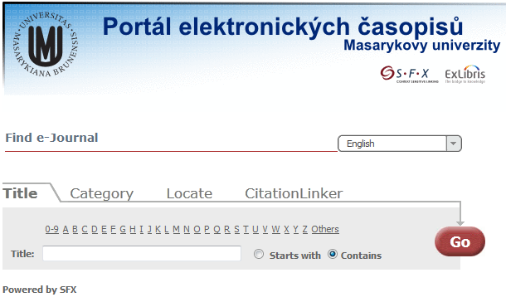
SerialsSolutions SFX®
http://sfx.muni.cz

Slide 30
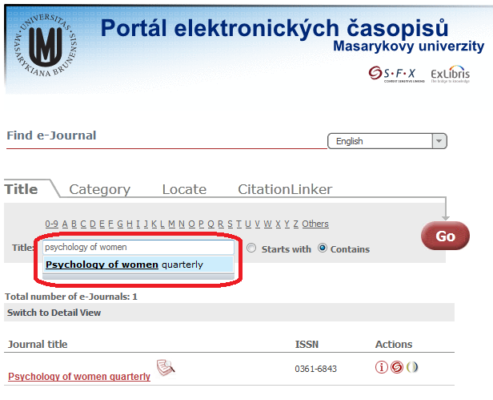
SerialsSolutions SFX®
http://sfx.muni.cz

Slide 31
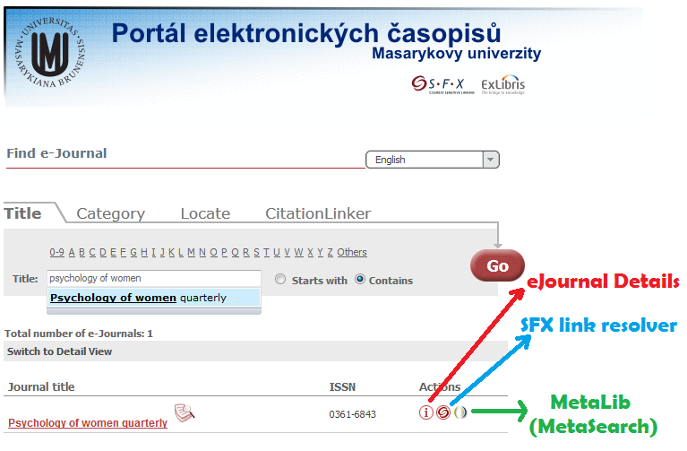
SerialsSolutions SFX®
http://sfx.muni.cz

Slide 32
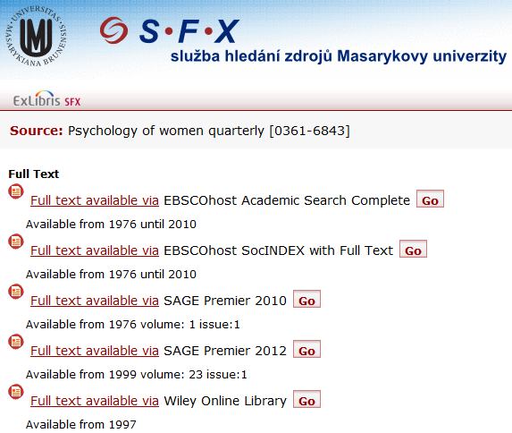
SerialsSolutions SFX®
http://sfx.muni.cz

Slide 33
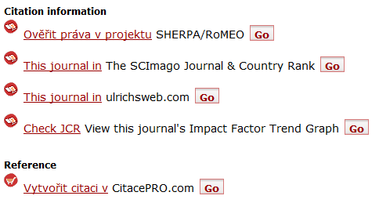
SerialsSolutions SFX®
http://sfx.muni.cz

Slide 35

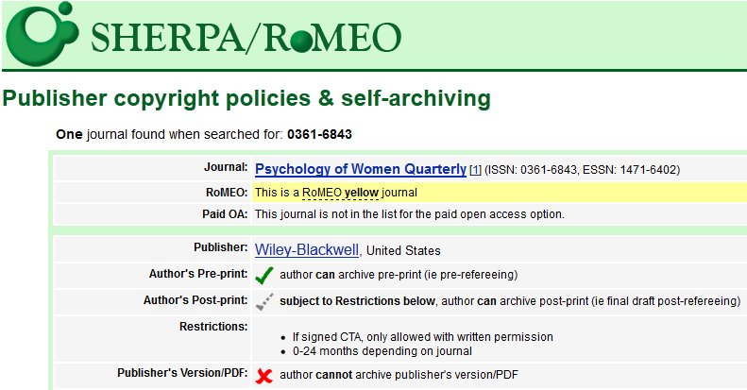
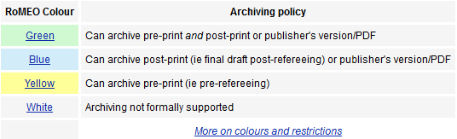
SHERPA/RoMEO
SHERPA/RoMEO provides you a summary of permissions that are normally given as part of each publisher's copyright transfer agreement.
http://www.sherpa.ac.uk/romeo/search.php

Slide 37

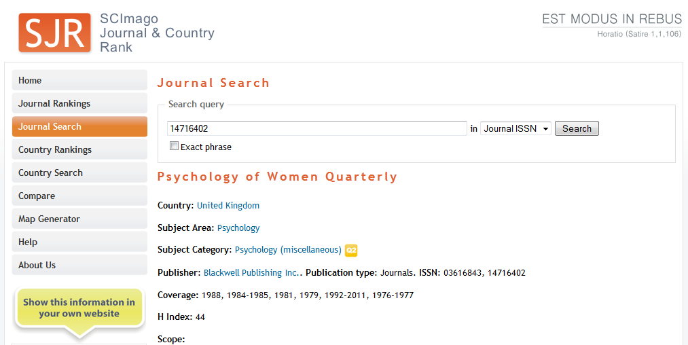
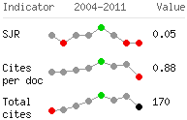
The SCImago Journal & Country Rank
Includes the journals and country scientific indicators developed from the information contained in the Scopus® database and based on the Google PageRank algorithm
http://www.scimagojr.com/journalsearch.php?

Slide 39

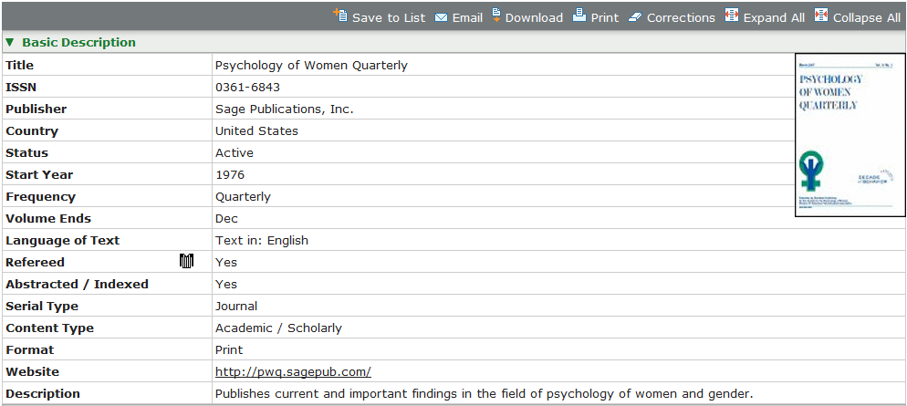
Ulrichsweb
Provides information about serials publications and their providers: price, online availability, abstract & indexing, Document Delivery Services, Reprint Services, etc.
http://ulrichsweb.serialssolutions.com/

Slide 41

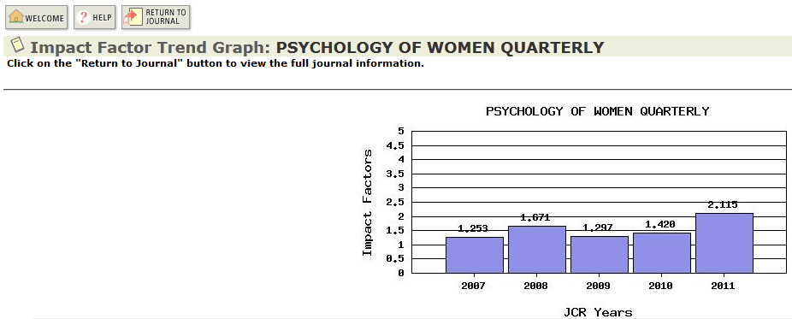
Journal Citation Reports
By compiling articles' cited references, helps to measure research influence and impact at the journal and category levels.
http://admin-apps.webofknowledge.com/JCR/JCR

Slide 42
Journals
EXERCISE 2:
  Using JCR, find the most important journal in your topic, (considering its impact factor)
  Using CUFTS, identify what databases offer the full text to that journal (including dates, etc.).

Slide 43
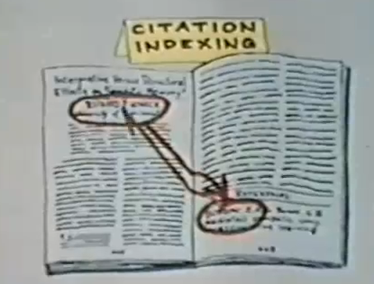
WEB OF SCIENCE
https://www.youtube.com/watch?v=YwPRI9ug6BY&index=7&list=PLED425A167A1AA7C2

Slide 44

Web of Science
As part of Web of Science platform, Web of Science Core Collection offers a true citation index, which is still the best tool for discovery and the only method of retrieving accurate citation counts.
Multidisciplinary content covers over 12,000 of the highest impact journals worldwide and over 160,000 conference proceedings.
http://wokinfo.com/products_tools/multidisciplinary/webofscience/

Slide 45
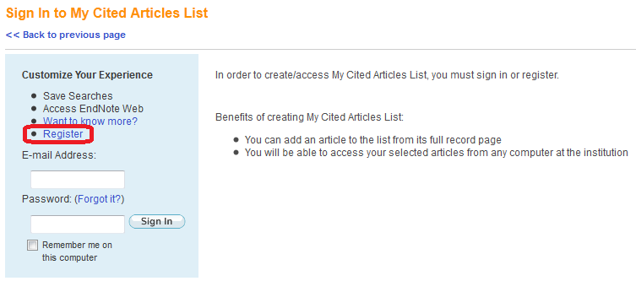
ISI Web of Knowledge
REGISTER
http://isiknowledge.com/

Slide 46
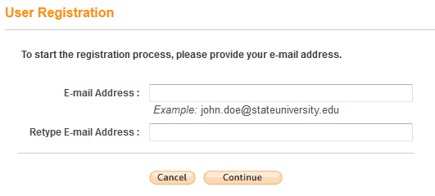
ISI Web of Knowledge
REGISTER
http://isiknowledge.com/

Slide 47
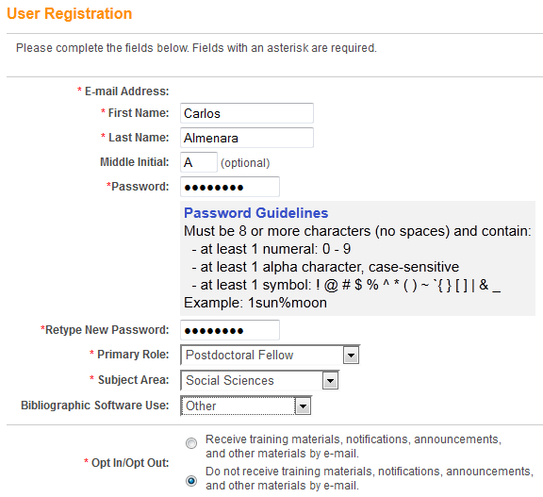
ISI Web of Knowledge
REGISTER
http://isiknowledge.com/

Slide 48
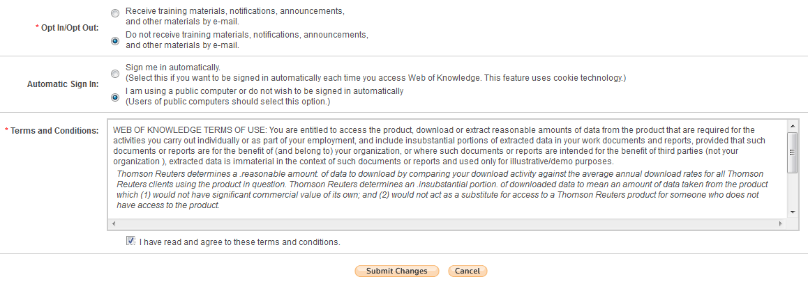
ISI Web of Knowledge
REGISTER
http://isiknowledge.com/

Slide 49
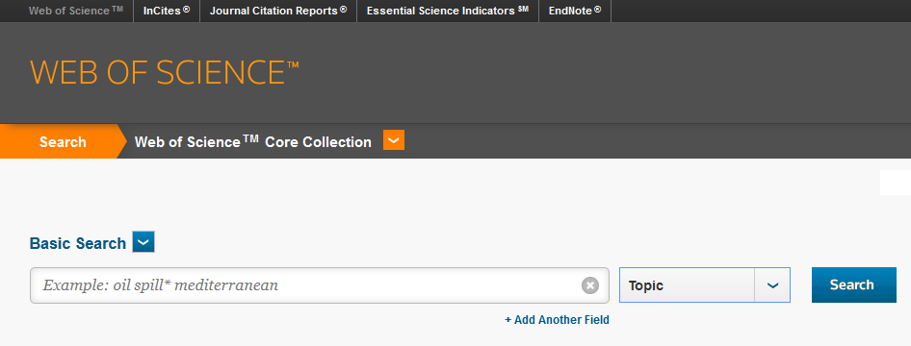
ISI Web of Knowledge
Search interface: Web of Science Core Collection
http://isiknowledge.com/

Slide 50
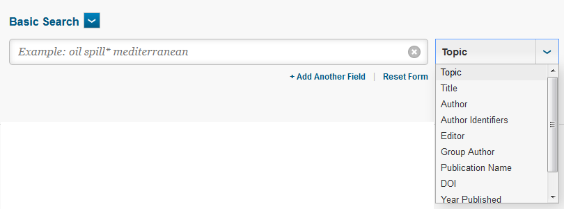
ISI Web of Knowledge
You have field codes for searching.
http://isiknowledge.com/

Slide 51
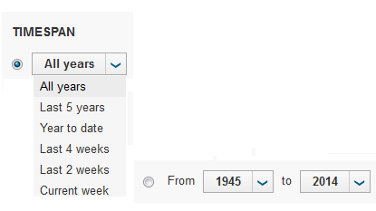
ISI Web of Knowledge
Time limits
http://isiknowledge.com/

Slide 52
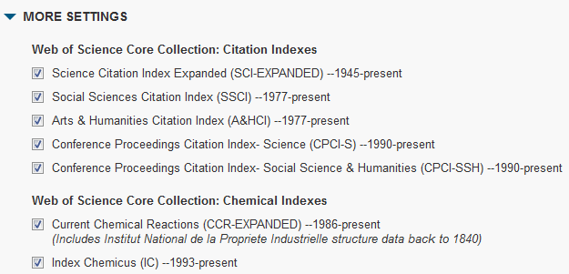
ISI Web of Knowledge
Citation Databases limits
http://isiknowledge.com/

Slide 53
BASIC SEARCH

Slide 54
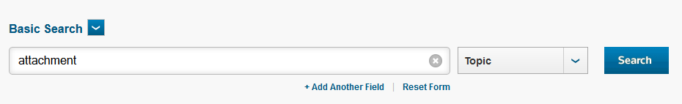
ISI Web of Knowledge
http://isiknowledge.com/

Slide 55
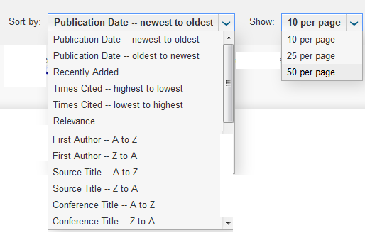
ISI Web of Knowledge
Sort the results as you wish.
You can display until 50 results per page.
http://isiknowledge.com/

Slide 56
AUTHOR SEARCH

Slide 57
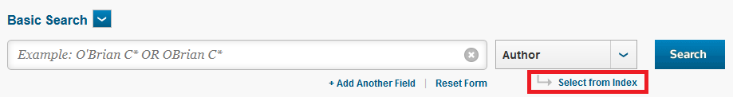
ISI Web of Knowledge
AUTHOR SEARCH.
http://isiknowledge.com/

Slide 58
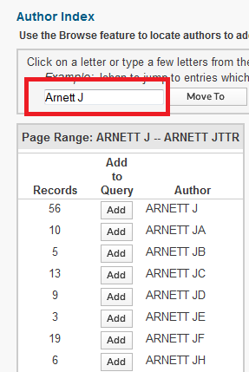
ISI Web of Knowledge
AUTHOR SEARCH.
  Click on Add
  Then on “OK” (below)
http://isiknowledge.com/

Slide 59
ADVANCED SEARCH

Slide 60
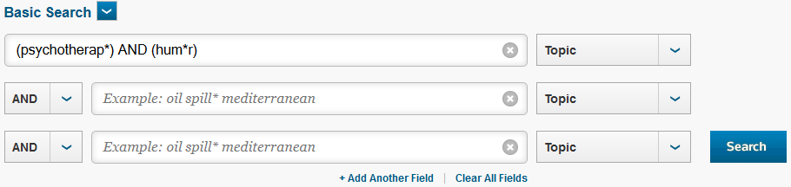
ISI Web of Knowledge
Basic search using Boolean operator (AND) and truncation (*)
http://isiknowledge.com/

Slide 61
REFINE RESULTS
(FILTERING)

Slide 62
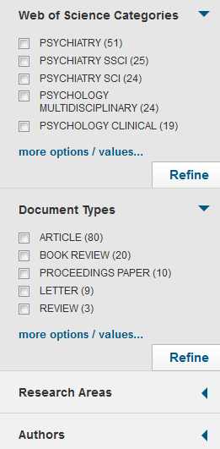
ISI Web of Knowledge
Refine your results filtering (including: limiting to; or excluding)
http://isiknowledge.com/

Slide 63
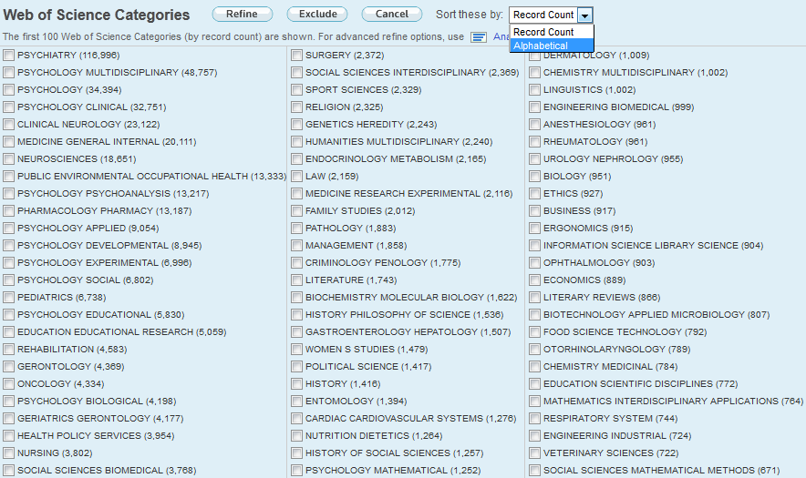
ISI Web of Knowledge
Refine your results: Up to 100 categories are displayed (alphabetically or by count).
http://isiknowledge.com/

Slide 64
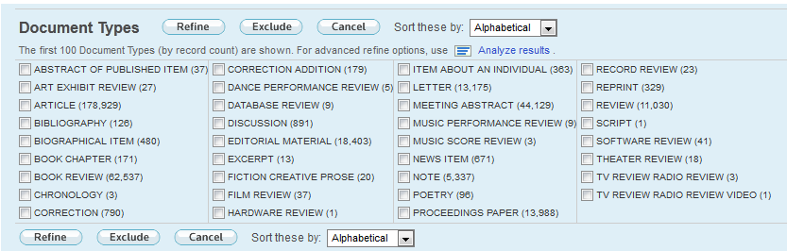
ISI Web of Knowledge
Refine your results: Document Types (are also displayed alphabetically or by count).
http://isiknowledge.com/

Slide 65
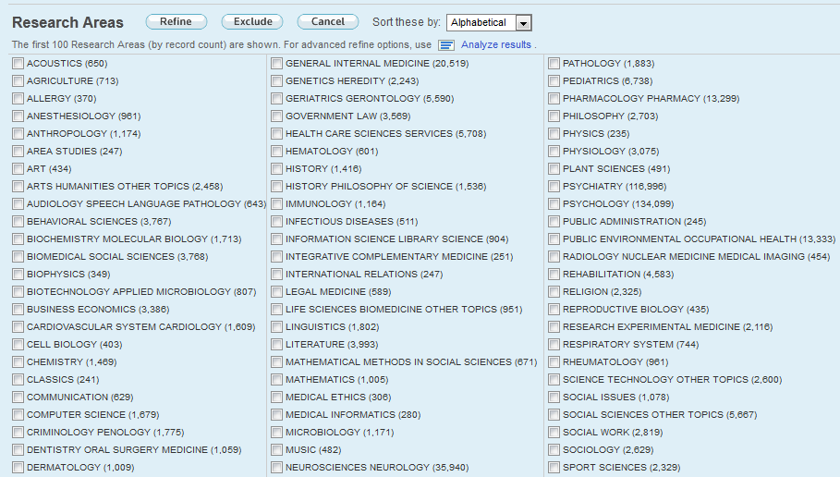
ISI Web of Knowledge
Refine your results: Choose Research Areas.
http://isiknowledge.com/

Slide 66
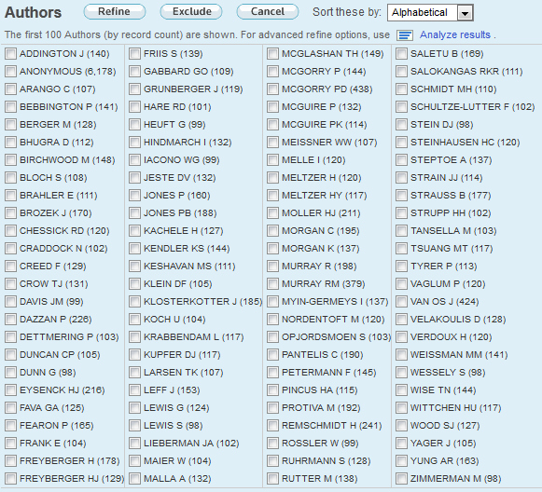
ISI Web of Knowledge
Refine your results: Limit to or exclude authors.
http://isiknowledge.com/

Slide 67
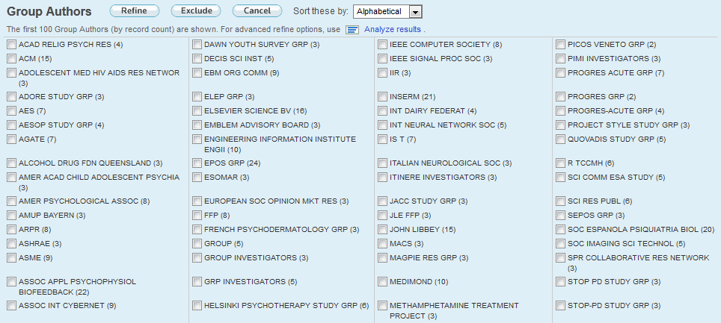
ISI Web of Knowledge
Refine your results: Limit to or exclude GROUP authors (Research groups, Societies, Institutions, etc.)
http://isiknowledge.com/

Slide 68
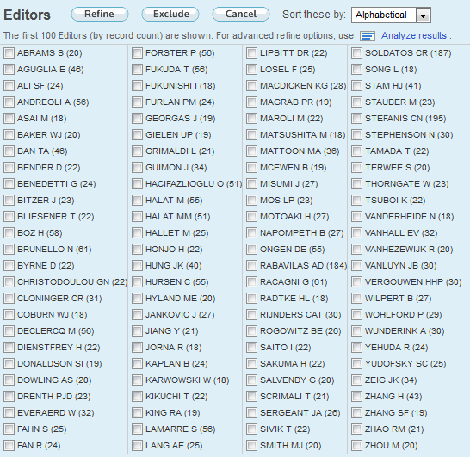
ISI Web of Knowledge
Refine your results: Limit to or exclude Editors.
http://isiknowledge.com/

Slide 69
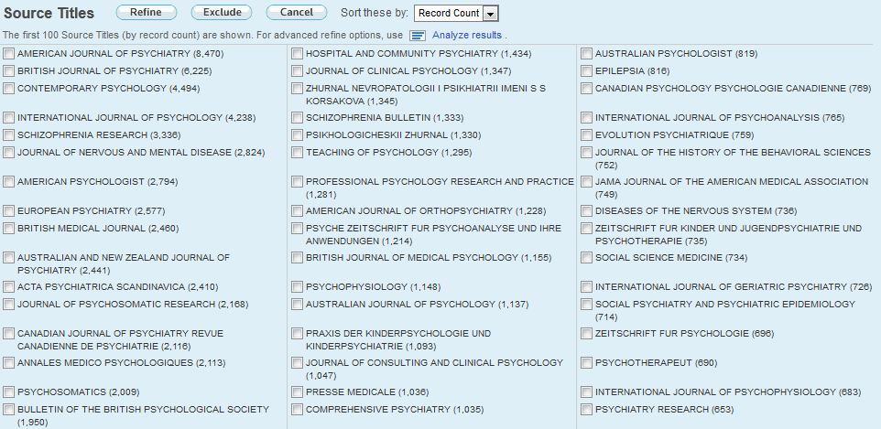
ISI Web of Knowledge
Refine your results: Limit to or exclude specific Sources.
http://isiknowledge.com/

Slide 70
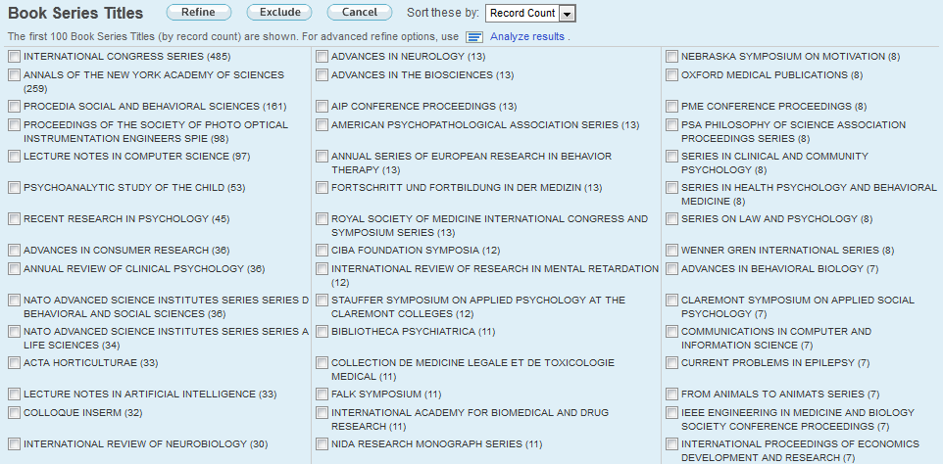
ISI Web of Knowledge
Refine your results: Limit to or exclude Book Series.
http://isiknowledge.com/

Slide 71
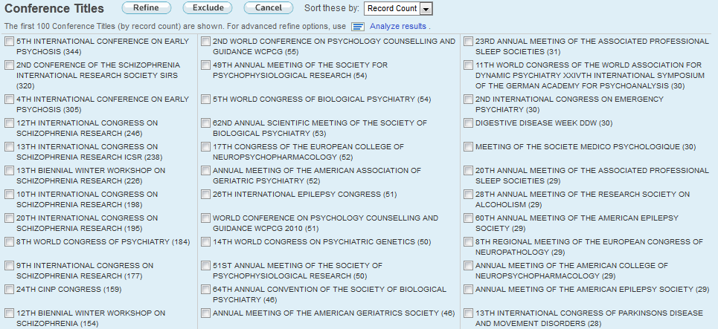
ISI Web of Knowledge
Refine your results: Limit to or exclude Conferences.
http://isiknowledge.com/

Slide 72
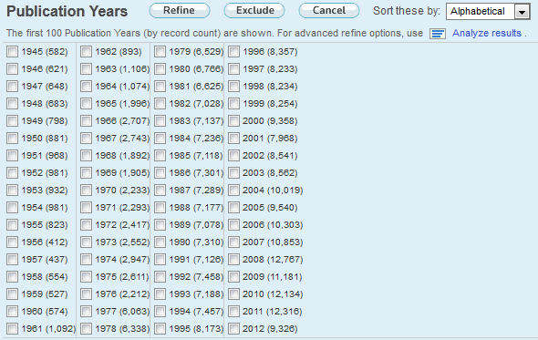
ISI Web of Knowledge
Refine your results: Limit to or exclude Dates.
http://isiknowledge.com/

Slide 73

ISI Web of Knowledge
Refine your results: Limit to or exclude Institutions.
http://isiknowledge.com/

Slide 74

ISI Web of Knowledge
Refine your results: Limit to or exclude Funding agencies.
http://isiknowledge.com/

Slide 75

ISI Web of Knowledge
Refine your results: Limit to or exclude Languages.
http://isiknowledge.com/

Slide 76

ISI Web of Knowledge
Refine your results: Limit to or exclude Countries.
http://isiknowledge.com/

Slide 77
ANALIZE RESULTS

Slide 78

ISI Web of Knowledge
http://isiknowledge.com/

Slide 79

ISI Web of Knowledge
http://isiknowledge.com/

Slide 80

ISI Web of Knowledge
Analyze the results
http://isiknowledge.com/

Slide 81

ISI Web of Knowledge
Analyze the results
http://isiknowledge.com/

Slide 82

ISI Web of Knowledge
Self-compassion research in Duke University.
http://isiknowledge.com/

Slide 83

ISI Web of Knowledge
Analyze the results
http://isiknowledge.com/

Slide 84

ISI Web of Knowledge
Sexual Identity research in Univ. California L.A.
http://isiknowledge.com/

Slide 85
ADVANCE SEARCH (USING FIELD CODES)

Slide 86

ISI Web of Knowledge
http://isiknowledge.com/

Slide 87

ISI Web of Knowledge
Advanced Search
http://isiknowledge.com/

Slide 88

ISI Web of Knowledge
Advanced Search: Field codes, operators (AND, OR, NOT, SAME*, NEAR)
* Only use SAME with the Address field. When SAME is used in other fields (such as Topic), it works exactly like AND.

Slide 89
ISI Web of Knowledge
Advanced Search: The most important Field codes:
  TS= Topic
  TI= Title
  AU= Author
  SO= Publication Name
  CU= Country
  IS= ISSN/ISBN
http://isiknowledge.com/

Slide 90
COMBINING SEARCHES

Slide 91

ISI Web of Knowledge
EXAMPLES
http://isiknowledge.com/

Slide 92

ISI Web of Knowledge
EXAMPLES
http://isiknowledge.com/

Slide 93

ISI Web of Knowledge
EXAMPLES
http://isiknowledge.com/

Slide 94

ISI Web of Knowledge
EXAMPLES: Combine previous searches
http://isiknowledge.com/

Slide 95

ISI Web of Knowledge
EXAMPLES
http://isiknowledge.com/

Slide 96
TIMES CITED

Slide 97

ISI Web of Knowledge
http://isiknowledge.com/

Slide 98

ISI Web of Knowledge
Citing Articles
http://isiknowledge.com/

Slide 99
CREATE CITATION ALERT

Slide 100

ISI Web of Knowledge
Select an article and click on “Create Citation Alert”
http://isiknowledge.com/

Slide 101

ISI Web of Knowledge
Select an article and click on “Create Citation Alert”
http://isiknowledge.com/

Slide 102
NEXT CLASS
READINGS:
  Hypothesis development [Part 2: How to conduct a literature review] (McBride, 2013)
  Systematic approaches (Booth, Papaioannou, & Sutton, 2012) (optional)

