Slide 1

Online and Offline Resources In
Psychological Assessment
PSY494P122 (2014-II)
April 8th, 2015

Slide 2
ProQuest Psychology Journals

Slide 3


ProQuest Psychology Journals
Provides abstracts and indexing for more than 1234 titles (1971 to present day), with over 818 titles available in full text.
Additionally, includes 4,000 full text dissertations spanning 2000 through 2006.
http://www.proquest.com/products-services/pq_psychology_journ.html

Slide 4
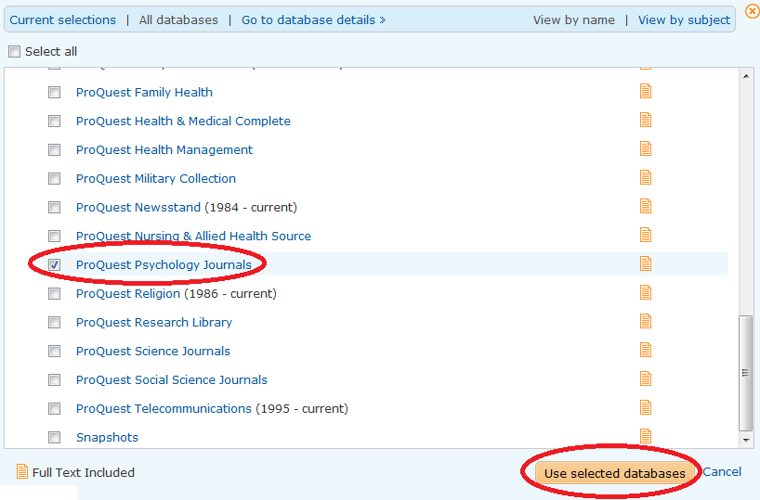
ProQuest Psychology Journals
Go to ProQuest, and select the database:
Direct access from On Campus computers: http://search.proquest.com/?username=IPAUTO&password=IPAUTO

Slide 5
JOURNALS

Slide 6
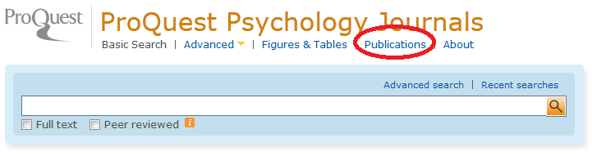
ProQuest Psychology Journals
Select Publications:
Direct access from On Campus computers: http://search.proquest.com/?username=IPAUTO&password=IPAUTO

Slide 7


ProQuest Psychology Journals
Annals of Dyslexia
  ISBN 0736-9387
  Full Text coverage: 1998-present (delayed 1 year)
Journal of Personality Assessment
  ISSN 0022-3891
  Full Text coverage: 2004-present
Direct access from On Campus computers: http://search.proquest.com/?username=IPAUTO&password=IPAUTO

Slide 8

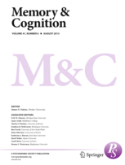
ProQuest Psychology Journals
Quality of Life Research
  ISBN 0962-9343‎
  Full Text coverage: 1997-present (delayed 1 year)
Memory & Cognition
  ISBN 0090-502X
  Full Text coverage: 1989-present
Direct access from On Campus computers: http://search.proquest.com/?username=IPAUTO&password=IPAUTO

Slide 9


ProQuest Psychology Journals
Behavioural and Cognitive Psychotherapy
  ISBN 1352-4658‎
  Full Text coverage: 2001-present (delayed 1 year)
Journal of Behavioral and Applied Management
  ISBN 1930-0158‎
  Full Text coverage: 2005-present
Direct access from On Campus computers: http://search.proquest.com/?username=IPAUTO&password=IPAUTO

Slide 10

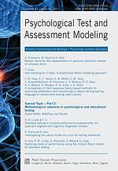
ProQuest Psychology Journals
Journal of Psychopathology and Behavioral Assessment
  ISBN 0882-2689
  Full Text coverage: 1997-present (delayed 1 year)
Psychological Test and Assessment Modeling
  ISBN 2190-0493
  Full Text coverage: 1999-2009
Direct access from On Campus computers: http://search.proquest.com/?username=IPAUTO&password=IPAUTO

Slide 11

ProQuest Psychology Journals
Journal of Psychopathology and Behavioral Assessment
  ISBN 0882-2689
  Full Text coverage: 1997-present (delayed 1 year)
Direct access from On Campus computers: http://search.proquest.com/?username=IPAUTO&password=IPAUTO

Slide 12
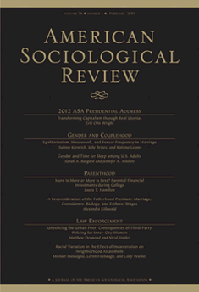
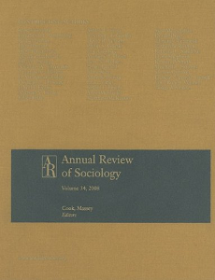
ProQuest Psychology Journals
American Sociological Review
  ISBN 0003-1224
  Full Text coverage: 1988-present (delayed 1 year)
Annual Review of Sociology
  ISSN 0360-0572
  Full Text coverage: 1995-2005
Direct access from On Campus computers: http://search.proquest.com/?username=IPAUTO&password=IPAUTO

Slide 13
MAGAZINES

Slide 14
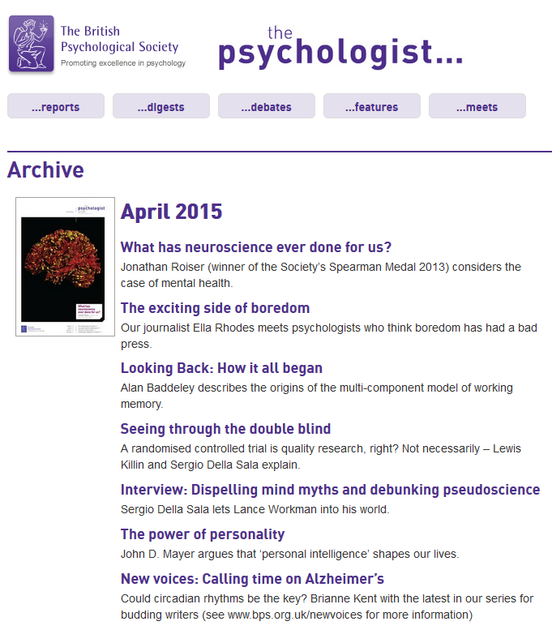
ProQuest Psychology Journals
MAGAZINES:
The Psychologist

Slide 15

ProQuest Psychology Journals
MAGAZINES:
Psychology Today

Slide 16
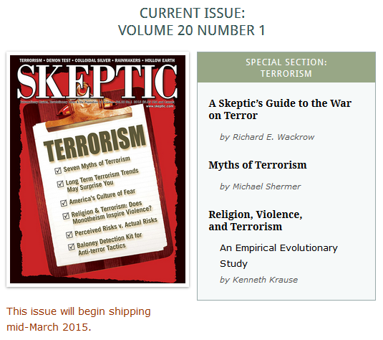
ProQuest Psychology Journals
MAGAZINES:
Skeptic

Slide 17
FIGURES
&
TABLES

Slide 18
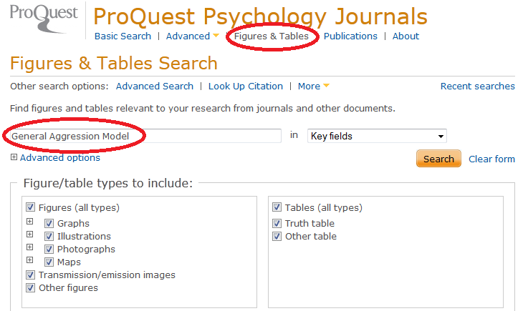
ProQuest Psychology Journals
Search Figures & Tables, useful to look up for theoretical models, prevalences, etc.
Direct access from On Campus computers: http://search.proquest.com/?username=IPAUTO&password=IPAUTO

Slide 19
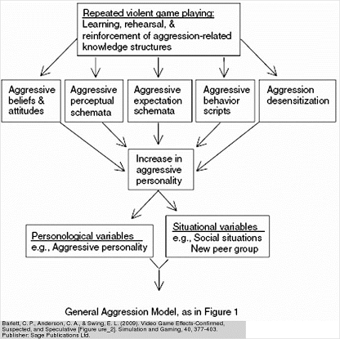
ProQuest Psychology Journals
A theoretical model of aggression
Direct access from On Campus computers: http://search.proquest.com/?username=IPAUTO&password=IPAUTO

Slide 20
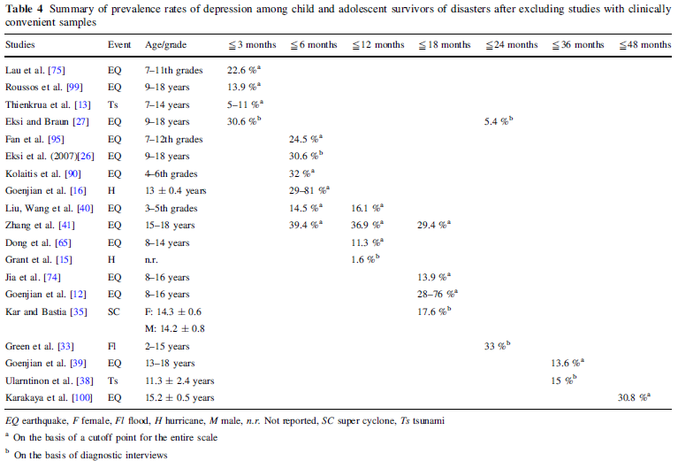
ProQuest Psychology Journals
Prevalence of depression among child survivors of disasters

Slide 21
ADVANCED
SEARCH

Slide 22
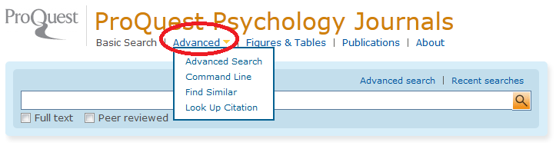
ProQuest Psychology Journals
Click on “Advanced”.
Direct access from On Campus computers: http://search.proquest.com/?username=IPAUTO&password=IPAUTO

Slide 23
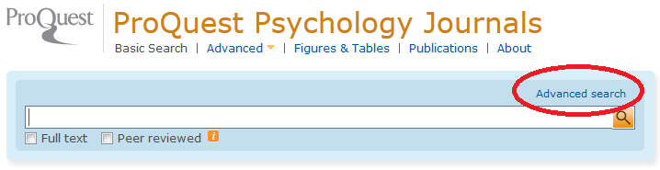
ProQuest Psychology Journals
Click on “Advanced Search”.
Direct access from On Campus computers: http://search.proquest.com/?username=IPAUTO&password=IPAUTO

Slide 24
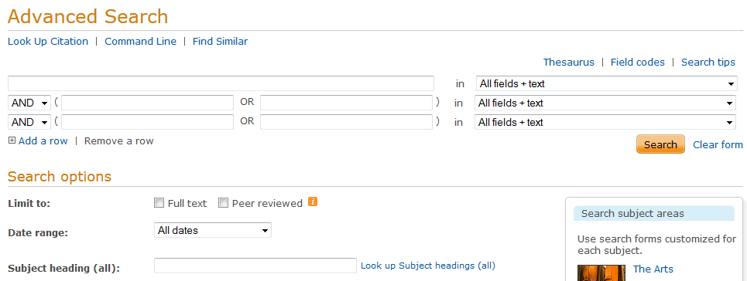
ProQuest Psychology Journals
Use field codes or limits.
Direct access from On Campus computers: http://search.proquest.com/?username=IPAUTO&password=IPAUTO

Slide 25
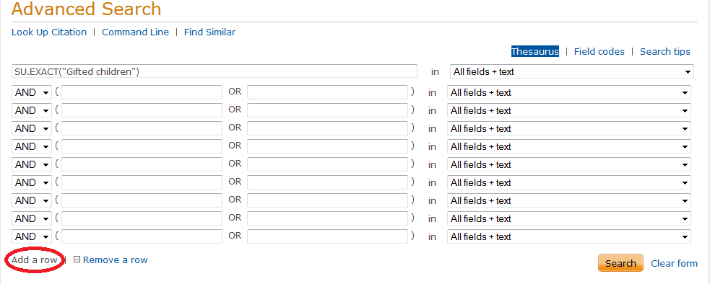
ProQuest Psychology Journals
Add up to 10 rows for your search.
Direct access from On Campus computers: http://search.proquest.com/?username=IPAUTO&password=IPAUTO

Slide 26
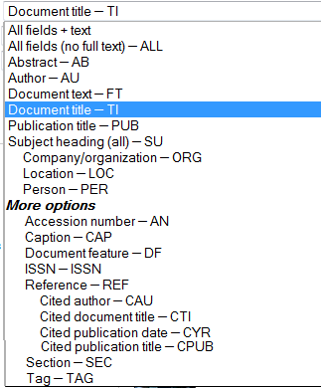
ProQuest Psychology Journals
Choose a field code
http://search.proquest.com/help/academic/webframe.html?View_Field_Codes.html

Slide 27
THESAURUS

Slide 28
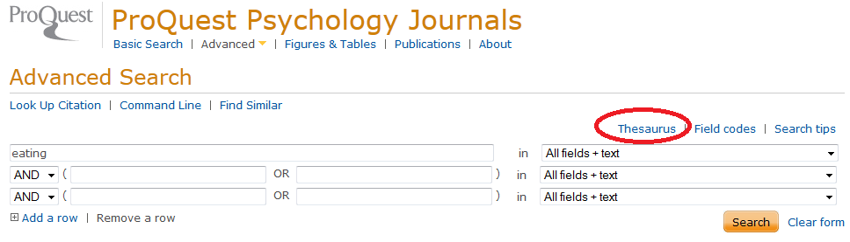
ProQuest Psychology Journals
You can also use the Thesaurus.
Direct access from On Campus computers: http://search.proquest.com/?username=IPAUTO&password=IPAUTO

Slide 29
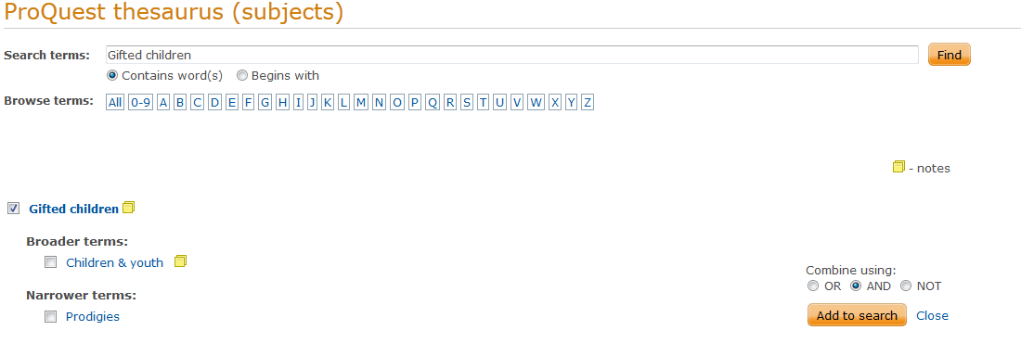
ProQuest Psychology Journals
The use of the ProQuest Thesaurus is like in PsycINFO, PubMed, ERIC, etc.
Direct access from On Campus computers: http://search.proquest.com/?username=IPAUTO&password=IPAUTO

Slide 30
SEARCH OPTIONS
(LIMITS)

Slide 31
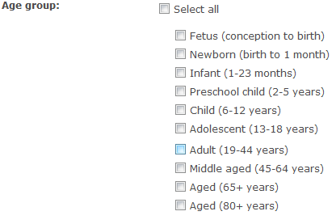
ProQuest Psychology Journals
10 age groups
Direct access from On Campus computers: http://search.proquest.com/?username=IPAUTO&password=IPAUTO

Slide 32
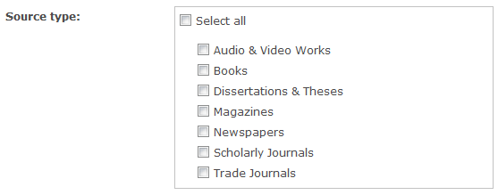
ProQuest Psychology Journals
Select any of the 7 source type.
Direct access from On Campus computers: http://search.proquest.com/?username=IPAUTO&password=IPAUTO

Slide 33
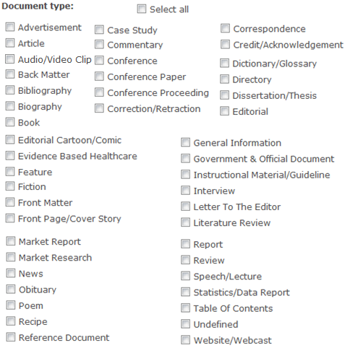
ProQuest Psychology Journals
Several types of documents
Direct access from On Campus computers: http://search.proquest.com/?username=IPAUTO&password=IPAUTO

Slide 34
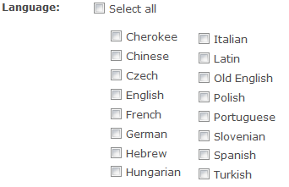
ProQuest Psychology Journals
Languages
Direct access from On Campus computers: http://search.proquest.com/?username=IPAUTO&password=IPAUTO

Slide 35
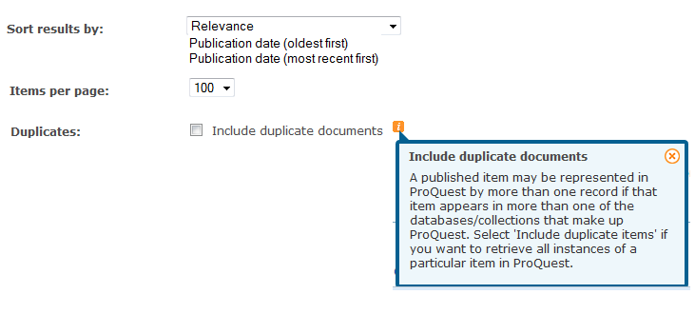
ProQuest Psychology Journals
Sort by relevance, publication date, display up to 100 results, include duplicates or not.
Direct access from On Campus computers: http://search.proquest.com/?username=IPAUTO&password=IPAUTO

Slide 36
FIND SIMILAR
(Advanced Search)

Slide 37
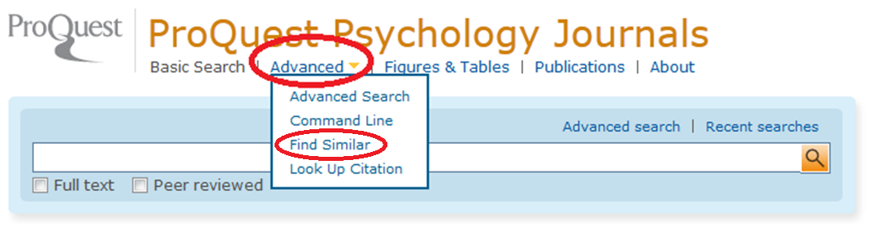
ProQuest Psychology Journals
Advanced Search -> Find Similar.
Direct access from On Campus computers: http://search.proquest.com/?username=IPAUTO&password=IPAUTO

Slide 38
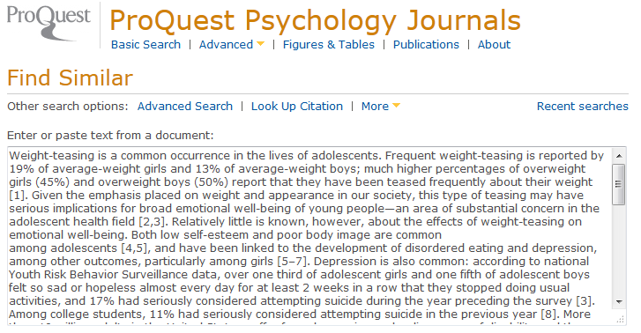
ProQuest Psychology Journals
Find Similar: e.g. copy and paste a text
Direct access from On Campus computers: http://search.proquest.com/?username=IPAUTO&password=IPAUTO

Slide 39
LOOKUP CITATION
(Advanced Search)

Slide 40
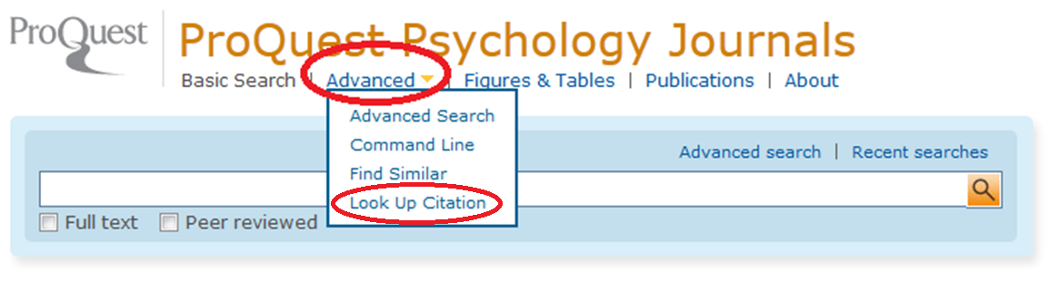
ProQuest Psychology Journals
Advanced Search -> Look Up Citation.
Direct access from On Campus computers: http://search.proquest.com/?username=IPAUTO&password=IPAUTO

Slide 41
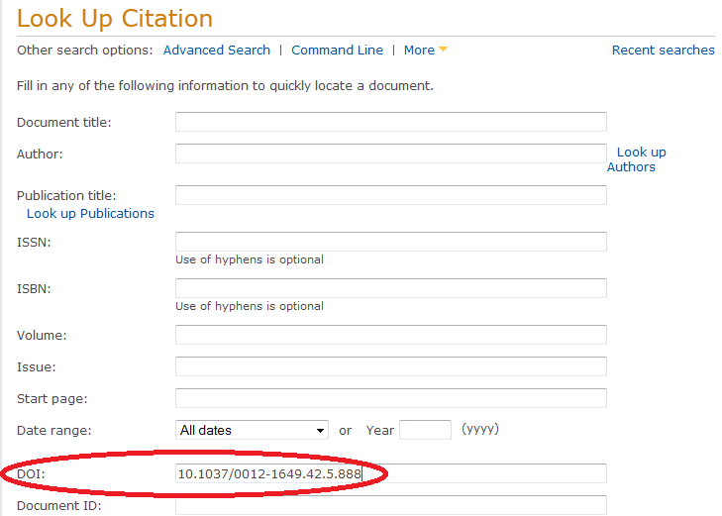
ProQuest Psychology Journals
Look Up Citation: Use it to find a specific article (e.g. using the DOI)
Direct access from On Campus computers: http://search.proquest.com/?username=IPAUTO&password=IPAUTO

Slide 42
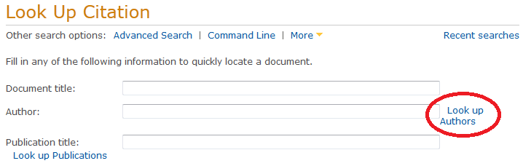
ProQuest Psychology Journals
Look Up Citation: Use it to find articles of a given author.
Direct access from On Campus computers: http://search.proquest.com/?username=IPAUTO&password=IPAUTO

Slide 43
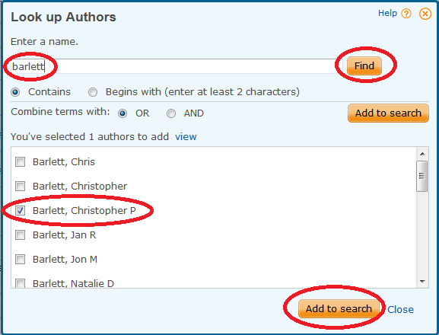
ProQuest Psychology Journals
Look Up Citation: Use it to find articles of a given author.
Direct access from On Campus computers: http://search.proquest.com/?username=IPAUTO&password=IPAUTO

Slide 44
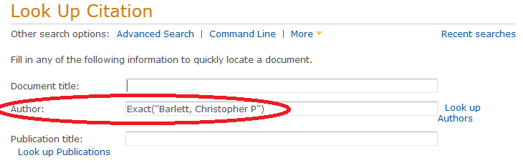
ProQuest Psychology Journals
Look Up Citation: Use it to find articles of a given author.
Direct access from On Campus computers: http://search.proquest.com/?username=IPAUTO&password=IPAUTO

Slide 45

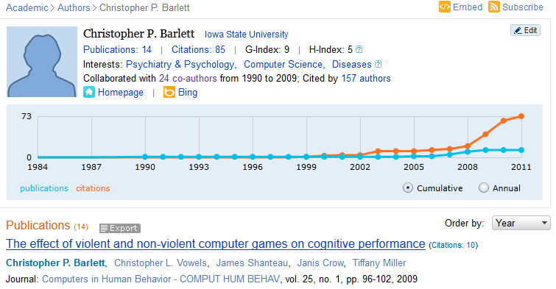
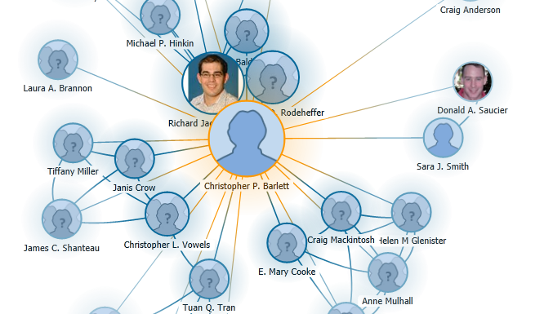
Microsoft Academic Search: Authors
You may use Microsoft Academics to look up for coauthors, etc.
http://academic.research.microsoft.com/

Slide 46
COMMAND LINE
(Advanced Search)

Slide 47
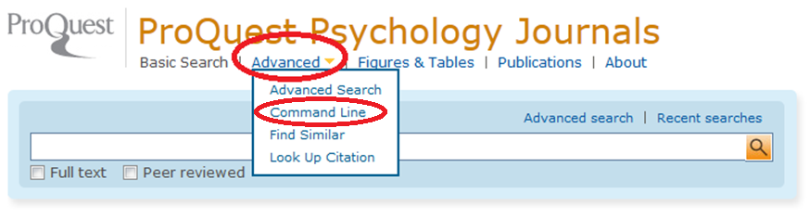
ProQuest Psychology Journals
Advanced Search -> Command Line.
Direct access from On Campus computers: http://search.proquest.com/?username=IPAUTO&password=IPAUTO

Slide 48
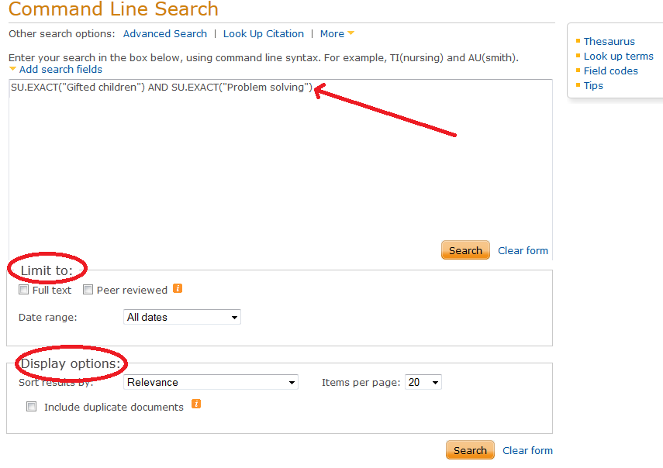
ProQuest Psychology Journals
In the Command Line you use the syntax
Direct access from On Campus computers: http://search.proquest.com/?username=IPAUTO&password=IPAUTO

Slide 49
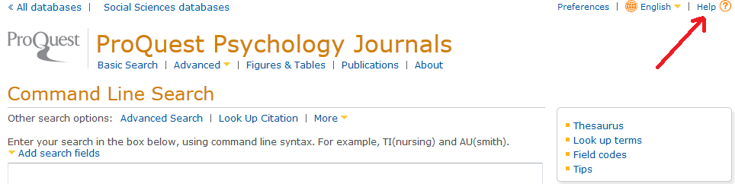
ProQuest Psychology Journals
Command Line Search: Click on Help to see the operators, field codes, etc. that you may use.
Direct access from On Campus computers: http://search.proquest.com/?username=IPAUTO&password=IPAUTO

Slide 50
ProQuest Psychology Journals
OPERATORS: The most common are:
  Boolean: AND / OR / NOT
  Proximity: NEAR/# or N/#
    aggress* N3 videogam* → ANY ORDER
  Proximity: PRE/# or P/#
    aggress * P3 videogam* → RESPECT THE ORDER
Direct access from On Campus computers: http://search.proquest.com/?username=IPAUTO&password=IPAUTO

Slide 51
ProQuest Psychology Journals
OPERATORS: The most common are:
  Exact Search: EXACT or X
    SU.X(“gifted children”) → Exact search in subject
    SU.EXACT(“gifted children”) → Exact search in subject
  Linking a search term: LNK
    MESH("anorexia nervosa" LNK prevention)
    ("anorexia nervosa" LNK prevention)
Direct access from On Campus computers: http://search.proquest.com/?username=IPAUTO&password=IPAUTO

Slide 52
ProQuest Psychology Journals
SPECIAL CHARACTERS:
  Wildcard: ?
    nurse? = nurses, nursed
    sm?th = smith and smyth
    ad??? = added, adult, adopt
Direct access from On Campus computers: http://search.proquest.com/?username=IPAUTO&password=IPAUTO

Slide 53
ProQuest Psychology Journals
SPECIAL CHARACTERS:
  Truncation: *
    nurse* = nurse, nurses, nursed
    behavio*r = behavior, behaviour
    *old = told, household, bold
    [*5]beat = upbeat, downbeat, offbeat, heartbeat
    nutr$5 or nutr[*5] = nutrition, nutrient, nutrients
Direct access from On Campus computers: http://search.proquest.com/?username=IPAUTO&password=IPAUTO

Slide 54
EXERCISES

Slide 55
ProQuest Psychology Journals
EXERCISE:
  Use the Thesaurus and select at least two terms related to your topic
Direct access from On Campus computers: http://search.proquest.com/?username=IPAUTO&password=IPAUTO

Slide 56
ProQuest Psychology Journals
EXERCISE:
  Use the Command Search Line:
    Use the Boolean operator AND
    Use the Field codes for title and/or keywords
    HOW MANY RESULTS DID YOU GET?
Direct access from On Campus computers: http://search.proquest.com/?username=IPAUTO&password=IPAUTO

Slide 57
ProQuest Psychology Journals
EXERCISE:
  Use the Command Search Line:
    Use the Boolean operator OR
    Use the Wildcard and Truncation
    Once you get the results, try to limit them within Czech Republic or Europe
    HOW MANY RESULTS DID YOU GET?
Direct access from On Campus computers: http://search.proquest.com/?username=IPAUTO&password=IPAUTO

Slide 58
ProQuest Psychology Journals
EXERCISE:
  Use the Advanced Search
    Try using the Field Code SU
    Limit your results by Age
    Search within the results for longitudinal/prospective studies
    HOW MANY RESULTS DID YOU GET?
Direct access from On Campus computers: http://search.proquest.com/?username=IPAUTO&password=IPAUTO

Slide 59
ProQuest Psychology Journals
EXERCISE:
  Use the Advanced Search
    Try using the Field Code SU
    Search within the results for REVIEW or Meta Analytic studies
Direct access from On Campus computers: http://search.proquest.com/?username=IPAUTO&password=IPAUTO

Slide 60
ProQuest Psychology Journals
EXERCISE:
  Use the Advanced Search
    Try using the Field Code SU
    Limit the results to CASE STUDY or INTERVIEW studies
Direct access from On Campus computers: http://search.proquest.com/?username=IPAUTO&password=IPAUTO

Slide 61
ProQuest Psychology Journals
EXERCISE:
  Use the Advanced Search
    Try using the Field Code SU
    Limit the results to Dissertations & Theses studies
Direct access from On Campus computers: http://search.proquest.com/?username=IPAUTO&password=IPAUTO

Slide 62
NEXT CLASS
  APA Tutorials
  http://www.apa.org/pubs/databases/training/tutorials.aspx

