Slide 1
02 Measuring Energy
Václav Šebek

Slide 2
Measuring Energy
Literature:
Bhattacharyya, S.C., 2011. Energy Economics: Concepts, Issues, Markets and Governance. Springer London, London.
Chapters 2 and 13

Slide 3
From data to information
Measuring energy

Slide 4
What is energy? recap
A property of objects meaning capability of doing work or being transferred elsewhere
Most common heat, electricity, motive
Units:
Energy: 1 [Watt hour] = 3.600 [Joule]
Power: 1 [Watt] = 1 [Joule per second]
Power gives you what are you able to do
Energy says what you have done already

Slide 5
What is energy? recap
Footnote
Ton of Oil Equivalent [toe] ≈ 42 GJ
Ton of Coal Equivalent [tce] ≈ 29 GJ
Czech lignite at 10 to 20 [GJ.t⁻¹]
British Thermal Unit [BTU] ≈ 1.05 kJ
Quad ≈ 1,055 PJ
US Dep. of Energy meaning quadrillion of BTU
Czech republic TPES 2014 ≈ 1.7 PJ ≈ 1.6 Quads

Slide 6
What is energy? recap
Heat, light, motive force, chemical transformation etc.
2 thermodynamic laws
Mass and energy cannot vanish but transform
No 100% conversion – losses inevitable
Primary x Secondary energy
Primary – directly from nature (oil, coal, wind, sun, nuclear…)
Secondary – derived from Primaries (electricity, gasoline…)

Slide 7
What is energy? recap
Other divisions (boundaries change)
Renewable x Non-Renewable
Commercial x Non-Commercial
Modern x Traditional
Conventional x Non-Conventional

Slide 8
Energy System
Supply – Conversion – Consumption
Extraction → PES → Transport → Final Energy → End use app → Useful energy
Losses
Energy corporations all through the system → wide variety of companies

Slide 10
Energy Information
Broadly required data:
Energy use by various economic activities
E production, transformation and delivery to various users
„Field“ technical and operating statistics
Financial and cost information
Macro-economic, social, political information

Slide 11
Energy Information
Transform into information about energy…
Pricing
Investment
Research & Development
System Management
Contingency Plan
Long-term Planning

Slide 12
Energy Accounting Framework
Comprehensive account of energy flows including losses and any consumption
See table
Production – transformation – consumption
Accounting units
Commodity (physical, tones, barrels…)
Overall Energy Balance (common unit, eg BTU, GJ, TOE…) – easier comparison

Slide 13
Energy Accounting Framework
Supply-side
Production (+)
Trade (import/export) (+/-)
Bunkers (transport costs, e.g. Tankers) (-)
Stock change (+/-)
Primary energy requirement (PER)
Conversion
Statistical difference (+/-)
Transformation input (-)
Energy sectors‘ own use (-)
Transmission and Distribution losses (-)
Net supply available
Net domestic consumption
Final energy consumption
Agriculture
Industry
Transport
Residential
Commercial
Non-energy uses
Total energy needed to satisfy country’s demand and transformation requirements
Primary need (shown in TPES)
Efficiency indicator
Sectorial situation may be analyzed

Slide 14
Energy Accounting Units - Example
Tab – A lignite surface mine yearly consumption decomposition
Consumer | TJ | kt | GJ/t | Share
 |  |  |  | TJ | kt | ktce | ktoe
PP Chvaletice | 16 631 | 978 | 17,00 | 32% | 33% | 567 | 397
Refinery Litvínov | 7 072 | 530 | 13,35 | 14% | 18% | 241 | 169
HP Otrokovice | 4 523 | 274 | 16,51 | 9% | 9% | 154 | 108
Paperworks Mondi Štětí | 4 358 | 180 | 16,70 | 8% | 6% | 149 | 104
HP Strakonice, a.s. | 1 754 | 112 | 15,66 | 3% | 4% | 60 | 42
HP Třinec | 1 698 | 106 | 16,00 | 3% | 4% | 58 | 41
HP Poříčí | 789 | 47 | 16,79 | 2% | 2% | 27 | 19
PP Hodonín | 446 | 27 | 16,63 | 1% | 1% | 15 | 11
Export | 6 640 | 332 | 20,00 | 13% | 11% | 227 | 159
Retail | 8 360 | 418 | 20,00 | 16% | 14% | 285 | 200
Total/mean | 52 271 | 3 004 | 17,40 | 100% | 100% | 1 784 | 1 248
All units above are scientific – commercial units (eg TCE) might be not

Slide 15
Lignite Surface Mine

Slide 16
Useful Ratios
Energy supply mix
Share of various sources on primary supply
Self-reliance
What portion of energy is of domestic origin
Share of renewables
Power generation mix
Efficiency
Electricity production
Refining
Overall
Per capita consumption (primary and final)
Energy intensity

Slide 17
Some energy data issues
Availability
lags, various sources, imprecision, confidentiality
Quality
Different standards and methodologies, deliberate changes, trade and balance discrepancies
Cross border comparison
Traditional fuels, terminologies, sectors definition, accounting
Common measurment
Conversion factors

Slide 18
At what price?
Measuring energy

Slide 19
Price - recap
Price x value
Price
Objective measurable figure
Result of supply/demand
Denotes relative scarcity of a good
Value
Subjective, individual, not measurable
Depends on time, place and people
Value of price is priceless

Slide 20
Energy Pricing
Self-sufficient country
Price set domestically between export and import parity price
Importing country
Import (world) price
P
P
S
p^{m}
S
p* = p^{m}
p*
D
p^{x}
D
Realized consumption
q*
Q
q’
q*
Q
Max domestic production below world price
+
Import
= domestic consumption

Slide 21
Energy Pricing
Net exporter
Domestic demand satisfied below world price
Equilibrium price should be that of world price
In reality domestic prices of oil exporters significantly lower due subsidies
P
S
D
p* = p^{x}
Q
Max domestic consumption
+
Export
= Total domestic production

Slide 22
Peak and Off-Peak Pricing
[MW]
Daytime

Slide 23
Peak and Off-Peak Pricing
[MW]
Daytime
Nuclear (yellow) – Renewables (green) – Coal (brown) – Peak gas (blue)

Slide 24
Peak and Off-Peak Pricing
[Kč/KWh]
D
Price

Slide 25
Renewables and Electricity Pricing
[Kč/KWh]
Demand
Price

Slide 26
Renewables and Electricity Pricing
[Kč/KWh]
Demand
Price

Slide 27
Renewables and Electricity Pricing
[Kč/KWh]
Demand
Price

Slide 28
Daily electricity price at European Power Exchange Leipzig
170 € daily mean, 250 € daily max 10.2.2012
€/MWh
100
50
0
Zdroj: https://www.epexspot.com/
0 € daily mean, -450 € daily min 25.12.2012
10/2010
10/2011
10/2012
10/2013
10/2014

Slide 29
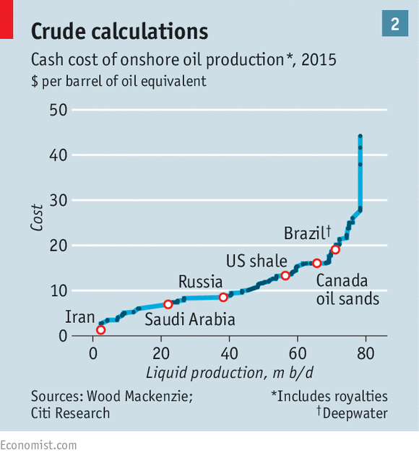
Merit order application - Oil
See: http://www.economist.com/blogs/graphicdetail/2016/01/daily-chart-6

Slide 30
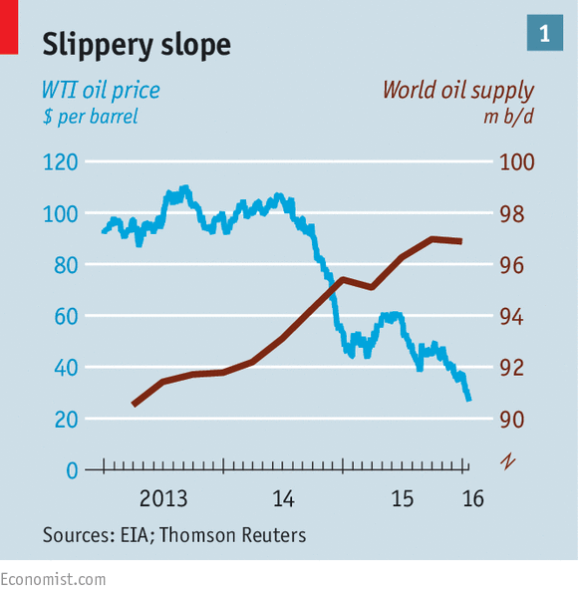
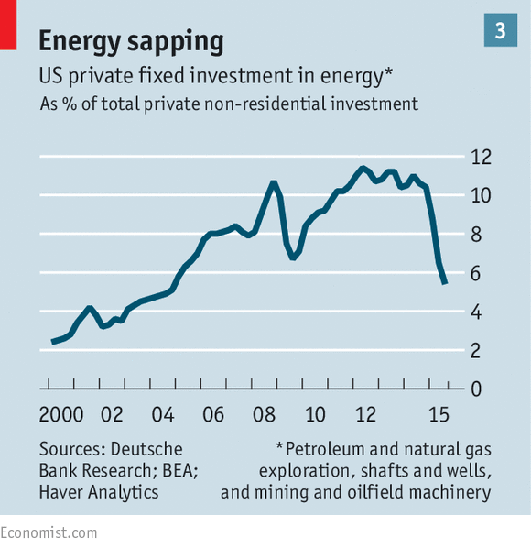
Price is vital piece of information

Slide 31
How to regulate?
Measuring energy

Slide 32
Allowances v Taxes
Government aims to decrease CO2 emissions
Two ways of achieving that:
Tax – payment for each ton of CO2 emitted
Tradable allowances – permission to emit particular volume of CO2
Different parameters
Tax – maximum price for decarbonisation is set
Allowances – maximum volume is set

Slide 33
Example 1
Two types of PP in a Country – A and B
Both emit 40t CO2 per year = total 80t/y
Different emission reduction costs per 10t
A = $2,000; B = $4,000
Government’ objective is 60t CO2 per year
Regulation
Tax
Allowances

Slide 34
Example 1
Regulation
Each PP must decrease emissions by 10t/y
Costs = 2,000 + 4,000 = $6,000
Allowances
60t allowances issued, both A and B get 30t
B buys 10t allowances from A and emits 40t
A emit 20t … total emissions 60t
Costs = 2 * 2,000 = $4,000
Price of allowance between $2k and $4k
Taxation
T < $2k … no emission reduction & C+T = $0 + $0…16k
$2k < T < $4k … 40t of A reduced & C+T = $8k + $8k…16k
$4k < T … all emissions reduced & C+T = $16k + $0

Slide 35
Example 2
Company | Emissions [t] | Costs reducing 1 t
A | 70 | 20
B | 80 | 25
C | 50 | 10
Total | 200
Government objective: 120 t
Method: Allowances
Who will sell at what price?
What will be final cost of reducing emissions?

Slide 36
Example 2
Company | Emissions [t] | Costs reducing 1 t
A | 70 | $20
B | 80 | $25
C | 50 | $10
Total | 200 (120 allowances issued)
C sells 40t allowances to B at price of $20
Total costs = $1,100
A reduces 30t at $20
B doesn’t reduce
C reduces 50 at $10
Costs w/o trade
$1,700
S
D

