Slide 1
Europe – strengths and weaknesses, competitiveness
Europe in International Economy
2016

Slide 2
2014 | Bill. USD (PPP) | Percent of GDP (PPP) | Spending per capita (PPP)
South Korea | 91.6 | 4.292% | 1,518.47
Israel | 11.2 | 4.109% | 1,361.56
Japan | 170.8 | 3.583% | 1,344.31
Finland | 7.0 | 3.174% | 1,290.58
Sweden | 14.2 | 3.161% | 1,460.98
Denmark | 7.6 | 3.051% | 1,361.51
Taiwan | 32.4 | 3.006% | 1,383.84
Austria | 10.9 | 3% | 1,416.14
Switzerland | 13.1 | 2.967% | 1,647.90
Germany | 106.5 | 2.842% | 1,313.46
United States | 473.4 | 2.742% | 1,442.51
Belgium | 11.9 | 2.465% | 1,063.38
Slovenia | 1.5 | 2.386% | 712.63
France | 58.4 | 2.256% | 914.54
Australia | 23.3 | 2.12% | 986.86
China | 344.7 | 2.046% | 270.56
Singapore | 8.7 | 2% | 1,608.86
Czech Republic | 6.3 | 1.997% | 600.04
Netherlands | 16 | 1.973% | 946.25
European Union | 334.3 | 1.94% | 657.48
Iceland | 0.27 | 1.891% | 832.59
Norway | 5.9 | 1.705% | 1,145.18
United Kingdom | 43.7 | 1.701% | 677.44
Canada | 25.7 | 1.612% | 724.87
Ireland | 3.6 | 1.519% | 779
Estonia | 0.53 | 1.432% | 399.24
Hungary | 3.4 | 1.371% | 343.01
Italy | 27.4 | 1.287% | 452.14
Portugal | 3.6 | 1.285% | 347.84
Luxembourg | 0.67 | 1.256% | 1,226.35
Spain | 19.2 | 1.222% | 413.46
Russia | 42.6 | 1.187% | 290.21
Research and development spending

Slide 3
Weaknesses of Europe (Eichengreen)
R&D spending + limited cooperation between industry and academia;
Small, new firms (tend to pioneer new niches, e.g. IT) – greater difficulties to cope with the complexity of European regulation;
Europe: immigration-unfriendly policies (less attractive for H-T specialist form Asia);
Lower hiring and firing costs make it easier for US entrepreneurs to experiment with unproven technologies (…of great promise but uncertain commercial potential);
European financial system – well suited to mobilizing saving and deploying it for investment by incumbent firms - does not go to the start-ups and small firms (engines of output and productivity growth);
IT producing sector is where US excels – but only 6% GDP – cannot explain differences in productivity trends:
  US productivity advantage since 1990s centered in retail trade, wholesale trade, financial services – ICT using activities;
Europe has faster productivity growth in telecommunications (privatization and uniform product standards);
Higher cost etc. computer hardware in Europe (localizing costs) – itself a barrier;

Slide 4
Employment (%)
 | 1970 | 1980 | 1990 | 2003 | 2014
EU 15 (2014: EU28)
Overall employment | 59 | 60 | 62 | 64 | 65
Employment male | 80 | 78 | 74 | 73 | 70
Employment female | 39 | 43 | 49 | 56 | 60
Employment 15–24 | 51 | 45 | 45 | 40 | 33
Employment 25–54 | 65 | 70 | 73 | 77 | 76
Employment 55–64 | 47 | 44 | 39 | 42 | 52
US
Overall employment | 64 | 67 | 72 | 71 | 67
Employment male | 83 | 80 | 81 | 77 | 78
Employment female | 46 | 55 | 64 | 66 | 62
Employment 15–24 | 53 | 59 | 60 | 54 | 48
Employment 25–54 | 70 | 74 | 80 | 79 | 84
Employment 55–64 | 60 | 54 | 54 | 60 | 61
EU: SWE 75% (AUT, UK, DEN, NETH, GER) vs. GRE 49% (SPA, ITA, CRO)

Slide 5
Strengths of Europe
Europeans have grater amounts of leisure time (Vs. US);
Higher level of earnings equality - more people with health insurance, infant mortality rates are lower, poverty rates are lower, rates of violent crime are lower;
  Number of prisoners is only 128/100k vs. 716 in US (2013, 22% of world total); homicide (per 100k) 2,7 vs. 5,9;
Rigidities have not stood in the way of rapid export growth;
  European exporters dominate in quality HVA, H-T; premium goods; precision manufactures;
Moving into H-T and premium goods is potential source of insulation from high competition of EM:
Europe has not been subject to the kind of great financial scandals;

Slide 6
Worked hours per head
(hours/year)
 | 1950 | 1973 | 1998
UK | 871 | 753 | 682
France | 905 | 728 | 580
Germany | 974 | 811 | 670
Italy | 800 | 669 | 637
US | 756 | 704 | 791
 | 2003 | 2014
UK | 1674 | 1677
France | 1484 | 1473
Germany | 1425 | 1371
Italy | 1816 | 1734
US | 1800 | 1789
Greece | 2091 | 2042
Japan | 1799 | 1729

Slide 7
Output per head and hour of work (%)
 | 1913 | 1929 | 1938 | 1950 | 1973 | 2003 | 2014
Product per WORKER as a % of US level
France | 66 | 68 | 73 | 55 | 79 | 73 | -
Germany | 69 | 59 | 82 | 41 | 72 | 64 | -
Italy | 48 | 45 | 54 | 37 | 64 | 66 | -
UK | 93 | 80 | 102 | 73 | 72 | 72 | -
EU15 (aver.) | 57 | 55 | 66 | 47 | 65 | 72 | -
Product per HOUR as a % of US level
France | 56 | - | - | 46 | 74 | 102 | 96
Germany | 59 | - | - | 32 | 79 | 98 | 94
Italy | 42 | - | - | 35 | 78 | 85 | 75
UK | 84 | - | - | 63 | 60 | 81 | 76
EU15 (aver.) | 61 | - | - | 44 | 71 | - | -
Japan | - | - | - | - | - | 65 | 63

Slide 8
Critique of competitiveness concept
Clinton (Tyson, Thurow 1992) – states as big corporations competing on world market (US vs. JAP);
Krugman 1994 (De Grauwe 2010):
  Corporations (almost) completely competing - selling vs. states produce (80%) for own citizens;
  Rival corporations are consuming only fraction of their respective production vs. States are important consumers (of each others products);
  States: much important source of improvement in standard of living is productivity growth (not larger sales at someone‘s expense); they are mutual consumers (trade) and employers (FDIs);

Slide 9
Lisbon Agenda
Lisbon European Council 2000: new strategic goal till 2010 – to become the most competitive and dynamic knowledge-based economy in the world capable of sustainable economic growth with more and better jobs and greater social cohesion;
Strategy aimed to:
  transition to a knowledge-based economy by better policies for the information society and R&D;
  structural reform for competitiveness and innovation and by completing the internal market;
  modernize the European social model, investing in people and combating social exclusion;
All-embracing - result of bargaining process + disagreement how economic performance should be improved;
Open method of coordination:
  Council agreeing guidelines that contain targets and recommendations which are adopted at the discretion of member states (intergovernmental process);
  policy operates via reports – containing the policy, objectives and progress;
  „enforcement“ is by recommendation, peer pressure and benchmarking;
  no penalties – government implement policies in line with their own priorities;

Slide 10
EU is continuing to lag behind – also in amount of inputs used: slower population growth and rigid labor markets (late from school, less hours, early retirement + higher benefits and less part-time jobs);
Lisbon is about everything and thus nothing (Kok’s Report 2004);
  commitments are rhetorical (agreed at the height of the Dotcom boom);
  states are committed only to parts of agenda;
Mid-term review (2005): Barroso’s Commission’s plans – three priorities for the policy concentrating on growth and jobs (Revised Lisbon Agenda) :
  more attractive place to invest and work – completing the Single Market and business-friendly regulation;
  knowledge and innovation for growth: raising expenditure on R&D to 3% of GDP;
  creating more and better jobs – increase employment by making the labor force more adaptable through raising the level of education and skills;
Concerns that slimmer agenda downgraded the environmental and social aspects of agenda;

Slide 11
Strategy Europe 2020
  Global crisis destroyed progress reached in last years (20 years of attempts for fiscal consolidation – in 2009 average fiscal deficit 7% and public debt 70%) + there have to be careful management of exit fiscal stimulus's;
  Goals:
    intelligent growth –> economy based on knowledge and innovations;
    sustainable growth –> support for more competitive and ecological economy less energy intensive;
    growth supporting social inclusion;
  Targets - 2020:
    Higher employment for 20-64 year old (from 69% to 75%);
    Increase investment into RD up to 3% GDP EU (US 2,9% vs. EU 1,7%);
    In energetic policy reach the goal 20-20-20 (less greenhouse gases, more renewable, more energy efficiency);
    Share of tertiary educated from 31% to 40%;
    25% less people living in poverty (from 20 mil.);

Slide 12
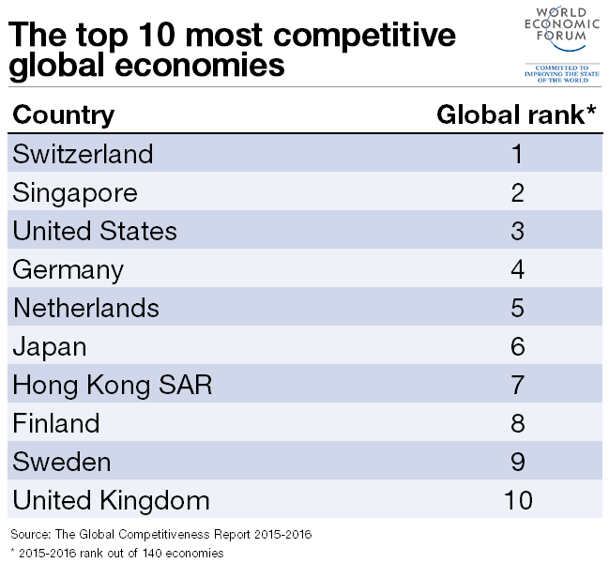

Slide 13
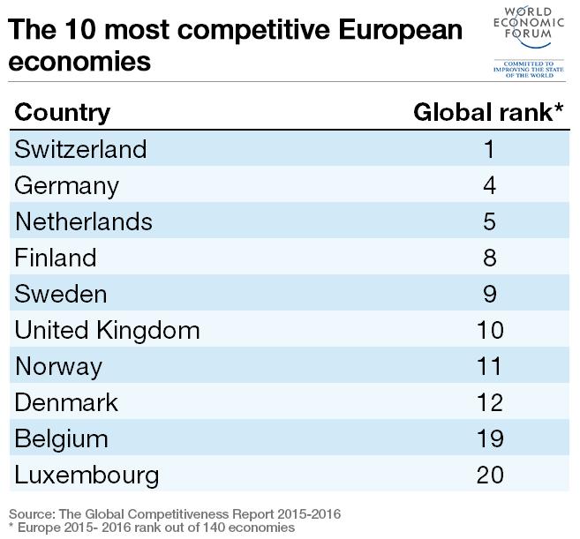

Slide 14
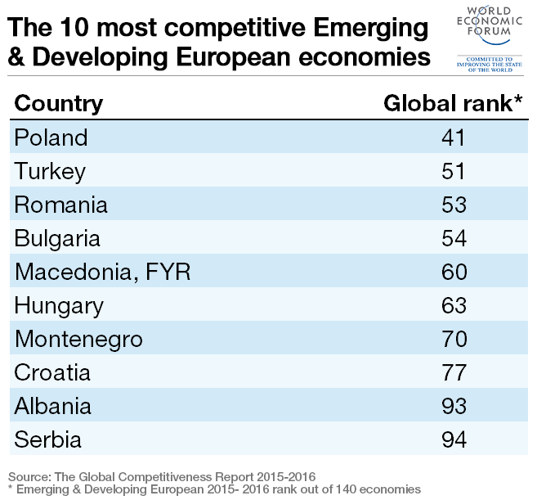

Slide 15
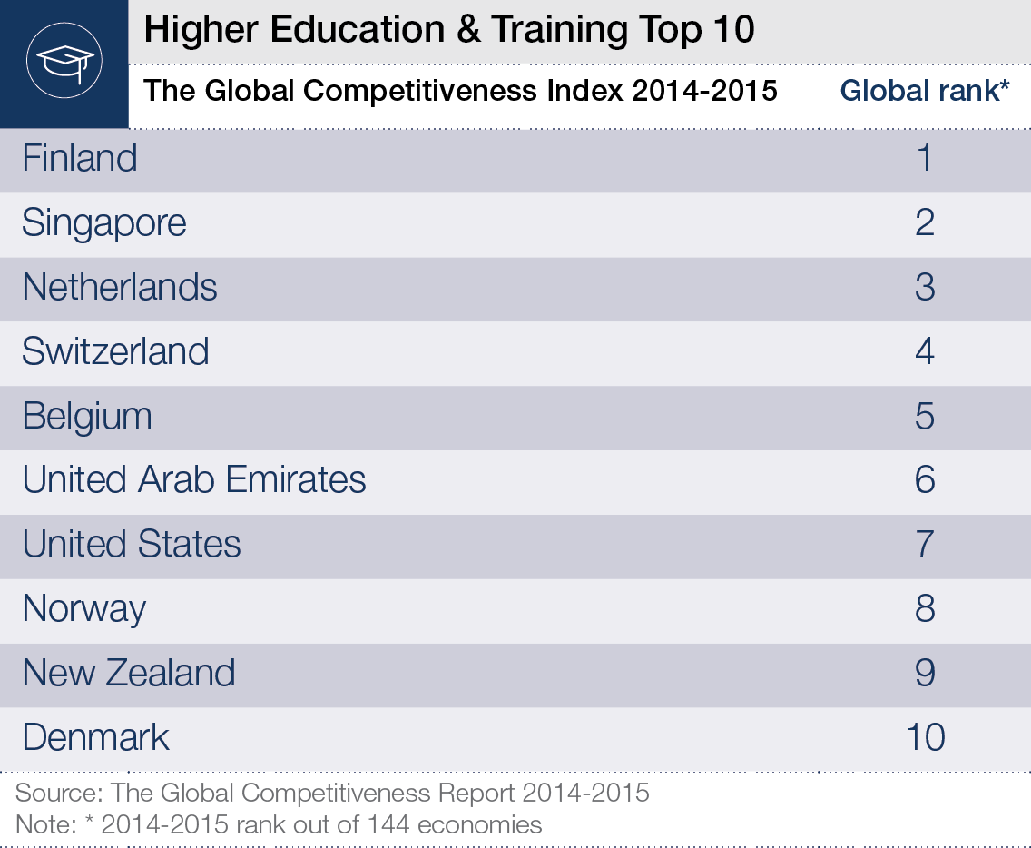

Slide 16
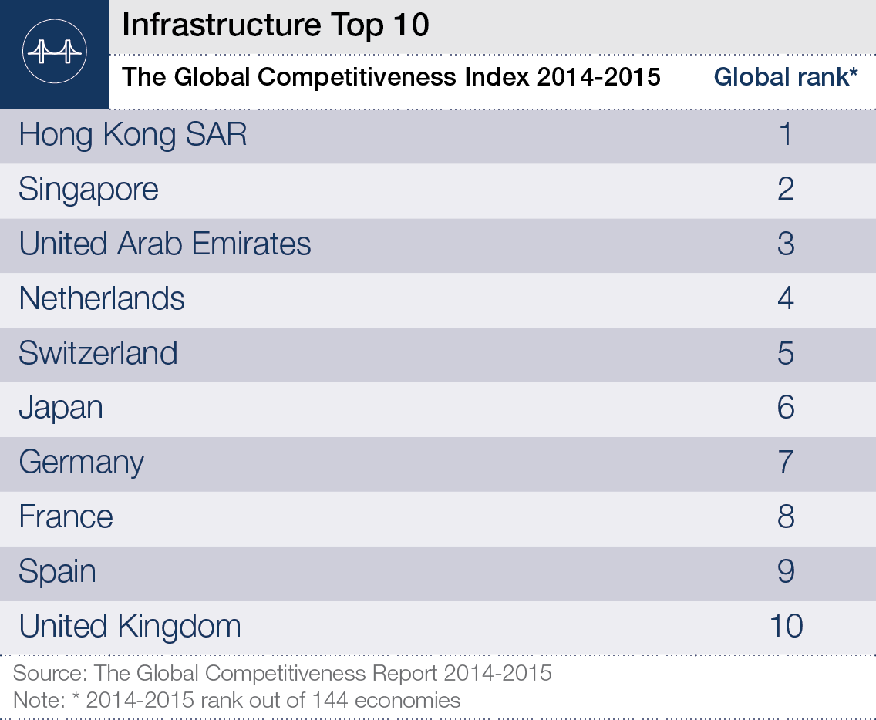

Slide 17
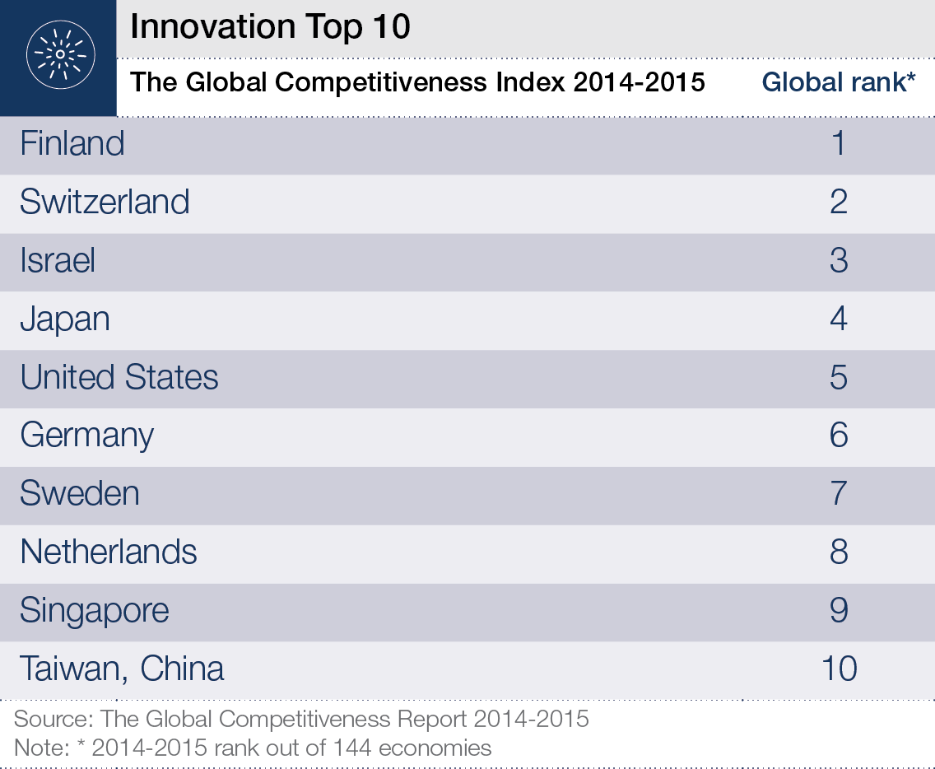

Slide 18
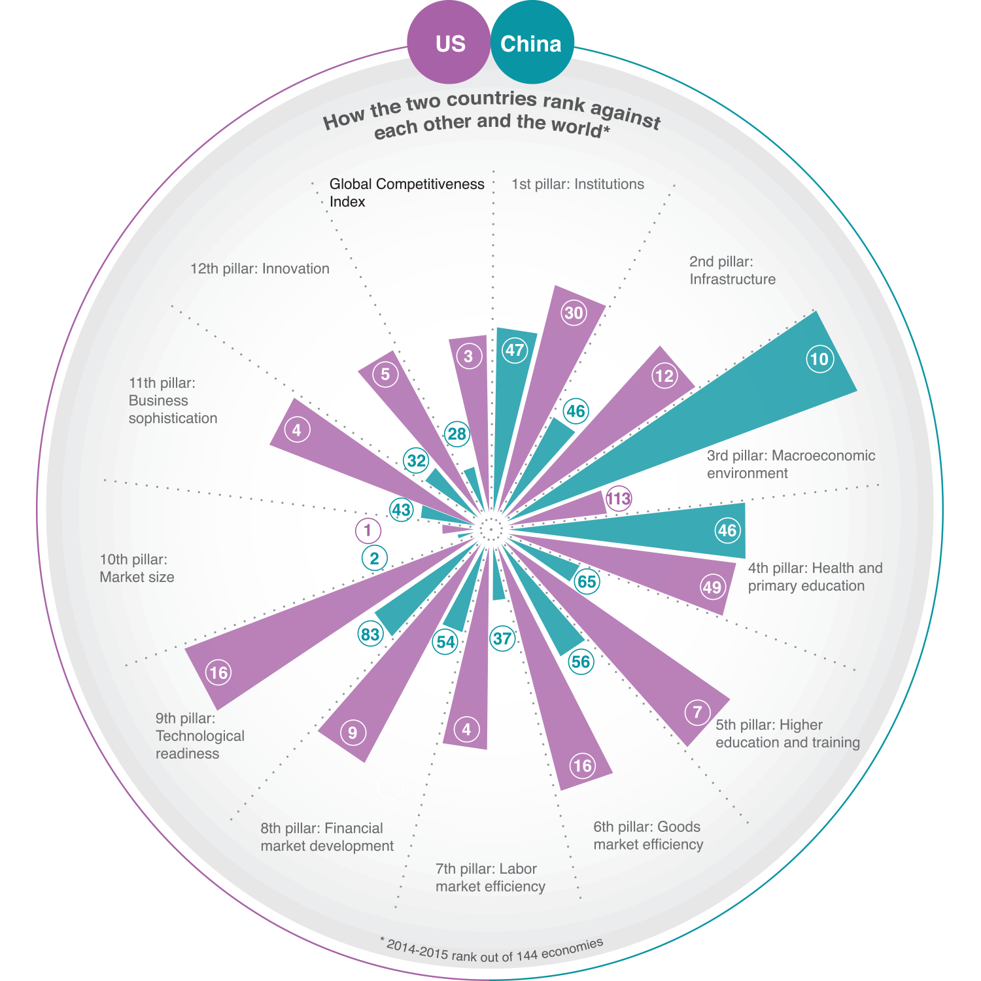

Slide 19

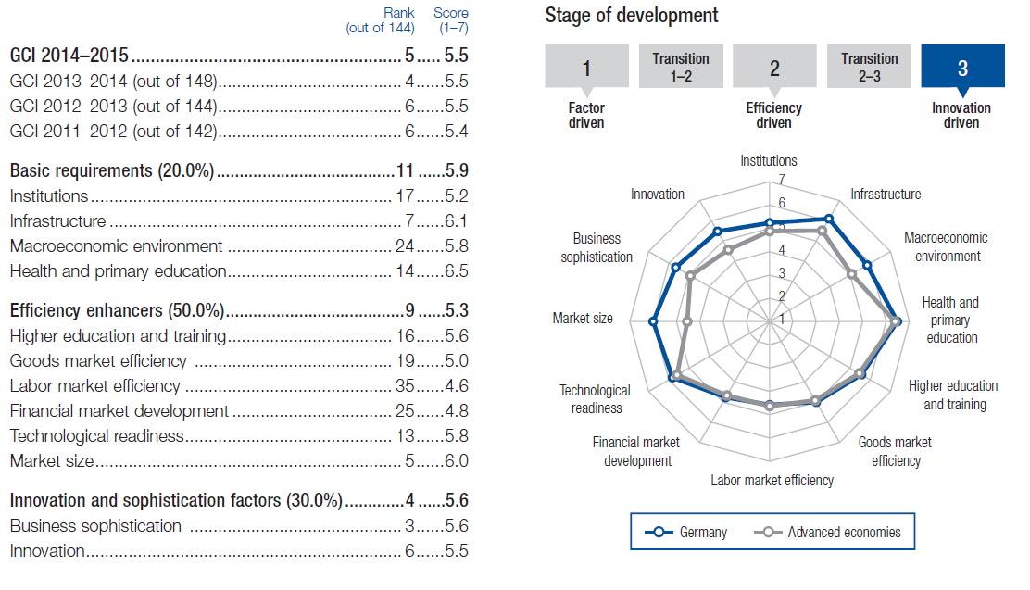

Slide 20

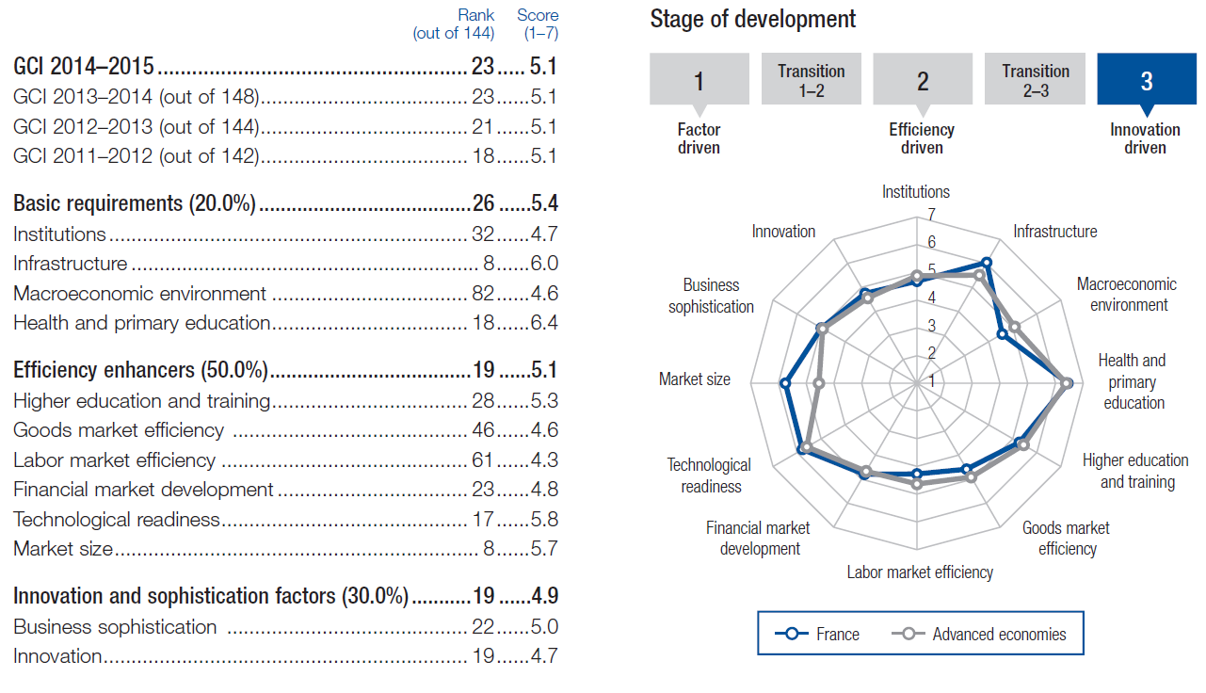

Slide 21

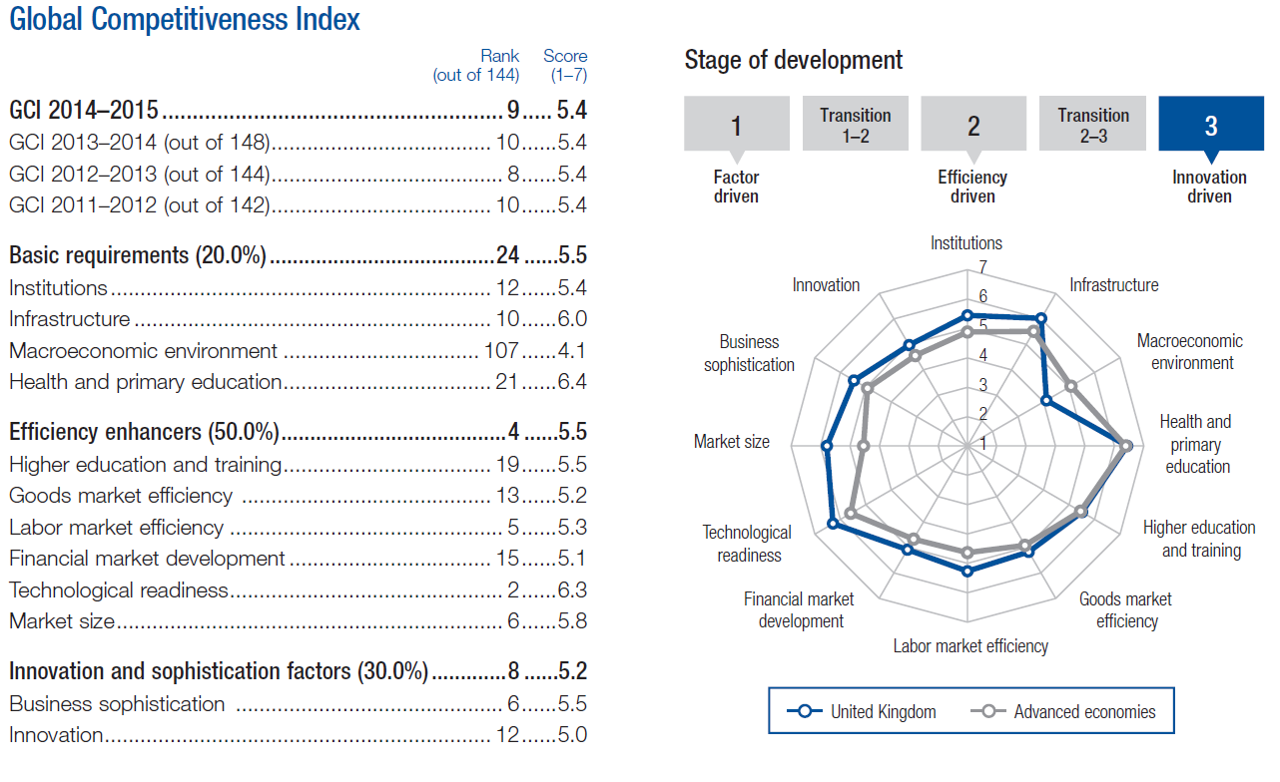

Slide 22
