Slide 1
BOSNIA‘S CIVIL WAR:
ORIGINS AND VIOLENCE DYNAMICS
by Stathis N. Kalyvas and Nicholas Sambanis

Slide 2
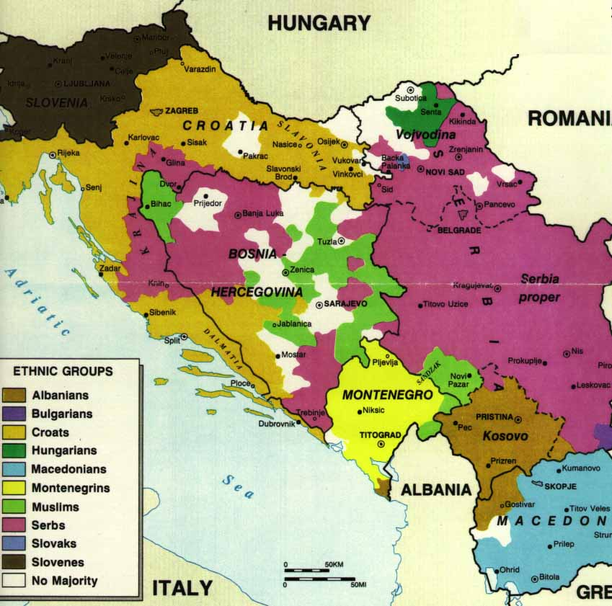
Structure of the Text
Background of the conflict
The COLLIER-HOEFFLER model „fit“ to the Bosnian Civil War
Dynamic of Violence in Bosnian Civil War
Conclusion(s)

Slide 3
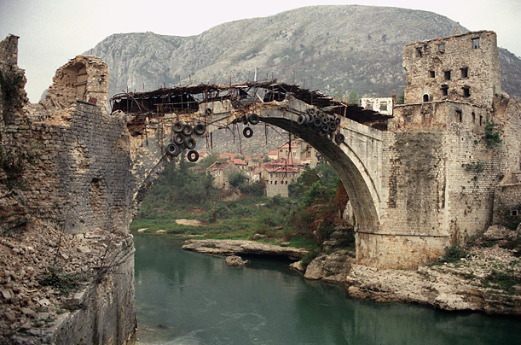
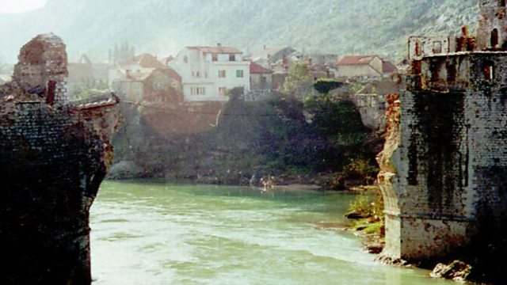
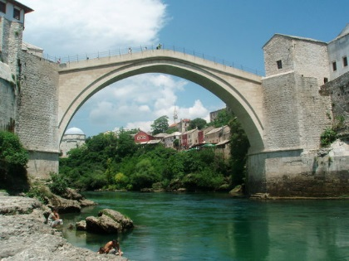
PART 1: Collier, Hoeffler and Bosnian Civil War
Collier-Hoeffler (CH) Model = econometric model which predicts the outbreak of civil conflict
Author applies the CH Model to Bosnian Civil War and observes any discrepancies

Slide 4
PART 1: Collier, Hoeffler and Bosnian Civil War
CH Model variables:
PRIMARY COMODITY EXPORTS
POPULATION SIZE
GDP PER CAPITA
SOCIAL FRACTIONALIZATION
DIASPORA
ETHNIC FRACTIONALIZATION
GDP GROWTH
RELIGIOUS FRACTINALIZATION
MONTAINIOUS TERRAIN
ETHNIC DOMINANCE
GEOGRAPHIC DISPERSION
INCOME INEQUALITY
DEMOCRACY
PEACE DURATION

Slide 5
PART 1: Collier, Hoeffler and Bosnian Civil War
CH Model variables:
PRIMARY COMODITY EXPORTS
POPULATION SIZE
GDP PER CAPITA
SOCIAL FRACTIONALIZATION
DIASPORA
ETHNIC FRACTIONALIZATION
GDP GROWTH
RELIGIOUS FRACTINALIZATION
MONTAINIOUS TERRAIN
ETHNIC DOMINANCE
GEOGRAPHIC DISPERSION
INCOME INEQUALITY
DEMOCRACY
PEACE DURATION

Slide 6
PART 1: Collier, Hoeffler and Bosnian Civil War
Ethnic Fractionalization /Dominance
Peacetime variable
Extend the impact of previous war
< Ethnic Polarization
Diaspora
Income inequality
Not just financial help
Switch to Interregional Inequality
GDP Growth
Level of Democracy
Extend the impact of political institutions
Woodward‘s theory about rapid liberalization

Slide 7
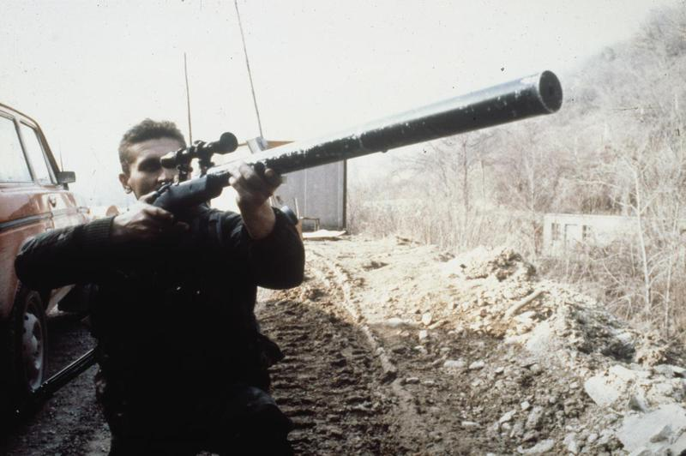
PART 2: The Dynamic of Violence
Bosnian Civil War = Symmetric Nonconventional War
always generates greater levels of violence

Slide 8
PART 2: The Dynamics of Violence
Bosnian Civil War = Symmetric Nonconventional War
always generates greater levels of violence
Ethnic Cleansing Greater violence at the beginning of the conflict, Northern Bosnia
Formation of vigilant groups and paramilitary forces However organized state forces were typically more restrained
Negative influence of the international community Negotiation increased military activities, changes in the dynamics of the conflict

Slide 9
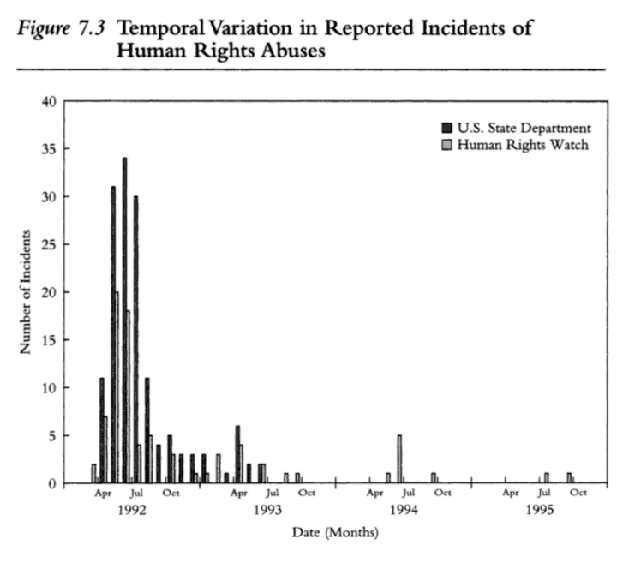

Slide 10
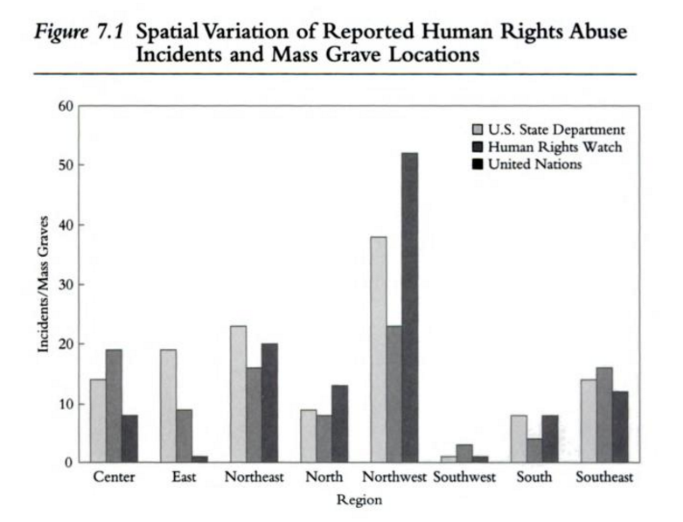

Slide 11
PART 2: The Dynamic of Violence
Bosnian Civil War = Symmetric Nonconventional War
always generates greater levels of violence
Ethnic Cleansing Greater violence at the beginning of the conflict, Northern Bosnia
Formation of vigilant groups and paramilitary forces However organized state forces were typically more restrained
Negative influence of the international community Negotiation increased military activities, changes in the dynamics of the conflict

Slide 12
PART 2: The Dynamic of Violence
ETHNIC CLEAVAGES
VIOLENCE
„Rather than translating deep divisions into violent conflict, the evidence suggests a situation of rapid „ethnification“ of violence once the war began.“ (Kalyvas and Sambanis, 2005)
Soldiers who volunteered just for vengeance
Evidence of violence with private motives
Large number of conscripts

Slide 13
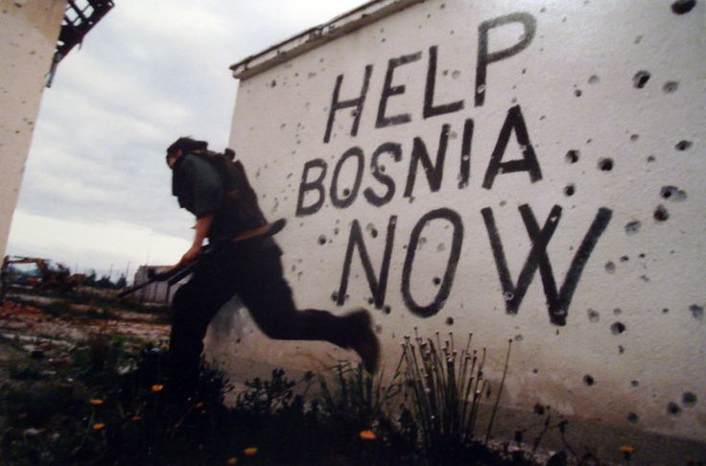
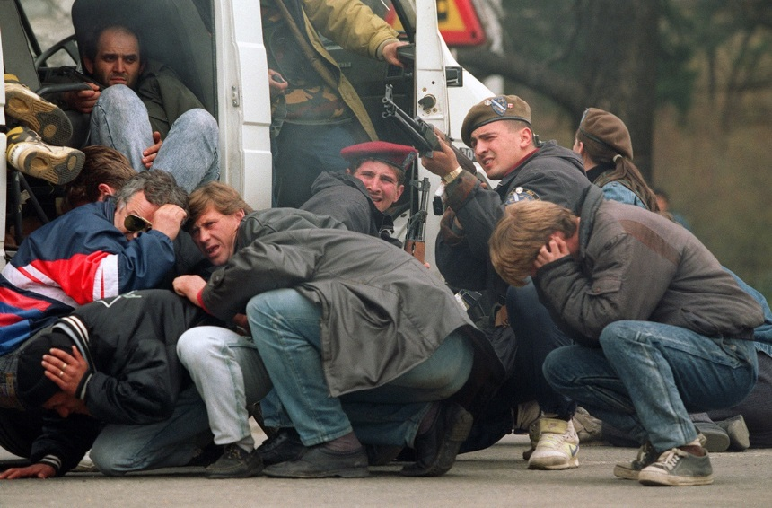
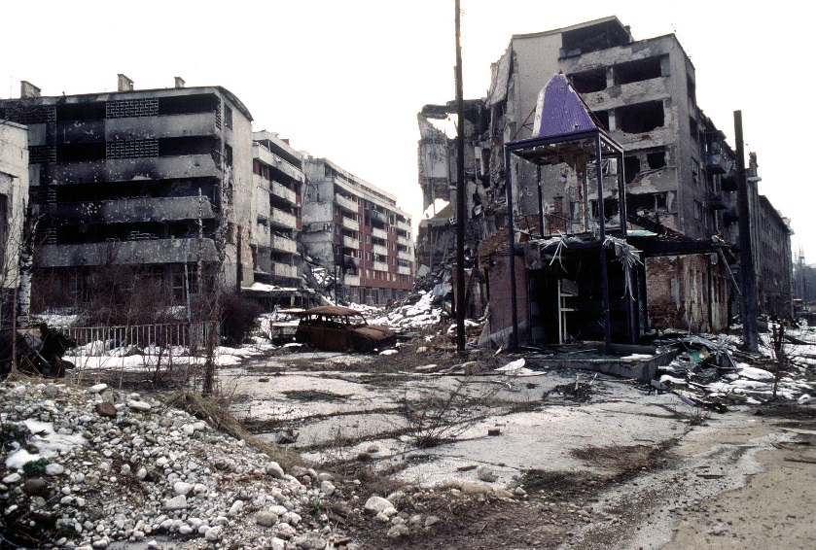
Conclusion
CH model does not fit perfectly
CH model itself changes after including data set from Bosnia
If there‘s ethnic polarization before the conflict, the war enlarges it significantly

Slide 14
Thank you for your attention.
Alžběta Bajerová

