Slide 1
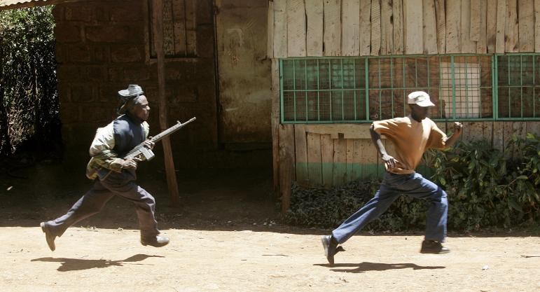
Why has Kenya not Experienced a Full-blown Civil War?
Sporadic Ethnic Violence
By M. S. Kimenyi & N. S. Ndung
Bilge Nisa Buyukkasap

Slide 2
A civil war occurs when a trigger factor/combination of factors results in a “tipping point”
  Tipping Point: factions in a society engaging in an all-out armed conflict.

Slide 3
Collier and Hoeffler
“CH model”
Systematic analysis of the casual factors of civil war initiation, duration, and recurrence
Empirical support for «opportunity cost» explanation of civil war onset

Slide 4
Unlike the most of the countries in Africa, Kenya has neither been under military dictatorship nor experienced any major internal problem that could be referred as a civil war.
However Kenya had gone through «ethnic clashes» which
  Didn’t last long.
  Localized in limited geographical areas
  Did not involve rebel groups fighting to dislodge governments.

Slide 5
«example of peace and stability»

Slide 6
Ethnic Violence in Kenya
Started in 1991
Sporadic ethnic violence
Serious threat to the existence of a united Kenyan nation, the rule of law, and the institutions of private property, and market economy
PARADOX!

Slide 7
Why is «ethnic violence» a paradox?
Didn’t involve significant numbers of any ethnic community against each other.
Although the targets are from specific ethnic groups, the aggressors can be hardly qualified as an ethnic group.

Slide 8
Causes of the Violence
Ethnicity
Land
Politics

Slide 9
Ethnicity
At least 42 distinct tribal groups
Ethnic hatred linked to electoral politics and competition among the new arrivals in the region

Slide 10
Land
Seen as the primary source of the ethnic clashes
Political independence was negotiated without resolving the land issue.
Positive correlation between violence and the amount of land that had been alienated by the colonists

Slide 11
But…
The violence occurred in small-scale farms with large populations.
Alienation of the lands is not related to the ethnic groups that are responsible for the violence.

Slide 12
Politics
Failure of public institutions to accommodate diverse interests
The lack of political models to deal with diversity in centralized states where competition for resources and power is prevalent leads to conflicts

Slide 13
Until 1991, Kenya was under a one-party rule and excessive centralization. Towards the end of 1991, people of Kenya had risen for a change of regime which resulted with a massive bloodshed by the government.
States in political transition experience more violence.

Slide 14
The government secretly employed ethnic militants to attack the supporters of opposition parties.
  Introduction of democracy would affect their financial fortunes.
  Opposition was keen prosecuting the members of government.
  Pre-elections showed that the current government was likely to lose power.

Slide 15
Why Has Kenya Not Experienced Civil War?

Slide 16
Ethnic Heterogeneity?
  these groups live together in urban areas.
  Problems are not large enough to trigger a war.
  Most regions are relatively homogeneous.
  The society is highly fractionalized. Most of the tribes contain subtribes in them. Safety in highly fractionalized societies is due to the high transaction costs of collective action.

Slide 17
Land issue?
  Only a small part of the country and a few ethnic groups are affected.
  Violence has not been directed at government.
  The inability to organize a counter to these ethnic clashes explains their sporadic nature.

Slide 18
Economic gain?
  no guarantees that those involved in the conflict would benefit themselves
  Those who takes a part in fighting face the cost but the benefits are spread among the group

Slide 19
Political expediency?
  The ruling party had to solve the problem of the instability that they created to gain the power in order to prevent production getting affected negatively.

Slide 20
conclusion
Why the conficts didn’t evolve into civil wars can partly be explained by CH model.

Slide 21
Thank You!

