Slide 1
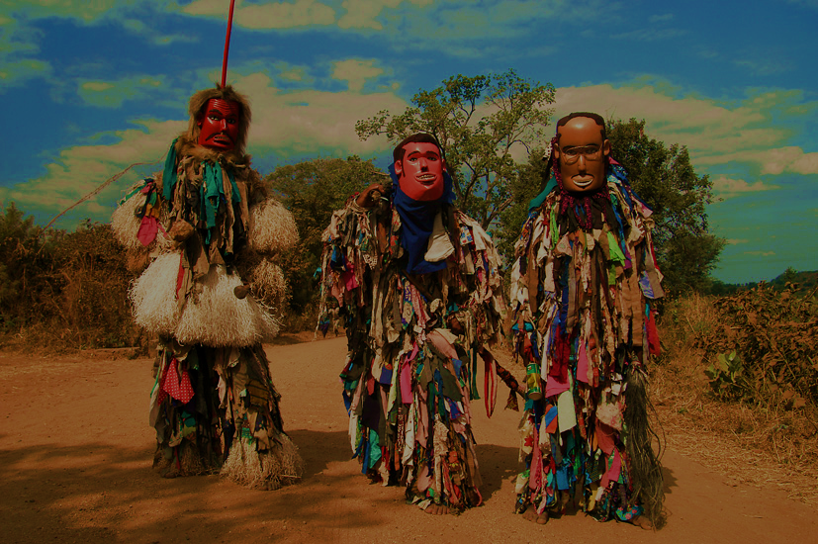
The Political Salience of Cultural Difference: Why Chewas and Tumbukas Are Allies in Zambia and Adversaries in Malawi
Zsolt Szabó

Slide 2
The Chewas and Tumbukas
Both groups divided by the Zambia-Malawi border
Border exists since the British conquest, set arbitrarily
In Malawi relations between these groups are largely hostile, in Zambia friendly

Slide 3
Cultural differences as sources of conflict
cultural differences often evoked when conflicts are analyzed, yet they cannot fully explain the emergence of conflicts
Why some cleavages matter more?
Suggested explanations:
- Degree of cultural differences, progress in society
The Malawi-Zambia situation seems to contradict the „Culturalistic” approach

Slide 4
Research setup
Members of both groups were interviewed on both sides of the border
Villages were similar: homogenous, no variation in geography and economy
Questions: 5 questions: what makes Chewas different from Tumbukas? Would a member of your tribe vote for a member of the other tribe in the case this person stood for president? Would you personally? Are you married to a member of the other group? Would you consider it?

Slide 5
Findings
small differences in language and culture
61 % in Malawi thought their group would not support a presidential candidate from the other group, just 21 % in Zambia, similar pattern by the marriage question

Slide 6
How to explain this discrepancy?
Political system
Electoral cycle
Different experience during colonialism
Higher relevancy of ethnicity in Malawi
None of the approaches above is satisfactory

Slide 7
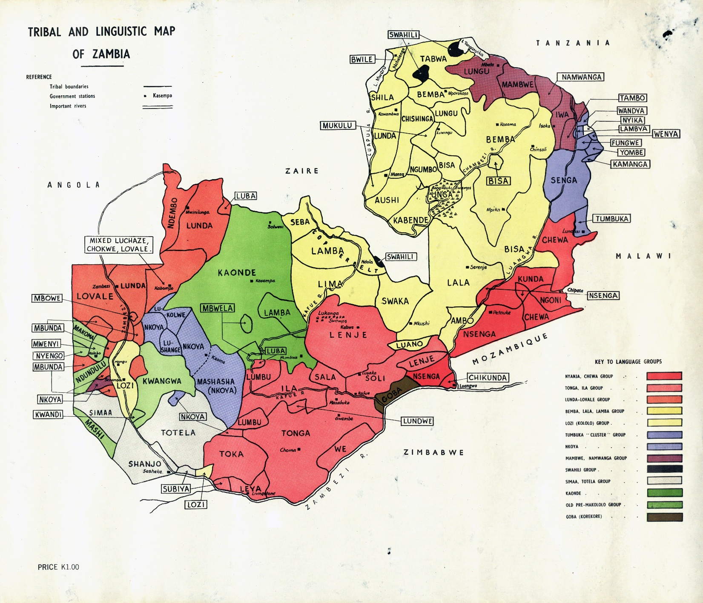
Relative size of the ethnic groups in their countries

Slide 8
Ethnicity as a basis for political mobilization
Both countries work on the basis of patronage networks
In Zambia, when the „ethnic card” is played, Chewas and Tumbukas are relatively small and are lumped together as „Easterns”
In Malawi, they are the biggest ethnic groups and are played out against each other

Slide 9
Other findings
Political hostility spills over to social situations
An arbitrary drawing of a border just as potent in creating a sense of belonging as cultural differences (the case of the Tongas) – this fits constructivism better than primordialism

Slide 10
Conclusion
ethnic diversity is a poor predictor of actual animosity, let alone violent conflict
In The Malawi-Zambia example, the real reason of non-violent conflict is access to resources and politicians attempt to mobilize support along cleavages, with ethnic cleavages being the most obvious cleavage to exploit as they already exist, but cleavages can be created artificially (by drawing a border arbitrarily). However, cultural differences alone, without politicians playing the “ethnic cards” are not enough for conflict
Conflicts rarely start out as ethnic, but they can become one after politicians instrumentalize cultural differences to mobilize support and thus divide their country along ethnic lines

Slide 11
Critical notes and questions for discussion
a well-written article about an often neglected region
It shows that the instrumentalization of cleavages by elites is critical for the emergence of animosity
It is also a clear example against the essentialist “ancient hatreds” argument
It also suggests interesting questions: if identity is seemingly so easily created, why couldn’t other states, that were carved out arbitrarily by colonial masters, ignoring ethnic-cultural realities (Sudan, Iraq) come up with a common identity?
Thanks to what factors didn’t the hostilities in Malawi turn violent?

