Slide 1
Crackdown- Harsh realities OF NONviolent protests in the bahraini civil conflict
Maryam AL- Khawaja
Lucia HudecovÁ
UČO: 414 936

Slide 2
Context of Bahraini civil conflict
Hypothesis
Causes of conflict
Uprising
International response - double standards?
3 years on
Summary

Slide 3

Context of Bahraini civil conflict
Regional context- Arab Spring
- the extent of violence used by the regimes pushed people to turn their uprisings into armed struggles
International context
- how Bahraini conflict was dealt with in regards to international law and mechanisms
Religion context- Islam
- majority of Shia, Sunni ruling family
- the sectrian discourse in Arab Spring- SA as protector of Sunnis, Iran as protector of Shias

Slide 4
hypothesis
"...the effectiveness of active nonviolence for creating social and political change was mitigated by the lack of international laws and mechanisms that protect those who choose to employ this method."

Slide 5
Causes of conflict
Long history of struggle against the ruling manarchy
Intifada (1990-1999), ended by promise of constitutional monarchy
In 2002, new Emir unilaterally changed the constitution
Bahrain is a kingdom with a king (Hamad ibn Isa Al Khalifa)
Long period of dissatisfaction with the regime, unfulfilled promises, return of torture
Inspiration to uprise from therevolutions in the Middle East and North Africa

Slide 6
Uprising
Started on 14.2. 2011 "Day of rage" protest, Bahraini regime responded with an use of force, first people killed
17.2.- attacking people sleeping at Pearl Square to create a fear
Giant result- more than 200 000 people protesting
Uprising was still non-violent (need to take the moral high ground )
Regime attemped to create a sectarian divide protesters - response was "human chain"
March 2011- economic and political breaking point
Peninsula Shield Force (PSF) was called in (mainly Saudi and UAE troops)- conspiracy theory of Iranian involvement in the uprisings

Slide 7
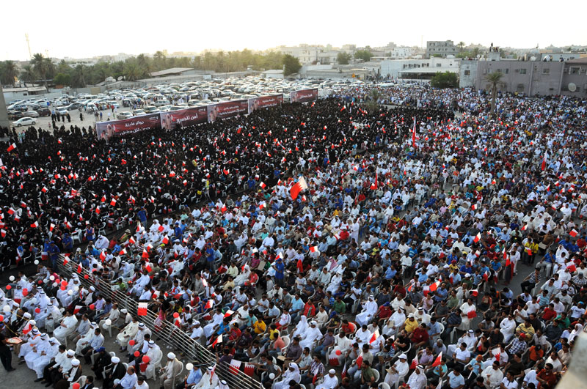
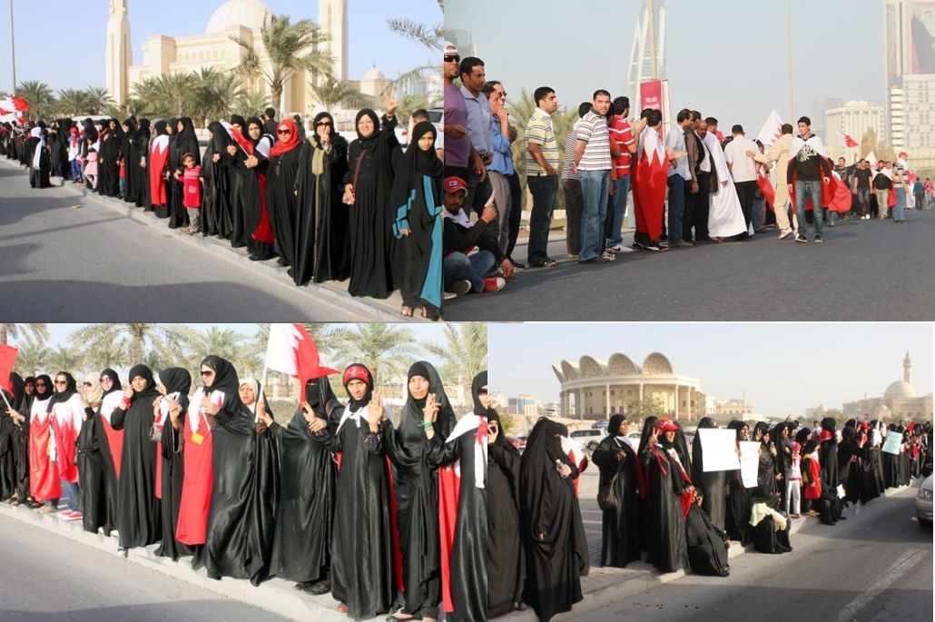

Slide 8
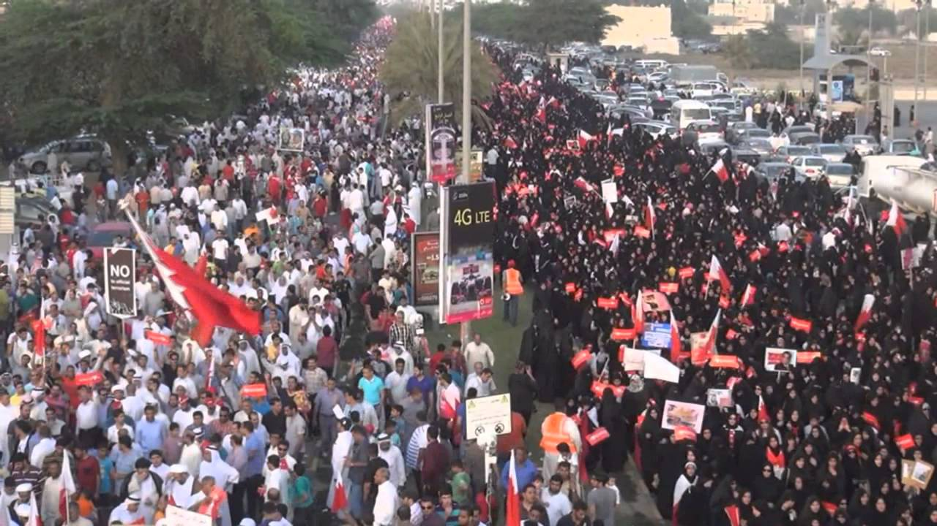
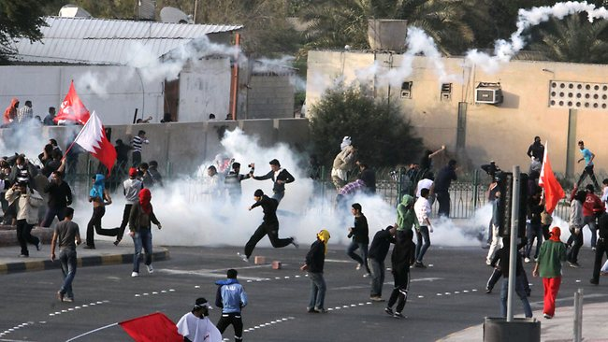
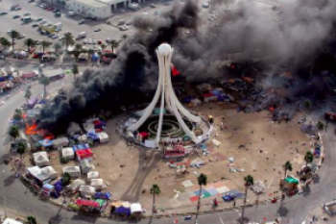
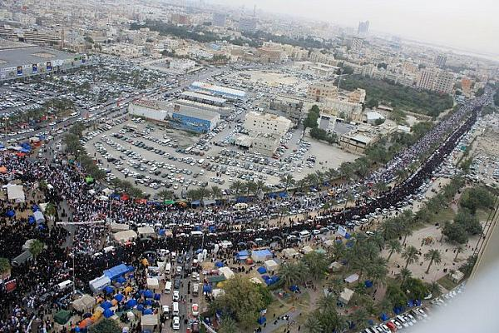

Slide 9
International response- double standards?
U.S. Secretary of State Hillary Clinton said that Bahrain “has the sovereign right to invite foreign troops into the country.”
Impossible for activists lobbying internationally to get other countries to counter with public statements condemning the action
Double standards: Libya - a no fly zone to protect civilians from the regime; Syria- arms supply and international support; Crimea- disaprovement and econimic sanctions
Majority Shia population revolting against Sunni ruling family- ignored due to sectarian discourse or regarded as Iranian conspiracy against Sunni
Western countries chose to ignore conflict- relationship with the GCC and antagonism towards Iran

Slide 10
3 years on
Sectarianism- main tool during the crackdown
GCC’s military involvement- Shia under collective punishment
Turn into violent conflict from january 2012- from protesters view it was self-defense
"Human rights defenders in Bahrain continued to push for nonviolence as the only method of protest, but were faced with the question of what nonviolence had accomplished since the start of the revolution. "
Nonviolence still the dominant response regime began targeting theirs leaders
more violence on the streets used as justification for use of force (protester= terorist)
Western countries- call on restreint from both sides
USA a UK – support the regime, regard Bahrain as ally

Slide 11
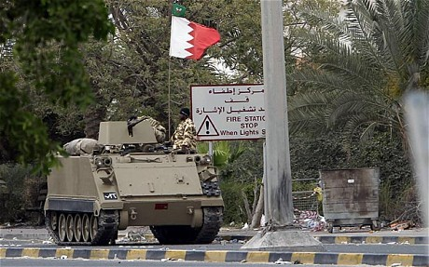
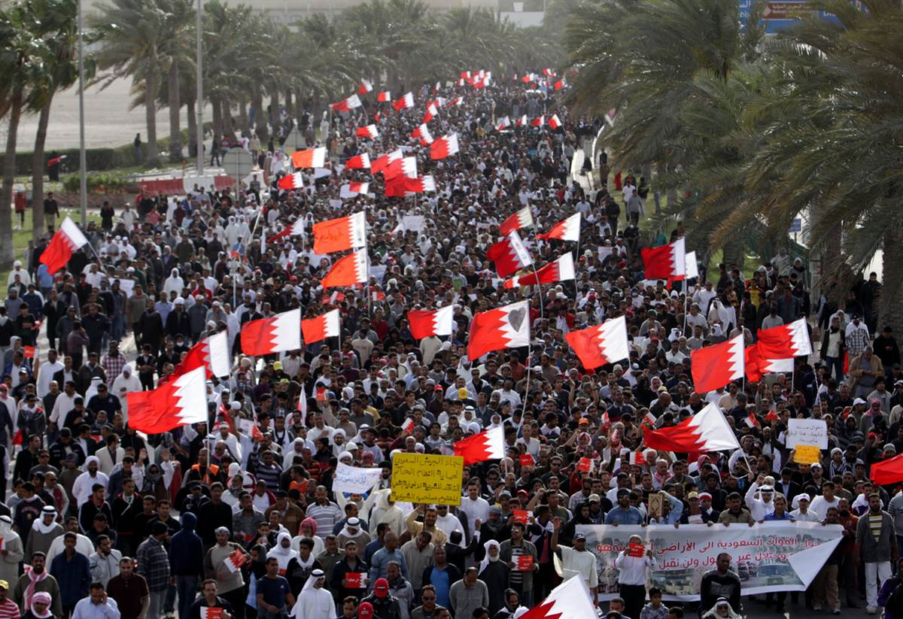
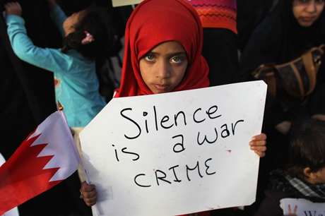
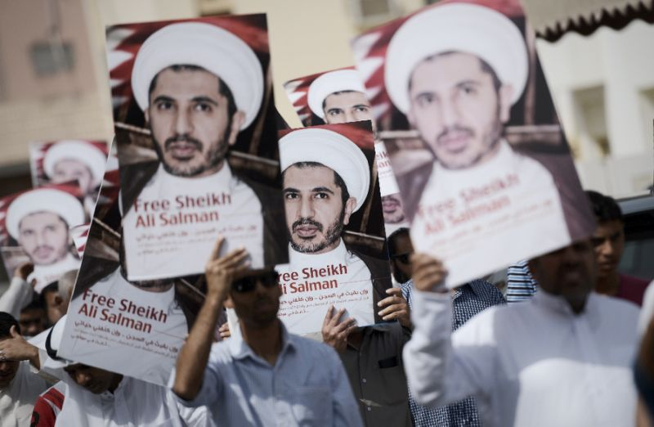

Slide 12
Summary
"...the lack of positive international response, coupled with active allied state support of the Bahraini regime and minor interference on behalf of the Bahraini authorities, have all severely undermined initial strategies of nonviolence."
no international law and/or mechanisms to protect civilians who choose nonviolence
Bahraini conflict = internal affair, no international response
According to current structure of international law and mechanisms, armed struggles are much more viable than the choice of active nonviolence
International community- there will always be geopolitical, economic, and security relations considerations that will cause double standards

Slide 13
Thank you for your attention

