Slide 1
«Copying and Learning from Outsiders? Assessing Diffusion from Transnational Insurgents in the Chechen Wars»
by Kristin M. Bakke
MVZ489
Anna Kosenko
UČO: 454888

Slide 2
Introdaction I
Aim: to research diffusion mechanisms through which
transnational insurgents affect domestic challengers to the state, based on empirical analysis of the Chechen wars.
Areas of interest:
intrastate conflicts (Chechen war model)
social movements
transnationalism
correlation between domestic and transnational insurgents.

Slide 3
Introdaction II
Hypothesis I:
-transnational and domestic non-state actors can equally influence the intrastate conflict.
Hypothesis II:
-participation of transnational insurgents in an intrastate conflict can radically change not only the process, but also the main goal of this conflict.
Literature = research base:
-Nye, Joesph S., and Robert O. Keohane “Transnational Relations and World Politics:An Introduction.”
-Malet, David “The More Irregular the Service’: Transnational Identity Communities and the Foreign Fighter.”
-Risse-Kappen, Thomas. 1995. “Bringing Transnational Relations Back In: Introduction.”

Slide 4
Transnational insurgents, who they are ?
They are «non-state actors that for either rational or material
reasons opt to participate in an intrastate conflict outside their own home country, siding with the challenger to the state» (David Malet).
Interaction Formula unfavorable balance of power + fragmented domestic movemen=coalitions between domestic and transnational fighters.
ethnic affinity
ideological bonds
manipulation of such ties
location in a bad neighborhood + weak state + traits of the transnational actors + domestic balance of power + cohesiveness of the domestic insurgent movement

Slide 5
Diffusion mechanism
How transnational insurgents affect domestic ones?
relational
mediated (Chechen wars case)
non-relational
shifts in domestic insurgents’ frame—attribution
mosques +charitable organizations+ schools
TOOLS
new ideology
tactical innovations
resource mobilization

Slide 6
Shifts in Framing
Framing of conflict = actors define what they are fighting for and who they are fighting against
+
relational diffusion
mediated diffusion
new contributes
=
transnational insurgents engender learning or emulation of new frames

Slide 7
Tactical innovations
-more radical tone;
-new ideas about morally accepted or effective and efficient forms of (collective) action;
- tactics that go beyond the laws of war=killing of civilians, torture, hostage-taking, degrading treatment, and extra-judicial executions.

Slide 8
Resource Mobilization
fighters
teaching how to use those
weapons skillfully
weapons
know-how
communication
increase the coercive
strength of the domestic movement
finance
result

Slide 9
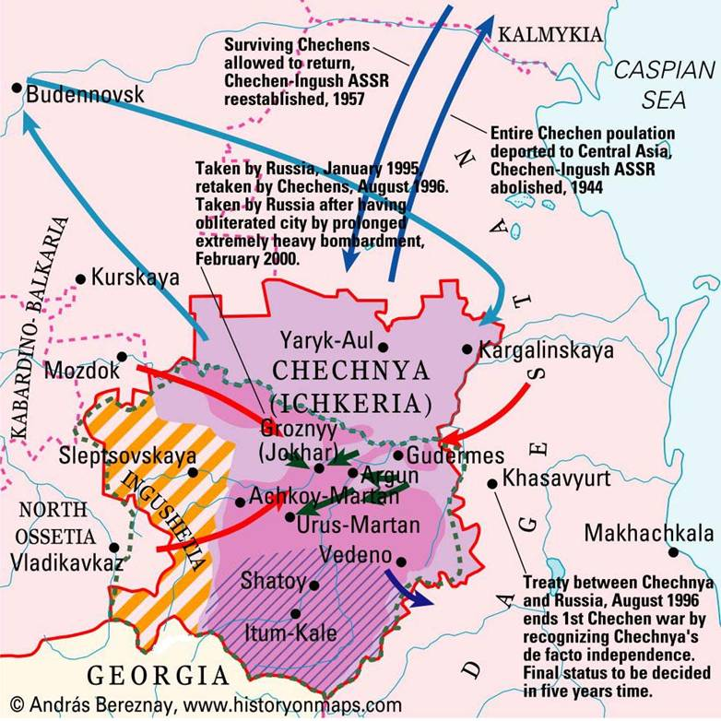
Transnational Insurgents in the Chechen Wars I
Research Design:
task=to examine Chechnya’s
conflict with the Russian federal government over time = investigate the mechanisms that create variation across processes of domestic mobilization.
the key question=framing process
How it was in Сhechen wars?

Slide 10
Transnational Insurgents in the Chechen Wars II
Who they are?
What they brought?
-Emir Ibn Al-Khattab (Saudi Arabia) + unit of eight Afghan-Arab fighters;
-Sheikh Ali Fathi al-Shishani (broker);
-Arabs from the Middle East, North Africa, Turkey, Pakistan and from Central Asia.
tactical innovations=suicide terrorism + kidnapping;
substantial funding;
advanced weapons
propaganda=new ideology = radical Islam=salafia+jihad;
Totally new scales of the conflict

Slide 11
Framing Effect in Chechen Wars
transnational insurgents
I war
Aim: self-determination, nationalism
transnational insurgents
new resource base
New inspiration to fight=
Islamism=salafija!
transnational insurgents
transnational insurgents
radical tactics
training+emulation
II war
Aim:djihad, establishment of an Islamic emirate!

Slide 12
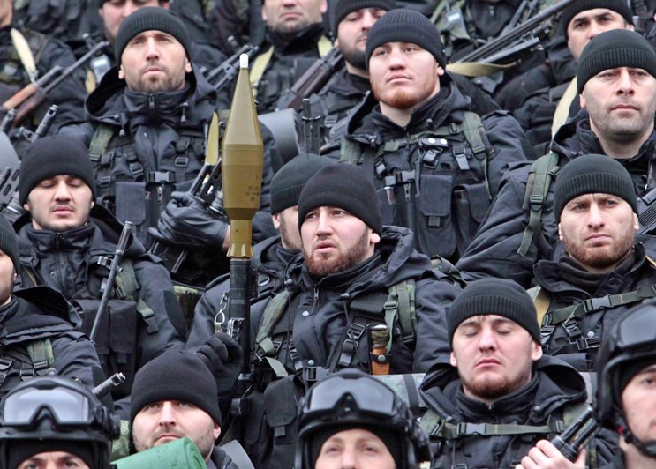
Conclusions:
transnational insurgents can affect a domestic movement’s framing of goals, tactical innovation, and resource mobilization through both relational and mediated diffusion.

Slide 13
Critical reflection
+
-
-sufficiently informative;
-overall understandable;
-meticulous analysis;
-filled with statistical data and interviews.
not clear structure=difficult to follow;
disrupted presentation logic;
frequent repeats.
No answers?
1.At what stage of the war does the diffusion of transnational insurgents happen?
2.What is the motivation for transnational insurgents?
3.Why does the legitimate authority of the state let this diffusion happen?

Slide 14
Thank you for attention!
Questions?

