Slide 1
Political campaigns in Poland
Sebastian Kubas
University of Silesia

Slide 2
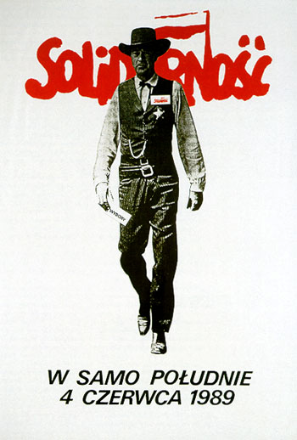
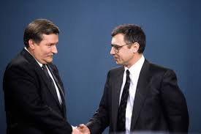
1989: Semi-free Parliamentary Elections 1990: Presidential Elections

Slide 3
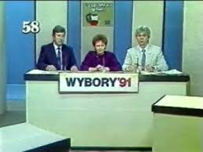
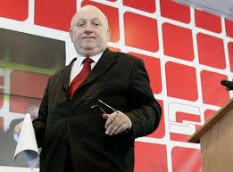
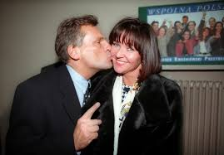
Campaigns in the mid 90-ties
1991: First Free 1993: Parliamentary 1995: Presidential
Parliamentary Elections Elections Elections

Slide 4
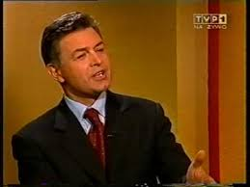
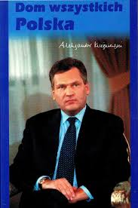
1997: Parliamentary Elections 2000: Presidential Elections

Slide 5
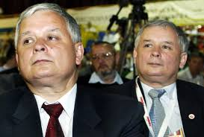
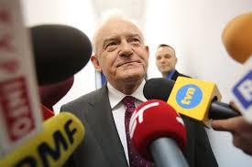
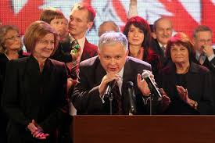
2001: Parliamentary 2005: Doubled Elections: Parliament and Elections President

Slide 6
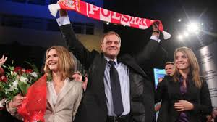
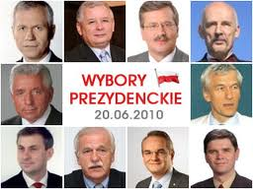
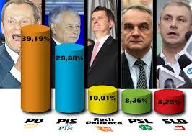
The Civic Platform Era 2007: Parliamentary Elections 2010: Presidential elections 2011: Parliamentary Elections

Slide 7
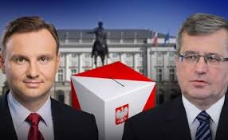
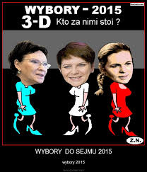
The Law and Justice Era 2015: Presidential Elections 2015: Parliamentary Elections

