Slide 1
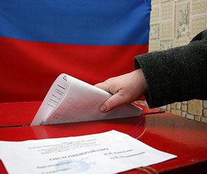
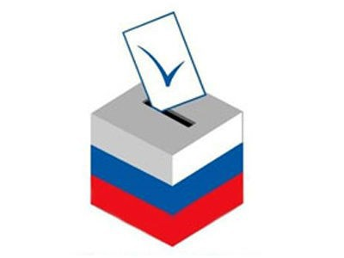
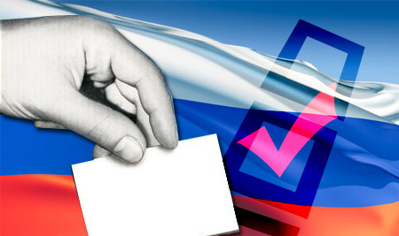
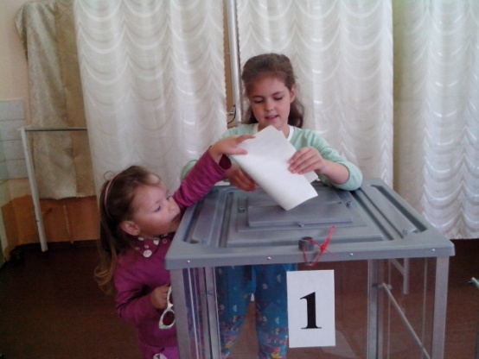
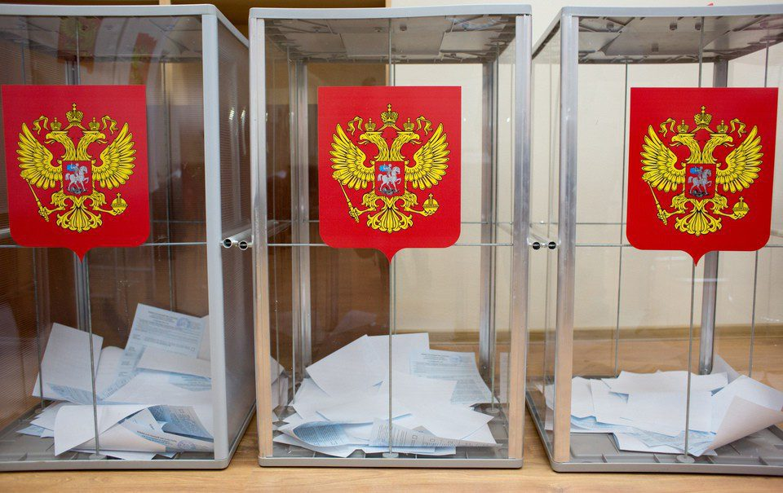
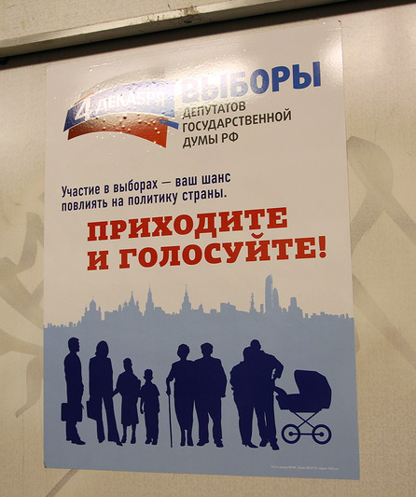
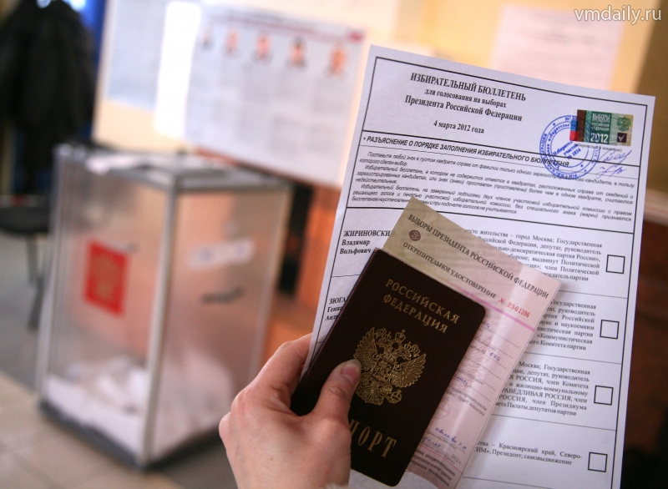
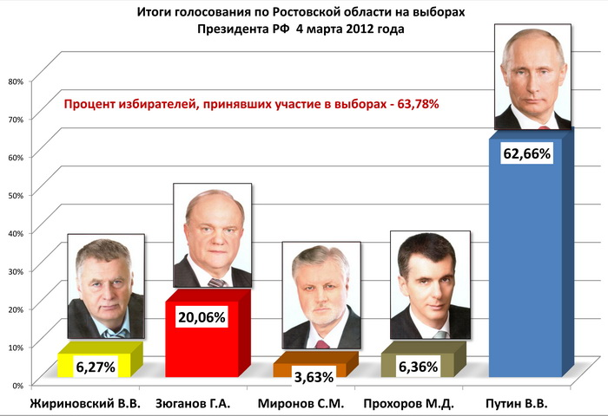
ELECTIONS in RUSSIA

Slide 2
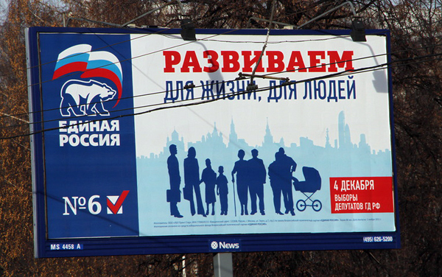
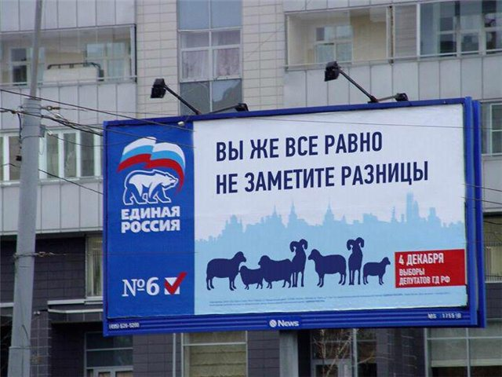

Slide 3
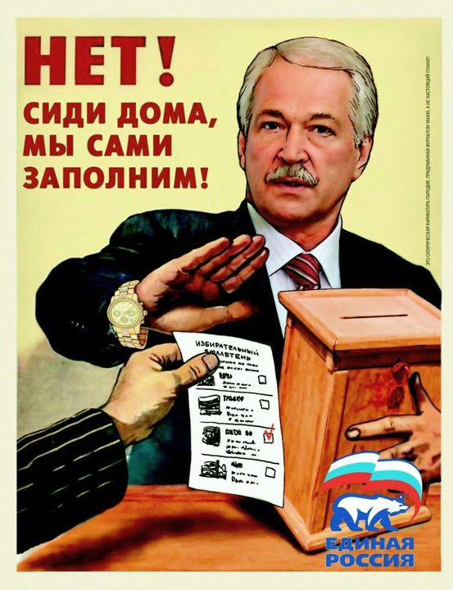
NO! Stay home, we’ll fill!

Slide 4
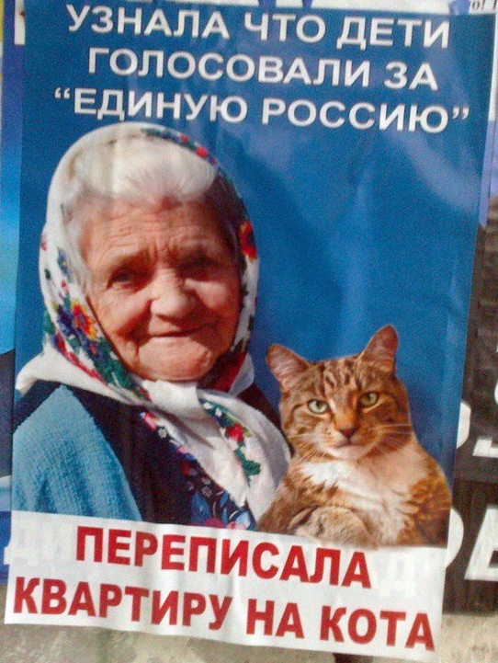
Having heard that son and daughter in law voted for UR rewrote my will, leaving flat to cat

Slide 5
HOW TO WIN ?
Administrative resources
Elite’s support
RULES – law frameworks
How to count?
(and it’s NOT about falsifications or fraud!)
Be popular?
Clear slogan?
Skillful team?
Headquarters ?
Charisma?
Money?
Actual agenda?
…..

Slide 6
administrative resources
the intervention of Executive authorities in the electoral process on the side of certain candidates and parties
Till 2000 – disconcentrated
From 2003 - concentrated with increasing

Slide 7
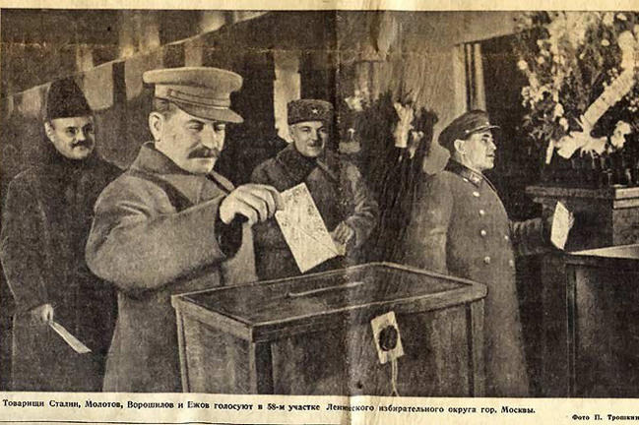
unchoiced

Slide 8
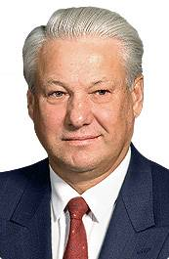
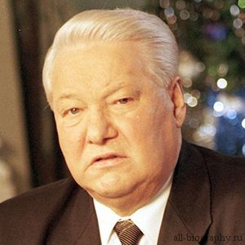
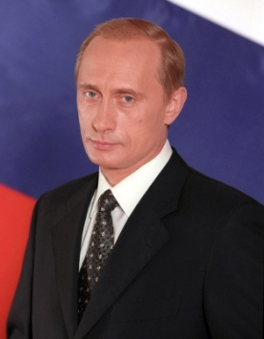
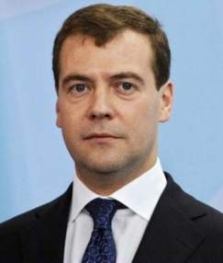
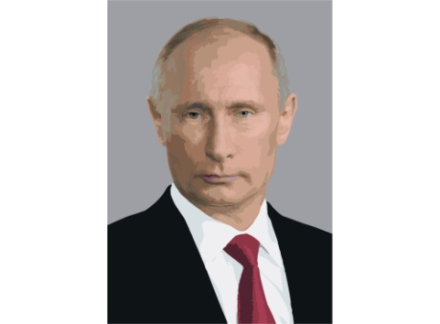
FEDERAL LEVEL
PRESIDENT
STATE DUMA
1991
1996
• 2000
• 2004
• 2008
• 2012
• ? 2018 ?
1990
• 1993
• 1995
• 1999
• 2003 UR
• 2007
• 2011
•? 2016 ?
Constitutional amendment 2008
to increase term of presidential powers till 6 years and the State Duma to 5 years

Slide 9
CASE #1
3%
? 97%
108 mln
2012- 65,3%
???
The rest DO
know who you are!
32%
1996

Slide 10
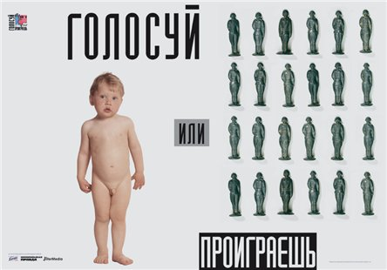
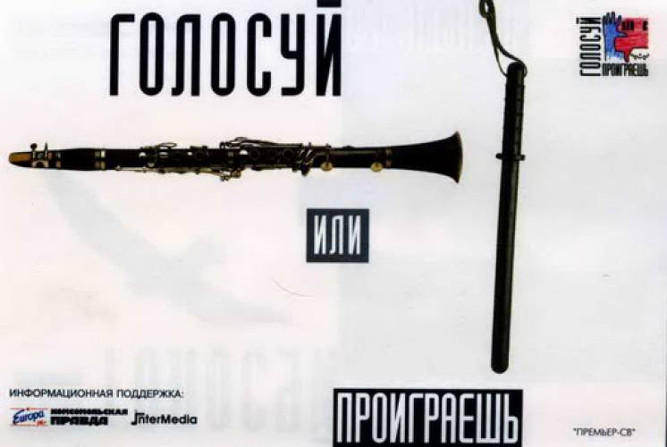
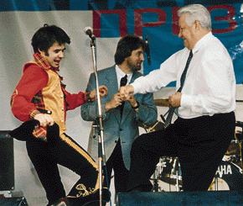
Case#1 Solution 1996 VOTE or LOOSE!
STRATEGY
MONEY
YOUTH
MUSIC

Slide 11
Case#1 Solution
https:/plus.google.com/u/0/

Slide 12
For PRESIDENCY
 | 1991 | 1996(1) | 1996(2) | 2000 | 2004 | 2008 | 2012
YELTSYN | 57,30 | 35,28 | 53,82
ZHIRINOVSKIY | 7,81 | 5,70 |  | 2,70 |  | 9,35 | 6,22
ZUGANOV |  | 32,03 | 40,31 | 29,24 |  | 17,72 | 17,18
YAVLINSKIY |  | 7,34 |  | 5,80
PUTIN |  |  |  | 52,99 | 71,31 |  | 63,60
MEDVEDEV |  |  |  |  |  | 70,28
MIRONOV |  |  |  |  | 0,75 |  | 3,85

Slide 13
2003-2006
2004 - direct elections of region’s heads was abolished
+ an obvious imposition on the heads of membership in UR
totally proportional electoral system at the Federal level
2005 – all-Russian voting day (2nd Sunday of March and September)
from 5% to 7% exclusion threshold
2006 - The line “against all” was abolished
the party lost the right to nominate as a candidate a member of another party
Out of faction – out of Deputy
Early voting returns

Slide 14
Back direction – after 2012
To 5 % exclusion threshold
??? Or abolish it at all?
To direct voting for heads of regions
Since 2015 – mixed system
??? “against all”
???Elections blocks

Slide 15
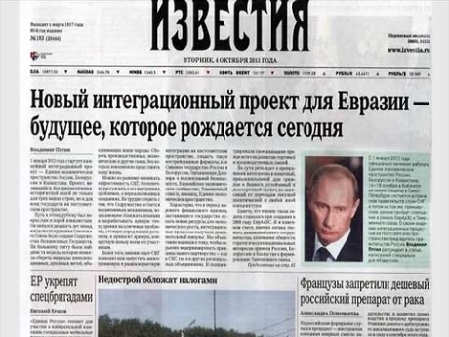
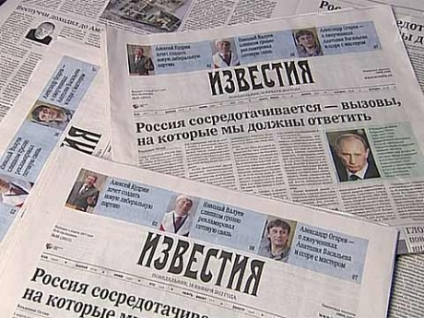
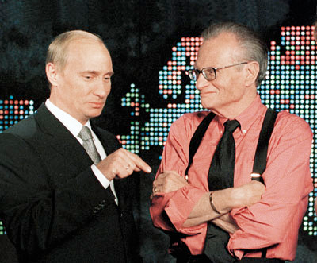
PUTIN’s IMAGE
Mass media
Annual press-conference
Annual “direct line”
Direct translation of message to Federal Assembly
News top
TV, newspapers
Twitter, Facebook …
not I am, but He is

Slide 16
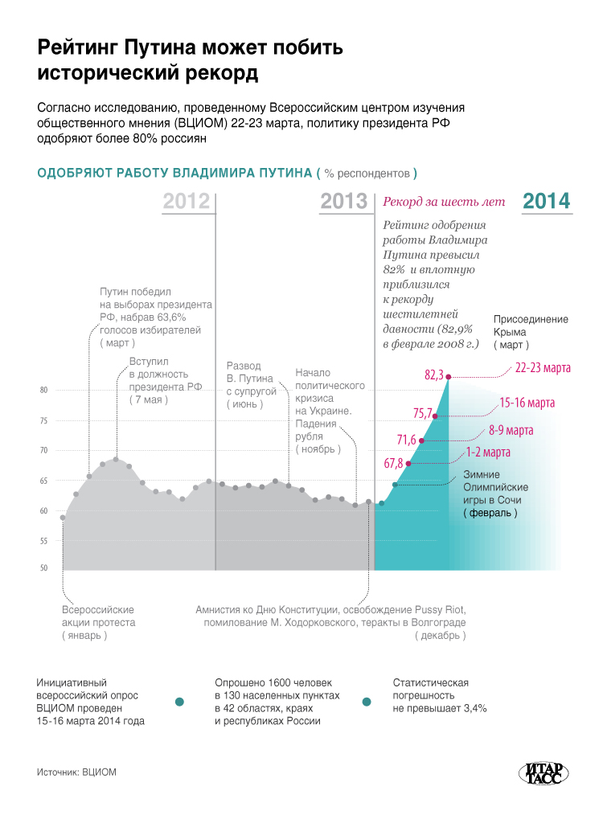
POLITICAL SITUATION in Russia
2000-2008
2008-2012
2012-2018-2024

Slide 17
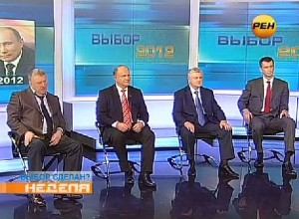
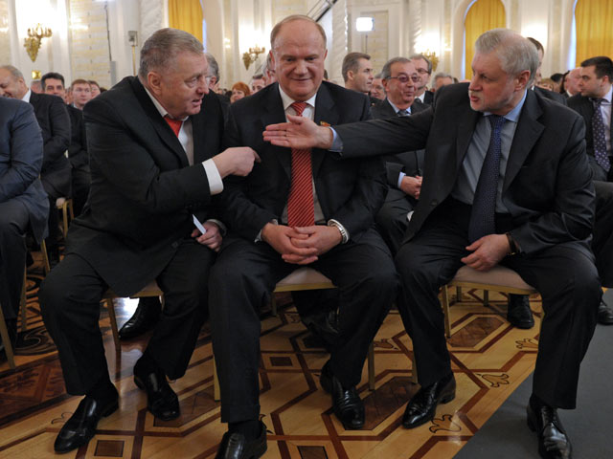

Slide 18
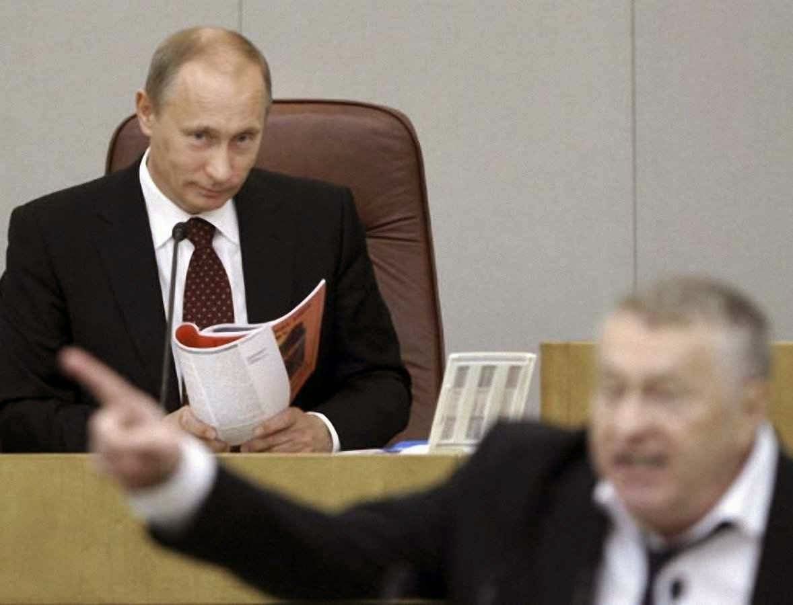
ABOVE POSITION

Slide 19
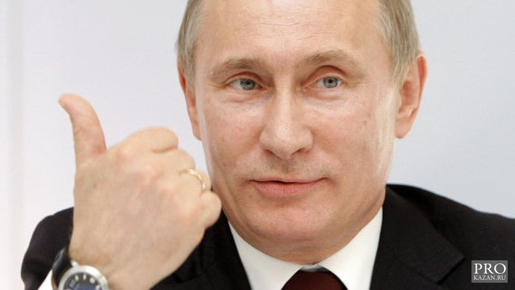
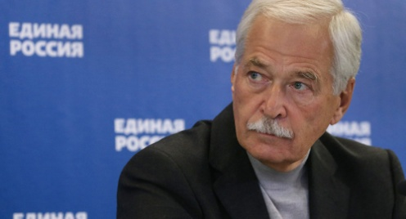
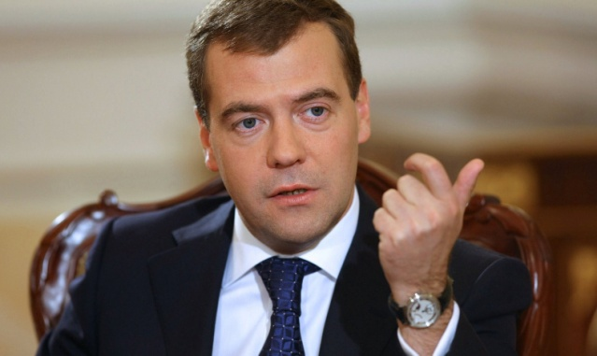
Case#2
YOU ARE POPULAR
THEY ARE NOT
35-64%
315/450
2007 “Putin’s plan – Russia’s victory”
2011
THE PARTY
OF THIEVES AND RASCALS

Slide 20
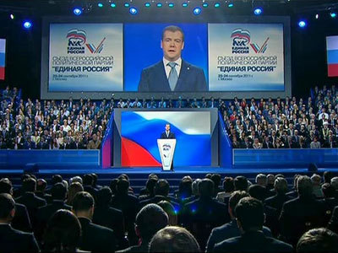
Case#2 Solution
1
2
238/450
all-russia people's front

Slide 21
THE PARTY
OF THIEVES AND RASCALS
front of scammers and crooks

Slide 22
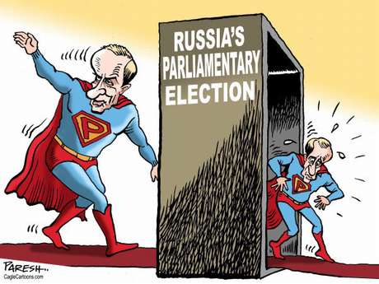

Slide 23
Case#3 How to count?
Ex: 2006 – UR got 38% and took qualified majority
Methods of proportional mandat’s distribution:
Hare-Niemeyer method (simple quotas)
Hamilton’s method
D'Hondt method (Jefferson's method)
Droop quota
Imperiali quota

Slide 24
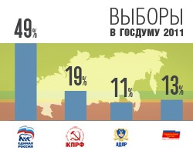
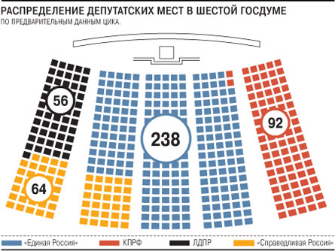
Case#3

