Slide 1
2. March 14
Assessment: 1. Currents news. 2. Reading. 3. Work on paper Russia’s Security Strategies Comparative Analyze.
Warming up: current news discussing (20 min).
Discussion: threats and challenges (20 min)
Reports on reading (20 min)
Lecture:
Security structure, institutes
faces in contemporary Russia (80 min).
Algorithm of official security documents analyzing (40 min).
Assessment:
Currents news.
Reading.
Work on paper comparative analyze of (by choice)
A) Russia’s NS Strategy to 2020 and Russia’s NS Strategy 2015
B) Russia’s NS Strategy 2015 and Security Strategy of the Czech Republic 2015 (or national state of your’s citizenship)
C) Russia’s NS Strategy 2015 and US National Security Strategy 2015
Use a scheme!!!
4. Choose a personality!

Slide 2
3. April 4
Warming up: current news discussing (20 min)
Reports on reading (20 min)
Lecture: Regional and global agenda for Russia’s NS. Main streams (Ukraine, ISIS, Syria, Iran, Afghanistan etc.), membership in regional organizations(G8, G20, Russia-NATO Council). Russia and EU in security context. Russia and former soviet members (CIS, CSTO, Customs Union). Internal security agenda for Russia. Economic development (natural resources/high technologies), political “stabilization” (United Russia party, Putin’s personality, opposition), human dimension (migration, brain drain, ethnic confrontations), etc. (120 min)
Explanations on Simulation process (20 min)
Assessment:
Currents news.
Reading for cyberday.
Simulation preparations

Slide 3
NEWS
+ pre-story
details
evidences
expert’s comments
Prognoses
compare the sources
try to weed out the propaganda
formulate ??? for the shortfall of information
when happened?
where?
what happened?
Who tells?
Whom tells?
What about?
What channel is used?
With what effects?

Slide 4
Theory. Definitions.
National security: case of Russia
S
O
Person
Nature
Technogenic
Social group
Society
State
Group of states
Person
Nature
Technogenic
Social group
Society
State
Group of states
___________________
___________________
___________________
___________________
__________________
___________________
___________________
___________________
___________________
___________________
______________

Slide 5
Theory. Definitions
National security: case of Russia
National Security
State Security
The indicator of the state of the nation,
meaning that
the cumulative impact of internal and external factors
Does not create threats to its existence
may not significantly reduce the quality of the life
The indicator of the situation with state and its institutions,
meaning that
they are able to perform its functions in relation to society.
The state needs:
Protection from other States
From civil society
From the destructive activities of officials

Slide 6
Theory. Definitions
National security: case of Russia
abilities
implementation
The national strategy
programs that are not associated explicitly with a total document
To anticipate
To prevent
Transfer
To recover from
ADVERSE EFFECTS

Slide 7
PRINCIPLES OF NS ENSURING
National security: case of Russia
The preservation of diversity (the adaptation factor)
The accumulation of reserves, creation of reserve capacity, industrial capacity
The growth of the potential manageability
The growth of intelligence of society
Maintaining optimum level of consumption
To teach the society to fight with difficulties
Providing attractive prospects, the General "bright future"

Slide 8
Criteria of NS providing
National security: case of Russia
High quality operational and strategic management, the availability of reserve capacity management
The ability to develop concepts and technologies
the ability to evacuate population and values
Protection of the built environment and population from external factors and destructive actions
The availability of supplies,
power reserve
the dominance of common interests
even if there are internal conflicts

Slide 9

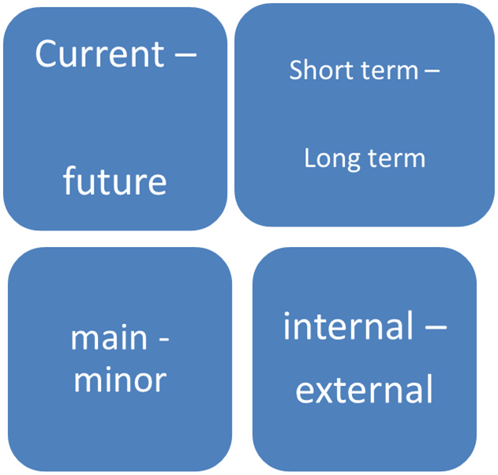
National interests
National security: case of Russia
conscious
goals and values
Arena of providing NI
External
Internal
Borders

Slide 10
Functioning regimes
National security: case of Russia
O
C
M
O
C
M
O
C
M
O
C
M
O
C
M
O - ordinary
M - military
C- catastrophe

Slide 11
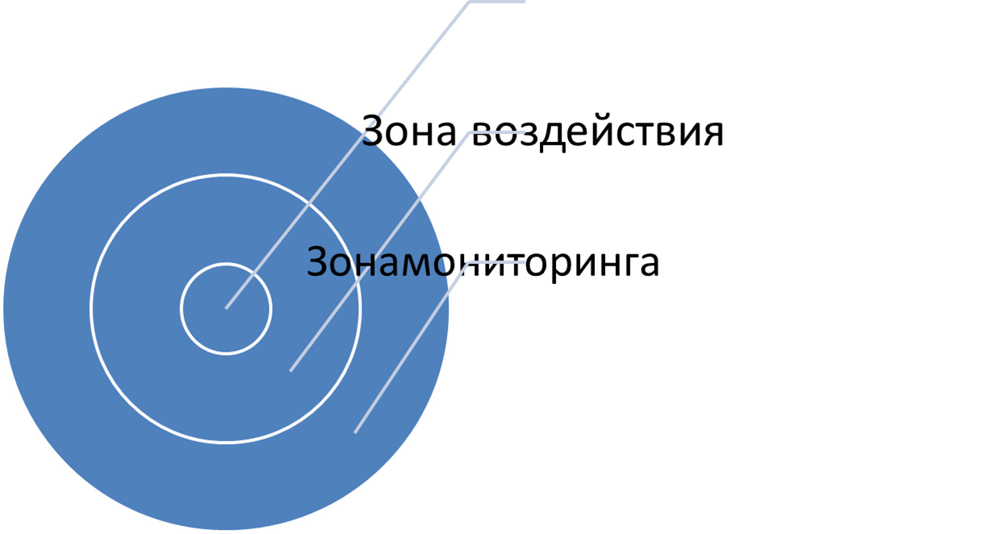



Zones of S providing
National security: case of Russia
The impact zone is the area within which the security system can greatly affect the circumstances.
The impact zone is wider then responsibility zone and may be wider than the monitoring zone.

Slide 12
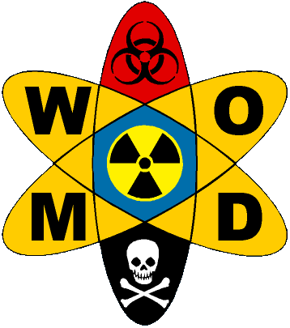
WMD
National security: case of Russia

Slide 13
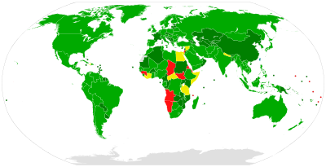
      Biological Weapon Convention (BWC, 1975)

Slide 14

      Chemical Weapon Convention (CWC, 1997)

Slide 15
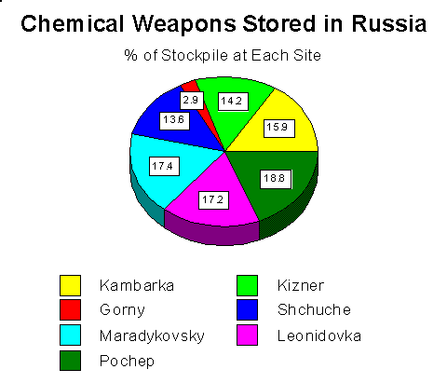
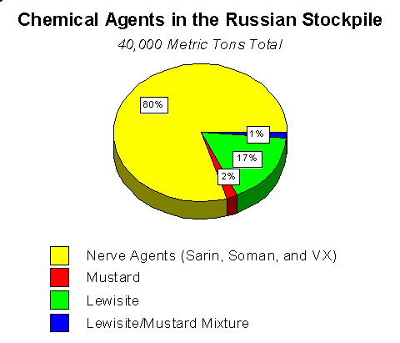

Slide 16
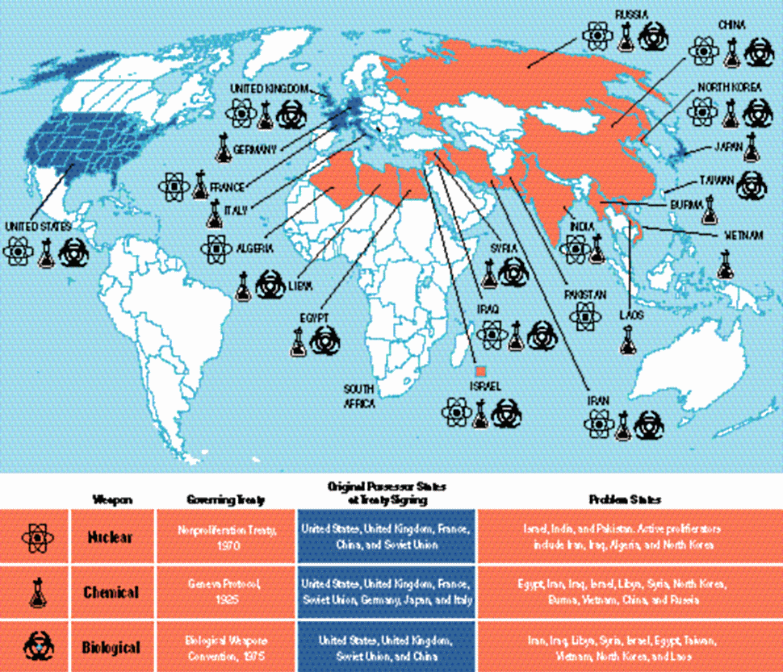

Slide 17
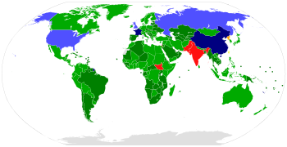
      Treaty on the Non-Proliferation of Nuclear Weapons (NPT, 1968)

Slide 18
NPT “PILLARS”
non-proliferation
A. 1,2
Disarmament
A. 6
right to use nuclear technology peacefully
A.4

Slide 19
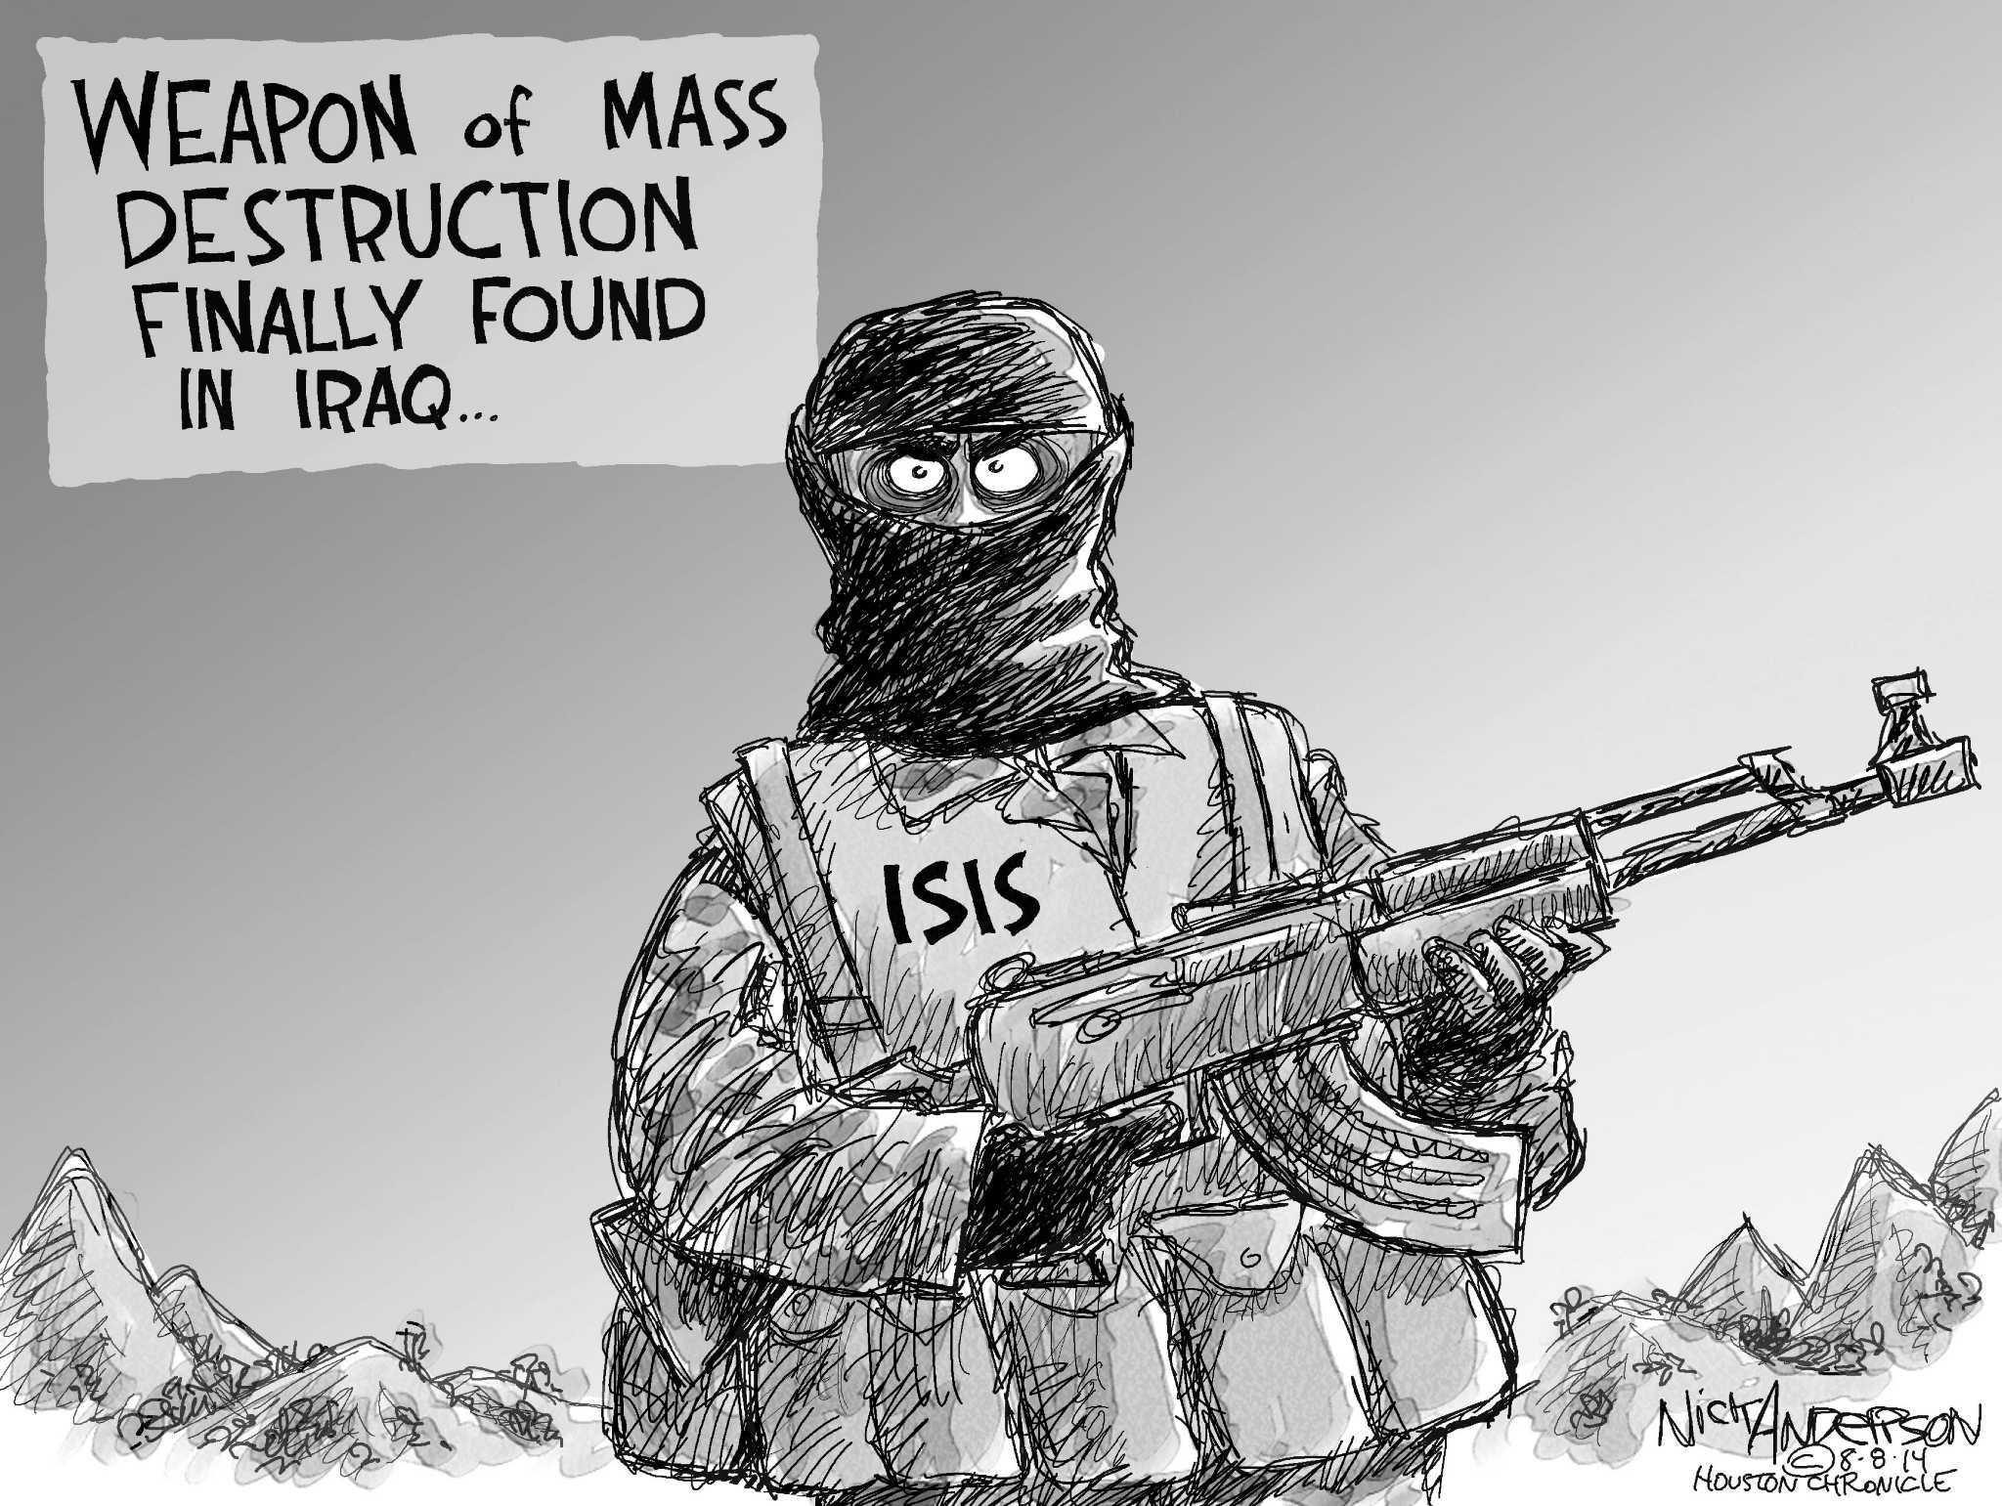

Slide 20
