Slide 1




Psychology of Self-knowledge
2 lecture
Olexandra Loshenko, Ph.D.

Slide 2
  Connection between self-knowledge and psychological categories
Reiteration
Self-knowledge is a complex multilevel process, that is individually expanded over time. Man learns the environment and at the same time – himself, through active interaction with the world.
Self-knowledge is a dynamic process that never ends, because, firstly, there is a constant development of cognitive abilities itself; secondly, the object of cognition – person - changes itself.

Slide 3
  Connection between self-knowledge and psychological categories
Reiteration
Three important meanings of self-knowledge:
for religious person self-knowledge is a way to unite with God through the knowledge of a Divine origin in himself;
on the facile psychological level self-knowledge is as means of the fullest usage of own abilities, skills in life and activities or as means of managing other people;
on a deep psychological level, which the science is trying to uncover, self-knowledge - is the way of gaining mental and psychological health, harmony and maturity, capacity for self-development and self-actualization.

Slide 4
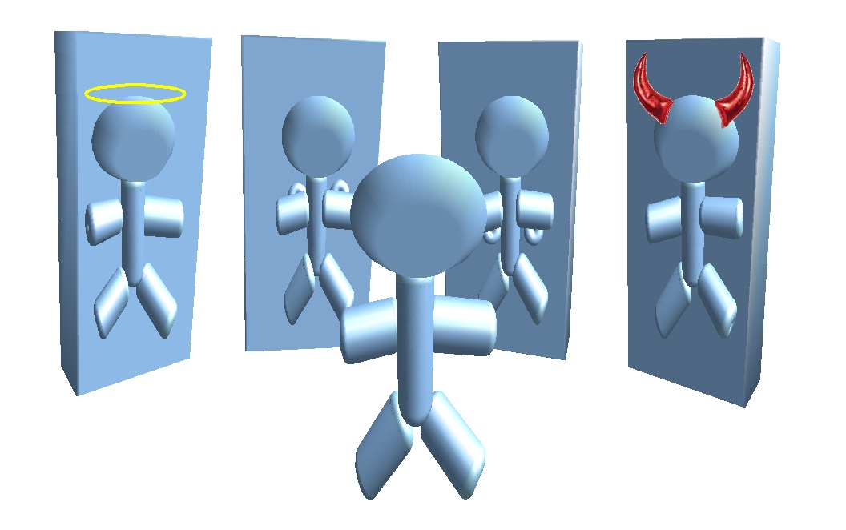
Connection between self-knowledge and psychological categories
Self-esteem
Experience of different emotions that accompany the processes of self-knowledge, forms a human attitude. Knowledge of himself, combined with a certain attitude toward himself is self-esteem.

Slide 5
Connection between self-knowledge and psychological categories
Types of self-esteem
Global and partial
Adequate and
inadequate
Understated or
overestimated

Slide 6
Connection between self-knowledge and psychological categories
Human self-esteem is influenced by various factors
This is the comparison between image of real "Self" and image of ideal "Self".
This is also appropriation of human estimates and standards, which he receives from others, especially from his immediate environment.
Finally, this is a success of human actions - both real and imaginary.

Slide 7
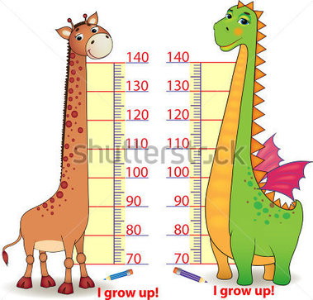
Connection between self-knowledge and psychological categories
How can you determine the self-esteem ?

Slide 8
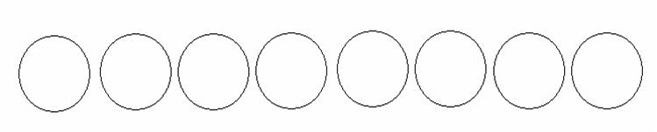
Connection between self-knowledge and psychological categories
Method for determining emotional self-esteem
(by Zaharov)
Instruction: Imagine that represented in figure number of circles - are people. Describe where you are.

Slide 9
Connection between self-knowledge and psychological categories
Results
The third and fourth circle on the left - it is a normal self-esteem. The man adequately perceives features of the “Self-image", realizes its value and accepts himself.
If you specify fifth and further circles – it is a low self-esteem.
If you specify the first circle – it is a high self-esteem.

Slide 10
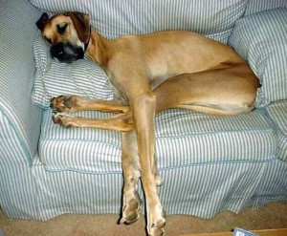


Connection between self-knowledge and psychological categories
Indicators of low self-esteem
The main feature - the attitude of others towards you
Lack of confidence
Applying of false masks
The tendency consistently recollect own failures in life, self-pity
AND SO ON….
Lack of close friends

Slide 11


Connection between self-knowledge and psychological categories
Indicators of high self-esteem
The desire to look better
Arrogant behavior
Rejection of help
Painful perception of criticism
Self-assertion at the cost of others
AND SO ON….

Slide 12
Connection between self-knowledge and psychological categories
Self-Regulation
Regulation of personality traditionally is considered as a streamlining of his properties and bringing them in the line with his requirements.
Modern psychology recognized levels of personal and mental regulation. The level of mental regulation that associated with the mobilization of mental activity, serves as a subjective condition of person's real activity. Personal level encompasses methods of including person in activity, his attitude towards it.

Slide 13
Connection between self-knowledge and psychological categories
The structure of regulation
experience
purpose
subjective model of significant conditions of activity
assessment of controlled conditions of activity
the selection of tactical plan
preparation for it’s implementation
the immediate implementation of the program
correction

Slide 14
Connection between self-knowledge and psychological categories
Self-management should be understood as self-tuning, optimization of mental state, increasing the level and stability of the mood of the person. These aspects are the core of mental regulation. This helps to preserve mental health, positive dynamics of all processes.

Slide 15
Connection between self-knowledge and psychological categories
Types of Self-management
operational (daily)
prospective (caused by distant goal)

Slide 16

Connection between self-knowledge and psychological categories
Self-understanding
Mainly the problem of self-understanding was mentioned in connection with the study of self-consciousness. Self-understanding was considered as a synonym for self-consciousness, self-knowledge, function of self-consciousness, as a sign of a certain level of self-knowledge.

Slide 17

Connection between self-knowledge and psychological categories
What is the difference between self-knowledge and self-understanding?

Slide 18
Connection between self-knowledge and psychological categories
The main function of self-understanding is to interpretate reality and the meaning of existence of his "Self" through awareness and understanding of "self-image" and "self-concept".
Self-knowledge is concerned with the search for knowledge, accumulation, analysis, categorization information about himself.
Self-understanding is concerned with understanding this information, providing of content, its explanation, considering possible causes and effects. It functions as a process of building and correcting the image of "Self".

Slide 19
Connection between self-knowledge and psychological categories
A person should know himself from three sides:
Firstly, self-understanding is a understanding himself as an individual, as a man who has a personality.
Secondly, self-understanding is a understanding himself as a member of the public life, the man who has one faith, one homeland, laws, language and customs with the others.
Thirdly, self-understanding is a understanding himself as creature of God.

Slide 20
Connection between self-knowledge and psychological categories
There is a certain connection between self-knowledge and self-understanding
However, self-understanding acts as the mechanism of social formation and development of personality. In the process of self-understanding occurs cognitive and emotional harmonization of existing ideas about himself with objective reality, which makes it possible to be adequate to the situation, independent from it, makes the man capable for purposeful activity in external changing conditions.

Slide 21
Connection between self-knowledge and psychological categories
Indicators of formed self-understanding
  if he is autonomous, concerns to himself with respect, able to express himself
  if he can understand the motivations and drivers of behavior and their impact on his life
  if he recognizes beliefs, settings that are destroying the harmony of his relationship with himself and the world

Slide 22
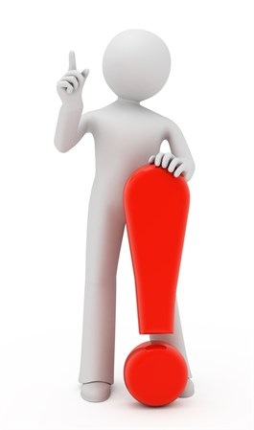
Connection between self-knowledge and psychological categories
Differences between the phenomena of "self-knowledge" and "self-understanding".
In self-knowledge – type of questions: "What am I ?" or "What do I know about myself ?"
In self-understanding - type of questions: "Why did I do so" ?, "Why do I not like this person ?“
The result of self-knowledge is a new knowledge.
The result of self-understanding is a new sense of what man already knows about himself.

Slide 23
Connection between self-knowledge and psychological categories
Self-attitude
Self-attitude is a global feeling "for" or "against" himself in the form of self-esteem, autosympathy, self-interest, expected attitude from others.

Slide 24
Connection between self-knowledge and psychological categories
Such characteristics of personality as communicative, emotional, volitional, motivation (achievement, affiliation), characterological features (dominance, self-control) are personal and activity, education, social environment, age, stressful situations, situations of deprivation - situational determinants of self-attitude.

Slide 25
Connection between self-knowledge and psychological categories
A number of studies have established a close relationship between the attitude of the individual to himself as the subject of life relationships and his behavior. High self-attitude of the individual is a condition of maximum activity, productivity in it, realization of creative potential and also impacts on freedom of feelings expression, the level of self-disclosure in communication. Positive and stable self-attitude is the foundation of human faith in his capabilities, independence, energy, linked to its willingness to take risks, makes optimistic expectations regarding the success of their actions in a situation of uncertainty.

Slide 26
Connection between self-knowledge and psychological categories
The structure of self-attitude
Positive evaluative self-attitude or self-respect
Negative self-attitude or self-abasement
Positive emotional self-attitude or autosympathy
"openness“
"confidence"
"self-management“
"reflected self-attitude"
"intrinsic value“
"self-acceptance“
"self-affection"
"self-incrimination"
"internal conflictness"

Slide 27
Workshop

Slide 28
Observation method in studying emotions
Observation method is one of the oldest methods in studying emotions. Observation methods suggest studying emotions by tracking changes in facial expressions, gestures, vocal response to emotional stimuli. Changes in the face (smile, moodiness, etc.) are an important aspects of social interaction.

Slide 29
Learning emotional expression by the test on recognition facial expressions (by P. Ekman)
Objective: To determine the features of assessment emotional experience by facial movements.
Material of the test consists of 14 photographs with images of the same girl who conveys different emotions. The study is carried out in three stages.

Slide 30
The list of possible emotions
anger
fear
sadness
disgust
contempt
surprise
pleasure

Slide 31
Record form
№ | Emotion (first part) | Emotion (second part) | Emotion (third part) | The keys

Slide 32
1

Slide 34
2

Slide 36
3

Slide 38
4

Slide 40
5

Slide 42
6

Slide 44
7

Slide 46
8

Slide 48
9

Slide 50
10

Slide 52
11

Slide 54
12

Slide 56
13

Slide 58
14

Slide 60
Processing of results:
Check the answers of each series
Calculate the percentage of correct answers

Slide 61
The keys
Photo 1. Light sorrow
Photo 2. Disgust
Photo 3. Light sorrow
Photo 4. Light pleasure
Photo 5. Quiet anger, irritation
Photo 6.Light fear
Photo 7. Disgust
Photo 8. Sadness, unhappiness
Photo 9. Masked anger
Photo 10.Fear or attention
Photo 11. Controlled anger
Photo 12. Concern
Photo 13. Controlled anger
Photo 14. Contempt

Slide 62
Make conclusions
Analyze which emotional feelings are rated most difficult and why. Provide an explanation of how and why the time of assessment of emotional feelings affects the outcome of this evaluation.

Slide 63

QUESTIONS?

Slide 64
YOUR TASK
You should think
Can the test on recognition facial expressions by P. Ekman be used to study the level of emotional intelligence ?
What is the difference in expressing emotions between the cultures?
You should do
Emotional diary
You should read
Facial Expression of Emotion by D. Keltner and P. Ekman
Assessing Self-Esteem by Todd F. Heatherton and Carrie L. Wyland
You should write
Essay on the next topic “Self-knowledge is a self-baring, or not ?”
Several questions based on the reading of D. Keltner and P. Ekman, Todd F. Heatherton and Carrie L. Wyland

Slide 65

Connection between self-knowledge and psychological categories

