Slide 1




Psychology of Self-knowledge
3 lecture
Olexandra Loshenko, Ph.D.

Slide 2
Emotional self-awareness of personality
Emotional self-awareness - is a cognition of our own emotions and feelings that disclose personality with the aim of self-transformation.
Emotional self-awareness can be seen as a way of human interaction with the world, in fact, as a process and as a statement of the result of this interaction, and as the external aspect of self-knowledge.

Slide 3
Emotional self-awareness of personality
Functions of emotional self- awareness
Identification of actual emotions
and feelings
Awakening of new emotions
and feelings
The purpose of emotional self-awareness - realization of emotional exchange.

Slide 4

Emotional self-awareness of personality
"Emotion - is the inevitable part of life. People should know about the fact that it is not harmful for making rational decisions".
(D. Goleman)

Slide 5
Emotional self-awareness of personality
An opportunity to understand ourselves and make important decisions.
The key to interpersonal interaction
Benefit of emotional competence
The ability to create diversity of links with the world
Preference in dealing with stress

Slide 6
Emotional self-awareness of personality
The structure of emotional competence
Personal competence
Social competence
understanding ourselves
self-regulation
motivation
empathy
social skills

Slide 7
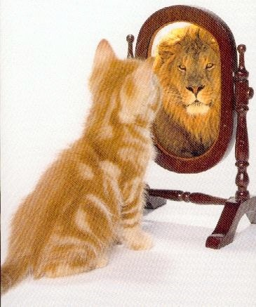
Emotional self-awareness of personality
Understanding ourselves
emotional understanding of ourselves
adequate self-esteem
self-confidence

Slide 8

Emotional self-awareness of personality
Self-regulation
self-control
reliability
conscientiousness
adaptability
openness to something new

Slide 9

Emotional self-awareness of personality
Motivation
the motive of achievement
obligatoriness
initiative
optimism

Slide 10

Emotional self-awareness of personality
Empathy
understanding of others
promoting the development of others
service orientation
use of diversity
political sensitivity

Slide 11

Emotional self-awareness of personality
Social skills
persuasion
communication
conflict resolution
leadership
catalyzation of changes
creating links
collaboration and cooperation
ability to work in a team

Slide 12
Emotional self-awareness of personality
The structure of emotional competence by C.Saarni
awareness of own emotional states;
ability to distinguish the emotions of others;
the ability to use a dictionary of emotions and expressions adopted in culture;
capability sympathetic and empathic inclusion in experiences of others;
the ability to understand that the internal emotional state does not necessarily correspond to the external expression both the individual and other people;
ability to cope with negative feelings;
the realization that the structure and nature of the relationship is largely determined by how emotions are expressed in the relationships;
ability to be emotionally adequate.

Slide 13
Emotional self-awareness of personality
The structure of emotional competence by O.Loshenko
self-acceptance
awareness of own emotional states and their expression
the ability to recognize the emotions of others
emotional self-improvement
self-regulation and regulation emotions of others

Slide 14

Emotional self-awareness of personality
Self-acceptance - is positive attitude towards ourselves and our past. Ability humorous look at things that occur in life.
It consists of:
self-love (as love to ourselves)
self-esteem
self-trust.

Slide 15
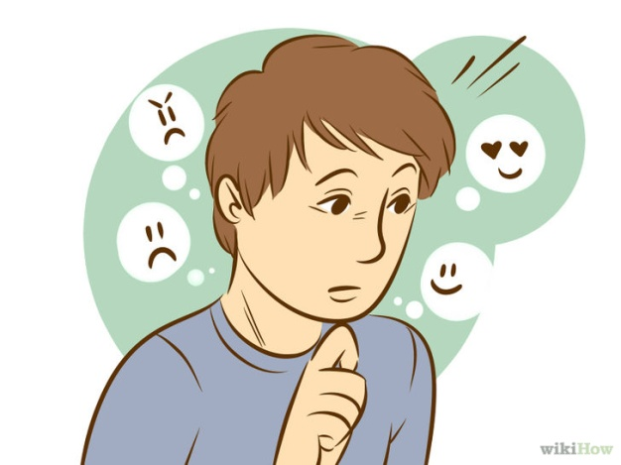
Emotional self-awareness of personality
Awareness of own emotional states and their expression (emotional self-awareness) - the ability to understand own feelings and experiences at any time, the ability to talk about them, the ability to gane knowledge about what is happening around us.
It consists of:
self-awareness
introspection
self-esteem

Slide 16
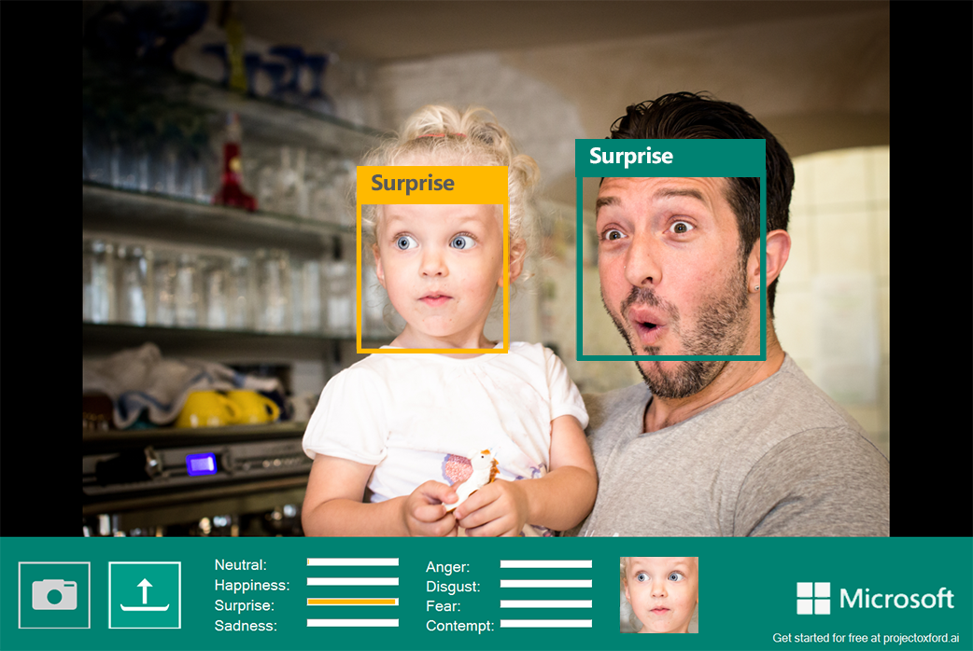
Emotional self-awareness of personality
The ability to recognize the emotions of others - at the same time, means the ability to maintain positive relationships with others. The ability to recognize the emotions of others - is a complex process that transforms the perceptual experience to inner experience, modifying it.
It consists of:
sympathy
openness
empathy

Slide 17

Emotional self-awareness of personality
Emotional self-improvement - the ability to develop own potential, openness to new experience.
It consists of:
emotional literacy
openness
activity

Slide 18

Emotional self-awareness of personality
Self-regulation and regulation emotions of others - is the ability to receive and control the feelings and emotions own, and others. The ability to use emotions to achieve goals.
It consists of:
self-control
sociability
trust to ourselves

Slide 19
Emotional self-awareness of personality
Criterias of emotional competence:
the level of emotional literacy,
the ability to use emotional knowledge in practice,
the formation of all components of emotional competence of personality.

Slide 20
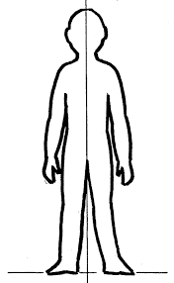
Emotional self-awareness of personality

Slide 21
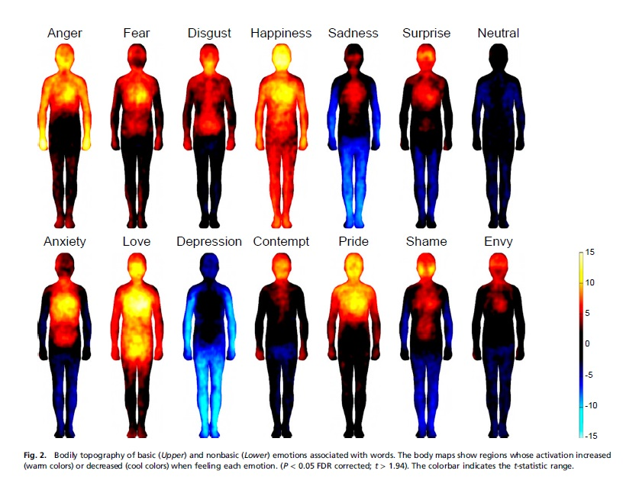
Emotional self-awareness of personality
Bodily maps of emotions

Slide 22
YOUR TASK
You should analyze
The role of emotional self-knowledge on the way to the interaction with the world.
The emotional readiness of the individual to change.
You should do
Emotional diary
You should read
Bodily maps of emotions by Lauri Nummenmaa, Enrico Glereana, Riitta Harib, and Jari K. Hietanend
Universals and cultural differences in facial expressions of emotion by P.Ekman
You should write
Essay on the next topic “Self-knowledge is a self-baring, or not ?”
Several questions based on the reading of new articles

Slide 23


