Slide 1
Psychology of Self-knowledge 4 lecture
Olexandra Loshenko, Ph.D.

Slide 2
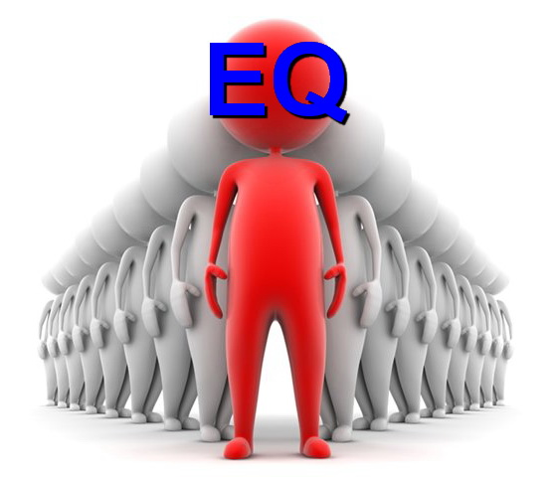
Emotional intelligence as a phenomenon of modern psychology
Contents
A definition and why EI is important
Components of EI
EI development
EI assessment

Slide 3
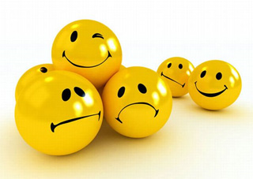
Emotional intelligence as a phenomenon of modern psychology
The term emotional intelligence was officially coined in 1990 by Salovey and Mayer.

Slide 4
Emotional intelligence as a phenomenon of modern psychology
Emotional Intelligence Defined
“an array of non-cognitive capabilities, competencies and skills that influence one’s ability to succeed in coping with environmental demands and pressures”
— Reuven BarOn
“the ability to perceive emotions, to access and generate emotions so as to assist thought, to understand emotions and emotional meanings, and to reflectively regulate emotions in ways that promote emotional and intellectual growth”
— Salovey & Mayer
“the capacity for recognizing our own feelings and those of others, for motivating ourselves, and for managing emotions well in ourselves and in our relationships”
— Daniel Goleman

Slide 5
Emotional intelligence as a phenomenon of modern psychology
What is Emotional Intelligence?
Emotional intelligence is not about being nice all the time. It is about being honest.
Emotional intelligence is not about being “touchy-feely.” It is about being aware of your feelings, and those of others.
Emotional intelligence is not about being emotional. It is about being smart with your emotions.

Slide 6
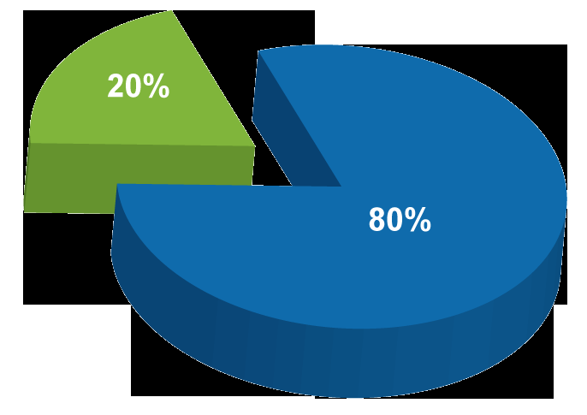
Emotional intelligence as a phenomenon of modern psychology
Why is Emotional Intelligence Important?
Some research shows that IQ can help you to be successful to the extent of 20 percent only in life. The rest of 80 percent success depends on your EQ.

Slide 7
Emotional intelligence as a phenomenon of modern psychology
Why is Emotional Intelligence Important?
Physical Health – The ability to take care of our bodies and especially to manage our stress, which has an incredible impact on our overall wellness, is heavily tied to our emotional intelligence. Only by being aware of our emotional state and our reactions to stress in our lives can we hope to manage stress and maintain good health.

Slide 8
Emotional intelligence as a phenomenon of modern psychology
Why is Emotional Intelligence Important?
Mental Well-Being – Emotional intelligence affects our attitude and outlook on life. It can also help to alleviate anxiety and avoid depression and mood swings. A high level of emotional intelligence directly correlates to a positive attitude and happier outlook on life.

Slide 9
Emotional intelligence as a phenomenon of modern psychology
Why is Emotional Intelligence Important?
Relationships – By better understanding and managing our emotions, we are better able to communicate our feelings in a more constructive way. We are also better able to understand and relate to those with whom we are in relationships. Understanding the needs, feelings, and responses of those we care about leads to stronger and more fulfilling relationships.

Slide 10
Emotional intelligence as a phenomenon of modern psychology
Why is Emotional Intelligence Important?
Conflict Resolution – When we can discern people’s emotions and empathize with their perspective, it’s much easier to resolve conflicts or possibly avoid them before they start. We are also better at negotiation due to the very nature of our ability to understand the needs and desires of others. It’s easier to give people what they want if we can perceive what it is.

Slide 11
Emotional intelligence as a phenomenon of modern psychology
Why is Emotional Intelligence Important?
Success – Higher emotional intelligence helps us to be stronger internal motivators, which can reduce procrastination, increase self-confidence, and improve our ability to focus on a goal. It also allows us to create better networks of support, overcome setbacks, and persevere with a more resilient outlook. Our ability to delay gratification and see the long-term directly affects our ability to succeed.

Slide 12
Emotional intelligence as a phenomenon of modern psychology
Why is Emotional Intelligence Important?
Leadership – The ability to understand what motivates others, relate in a positive manner, and to build stronger bonds with others in the workplace inevitably makes those with higher emotional intelligence better leaders. An effective leader can recognize what the needs of his people are, so that those needs can be met in a way that encourages higher performance and workplace satisfaction. An emotionally savvy and intelligent leader is also able to build stronger teams by strategically utilizing the emotional diversity of their team members to benefit the team as a whole.

Slide 13
Emotional intelligence as a phenomenon of modern psychology
What is the Bar-On Model?

Slide 14
Emotional intelligence as a phenomenon of modern psychology
Emotional Competencies (BarOn EQ-i®)
INTRAPERSONAL SCALES
Self-regard
Emotional self-awareness
Assertiveness
Independence
Self-actualization
INTERPERSONAL SCALES
Empathy
Social responsibility
Interpersonal relationship
ADAPTABILITY
Reality testing
Flexibility
Problem solving
STRESS MANAGEMENT
Stress tolerance
Impulse control
GENERAL MOOD
Optimism
Happiness

Slide 15
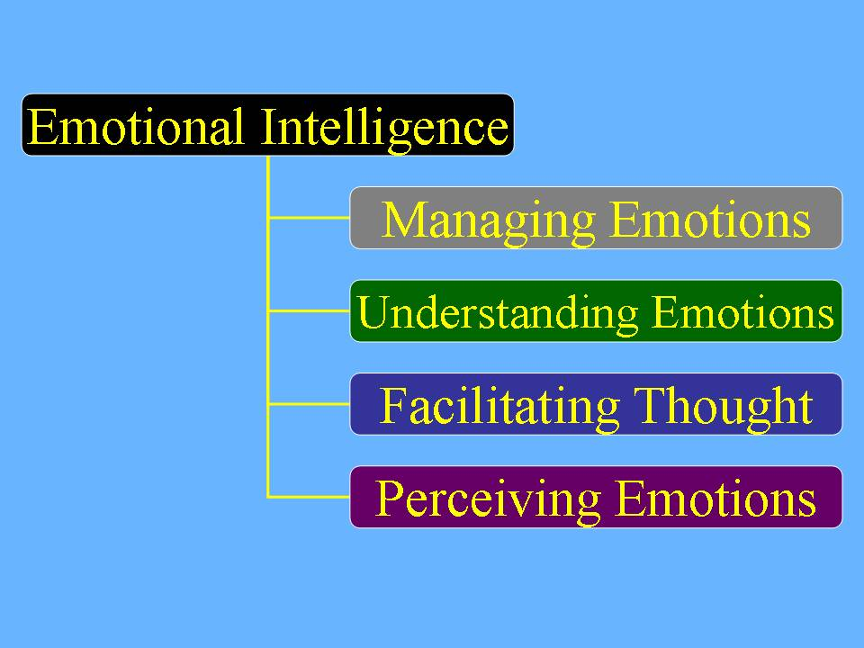
Emotional intelligence as a phenomenon of modern psychology
What is the Salovey-Mayer Model?

Slide 16
Emotional intelligence as a phenomenon of modern psychology
1. Perception, Appraisal and Expression of Emotion
Ability to identify emotion in one's physical states, feelings, and thoughts.
Ability to identify emotions in other people, designs, artwork, etc. through language, sound, appearance, and behavior.
Ability to express emotions accurately, and to express needs related to those feelings.
Ability to discriminate between accurate and inaccurate, or honest vs. dishonest expressions of feeling.

Slide 17
Emotional intelligence as a phenomenon of modern psychology
2. Emotional Facilitation of Thinking
Emotions prioritize thinking by directing attention to important information.
Emotions are sufficiently vivid and available that they can be generated as aids to judgment and memory concerning feelings.
Emotional mood swings change the individual's perspective from optimistic to pessimistic, encouraging consideration of multiple points of view.
Emotional states differentially encourage specific problem-solving approaches such as when happiness facilitates inductive reasoning and creativity.

Slide 18
Emotional intelligence as a phenomenon of modern psychology
3. Understanding and Analyzing Emotions; Employing Emotional Knowledge
Ability to label emotions and recognize relations among the words and the emotions themselves, such as the relation between liking and loving.
Ability to interpret the meanings that emotions convey regarding relationships, such as that sadness often accompanies a loss.
Ability to understand complex feelings: simultaneous feelings of love and hate or blends such as awe as a combination of fear and surprise.
Ability to recognize likely transitions among emotions, such as the transition from anger to satisfaction or from anger to shame.

Slide 19
Emotional intelligence as a phenomenon of modern psychology
4. Reflective Regulation of Emotion to Promote Emotional and Intellectual Growth
Ability to stay open to feelings, both those that are pleasant and those that are unpleasant.
Ability to reflectively engage or detach from an emotion depending upon its judged informativeness or utility.
Ability to reflectively monitor emotions in relation to oneself and others, such as recognizing how clear, typical, influential or reasonable they are.
Ability to manage emotion in oneself and others by moderating negative emotions and enhancing pleasant ones, without repressing or exaggerating information they may convey.

Slide 20
Emotional intelligence as a phenomenon of modern psychology
In 1997 Salovey and Mayer said that the branches in the chart are:
“arranged from more basic psychological processes to higher, more psychologically integrated processes. For example, the lowest level branch concerns the (relatively) simple abilities of perceiving and expressing emotion. In contrast, the highest level branch concerns the conscious, reflective regulation of emotion”.

Slide 21
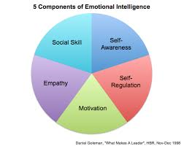
Emotional intelligence as a phenomenon of modern psychology
What is the Goleman Model?

Slide 22
Emotional intelligence as a phenomenon of modern psychology
Self-awareness. The ability to recognize and understand personal moods and emotions and drives, as well as their effect on others. Self-awareness include self-confidence, realistic self-assessment, and a self-deprecating sense of humor. Self-awareness depend on one's ability to monitor one's own emotion state and to correctly identify and name one’s emotions.

Slide 23
Emotional intelligence as a phenomenon of modern psychology
Self-regulation. The ability to control or redirect disruptive impulses and moods, and the propensity to suspend judgment and to think before acting. Self-regulation includes trustworthiness and integrity; comfort with ambiguity; and openness to change.

Slide 24
Emotional intelligence as a phenomenon of modern psychology
Internal motivation. A passion to work for internal reasons that go beyond money and status -which are external rewards, - such as an inner vision of what is important in life, a joy in doing something, curiosity in learning, a flow that comes with being immersed in an activity. A propensity to pursue goals with energy and persistence. Internal motivation includes a strong drive to achieve, optimism even in the face of failure, and organizational commitment.

Slide 25
Emotional intelligence as a phenomenon of modern psychology
Empathy. The ability to understand the emotional makeup of other people. A skill in treating people according to their emotional reactions. Empathy includes expertise in building and retaining talent, cross-cultural sensitivity, and service to clients and customers. (In an educational context, empathy is often thought to include, or lead to, sympathy, which implies concern, or care or a wish to soften negative emotions or experiences in others.)

Slide 26
Emotional intelligence as a phenomenon of modern psychology
Social skills. Proficiency in managing relationships and building networks, and an ability to find common ground and build rapport. Social skills include effectiveness in leading change, persuasiveness, and expertise building and leading teams.

Slide 27
Emotional intelligence as a phenomenon of modern psychology
The development of EI

Slide 28
Emotional intelligence as a phenomenon of modern psychology
The development of EI
Practice Observing How You Feel
Pay Attention to How You Behave
Take Responsibility for Your Feelings and Behavior
Practice Responding, Rather than Reacting
Practice Empathizing with Yourself and Others
Create A Positive Environment
Remember EI is a Lifetime Process

Slide 29
Emotional intelligence as a phenomenon of modern psychology
EI assessment
Many tests that promise to measure emotional intelligence have appeared in recent years. Some of these tests seem promising, but many have not been empirically evaluated.
Here are some of them:
BarOn Emotional Quotient Inventory
Emotional & Social Competence Inventory
Emotional & Social Competence Inventory – U
Genos Emotional Intelligence Inventory
Group Emotional Competency Inventory
Mayer-Salovey-Caruso EI Test (MSCEIT)
Schutte Self Report EI Test
Trait Emotional Intelligence Questionnaire (TEIQue)
Work Group Emotional Intelligence Profile
Wong's Emotional Intelligence Scale

Slide 30
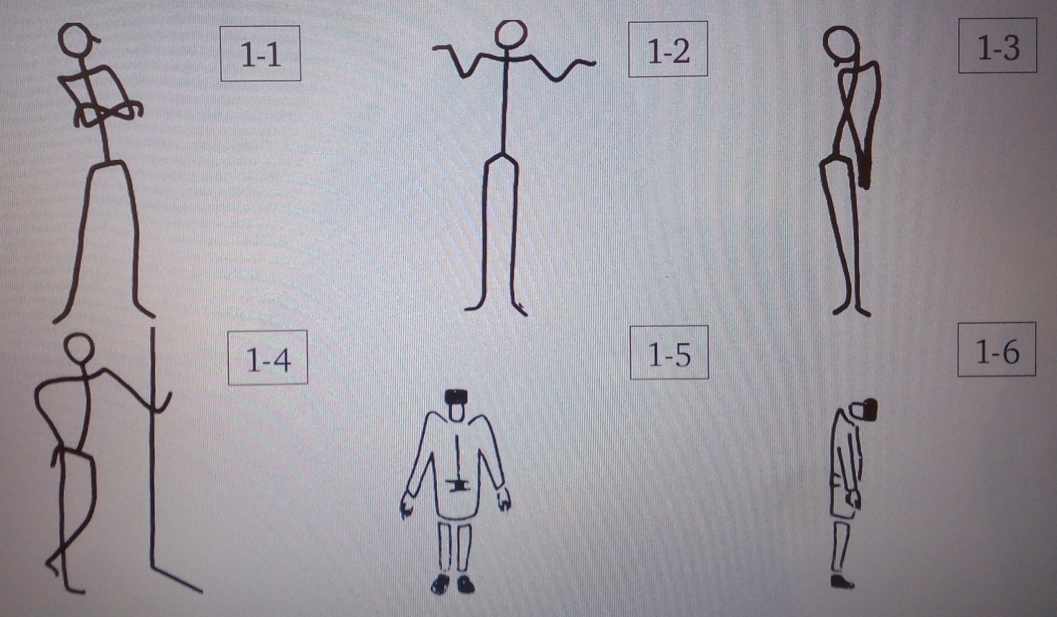
Emotional intelligence as a phenomenon of modern psychology
Poses

Slide 31
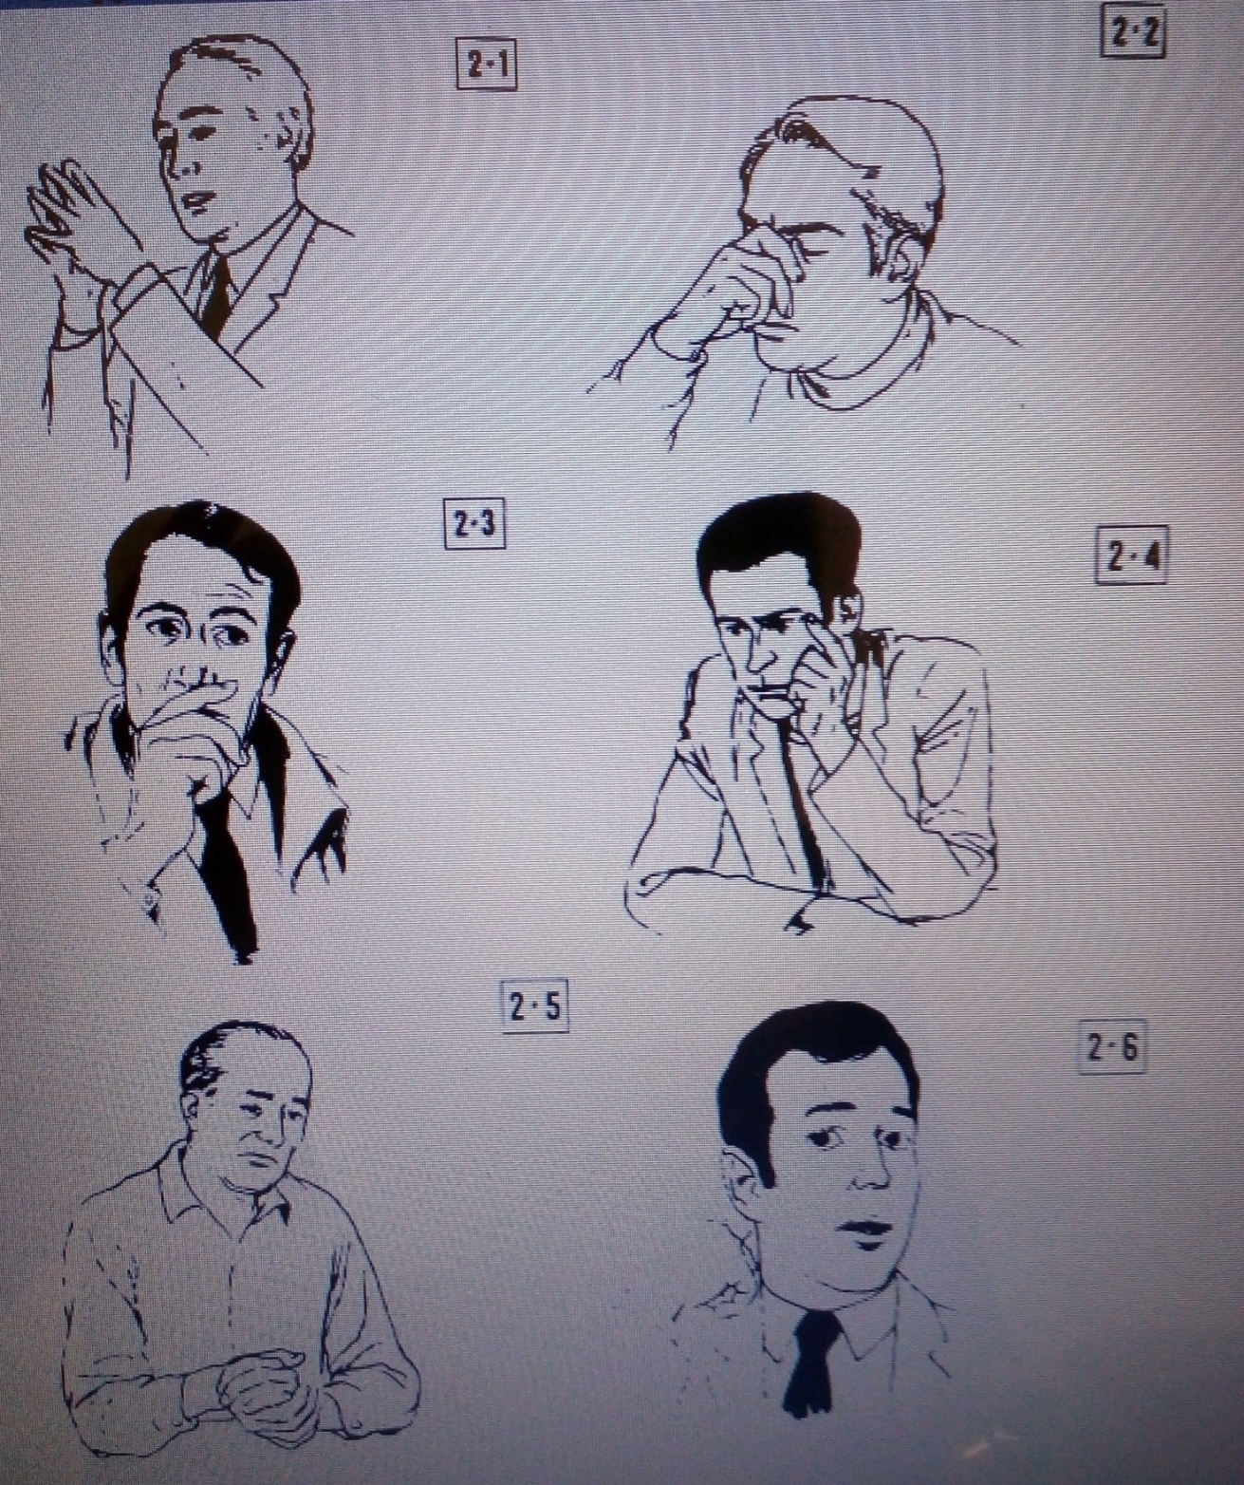
Facial expressions,
gestures

Slide 32
YOUR TASK
You should analyze
Justify the connection between emotional intelligence and success in life.
Modern problems in studying emotional intelligence.
You should do
Emotional diary
You should read
McPheat Sean (2010) Emotional Intelligence. MTD Training & Ventus Publishing ApS.
Goleman D. (1996) Emotional Intelligence: Why It Can Matter More Than IQ. New York Times.
You should write
Essay on the next topic “Self-knowledge is a self-baring, or not ?”
Several questions based on the reading of new articles

