Slide 1
Online aggression and current youth
Dr. Hana Macháčková

Slide 2
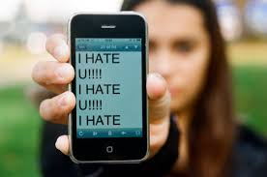
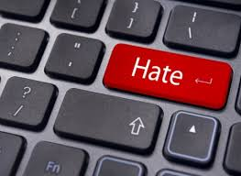

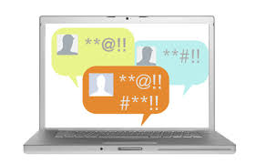
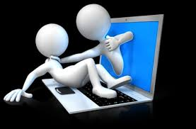
Aggression online
Seemingly ubiquitous
Everyday experience?
  Discussions: increased hostility, prejudices,
  intolerance, aggressivity…
Without boundaries?

Slide 3
Aggression
Broad and complex term
Aggression is….“any form of behavior directed toward the goal of harming or injuring another living being who is motivated to avoid such treatment“ (Baron & Richardson, 2004, p.7)
It can take many forms:
Direct/nondirect
Verbal/physical/sexual….
Other-oriented/self-oriented
Interpersonal/intergoup
Etc.
Online/offline

Slide 4
Aggression
Broad and complex term
Aggression is….“any form of behavior directed toward the goal of harming or injuring another living being who is motivated to avoid such treatment“ (Baron & Richardson, 2004, p.7)
It can take many forms:
Direct/nondirect
Verbal/physical/sexual….
Other-oriented/self-oriented
Interpersonal/intergoup
Etc.
Online / offline
Need to specify type of aggression we are talking about

Slide 5
Aggression online
Various types
  Mirroring offline ones
  Cyberbullying, online harassment, trolling, cyberhate, cybercrime, cyberterrorism…

Slide 6
Aggression online
Various types
  Mirroring offline ones
  Cyberbullying, online harassment, trolling, cyberhate, cybercrime, cyberterrorism…
We will focus on cyberbullying/aggression and hate communities

Slide 7
Aggression online
Various types
  Mirroring offline ones?
  Cyberbullying, online harassment, trolling, cyberhate, cybercrime, cyberterrorism…
Interconnection with offline life
  Extension, augmentation, blending…
Cyberspace: Important aspect of everyday life
  „virtual“ but „real“
Cyberspace: specific social environment

Slide 8


Differences from offline environment(s)
Computer-mediated communication (CMC)
  Text, visuality, hypertexts
  A/synchronic communication
  Absence of many cues
    Currently, more rich (emoticons, audio-visual cues etc.)
    „say it with gif“, memes
LOL

Slide 9
Differences from offline environment(s)
Control of self-expressions
Asynchronous communication
Visuals (graphs), hyperlinks
No others clues (gestures, posture, voice, speach)
  The lack of cues as a source of misunderstandings
  BUT, they may pose a barrier in communication offline
  Distance, anonymity, invisibility….
Storing, sharing, spreading
  Materials and information
24/7 accessibility
  countries with high internet penetration
  Digital divide

Slide 10
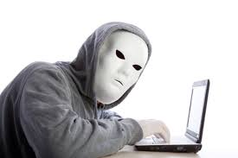
Online disinhibition effect (Suler, 2004)
Anonymity, invisibility, asynchronicity, solipstic introjection, dissociative imagination, minimization of status and authority
Toxic and benign
  hostillity x self-disclosure and support
Developed before web2.0
Anonymity???

Slide 11
Online disinhibition effect (Suler, 2004)
Anonymity, invisibility, asynchronicity, solipstic introjection, dissociative imagination, minimization of status and authority
Toxic and benign
  hostillity x self-disclosure and support
Developed before web2.0
Anonymity???
Still applicable
Psychological vs.
informatial

Slide 12
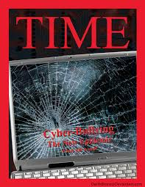
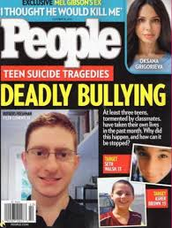
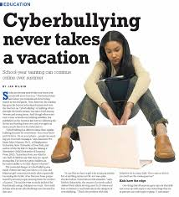
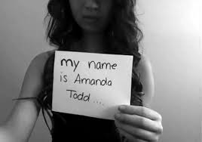
Cyberbullying and online aggression (harassment)
Cyberbullying: do you know the term?
Highly medialized
Contrast with empirical evidence

Slide 13
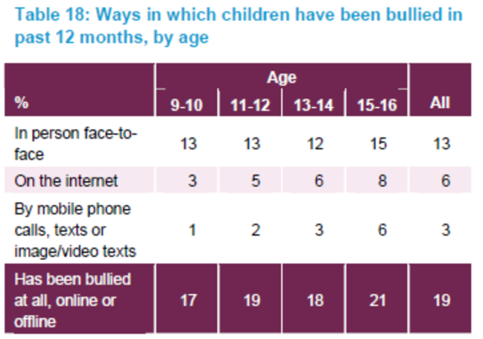
Cyberbullying and online aggression (harassment)
Cyberbullying: do you know the term?
Highly medialized
Contrast with empirical evidence
Kowalski et al. (2014): 10% - 40%
Also 3% - 70%

Slide 14
Cyberbullying and online aggression (harassment)
Definition of school bullying (Olweus, 1991) – criteria of
1 Intentional, causing harm
2 Repetitive
3 Power imbalance
Also many forms:
Overt/covert
Relational/Physical/Social
Physical/verbal attacks, degradation/humiliation, blackmailing, destroying things, social exclusion, ignoring…

Slide 15
Cyberbullying and online aggression (harassment)
Cyberbullying: intentional and aggressive act carried out through electronic media, which may be repetitive in nature (Nocentini et al., 2010; Tokunaga, 2010)
What are the forms here?
Verbal attacks, insults, threats, gossips…
Spreading of personal and sensitive information
  Without consent
Identity theft, mascarade
Social exclusion, ostracism
Publishing of harmful audiovisual material (changed)
Happy slapping
...

Slide 16
Cyberbullying and online aggression (harassment)
We are talking about cyberbullying if the aggressive attacks :
are conducted via internet or mobile phones
are intentionally harmful (conducted by individual or group)
  and are harmful for victim
are repeated (however….)
there is power imbalance – the victims can‘t easily defend themselves

Slide 17
Cyberbullying and online aggression (harassment)
We are talking about cyberbullying if the aggressive attacks :
are conducted via internet or mobile phones
are intentionally harmful (conducted by individual or group)
  and are harmful for victim
are repeated (however….)
there is power imbalance – the victims can‘t easily defend themselves
Harm is not always present!
Difficulties of harm assessment

Slide 18
Cyberbullying and online aggression (harassment)
We are talking about cyberbullying if the aggressive attacks :
are conducted via internet or mobile phones
are intentionally harmful (conducted by individual or group)
  and are harmful for victim
are repeated (however….)
there is power imbalance – the victims can‘t easily defend themselves
Repetition: problematic online
„once published, always online“
Important in messaging (email, phones…)

Slide 19
Cyberbullying and online aggression (harassment)
We are talking about cyberbullying if the aggressive attacks :
are conducted via internet or mobile phones
are intentionally harmful (conducted by individual or group)
  and are harmful for victim
are repeated (however….)
there is power imbalance – the victims can‘t easily defend themselves
Digital skills?
Always online
Aggressors‘ anonymity (rare)

Slide 20
Cyberbullying and online aggression (harassment)
We are talking about cyberbullying if the aggressive attacks :
are conducted via internet or mobile phones
are intentionally harmful (conducted by individual or group)
  and are harmful for victim
are repeated (however….)
there is power imbalance – the victims can‘t easily defend themselves
If these criteria are not fullfilled:
online aggression/harassment

Slide 21
Cyberbullying and online aggression (harassment)
„New bottle, old wine“?
What is „new“?
No time/space limits – no escape
Distance – the victim does not have to be present (adding comments, likes, spreading of information….)
Wide audience - potential
Spreading and sharing – easy and fast, unlimited
No control over the content
Can be „hidden“ – out of control of adults

Slide 22
Cyberbullying and online aggression (harassment)
„New bottle, old wine“?
What is „new“?
Victims – offline often vulnerable
In cyberbullying: potential for new vulnerability
Remember „diminishing of authority“, anonymity?
More often: frequent internet users, users of webcams and IM

Slide 23
Cyberbullying and online aggression (harassment)
Cyberbullying: detrimental effect on victims
Similar to offline bullying
Including:
Internalization and externalizing behaviors
Emotional problems (depression, anxiety, suicidal thougths)
Social problems
Lower self-esteem
Helplessness
Academic problems
Etc.

Slide 24
Cyberbullying and online aggression (harassment)
The impact depends on the severity of the attacks
- importance to distinguish cyberbullying and harassment!
CB could be more harmful then offline
  Especially cases of public forms, and especially including audiovisual materials (Sticca & Perren, 2013)
Depends on the interconnection with offline bullying
- usually connected („double whammies“)
Also depends on coping with cyberbullying

Slide 25
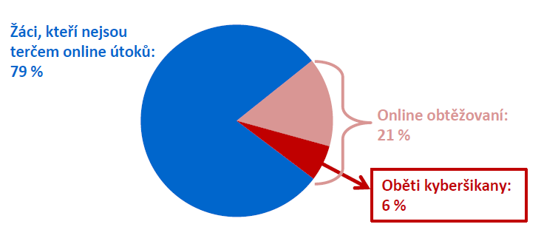
Cyberbullying and online aggression (harassment)
The impact depends on the severity of the attacks
- importance to distinguish cyberbullying and harassment!
Could be more harmful then offline
  Especially cases of public forms, and especially including audiovisual materials (Sticca & Perren, 2013)
Differences in prevalences and impact
Cyberbullying: less common, but more severe
Czech project: 79% no victimization
21% harassment
See: http://irtis.fss.muni.cz/wp-content/uploads/2013/06/COST_CZ_report_II_CJ.pdf
6% CB victims

Slide 26
Cyberbullying and online aggression (harassment)
The impact depends on the severity of the attacks
- importance to distinguish cyberbullying and harassment!
Could be more harmful then offline
  Especially cases of public forms, and especially including audiovisual materials (Sticca & Perren, 2013)
Depends on the interconnection with offline bullying
- usually connected („double whammies“)
Also depends on coping with cyberbullying

Slide 27
Cyberbullying and online aggression (harassment)
Coping with cyberbullying
Many different strategies
Emotion/problem focused
Mal/adaptive?
Similar to offline responses
new – „technological coping“
Question of effectiveneess in coping with online attacks

Slide 28
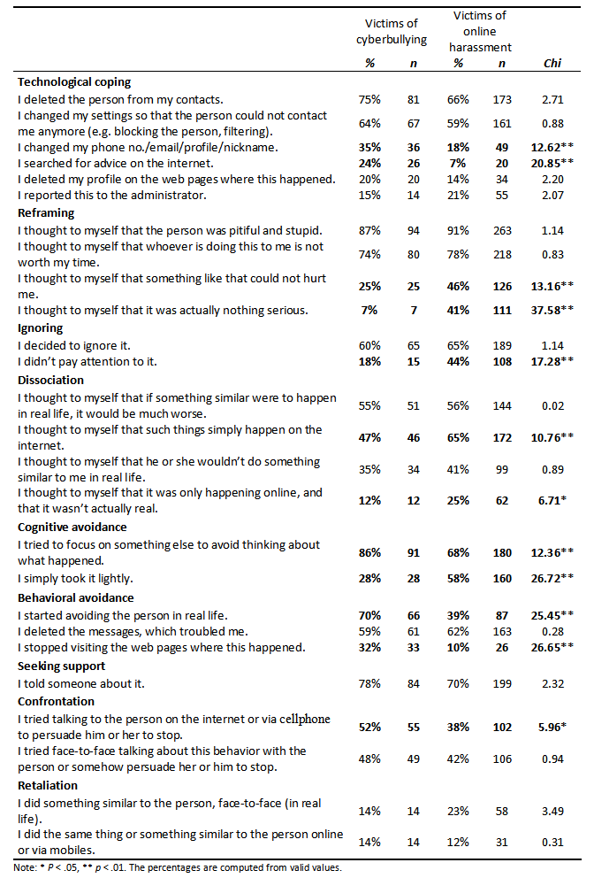
Strategies applied
CB victims more active
Cognitive strategies:
- reframing to depreciate the bully and avoided or purposefully ignored them
cognitive distancing
not much disociation
Tech. Coping – not so often
Machackova, H., Cerna, A., Sevcikova, A., Dedkova, L., & Daneback, K. (2013). Effectiveness of coping strategies for victims of cyberbullying. Cyberpsychology: Journal of Psychosocial Research on Cyberspace, 7(3), article 5. doi: 10.5817/CP2013-3-5

Slide 29
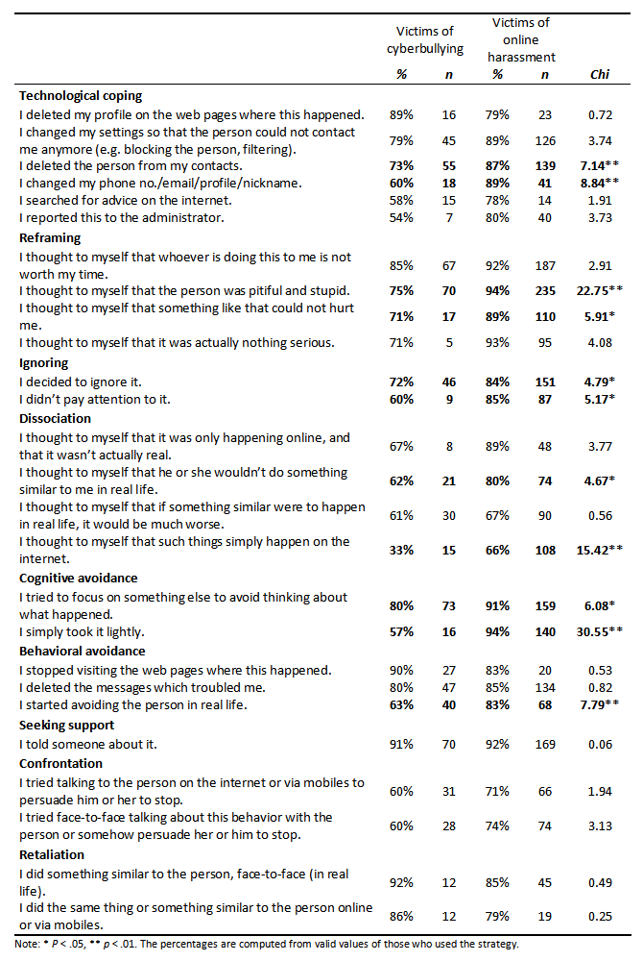
Strategies helping emotionally
- generally, less often effective among CB victims
- effective cognitive strategies
not all – „taking it lightly“ it „happens online“

Slide 30
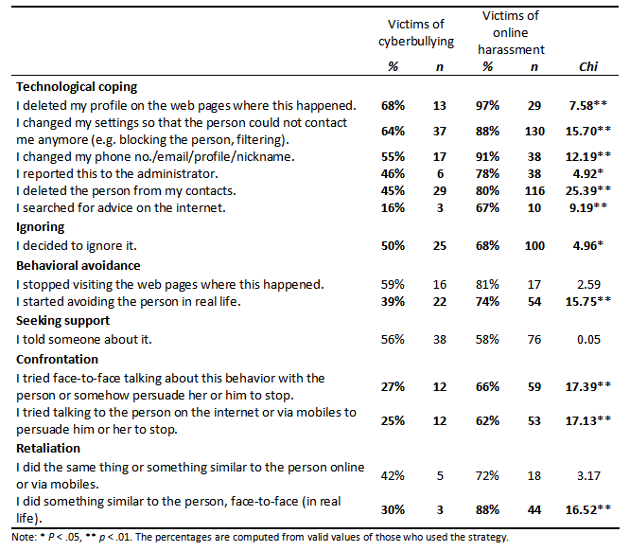
Strategies helping stop the attacks:
- technological coping
- but not all (and often not applied)
Ignoring
Confrontation or retaliation not much effective

Slide 31
Cyberbullying and online aggression (harassment)
Outcome also depends on the context
Including responses of others – the audience
Bystanders in cyberbullying
much more common than victimization
Czech project: 53%

Slide 32
Cyberbullying and online aggression (harassment)
What can they do? (online and offline)
Support the victim: emotionaly, advice provision, confrontation of aggressor…
Reinforce the bully: joining in, reposts, sharing, likes, comments…
Passivity: most common
Helpful:
decreases impact, can stop the attacks, help to cope

Slide 33
Cyberbullying and online aggression (harassment)
What can they do? (online and offline)
Support the victim: emotionaly, advice provision, confrontation of aggressor…
Reinforce the bully: joining in, reposts, sharing, likes, comments…
Passivity: most common
Increases the impact, especially when wide audience, causes of repetiveness…

Slide 34
Cyberbullying and online aggression (harassment)
What can they do? (online and offline)
Support the victim: emotionaly, advice provision, confrontation of aggressor…
Reinforce the bully: joining in, reposts, sharing, likes, comments…
Passivity: most common
Harmless? No
Increases impact, may be interpreted as silent approval by both victim and aggressor
Metadata: visits, views…

Slide 35

Cyberbullying and online aggression (harassment)
Who helps victim?
Empathy, prosocial behavior, norms, relationship with the victim…
Who reinforces bully?
Low empathy, aggressive beliefs, relationship with aggressor…
Who stay passive???
Usually – antibullying norms

Slide 36
Cyberbullying and online aggression (harassment)
What is „new“? – Context
Specific communication and environment
Distance
Lack of cues
Wide audience

Slide 37
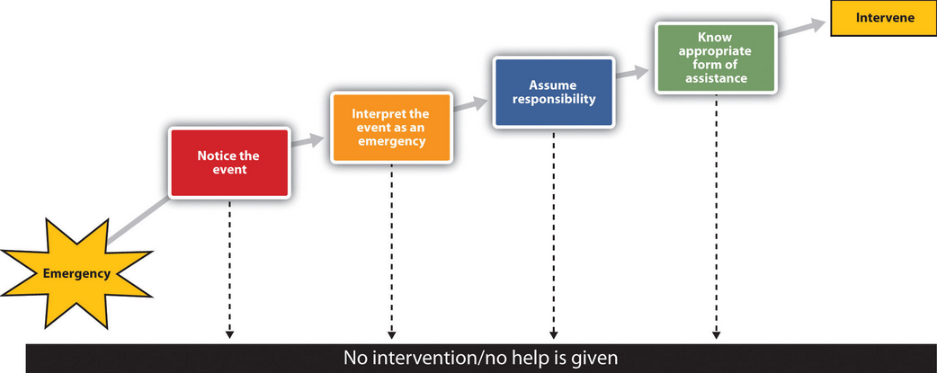
Cyberbullying and online aggression (harassment)
Latané & Darley (1970)

Slide 38
Cyberbullying and online aggression (harassment)
Attention and distractions

Slide 39
Cyberbullying and online aggression (harassment)
Complicated assessment, „just a joke“, not serious

Slide 40
Cyberbullying and online aggression (harassment)
Wide audience, who (where) is victim, ongoing event?

Slide 41
Cyberbullying and online aggression (harassment)
Assessment, self-efficacy, own victimization, aggravation of problem?

Slide 42
Audience in aggressive events
These aspects concern also responses to other aggressive events
What is your experience with such online aggression?

Slide 43
Hate communities online
Another type of aggression encountered on the internet
Intergroup aggression
Intolerant online communities
  Attacks on and from specific (online) communities/groups

Slide 44
Hate communities online
Online communities
Specific online places in which and through which people interact
Shared interests, goals, identity (sense of belonging)
Opportunity for self-expression
  Individual and group level
Opportunity for sense of belonging
  And in-group behavior
Discourse, materials

Slide 45
Hate communities online
Positive and negative outcomes
  Sometimes very hard to untangle
  For whom?
Clash of different (offline) communities online
Example: extreme right communities, extremist communities…

Slide 46
Online hate & intolerance
Roots in offline world
Attitides, opinions
Social norms
Group identity
In-groups and out-groups
Prejudices

Slide 47
Online hate & intolerance
Online
Increasing? (increasing internet use)
Dispersing?
many new platforms
prominently SNS

Slide 48
In the past 12 months, have you seen websites where people discuss hate messages that attack certain groups or individuals ? (EUKO, 2010; NCGM, 2013)

Slide 49
Combating hate online?
Problem with evaluation
…and freedom of speech
Ban
  Resistance, strengthening of identity?
  Free speech?
Law
  no united international law
General protest
Humor, sarcasm
Trolling
http://www.adl.org/combating-hate/
http://www.hatefree.cz/
https://cs-cz.facebook.com/CeskeObludarium

Slide 50
Combating hate online?
Problem with evaluation
What is normal? What is moral? Legitimate? Legal? Normative?
Back to conceptualization aggression – different types
Different purposes
Hate communities
Framing: aggression as a mean to – seemingly justified - end

Slide 51
Online hate & intolerance
Online disinhibition
  Hostility
  Anonymity, invisibility, asynchronicity, solipstic introjection, dissociative imagination, minimization of status and authority
SIDE model
  Strengthening of social identity (Tajfel, Turner)
  Potential for expression of normatively negative attitudes, behavior
Anonymity vs. identifiability
  still no such constrains to join such group/express an attitude

Slide 52
Online hate & intolerance
In concentrated form (online communities)
„Link, educate, recruit“ (Douglas, 2007)
Persuasion:
  Not often advocating violence as such
  „Objectivity“
  Establishing specific discourse and norms
  In-group

Slide 53
„Socialy creative“
Moral disengagement
Bandura: Morality – norms, social and internalised sanctions
Self-monitoring, evaluation, regulation (affective)
Moral disengagement: cognitive restructuring of inhumane conduct into a benign or worthy one
moral justification, sanitizing language, and advantageous comparison;
disavowal of a sense of personal agency by diffusion or displacement of responsibility;
disregarding or minimizing the injurious effects of one 's actions
attribution of blame to, and dehumanization of those who are victimized.
Bandura, A. (1999). Moral disengagement in the perpetration of inhumanities. Personality and social psychology review, 3(3), 193-209.

Slide 54
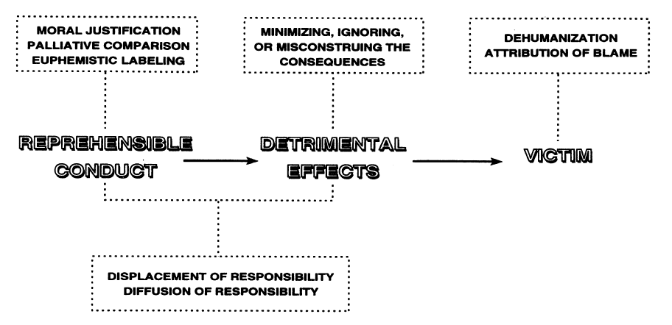

Slide 55
„We are saving humanity“
„Its better then what they did!“
„War vs. Fight for freedom“

Slide 56
„Nobody did nothing“
„It was an order“
„I was just a messanger“

Slide 57
„It was not that bad“
„Its not like we killed them“
„We just teached them a lesson“

Slide 58
„They are like rats“
„They just got what they deserved“

Slide 59
Hate communities online
Concentrated materials, information – selected discourse, no opposite views
Mutual support, reinforcement of attitudes
In-group: shared identity, belonging
Access
May be invisible to offline environment
  Chance for discussions with family, friends?

