Slide 1
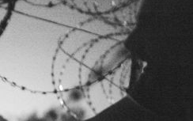
SOC 797
Contemporary Migration Research
Workshop 1/3
10. 3. 2016

Slide 2
Welcome
Hello
Dobrý den
Прывiтанне
Dobrý deň
Merhaba
今日は
Guten Tag
مرحبا
Grüss Gott
Nadya
Adéla, Lucie
Vitalia
Miriam
Yasemin
Fujita
Kristin
Lahcene
Kärnten

Slide 3
Political participation of refugees in CZ/South Moravia and AT/Kärnten

Slide 4
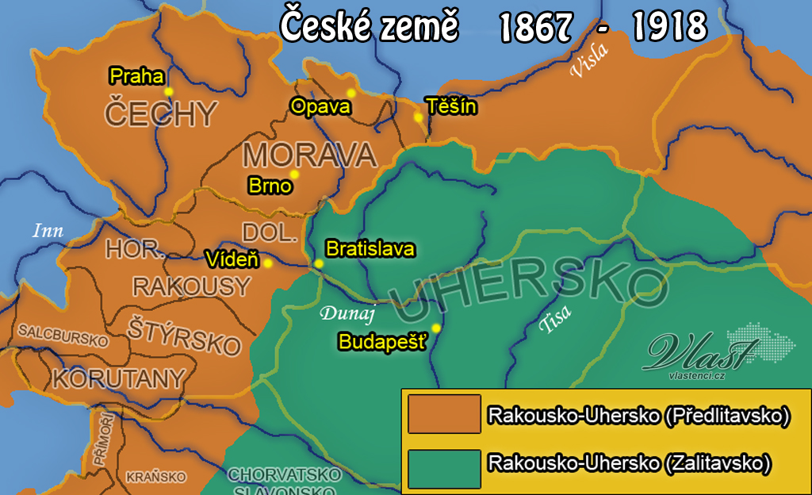
CZ/South Moravia
AT/Kärnten

Slide 5
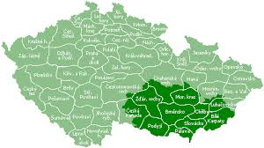
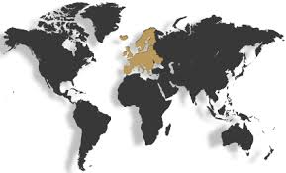
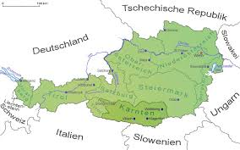
AT 1994
CZ 2004

Slide 6
Analyzing mass media
CZ national
http://www.ceskatelevize.cz/ct24/1718926-na-recko-makedonske-hranici-ceka-14-tisic-uprchliku-frustrace-roste
AT national
http://tvthek.orf.at/program/ZIB-20/1218/ZIB-20/12156248
AT local
http://tvthek.orf.at/program/Kaernten-heute/70022/Kaernten-heute/12145081
CZ local
http://www.ceskatelevize.cz/ivysilani/10122427178-udalosti-v-regionech-brno/315281381990901-udalosti-v-regionech/obsah/420173-uprchlici-ve-sportovnim-arealu-policie

Slide 7
General (discoursive) discription
Figures
Speaches, poses, actions
Where is the story? What happens?
„Solving the problem“. What will/should happen next?
Ordering of narratives, posing „talking heads“
What is NOT present?
Further comments

Slide 8
World research view
What is present/relevant?
People
Populations
Places
World systems
Official documents

