Slide 1
Party-Based Euroscepticism in the Czech Republic
Vlastimil Havlík
Department of Political Science
Masaryk University (Brno)
havlik@fss.muni.cz

Slide 2
Outline
Why the Czech Republic?
Context
Party-based Euroscepticism – many faces but limited influence

Slide 3
Questions
Q1: Which Czech political parties are Eurosceptic? (including concept of Euroscepticism)
Q2: How (much) Eurosceptic are they?
Q3: Does it matter?

Slide 4
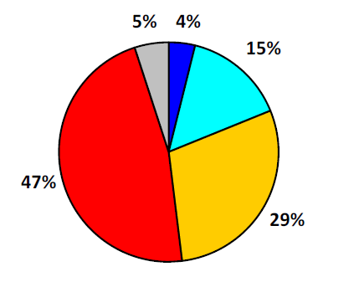
Why the Czech Republic?
Because of public Euroscepticism
Adoption of Euro (April 2014)
Surely yes
DK
Rather yes
Surely not
Rather not
Source: CVVM

Slide 5
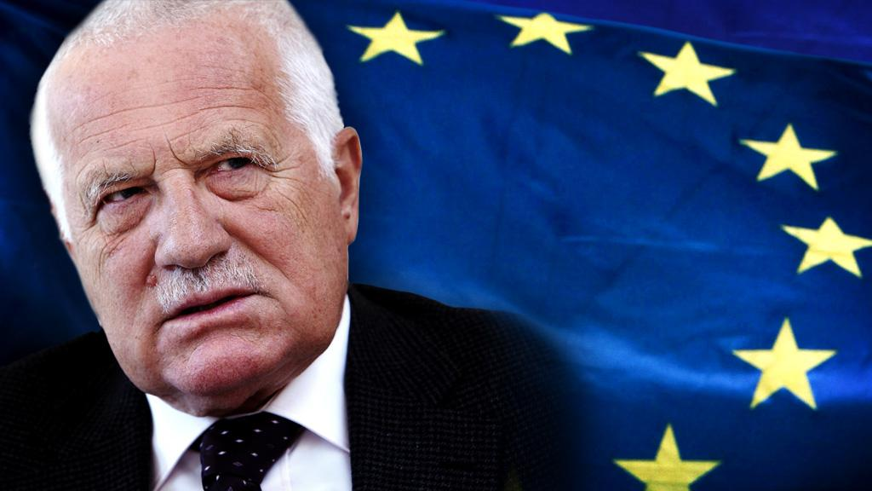




Why the Czech Republic?
Because of many faces of party-based Euroscepticism

Slide 6





Context – party system in the Czech Republic
One of the most stable party systems in CEE
1996 – 2010: two main poles + several smaller parties
  Unidimensional competition (+ religious question)
KSČM – ČSSD – liberal centre (SZ, US) – KDU-ČSL – ODS

Slide 7
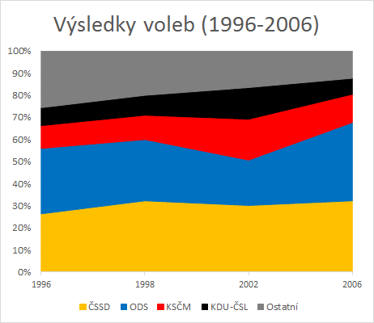
Election results (1996-2006)
Others

Slide 8
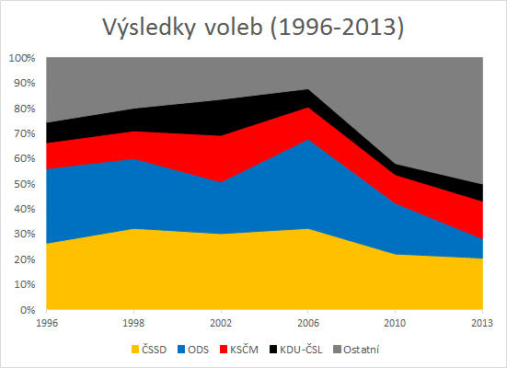
Election results (1996 – 2013)
Others

Slide 9
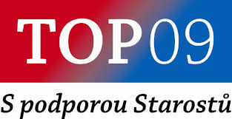
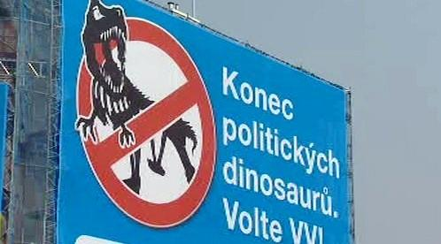
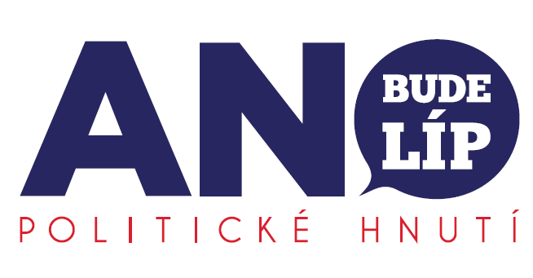
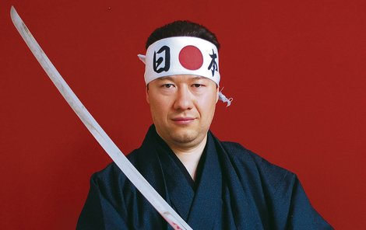

New political parties (2010 – 2013)
(2010: 16.7 %) – split from KDU-ČSL, conservative-liberal „purifier“ of ODS
Public Affairs - VV (2010: 10.9%) – centrist populist party
ANO 2011 (2013: 18.7%) – centrist populist party
Tomio Okamura`s Dawn of Direct Democracy –
Úsvit (2013: 6.88%) – (radical right-wing) populist party
Party of Free Citizens (EP 2014 – 5.24%)

Slide 10
Euroscepticism
Hard Euroscepticism: “a principled opposition to the project of European integration as embodied in the EU, in other words, based on the ceding or transfer of powers to [a] supranational institution such as the EU.”
Soft Euroscepticism: “not a principled objection to the European integration project of transferring powers to a supranational body such as the EU, but there is opposition to the EU's current or future planned trajectory based on the further extension of competencies that the EU is planning to make.”
(Szczerbiak and Taggart 2003: 12)

Slide 11
Which Czech parties are Eurosceptic?

Slide 12
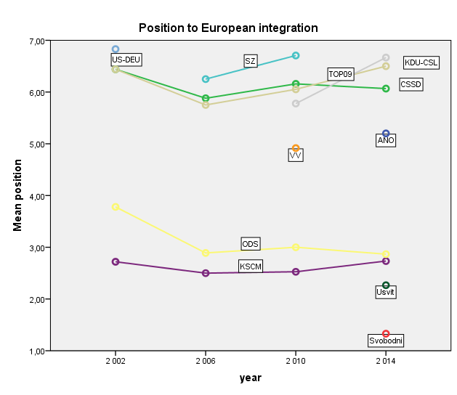
+
Source: author, based on CHES (2002-2014)
-

Slide 13
Shapes of Czech party-based Euroscepticism

Slide 14
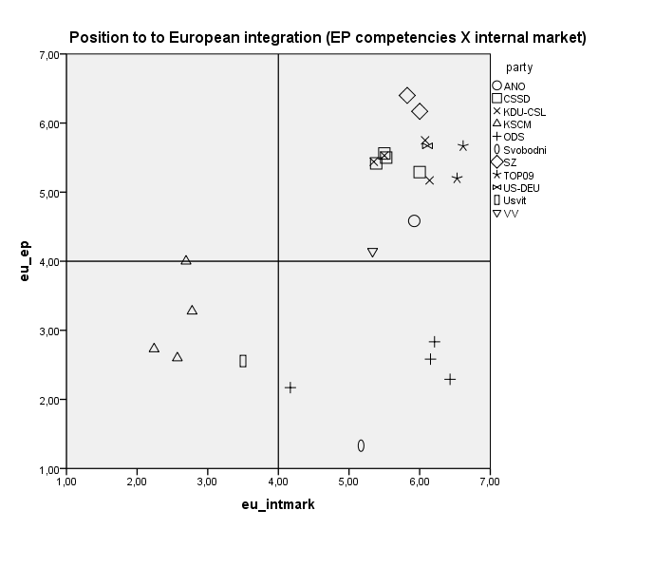




Source: author, based on CHES

Slide 15
Civic Democratic Party
Not against membership (2003 referendum)
National/sovereingty based Euroscepticism – opposing further integration, against the Lisbon Treaty
Against: the „federal superstate“, strenghtening of EP and ECom., majority voting in the Council
Proponents of economic integration (Common Market) but against Euro (sovereingty + economic arguments), current CAP
„back to the concept of free economic area“ (ODS 2014)
Economically liberal arguments (againts allegedly socialist EU)
preference of „flexible integration“
Pragmatic perception of the membership – „an instrument to support the Czech economy“
Challenge of incumbency – the Constitutional Treaty

Slide 16
Communist Party of Bohemia and Moravia
Dilemma of socialist/communist internationalism
Against capitalist, imperialist and right-wing EU of bureaucrats and financers, initially critical to the membership (2003 referendum)
For „more democratic, socialist integration and strenghtening of integration of the Eueopean left against the offensive of neoliberalism and sings of neofascism and neonacism“ (KSČM 2014)
We want to rebuild Europe on the basis of solidarity and sovereingty of the people, equality and cooperation“ (KSČM 2014)
A platform for socialist cooperation
Internally divided (hardliners vs reformist/moderates)
Socialization of MEPs of the party, softening of the Euroscepticism

Slide 17
Party of Free Citizens
(neo)liberal frames of Euroscepticism – freedom as the main principle (with national soveregeinty)
Rejection of the Lisbon Treaty
the Union of Nations as an alternative – „the European Union has to change into into a community of sovereign democratic nations, voluntarily collaborating on the basis of equality“
Initially soft Euroscepticism, but gradually serious doubts about the membership, rejection of the current trajectory of the integration project – a case of a hard Eurosceptic party (?)

Slide 18
Dawn of Direct Democracy
Not too much focused on the EU
Selective/non-systemic policy-based Euroscepticism – immigration policy X security and defence policy, internal market
Eurosceptic frames – populism (sovereignty of the people, bureaucracy, corruption)
Conditional acceptance of Euro (referendum)
Sovereingty based arguments – „we are against weakening of the competencies of the Czech Republic, we do not agree with transformation of national states into provinces with limited powers, we do not want to be the slaves of the European Union.“ (Úsvit 2014)

Slide 19
Summary – a paradise for Euroscepticism research
Electorally successful Eurosceptic parties
Varieties and different intensity of party based Euroscepticism
Driven by the primary ideologies of the parties
Dynamics of Eurosceptic stances
But does Euroscepticism matter for Czech party politics?

Slide 20
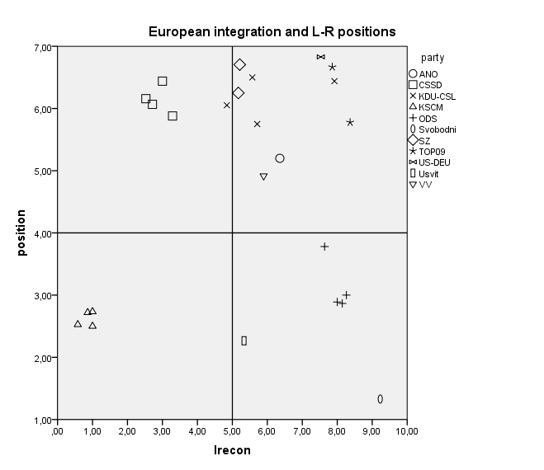
US
ČSSD
KDU-CSL
TOP09
ODS
KSČM

Slide 21
US
ČSSD
KDU-CSL
TOP09
ODS
KSČM

Slide 22
US
ČSSD
KDU-CSL
TOP09
ODS
KSČM

Slide 23
Does the EU issue matter?
Interactions between parties
The 2002 elections and the formation of the pro-European cabinet of ČSSD – KDU-ČSL – US
X
2006 and 2010 cabinets (ODS X KDU, SZ and TOP 09)
Potential impact on volatility (party – voters congruence)
The crucial role of the salience of the issue – low in a longterm perspective

Slide 24
Conclusion
Electorally succesful Eurosceptic parties – a variety of Euroscepticisms
The role of the primary ideologies of the parties – from left wing, neoliberal to nationalist Euroscepticism
Euroscepticism as established sets of ideas (the 2013 election)
BUT limited impact on electoral competition

Slide 25
Thank you for your attention.

