Slide 1
An Evolution For The Future
MVZ248

Slide 2
Peace and Future of Israeli Foreign Policy
Public opinion
GOI and PMO
Divided Palestinian loyalties
The chaotic Middle East

Slide 3
Israel and the US
Since 2010 asset and liability
post-2020?

Slide 4
Liability
Political costs to the U.S. internationally of having to spend our political capital this way are huge.
Protecting ally (Israel) from continual and increased international indignation about Israel’s behavior
grave damage to U.S. global and regional standing.
Severely impaired U.S. ties with the world’s 1.6 billion Muslims not only in the Middle East.
But it has also cost us much of our followership in international organizations.
U.N.

Slide 5
Liability specifics
The conflict foments anti-American sentiment, due to a perception of U.S. favoritism for Israel.
Arab anger over the Palestinian question limits the strength and depth of U.S. partnerships with governments and peoples in the AOR and weakens the legitimacy of moderate regimes in the Arab world.
Meanwhile, al-Qaeda and other militant groups exploit that anger to mobilize support.
The conflict also gives Iran influence in the Arab world through its clients, Lebanese Hizballah and Hamas.
Gen. Petraeus (2010)

Slide 6
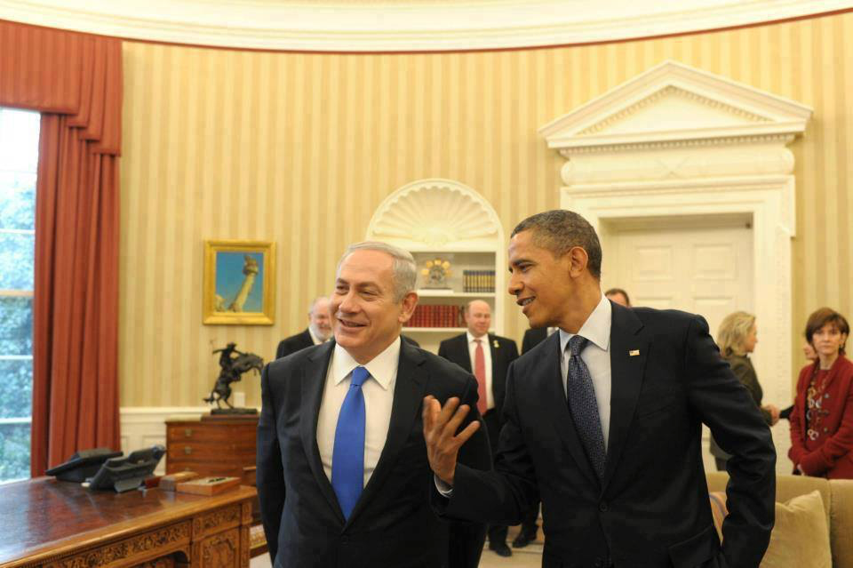
Asset or Liability?

Slide 7
Asset
Shared values and moral responsibility remain unshakable foundations of U.S.-Israel relations,"
Robert D. Blackwill and Walter B. Slocombe Israel: A Strategic Asset for the United States.
"But the relationship stands equally on an underappreciated third leg: common national interests and collaborative action to advance those interests."

Slide 8
Asset
It is to America’s advantage to have in Israel an economy that is so closely associated with the USA.
innovator in the information and technology field,
high-tech medicine, and in
green technologies like the electric car.
The Obama administration made the economic health and well-being of the United States the pillar of its National Security Strategy.
Clinton administration, James D. Boys Clinton Grand Strategy

Slide 9
Asset
The peace process has been a vehicle for American influence throughout the broad Middle Eastern region.
An excuse for Arab declarations of friendship with the United States,
regardless if Americans remain devoted to Israel.
Helped eliminate what might be a zero-sum game

Slide 10
Asset
A long list of military-related advantages.
Israel—through its intelligence, its technology, and the lessons learned from its own experience in counterterrorism and asymmetric warfare
Israel’s unique counterproliferation efforts—destroying nuclear reactors in Iraq (1981) and Syria (2007) Israel’s contribution to Western security is greater.
Bottom line: do a cost-benefit analysis of the U.S. relationship with Israel over the past thirty-plus years and the U.S. relationship with its Arab friends in the Gulf.
To secure its interests in the Arab-Israeli arena, the United States has spent about $100 billion in military and economic assistance to Israel, plus another $30 billion to Egypt and relatively small amount to other Arab nations.
On a state-to-state basis, investment in Israel has paid off in terms of regional stability. pre-2011.

Slide 11
Foreign Policy Review and
New friends
Israel as a strong and stable factor capable of replacing to some degree the American anchor that is steadily dissipating.
Israel stands at the forefront of the battle of the democratic and modern world against the forces of radical Islam.
Old enemies
Iran

