Slide 1
Electoral system and its reforms
Peter Spáč
10.4.2017

Slide 2
Electoral systems
Mechanisms which transform votes of citizens into seats of the elected body (e.g. Parliament, local assembly)
Areas included:
Geography
Mathematics
No such thing as a perfectly neutral electoral system
No such thing as the best electoral system

Slide 3
Electoral systems - division
Many possibilities how to classify electoral systems
Most common criterion – electoral formula (the main „logic“ of the system):
Single-member district systems
Proportional representation systems
Mixed systems
(only a very rough list)

Slide 4
Single member district systems
„The winner takes all“
Country is divided into constituencies
In each constituency only 1 person is elected and gets the seat
How many votes does the winner need?
Plurality – the most votes from all candidates
Majority – at least 50 % + 1 vote

Slide 5
UK election 2010
Constituency: Chichester (southeastern England)
Sarah Newton elected as MP for Chichester constituency
Candidate | Party | Votes | Votes in %
Sarah Newton | Conservative | 20 349 | 41,7
Terrye Teverson | Liberal Democrat | 19 914 | 40,8
Charlotte MacKenzie | Labour | 4 697 | 9,6
Harry Blakeley | UK Indep. Party | 1 911 | 3,9
Loic Rich | Mebyon Kernow | 1 039 | 2,1
Ian Wright | Green | 858 | 1,8

Slide 6
Czech Senate election 2012
Constituency: Zlín
No candidate got more than 50 % of votes – what now?
A second round (runoff)
Candidate | Party | Votes | Votes in %
Ludvík Hovorka | KDU-ČSL | 6 398 | 16,5
Tomio Okamura | Independent | 11 772 | 30,3
Stanislav Mišák | ČSSD | 9 740 | 25,1
Jana Jurenčáková | STAN | 4 736 | 12,2
Others |  | 6232 | 15,9

Slide 7
Czech Senate election 2012
Constituency: Zlín, second round
Tomio Okamura elected as senator for Zlín constituency
Candidate | Party | Votes | Votes in %
Tomio Okamura | Independent | 17 401 | 66,23
Stanislav Mišák | ČSSD | 9 740 | 33,76

Slide 8
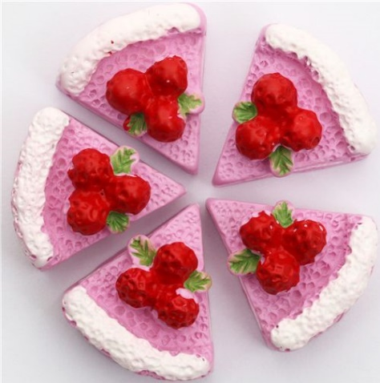
Proportional representation
Aim – the composition of the elected body (Parliament) should be a copy of the public opinion
Ideally – a party which gets 30 % of votes should receive 30 % of seats etc.
The reality may be quite different
Less wasted votes, more parties can get seats
Main category – List PR systems

Slide 9
List PR systems
Constituencies:
Only multi-member
The bigger the constituencies, the better for smaller parties and vice versa
Threshold:
Amount of votes which a party needs to get to be included to the allocation of seats
How to transform votes into seats?
Divisor
Quota

Slide 10
Quota
A number of votes which are needed to obtain a seat
Political party gets as many seats as many times it acquired the quota
Example:
Quota = 10 000 votes
Votes of party = 263 000
Party gets 26 seats as it acquired quota for 26 times
Many types: Hare, Hagenbach-Bischoff, Imperiali..

Slide 11
Hagenbach-Bischoff quota
Q = V / (S + 1)
Q – quota
V – valid votes
S – seats
Example:
We want to divide 100 seats and all political parties got 250 000 votes together
Q = 250 000 / (100 + 1) = 250 000 / 101 = 2475

Slide 12
Hagenbach-Bischoff quota
Q = 2475
Party | Votes | Quota | Division | Seats | Remaining votes | Seats
A | 95 438 | 2475 | 38,56 | 38 | 1 388 | 38
B | 76 522 |  | 30,92 | 30 | 2 272 | 31
C | 47 183 |  | 19,06 | 19 | 158 | 19
D | 30 857 |  | 12,47 | 12 | 1 157 | 12
Sum | 250 000 |  |  | 99 |  | 100

Slide 13
Divisor
A line of numbers by which the parties’ votes are divided
The results are ranked according to their size
The highest results are awarded with seats
Advantage – all seats are allocated altogether and there are no remaining votes
Many types: D’Hondt, Danish, Imperiali…

Slide 14
Divisor D’Hondt
1, 2, 3, 4, 5 …
We want to allocate 10 seats
 |  | Divided by number
Party | Votes | 1 | 2 | 3 | 4 | 5
A | 120 | 120 | 60 | 40 | 30 | 24
B | 100 | 100 | 50 | 33,3 | 25 | 20
C | 60 | 60 | 30 | 20 | 15 | 12
D | 40 | 40 | 20 | 13,3 | 10 | 8

Slide 15
Divisor D’Hondt
Allocation of seats if we are dividing:
4 seats
10 seats
 |  | Divided by number
Party | Votes | 1 | 2 | 3 | 4 | 5
A | 120 | 120 | 60 | 40 | 30 | 24
B | 100 | 100 | 50 | 33,3 | 25 | 20
C | 60 | 60 | 30 | 20 | 15 | 12
D | 40 | 40 | 20 | 13,3 | 10 | 8

Slide 16
Slovak electoral system

Slide 17
Electoral systems in 20th century
No linear tradition
Single member districts:
Era before 1918
Later communist rule
Proportional representation:
1st Czechoslovak Republic (1918-1938)
Slovak autonomy
3rd Czechoslovak Republic (1945-1948)
Early communist rule

Slide 18
After 1989
Need to change the political system and its features
Change of electoral system:
Symbolic
Pragmatic
Adoption of historical tradition
Electoral reforms in accordance with federal level

Slide 19
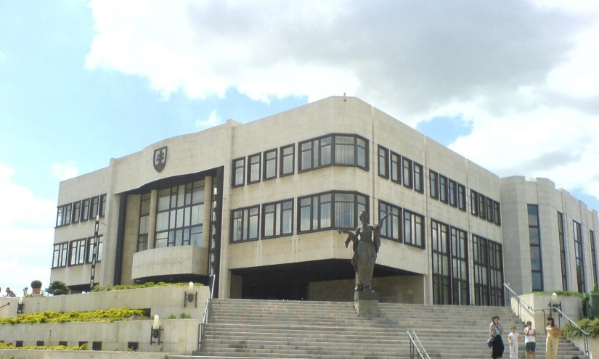
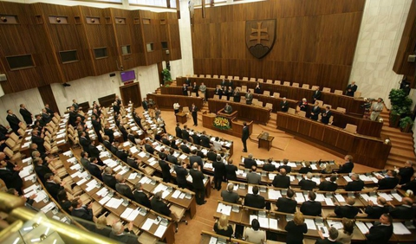
Slovak parliament
Name:
Until 1993 - Slovak National Council (SNR)
Since 1993 – National Council of Slovak Republic (NR SR)
Features:
Unicameral
150 MPs

Slide 20
Electoral system in 1990
List PR system (unchanged until now)
Slovakia divided into 4 constituencies:
Bratislava (the capital city), Western, Central and Eastern Slovakia
Great differences in their size – large constituencies (41, 46, 50 seats) except of Bratislava (13)
Threshold of 3 % of votes
Hare quota (Q = V / S)
Altogether – a highly proportional system

Slide 21
Elections 1990
Party | Votes (in %) | Seats | Seats (in %) | I_{D}
VPN | 29,4 | 48 | 32 | 1,09
KDH | 19,2 | 31 | 20,67 | 1,08
SNS | 13,9 | 22 | 14,67 | 1,06
KSC / KSS | 13,4 | 22 | 14,67 | 1,1
Hungarian parties | 8,7 | 14 | 9,33 | 1,07
DS | 4,4 | 7 | 4,67 | 1,07
Green party | 3,5 | 6 | 4 | 1,14
Others | 7,6 | 0 | 0 | 0

Slide 22
Electoral reform 1992
Increase of threshold:
5 %
Special threshold for coalitions:
7 % – 2 and 3 members
10 % - 4 and more
Change of votes to seats calculation:
Hagenbach-Bischoff quota
No real impact of this change

Slide 23
Elections 1992
Party | Votes (in %) | Seats | Seats (in %) | I_{D}
HZDS | 37,26 | 74 | 49,33 | 1,32
SDL | 14,7 | 29 | 19,33 | 1,31
KDH | 8,89 | 18 | 12 | 1,35
SNS | 7,93 | 15 | 10 | 1,26
Hungarians | 7,42 | 14 | 9,33 | 1,26
Others | 23,8 | 0 | 0 | 0

Slide 24
Elections 1994
Party | Votes (in %) | Seats | Seats (in %) | I_{D}
HZDS | 34,96 | 61 | 40,67 | 1,16
SV | 10,41 | 18 | 12 | 1,15
Hungarians | 10,18 | 17 | 11,33 | 1,11
KDH | 10,08 | 17 | 11,33 | 1,12
DÚ | 8,57 | 15 | 10 | 1,17
ZRS | 7,34 | 13 | 8,67 | 1,18
SNS | 5,4 | 9 | 6 | 1,11
Others | 13,06 | 0 | 0 | 0

Slide 25
Era of Vladimír Mečiar
Government 1994-1998:
HZDS and 2 small partners
Problematic style of politics
Decreasing support of population
Solution – change of electoral rules

Slide 26
Non-realized reform
Aim to make a single member district system
Logic:
HZDS still ranked as the most popular political party
Although the opposition had a high cumulative support, it consisted of heterogeneous parties
First step – new administrative division of Slovakia:
76 districts (possible electoral constituencies)
Great differences in their population

Slide 27
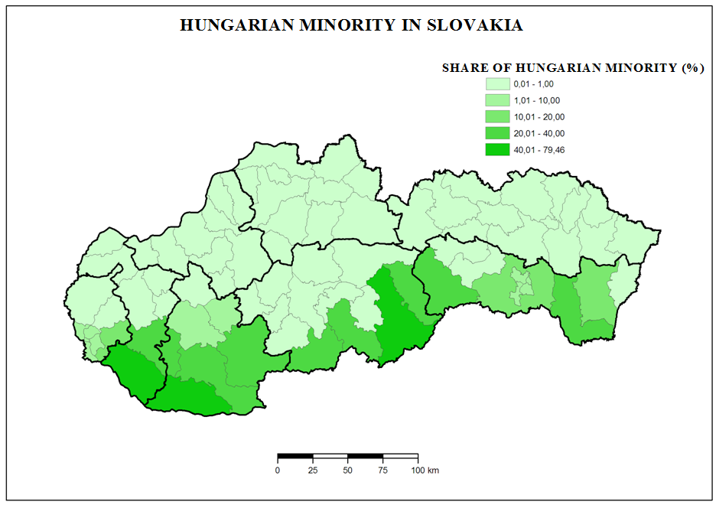

Slide 28
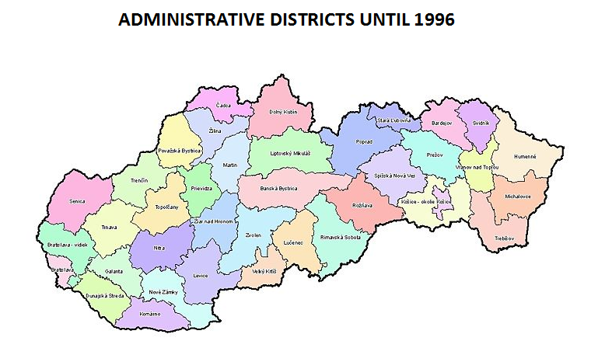

Slide 29
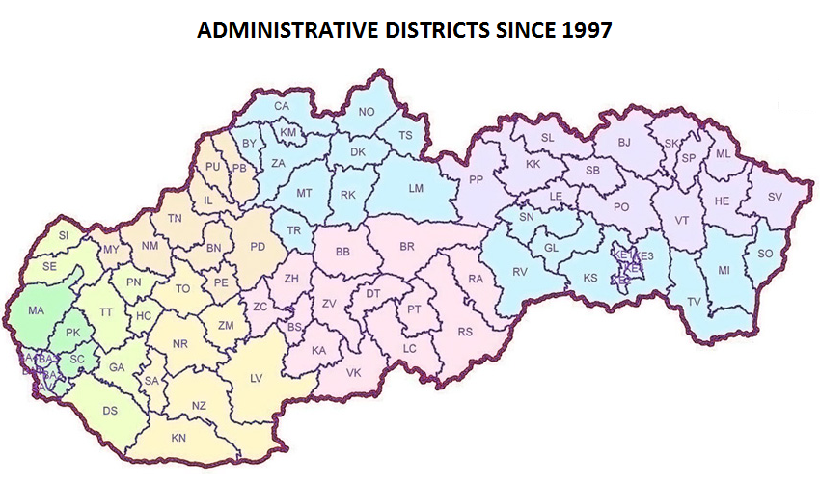

Slide 30
Non-realized reform
Average number of citizens entitled to vote
All districts (79) | 42 521
„Slovak“ districts (64) | 39 478
„Hungarian“ districts (15) | 55 505

Slide 31
Non-realized reform
New administrative division:
Higher support of HZDS in smaller districts and vice versa
Areas of highest concentration of Hungarians joined into few very populated districts
If such division would be used for elections:
Possible breach of the equality of voters
Advantage to voters of smaller districts = advantage to HZDS
The reform was not realized possibly due to refusal of HZDS’s small coalition partners

Slide 32
The „Mečiar’s reform“
Adopted only a few months before election 1998
1 nationwide constituency (all 150 MPs)
Ban of campaign in private media
Coalitions:
Each party in coalition had to gain 5 %

Slide 33
The „Mečiar’s reform“
Impact of reform:
No change of proportionality
The name of the party leaders visible to all voters
No sense to create coalitions → measure against opposition (SDK, Hungarians)
Reaction of opposition – transformation from coalitions to single parties

Slide 34
Elections 1998
Party | Votes (in %) | Seats | Seats (in %) | I_{D}
HZDS | 27 | 43 | 28,67 | 1,06
SDK | 26,33 | 42 | 28 | 1,06
SDL | 14,66 | 23 | 15,33 | 1,05
SMK | 9,12 | 15 | 10 | 1,1
SNS | 9,07 | 14 | 9,33 | 1,03
SOP | 8,01 | 13 | 8,67 | 1,08
Others | 13,06 | 0 | 0 | 0

Slide 35
Development ‘after Mečiar’
Partial corrections made by Dzurinda’s government
Threshold for coalitions back to 7 and 10 %
No special requirements for parties in coalitions
1 nationwide constitution preserved
Some features of Mečiar’s reform banned by the Constitutional court (campaign in private media)

Slide 36
Elections 2002
Party | Votes (in %) | Seats | Seats (in %) | I_{D}
HZDS | 19,5 | 36 | 24 | 1,23
SDKU | 15,09 | 28 | 18,67 | 1,24
SMER | 13,46 | 25 | 16,67 | 1,24
SMK | 11,16 | 20 | 13,33 | 1,19
KDH | 8,25 | 15 | 10 | 1,21
ANO | 8,01 | 15 | 10 | 1,25
KSS | 6,32 | 11 | 7,33 | 1,16
Others | 13,06 | 0 | 0 | 0

Slide 37
Elections 2006
Party | Votes (in %) | Seats | Seats (in %) | I_{D}
SMER | 29,14 | 50 | 33,33 | 1,14
SDKU | 18,35 | 31 | 20,67 | 1,13
SNS | 11,73 | 20 | 13,33 | 1,14
SMK | 11,68 | 20 | 13,33 | 1,14
HZDS | 8,79 | 15 | 10 | 1,14
KDH | 8,31 | 14 | 9,33 | 1,12
Others | 13,06 | 0 | 0 | 0

Slide 38
Elections 2010
Party | Votes (in %) | Seats | Seats (in %) | I_{D}
SMER | 34,79 | 62 | 41,33 | 1,19
SDKU | 15,42 | 28 | 18,67 | 1,22
SaS | 12,14 | 22 | 14,67 | 1,21
KDH | 8,52 | 15 | 10 | 1,18
Bridge | 8,12 | 14 | 9,33 | 1,15
SNS | 5,07 | 9 | 6 | 1,19
Others | 13,06 | 0 | 0 | 0

Slide 39
Elections 2012
Party | Votes (in %) | Seats | Seats (in %) | I_{D}
SMER | 44,41 | 83 | 55,33 | 1,25
KDH | 8,82 | 16 | 10,67 | 1,21
OLaNO | 8,55 | 16 | 10,67 | 1,25
Bridge | 6,89 | 13 | 8,67 | 1,26
SDKU | 6,09 | 11 | 7,33 | 1,2
SaS | 5,88 | 11 | 7,33 | 1,25
Others | 13,06 | 0 | 0 | 0

Slide 40
Elections 2016
Party | Votes (in %) | Seats | Seats (in %) | I_{D}
SMER | 28,28 | 49 | 32,67 | 1,16
SaS | 12,1 | 21 | 14 | 1,16
OĽaNO | 11,02 | 19 | 12,67 | 1,15
SNS | 8,64 | 15 | 10 | 1,16
LSNS | 8,04 | 14 | 9,33 | 1,16
SR - BK | 6,62 | 11 | 7,33 | 1,11
Bridge | 6,5 | 11 | 7,33 | 1,13
Network | 5,6 | 10 | 6,67 | 1,19
Ostatní | 13,20 | 0 | 0 | 0

Slide 41
Impact of electoral reforms
High proportionality
Number of relevant parties
Personal composition of the parliament

Slide 42
High proportionality
Czech election 2006
Party | Votes (in %) | Seats (in %) | I_{D}
ODS | 35,38 | 40,5 | 1,14
SZ | 6,29 | 3 | 0,48
Slovak election 2006
Party | Votes (in %) | Seats (in %) | I_{D}
Smer | 29,14 | 33,33 | 1,14
KDH | 8,31 | 9,33 | 1,12

Slide 43
Number of relevant parties
Elections | Threshold | Change | Parties in parliament | Waster votes (in %)
1990 | 3 | - | 7 | 7,6
1992 | 5 | + 2 | 5 | 23,8
1994 | 5 | - | 7 | 13,06
1998 | 5 | - | 6 | 5,81
2002 | 5 | - | 7 | 18,21
2006 | 5 | - | 6 | 11,89
2010 | 5 | - | 6 | 15,94
2012 | 5 | - | 6 | 19,36
2016 | 5 | - | 8 | 13,20

Slide 44
Personal composition of NR SR
Preferential voting
1. half of 90s
Each voter has 4 preferential votes
To move to the top of the list a candidate needs to gain such amount of preferential votes which is at least 10 % of the votes of his/her party in the constituency
1998:
1 nationwide constitution → paralysis of the system

Slide 45
Personal composition of NR SR
MPs thanks to preferential votes:
1998 – 0
2002 – 1 (out of 150!)
Solution – lowering the amount from 10 to 3 % of party votes
Impact – more MPs thanks to preferential votes:
2006 – 7
2010 – 11
2012 – 15
2016 - 13

Slide 46
Share of preferential votes for candidates in elections 2006 (in %)
 | Smer | SDKÚ | SNS | SMK | HZDS | KDH
1-10 | 73,28 | 75,81 | 68,07 | 64,4 | 67,6 | 69,75
11-20 | 7,48 | 11,69 | 8,61 | 12 | 10,38 | 8,8
21-30 | 4,72 | 3,27 | 5,5 | 7,02 | 9,74 | 4,47
31-40 | 2,99 | 1,88 | 3,68 | 5,79 | 2,55 | 3,51
41-50 | 1,57 | 1,01 | 2,01 | 1,82 | 2,05 | 1,82
51-60 | 2,24 | 1,34 | 2,73 | 2,16 | 1,99 | 1,05
61-70 | 1,81 | 1,42 | 2,88 | 1,34 | 1,22 | 1,51
71-80 | 1,41 | 0,43 | 1,41 | 1,38 | 0,9 | 2,69
81-90 | 0,57 | 0,33 | 0,61 | 1,16 | 0,85 | 0,92
91-100 | 0,59 | 0,4 | 0,71 | 0,79 | 0,78 | 1,32
101-110 | 0,79 | 0,41 | 0,51 | 0,4 | 0,5 | 0,54
111-120 | 0,59 | 0,36 | 0,67 | 0,44 | 0,8 | 1,05
121-130 | 0,67 | 0,28 | 0,4 | 0,38 | 0,46 | 0,75
131-140 | 0,49 | 0,36 | 0,59 | 0,52 | 0,48 | 1,08
141-150 | 0,81 | 1 | 1,56 | 0,4 | 0,46 | 0,74

Slide 47
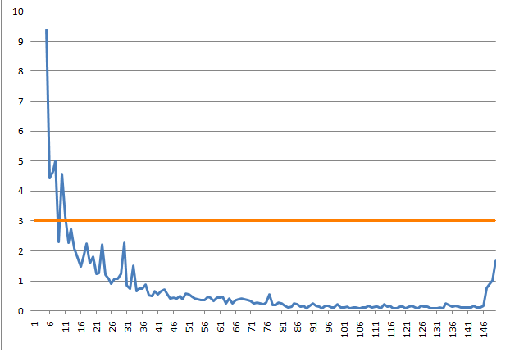
Preferential votes of candidates

Slide 48
Summary
Since 1993 only a list PR system has been used
Most important reforms:
Higher threshold in 1992
Mečiar’s reform
Impact of nationwide constituency:
Strong position of parties’ leaderships
Low influence of voters on personal composition of NR SR
No political party which passes the 5 % threshold can be harmed by the system

