Slide 1
Nationalism in Slovak politics
Peter Spáč
15.5.2017

Slide 2
Preamble of the Constitution
„We, the Slovak Nation, bearing in mind the political and cultural heritage of our predecessors, the experience gained through centuries of struggle for our national existence, and statehood…“
„…together with members of national minorities and ethnic groups living on the territory of the Slovak Republic“

Slide 3
The Hungarian issue

Slide 4
The basic facts
Slovakia:
Population of 5,4 mil.
Ethnic composition: Slovaks (85,2 %), Hungarians (9,4), Roma (2), Czechs (1), Ruthenians (0,4), Ukrainians (0,2), other (1,6)
Hungarian minority:
Around 500 000 citizens
Concentrated in southern part of Slovakia but this land does not form a solid region

Slide 5
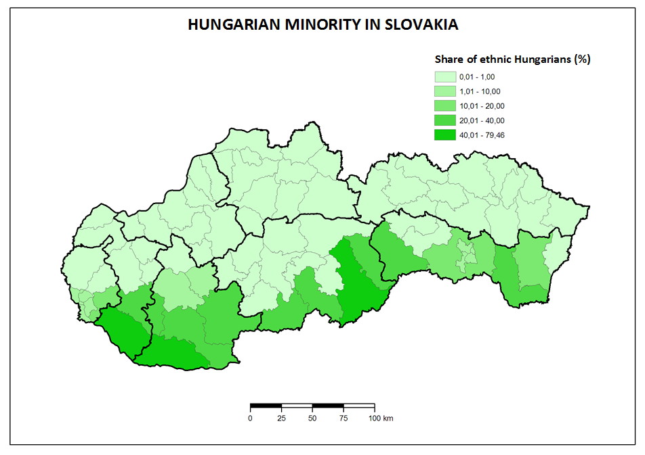

Slide 6
Hungarian parties in Slovakia
1990 – 1998:
Three independent and relevant parties
Mutual cooperation
1998 – 2009:
Integration in one subject representing the minority
2009 –
Split to 2 parties
Unsuccessful aims for cooperation yet

Slide 7
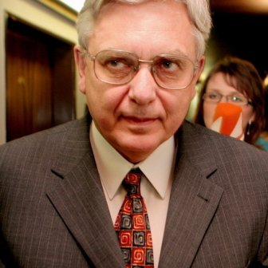
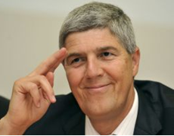
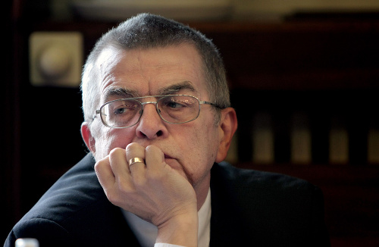
1990 – 1998
Coexistence:
„Hawks“
Miklós Duray
Hungarian Christian Democratic Movement:
„Moderates“
Béla Bugár
Hungarian Civic Party:
„Liberals“
László Nagy
Elections 1994 – together as the Hungarian Coalition (MK)

Slide 8
1998 - 2009
1998 – Mečiar’s electoral reform against coalitions → MK transforms to Party of Hungarian Coalition (SMK)
Participation on executive power in both governments led by Mikuláš Dzurinda
Internal tension after elections 2006
2009 – group led by Bugár leaves SMK

Slide 9
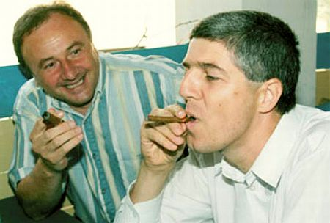
Since 2009
Existence of two parties:
SMK
The Bridge (Most-Híd)
Most-Híd took the earlier position of SMK
SMK stays out of parliament
Unsuccessful effort to cooperate

Slide 10
Influencing relations
3 models of relations:
International (Hungary – Slovakia)
Domestic (Slovakia – Hungarian minority)
National (Hungarian minority – Hungary)
Primary features:
Reflection of historical issues in present time (Treaty of Trianon, Beneš decrees)
Changing intensity of mutual tension

Slide 11
Trianon
Occasional topic for the radicals
Relevance of the topic neutralised with entry of Slovakia and Hungary to the EU
„Does anyone understand that since Trianon we do not have our home? Todays Hungary is not a real home even for those who live there, but it is only a „residual“ country“
Miklós Duray, 2006

Slide 12
Autonomy
A topic situated more in the 90s than in the present
Different understanding of the word „autonomy“ and its content by Hungarian politicians
Autonomy of culture and schools vs. territorial autonomy
Approval of Hungarian politicians not to open this topic allowed them to participate on government

Slide 13
Hungarian exterritorial laws
„“In a legal sense, in accordance with the Constitution, I want to act as the head of the government of all the citizens of this 10 million strong country, but inspirit and sentiment as the prime minister of 15 million Hungarians.”
József Antall, Hungarian prime minister in early 90s
„14-15 million Hungarians can do much more than 10 million”
Viktor Orbán, current Hungarian prime minister

Slide 14
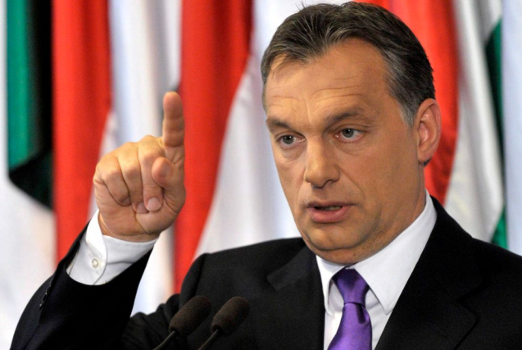
Hungarian exterritorial laws
Foreign IDs (2002):
Available for „minority“ Hungarians except from Austria
Financial advantages directly from Hungary
Some SMK officials got these IDs
Dual citizenship (2010):
Possibility to gain also a Hungarian citizenship
Slovakia adopted a counter-law leading to abandoning the Slovak citizenship
Until 2012 – about 200 thousand requests (minimum from Slovakia)

Slide 15
The Hungarian issue Now from the other side

Slide 16
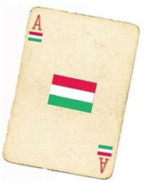
Anti-Hungarian nationalism
Playing with the so called „Hungarian card“
Various ways of usage:
Electoral campaign
Daily politics
Reactions on Hungarian political actions
Suitable way how to overlay other negative problems

Slide 17
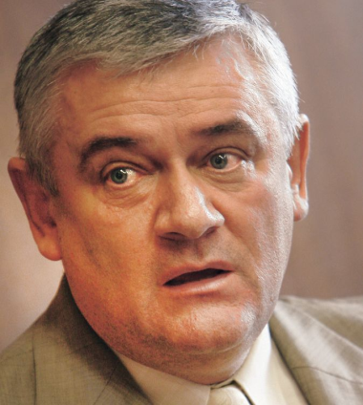
Slovak National Party
Created in 1990, claims a link with historical SNS
Radical right party:
Nationalism, xenophobia
Topics – Hungarians, Roma, homosexuals, against NATO, reserved towards EU
Main leaders:
Ján Slota (excluded)
Anna Belousovová (excluded)

Slide 18
Slovak National Party
Development:
Early years – searching for identity → radicalization since 1994
2001 – Slota creates the True SNS (PSNS)
2003 – unification after unsuccessful elections
Position in the system:
Member of governments led by Mečiar (1994-1998) and Fico (2006-2010)
Out of parliament (2012 – 2016)
Since 2016 back in government (with Most-Hid)

Slide 19
The peak of nationalism
Mečiar’s government in 1994 - 1998
SNS got ministries of education and defense
Topics:
Bilingual school reports
Name of towns
Names and surnames in registers
New administrative division of Slovakia
Lowering the funds for minorities’ culture

Slide 20
Issues - Language
1990 – aim to allow Slovak as the only official language
2009 – controversial language law:
Government of Robert Fico
Spread of areas where Slovak has to be used
High sanctions for breach of the law
Usage of minority languages:
Share of towns’ minority inhabitants
Trench warfare between 10 and 20 %

Slide 21
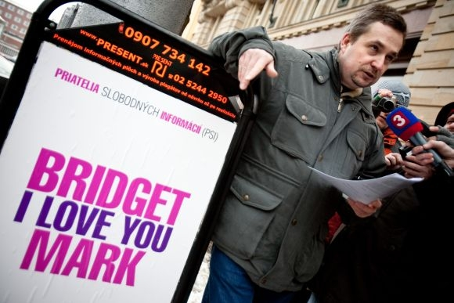

Slide 22
Issues – Administrative division
1997 – new districts:
Mečiar’s government (potential aim for electoral reform)
2001 – regions:
Plan of Dzurinda’s government – 12 regions
SMK’s proposal for a 13th „Hungarian“ region
Result – Dzurinda’s government (most of its Slovak parties) and opposition adopted 8 regions in existing borders
In every region Hungarians compose only a minority

Slide 24
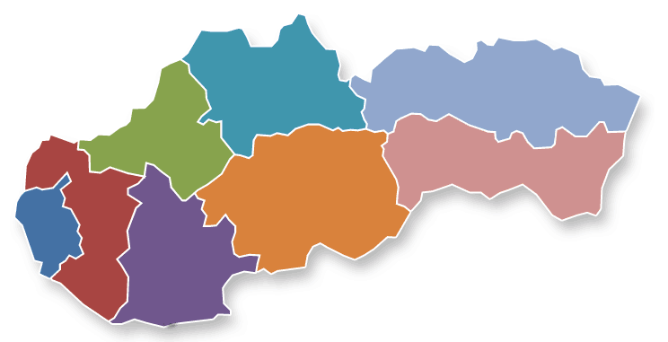

Slide 25
Issues – Electoral Campaign
We are Slovaks. A Slovak government for Slovaks“
Program of SNS for elections 2006
Reaction to presence of Hungarians in government
SNS - billboards, slogans etc. with clear message:
Hungarians as an enemy
Hungarians as a threat
Regional elections 2001 in Nitra district:
2nd round of chairman elections – Slovak vs. Hungarian candidate
Slovak candidate used the word „Slovak“ to differ from his opponent

Slide 26
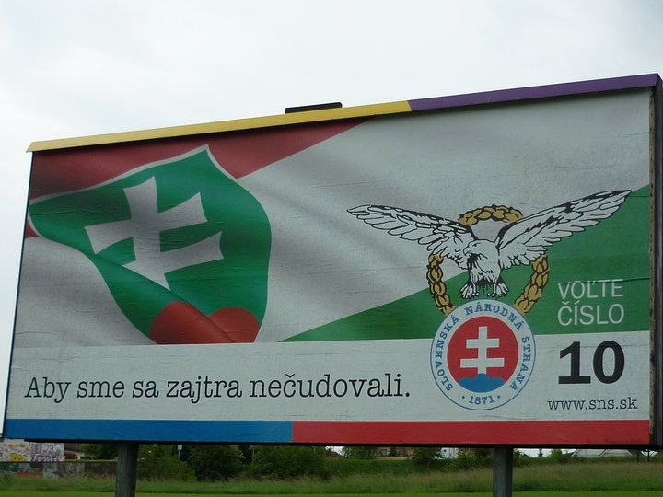
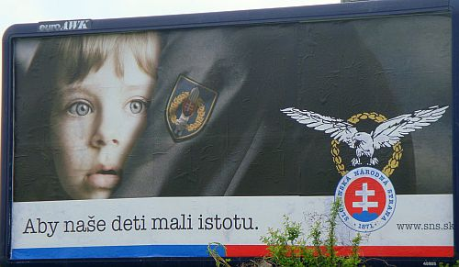
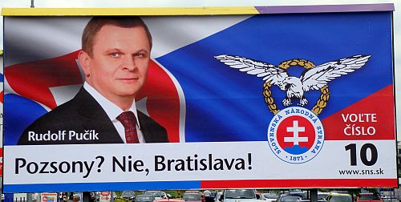
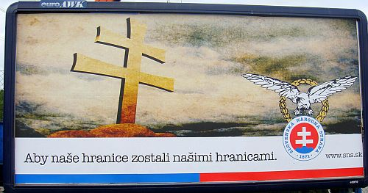

Slide 27
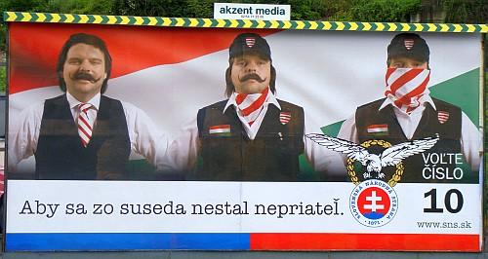

Slide 28
Ján Slota
The most visible representative of Slovak nationalism until 2010
Very offensive language towards various social groups
Verbal attacks on:
Hungary, its history, symbols and politicians
Hungarian minority
Roma
Homosexuals
Slovak politicians including prominent members of SNS
Media

Slide 29
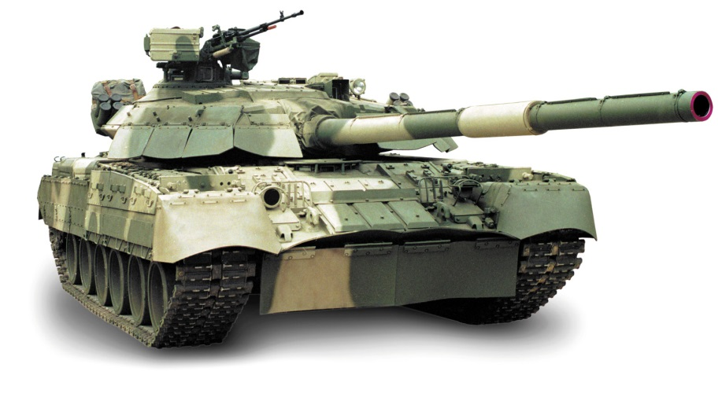
The tank attack on Budapest
Most „popular“ incident
Occurred in 1999 on a meeting of HZDS where he was present
Slota called for a tank attack on Budapest
„We will not leave it like this, we will go in tanks and we will flatten Budapest“

Slide 30
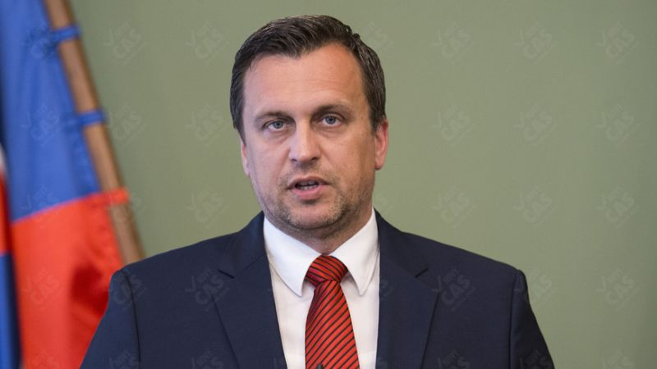
SNS today
The party officially proclaims to be `different` and `renewed`
New leader – Andrej Danko
Many representatives from the 90s remained in the party
In government with Hungarian party Bridge

Slide 31
The Roma issue

Slide 32
Roma in Slovakia
Unclear proportion of the population
Official census:
1991 – 75 802 (1,4 %)
2001 – 89 920 (1,7 %)
2011 - 105 738 (2 %)
Real estimations around 400 000
Geographically concentrated in Central and Eastern Slovakia

Slide 33
2,14
40,76
0,54
34,5
14,68
2,88
0,73
3,77

Slide 34
Roma in Slovakia
Very bad image from the majority’s point of view
Associated features:
Lack of education
Unemployment
Living conditions and habits
Criminality

Slide 35
Public surveys – „Who would you not accept as your neighbor?“
Category | 2006 | 2008
Drug addict | 84,9 | 88,6
Roma | 72,8 | 82,4
Convicted felon | 58,8 | 71,3
Right-wing extremist | 62 | 66,8
Muslim | 49,5 | 54,7
Homosexual | 38,8 | 51,2
Immigrant | 35,2 | 41,5
Person of a different race | 28,8 | 39,5
Jew | 21,5 | 29
Disabled | 6 | 8,7

Slide 36
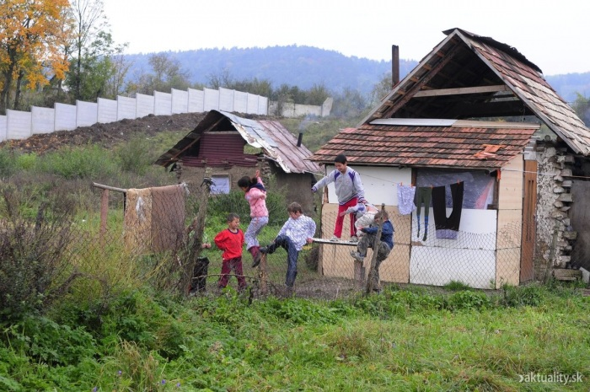
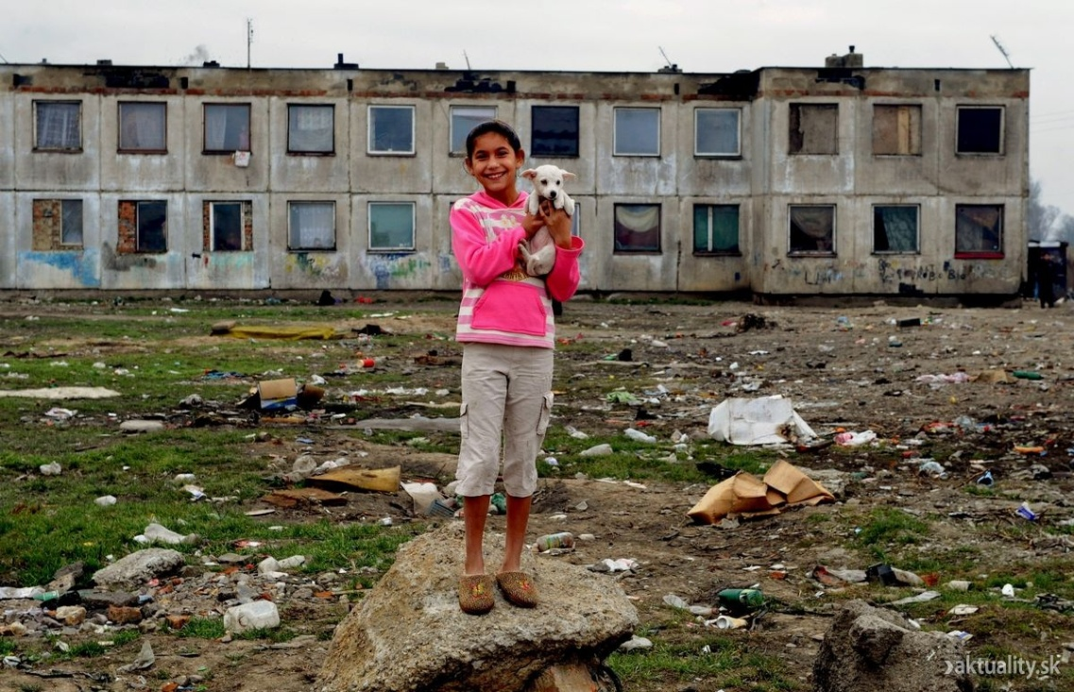
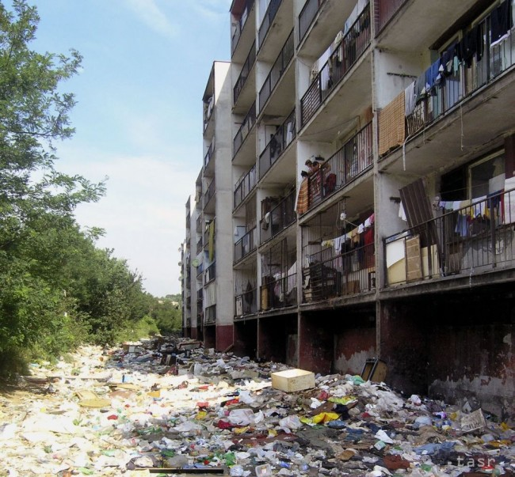
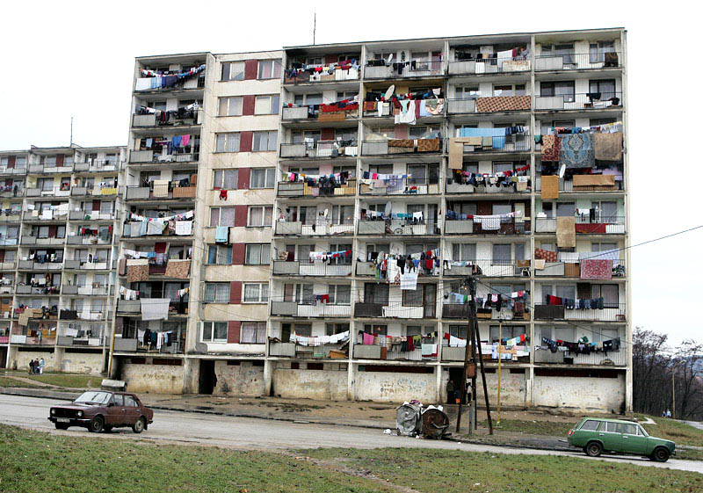

Slide 37
Roma and politics
No relevant Roma political party
Attempts to create such subjects end without any success
Lack of organizational skills
Non disciplined voters (regular attempts to buy their votes)

Slide 38
Roma as a topic for nationalists
Mostly stressed by SNS in the past
Ideas even beyond the principles of democracy or human rights
Examples:
Reservations (as Indians in North America)
„A small yard and a big whip“

Slide 39
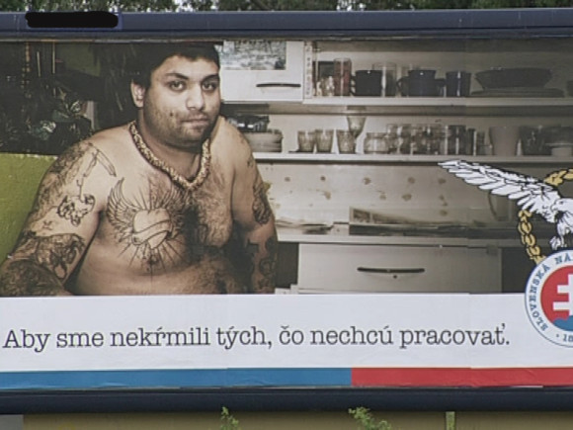
SNS campaign in 2010

Slide 40
Rise of extremism?
People`s Party – Our Slovakia (LSNS)
Leader – Marian Kotleba
Emerged in 2010
Previous links with Slovak Brotherhood:
Electoral failure in 2006
Dissolved in 2008

Slide 41
Ideology
Slovak Brotherhood:
Various topics
Slovak wartime state, Hungarians, Roma, NATO, homosexuals…
LSNS:
Modification of the profile
Primary focus on Roma
Other topics present, but rather secondary
Change after 2012?

Slide 42
LSNS and Roma minority
Party`s framing of the minority:
Asocial parasites
Gypsy terrorists
LSNS blames the mainstream parties for being passive and for keeping the majority unprotected
Trips to towns with Roma settlements
Kotleba`s purchase of land with an illegal settlement

Slide 43
Performance in elections
Only minor success in national elections:
2010 – 1,33 %
2012 – 1,58 %
2016 – wait for it
Kotleba`s unsuccessful attempt to become governor in 2010
Regional election 2013:
Kotleba scored second in the first round
In runoff Kotleba won over SMER`s incumbent

Slide 44
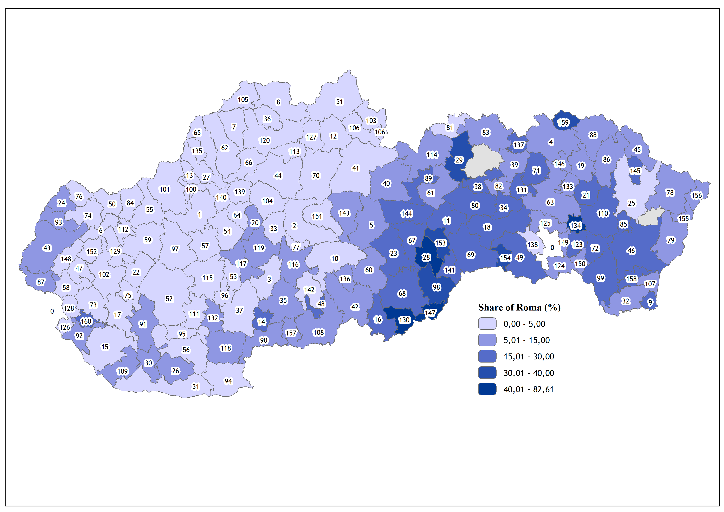

Slide 45
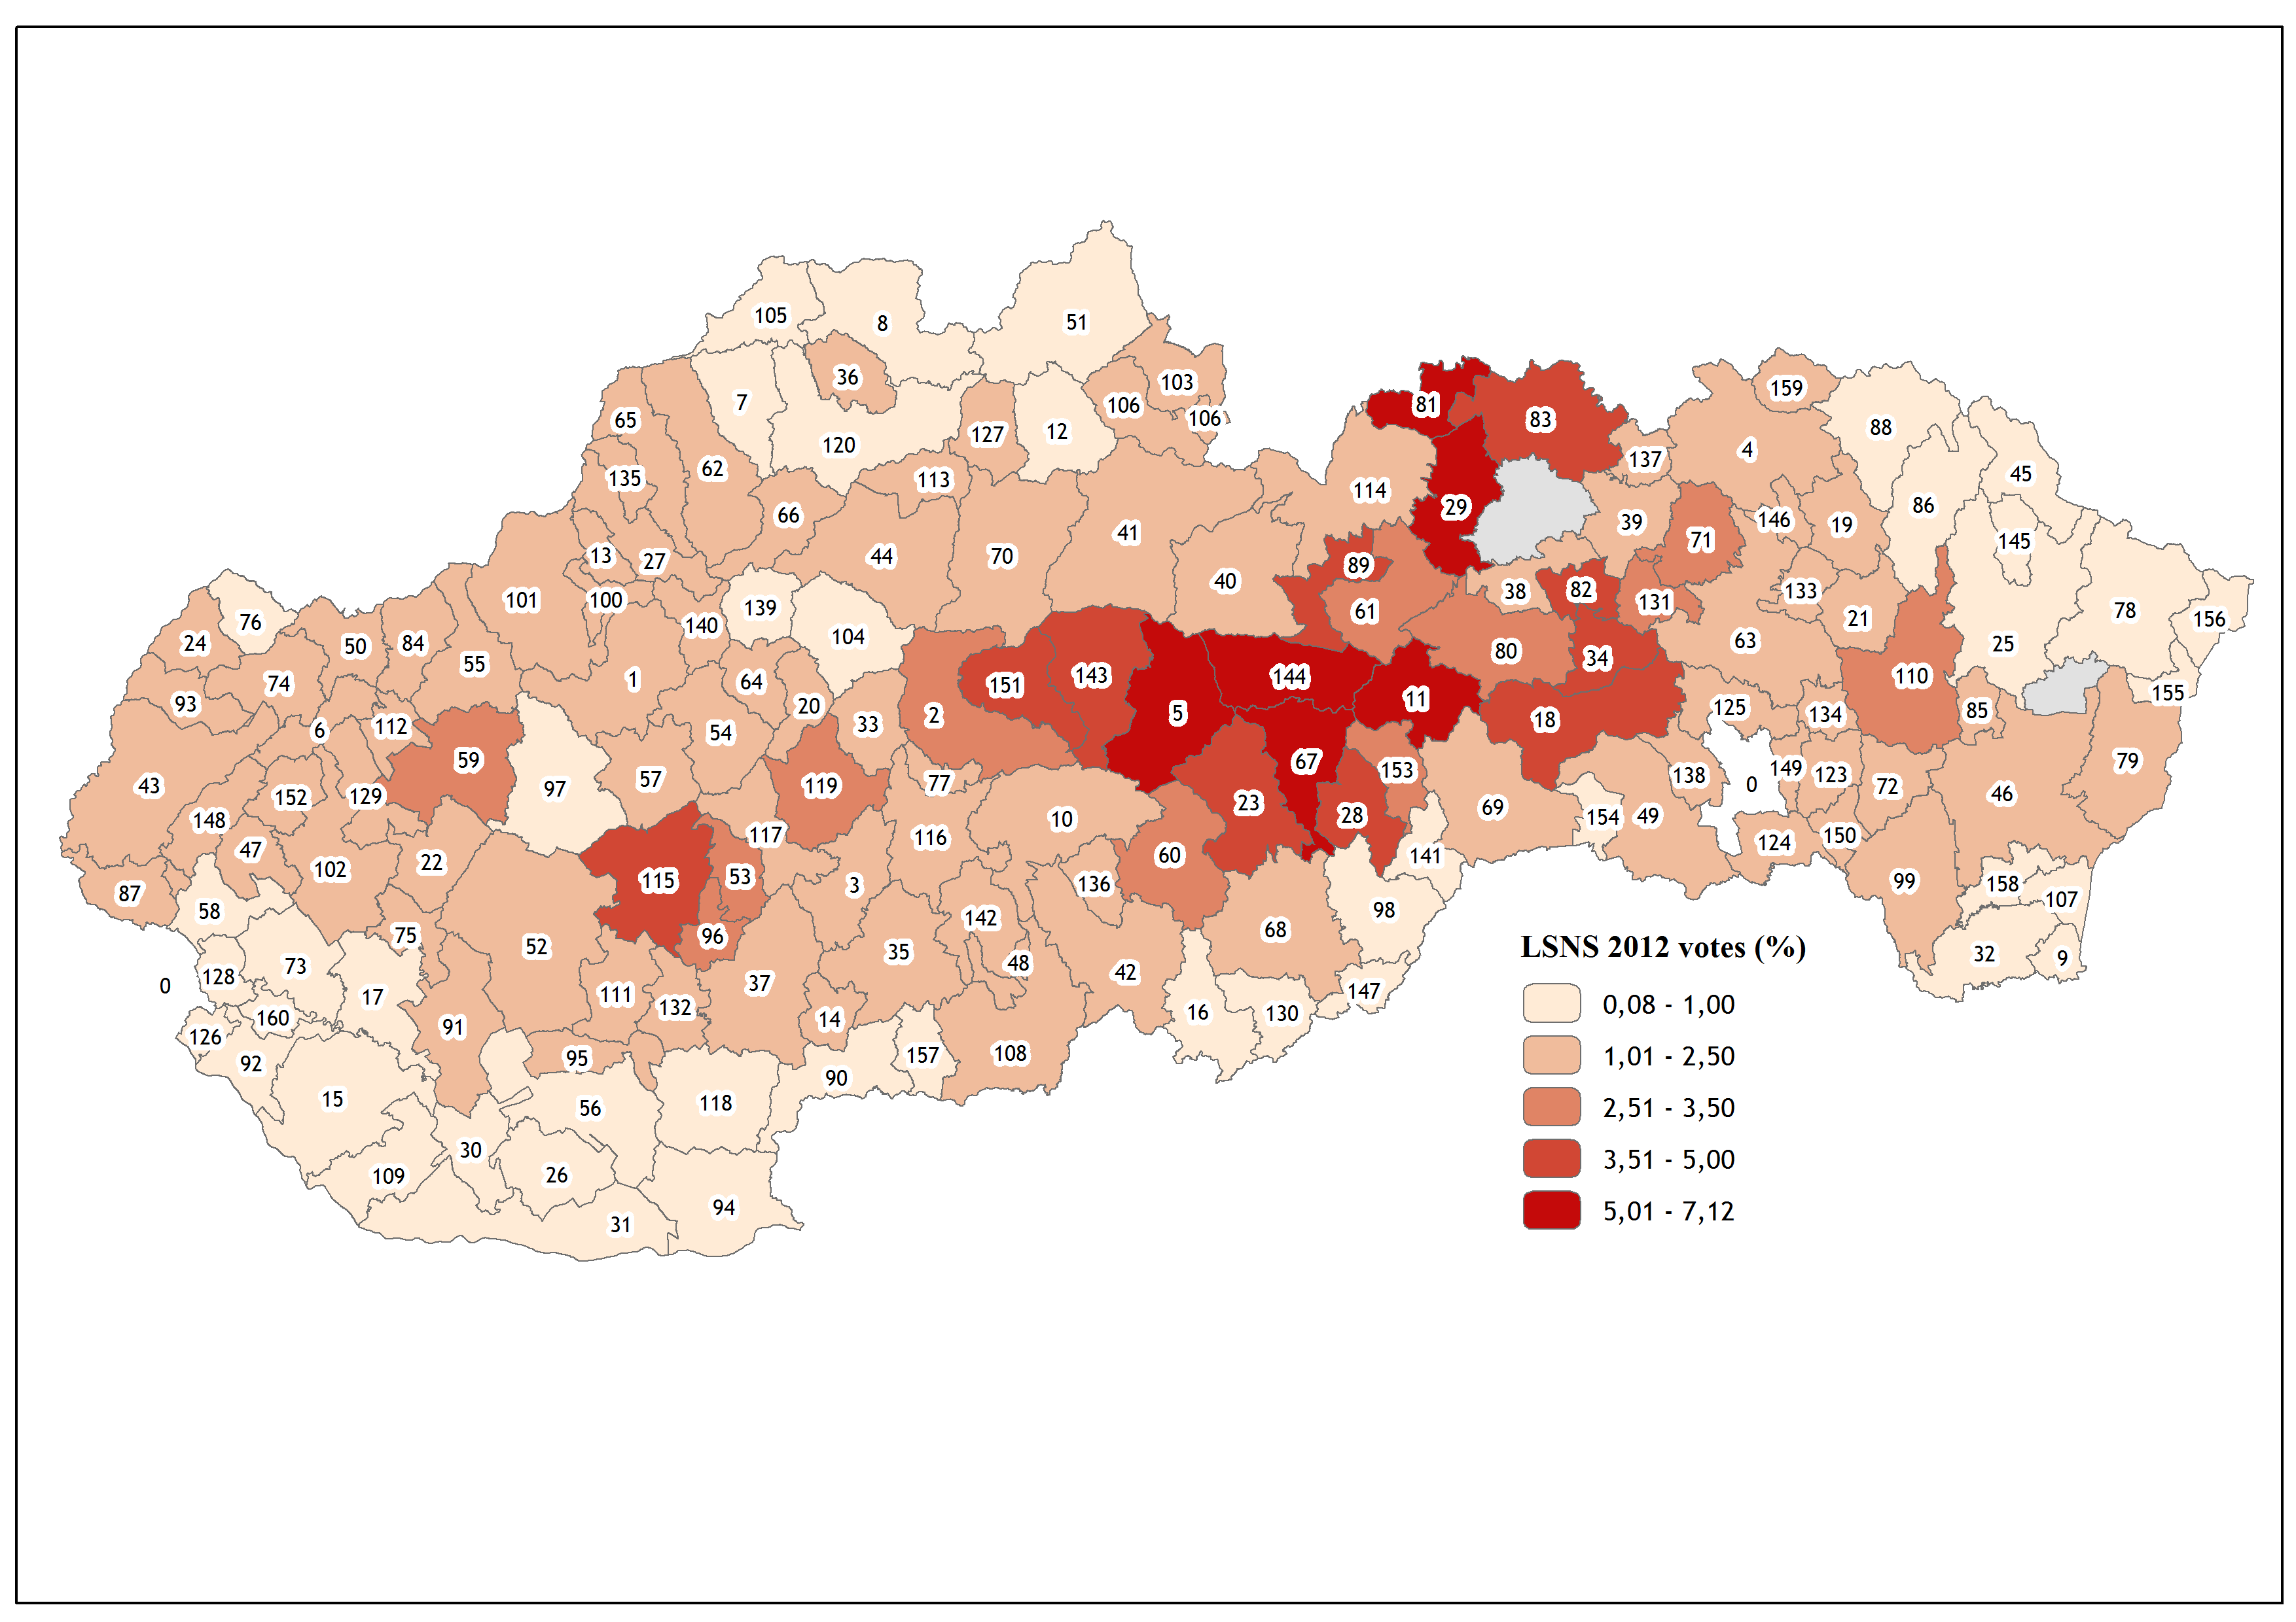

Slide 46
National election 2012
LSNS support grows with rising share of Roma in municipalities
Maximum votes obtained in areas with 25.1 – 50 per cent Roma
Slight increase of votes in areas near Roma settlements

Slide 47
National election 2016
LSNS gained 8 per cent (more than 200 000 votes) and entered parliament
Five times more votes than in 2012 election
The party won among young people
Rise of extremism or adoption of protest image?

Slide 48
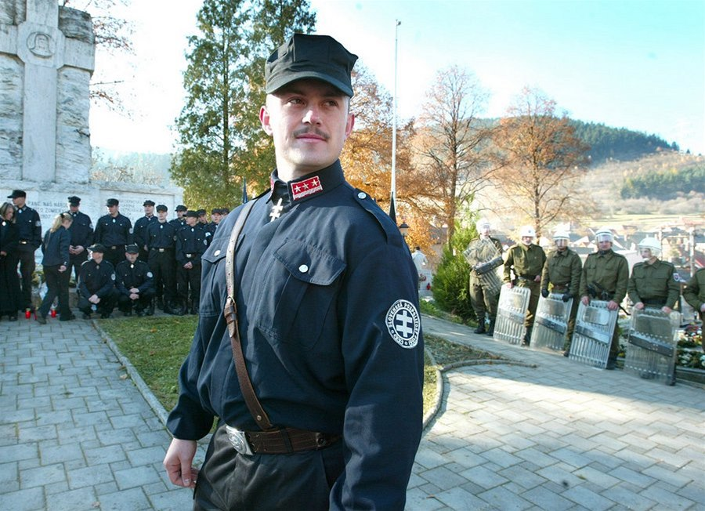
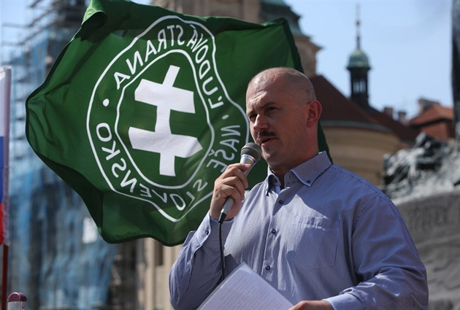
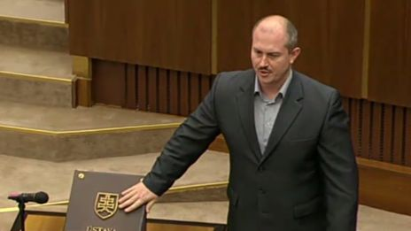
Extremism or protest?

