Slide 1
Referendum in Slovakia
Peter Spáč
24.4.2017

Slide 2
Direct democracy
The original type of democracy
Direct vs. representative democracy
All citizens entitled to participate on all political decisions
Examples:
  Ancient Athens
  Parish meetings in England
  J. J. Rousseau – the renaissance of direct democracy
  Landsgemeinde in Switzerland

Slide 3
Direct democracy
Shift from direct to representative democracy:
  Effectiveness
  Politics as permanent occupation
  More complicated issues
Result:
  Direct democracy now only as a supplementary tool
  Dominance of representative democracy

Slide 4
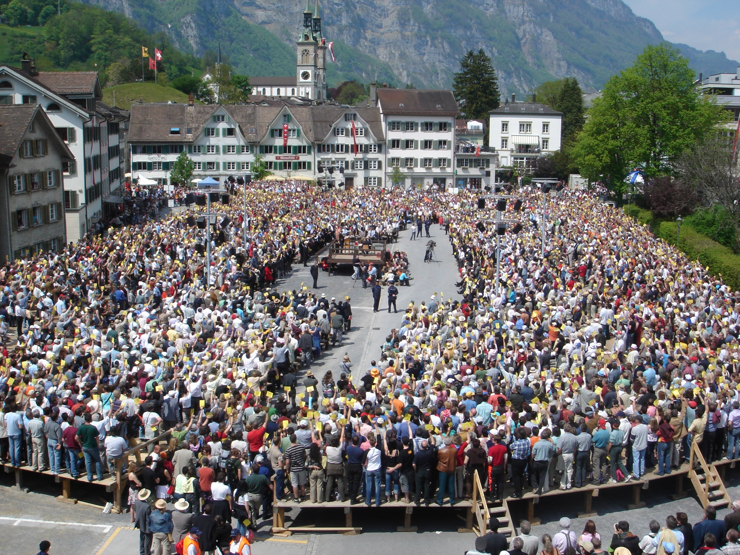

Slide 5
Referendum
The main tool of direct democracy in presence
Origin in Switzerland in 13th century
Mechanism which allows citizens to express their attitude on a specific question mostly by either a „yes“ or a „no“ vote
Similar attributes as elections – universal suffrage, secret vote, equal weight of votes etc.

Slide 6
Referendum - types
Obligatory – must be held
Facultative – may be held
Binding – results bind the elected representatives
Consultative – results only as a recommendation
Preliminary – held before the actual decision
Subsequent – held after the actual decision

Slide 7
Positives of referendum
Higher legitimacy of decisions
Inclusion of citizens into decision-making process
Encouragement of public discussion
Indicator of public opinion

Slide 8
Negatives of referendum
Polarization of society
Limitation of expression - nothing between „yes“ and „no“ option
Ability of citizens to handle more complicated and technical issues
Referendum as a demonstration of power used by non-democratic regimes

Slide 9
Tradition of referendum?
1st Czechoslovak Republic (1918-1938):
  Constitution – the government may call a referendum if the parliament declined its law proposal
  The implementing law was never adopted
Other periods – no mention of referendum
Split of ČSFR – a constitutionally stated referendum was not used
Result – no nationwide referendum held until 1993

Slide 10
Referendum in Slovakia since 1993

Slide 11
Formal aspects
All main attributes defined in Constitution
Obligatory:
  Confirmation of a constitutional law on entering into or withdrawing from an alliance with other states
Facultative:
  About „important issues of public interest“
  Excluded issues – basic rights and liberties, taxes, state budget

Slide 12
Formal aspects
Initiation:
  Petition of at least 350 000 citizens
  Resolution of the parliament
President calls the referendum:
  Not within 90 days before parliamentary elections
  But it may be held on the day of parliamentary elections

Slide 13
Formal aspects
A referendum is valid if:
  The turnout reaches at least 50 % and
  A decision is endorsed by at least 50 % of those who participated
Effect:
  The result is promulgated by the parliament as a law
  For the next 3 years neither the parliament may modify this result nor another referendum on the same issue may be held

Slide 14
What will we track?
Who initiated the referendums
What were the official and real motives of these subjects
What were the results and their impact

Slide 15
Part I – Referendum as a part of election campaign

Slide 16
Referendum 1994
High impacts of economic transformation in Slovakia since 1989 (inflation, unemployment)
Slovak ex-communists (SDL) resigned to be a protest party due to their intellectual profile
Secession of radical leftist ZRS (Association of Slovak Workers) in 1994 only a few months before election
Referendum as a part of their electoral campaign how to mobilize protest voters

Slide 17
Referendum 1994
Topic – reveal of property used in privatization and auctions (against „the rich“)
ZRS started a petition but eventually the idea of referendum was supported in parliament
Referendum was held only one month after elections → ZRS could lead both campaigns at once

Slide 18
Referendum 1994
Question – Would you agree to adopt a law about reveal the origin of finances used for privatization and auctions?
 | Votes | %
Total | 773 624 | 19,96
Out of it
Yes | 724 448 | 93,64
No | 30 733 | 3,97

Slide 19
Elections 1994
Party | Votes (in %) | Seats | Seats (in %)
HZDS | 34,96 | 61 | 40,67
SV | 10,41 | 18 | 12
Hungarians | 10,18 | 17 | 11,33
KDH | 10,08 | 17 | 11,33
DÚ | 8,57 | 15 | 10
ZRS | 7,34 | 13 | 8,67
SNS | 5,4 | 9 | 6
Others | 13,06 | 0 | 0

Slide 20
Referendum 1994
Initiator:
  Official – the parliament
  Real – ZRS and its leader Ján Ľupták
Motives:
  Official – reveal of property from privatization
  Real – mobilize protest voters and raise the chances of ZRS in parliamentary elections
Results:
  Referendum was not valid
  ZRS entered parliament

Slide 21
Referendum 1998
In 1998 Mečiar’s HZDS faced:
  A decline of public support since elections 1994
  A risk that it will be in opposition after elections 1998
Referendum as a tool how to:
  Mobilize supporters of HZDS
  Potentially harm the next government if created by opposition parties
Topic – ban of privatization of strategic companies (nationalist sentiments)

Slide 22
Referendum 1998
Petition:
  Started in summer 1998 (two months before elections)
  Even the employees of civil service (controlled by HZDS) were assigned to help with the petition!
Referendum joined with parliamentary election to secure its maximum mobilizing effect

Slide 23
Referendum 1998
Question – Do you favor that National Council adopts a constitutional law to ban privatization of selected strategic companies?
 | Votes | %
Total | 1 772 223 | 44,25
Out of it
Yes | 1 432 845 | 80,48
No | 266 991 | 14,99

Slide 24
Referendum 1998
Initiator:
  HZDS – the party of that time Prime Minister Mečiar
Motives:
  Official – to secure the property of strategic companies
  Real – to increase chances of HZDS in parliamentary election
Results:
  Referendum was not valid
  HZDS won the election but ended in opposition

Slide 25
Referendum 2010
Very similar to referendum 1994
In 2008 a civic association Freedom and Solidarity (SaS) started a petition against unfair media fees
In November 2008 SaS emerged as a political party
In 2009 the original petition was widened and was aimed to call for a referendum
  Reducing the MPs immunity
  Limits on prices of cars used by government officials etc.

Slide 26
Referendum 2010
SaS wanted to join the referendum with elections 2010
President Gašparovič effectively prevented this effort
SaS compensated this by gathering signatures until the date of parliamentary elections

Slide 27
Referendum 2010
1. Repeal of the duty to pay a fee for services provided to public by Slovak television and radio
2. Extension of the possibility to hear a performance of a National Council’s member as a misdemeanour
3. 100 instead of 150 members of NR SR
4. Price of governmental vehicles only up to 40K EUR
5. Parliamentary and European elections on Internet
6. Ban of the right of reply for public officers in press

Slide 28
Referendum 2010
 |  | Votes | %
 | Total | 998 142 | 22,84
1 | Yes | 870 864 | 87,24
 | No | 90 058 | 9,02
2 | Yes | 952 281 | 95,4
 | No | 17 333 | 1,73
3 | Yes | 925 888 | 92,76
 | No | 38 450 | 3,85
4 | Yes | 886 767 | 88,84
 | No | 61 532 | 6,16
5 | Yes | 703 336 | 70,46
 | No | 221 847 | 22,22
6 | Yes | 747 983 | 74,93
 | No | 134 163 | 13,44

Slide 29
Elections 2010
Party | Votes (in %) | Seats | Seats (in %)
Smer | 34,79 | 62 | 41,33
SDKÚ | 15,42 | 28 | 18,67
SaS | 12,14 | 22 | 14,67
KDH | 8,52 | 15 | 10
Most | 8,12 | 14 | 9,33
SNS | 5,07 | 9 | 6
Others | 13,06 | 0 | 0

Slide 30
Referendum 2010
Initiator:
  Freedom and Solidarity (SaS)
Motives:
  Official – solving several public topics
  Real – mobilize voters and raise chances of SaS in election
Results:
  Referendum was not valid
  SaS entered parliament and also the government

Slide 31
Part II – Referendum as a way how to challenge the elections

Slide 32
Referendum 2000
Government of M. Dzurinda formed after 1998:
  Negative economic impact of previous era
  Decline of public support
Non-cooperative parliamentary opposition:
  Mečiar’s HZDS and nationalist SNS
  Newly created populist party SMER (Direction) led by Robert Fico

Slide 33
Referendum 2000
In 2000 HZDS and SNS started a petition for referendum about early elections
Official motive – the inability of government to solve economic problems
Party SMER originally refused the idea but eventually supported it
The question whether an early elections may be called based on referendum results

Slide 34
Referendum 2000
Question – Do you favor that National Council agrees on early elections up to 150 days after the referendum?
 | Votes | %
Total | 816 254 | 20,03
Out of it
Yes | 759 124 | 92,74
No | 39 363 | 4,8

Slide 35
Referendum 2000
Initiator:
  HZDS and SNS – that time opposition parties
Motives:
  Official – inability of the government to solve economic problems of Slovakia
  Real – aim of the Dzurinda’s government to investigate scandals of Mečiar’s government?
Results:
  Referendum was not valid
  Mečiar’s amnesties preventing the investigation still exist

Slide 36
Referendum 2004
Second government led by M. Dzurinda:
  Vast liberal economic reforms – taxes, healthcare
  High frustration of voters
Opposition:
  Since 2002 SMER became the main opposition party
  SMER shifted to social democracy and launched harsh criticism of governmental reforms

Slide 37
Referendum 2004
In November 2003 the trade unions started petition for referendum about early elections
Opposition parties:
  Supported the petition
  Some of them actively gathered the signatures
  SMER even made a financial contribution
Government logically opposed the idea and advised its voters to ignore the referendum

Slide 38
Referendum 2004
Question – Do you favor that National Council agrees on early elections in 2004?
 | Votes | %
Total | 1 503 784 | 35,86
Out of it
Yes | 1 305 023 | 86,78
No | 179 524 | 11,93

Slide 39
Referendum 2004
Initiator:
  Trade unions backed by opposition parties (mostly SMER)
Motives:
  Early elections and mobilization of citizens aimed against the government
Results:
  Referendum was not valid
  Party SMER tested its electoral potential

Slide 40
Part III – Referendum as a way how to solve (or create) problems

Slide 41
Referendum 1997
The era of Vladimír Mečiar:
  Decline of quality of democracy
  High polarization of society and domestic politics
Risk of inability to elect the new president in parliament → opposition parties started petition for a referendum about direct presidential elections
After 350 000 signatures were acquired the government reacted by proposing a referendum about integration to NATO

Slide 42
Referendum 1997
Two initiatives at the same time:
  Direct elections of president
  Integration to NATO (3 separate questions)
President called a joint referendum with 4 questions
Mečiar’s government announced that president broke the Constitution
Ministry of interior published ballots only with the 3 NATO questions

Slide 43
Referendum 1997
1. Are you in favor of Slovakia's entry into NATO?
2. Are you for deploying nuclear weapons on the territory of Slovakia?
3. Are you for locating foreign military bases on the territory of Slovakia?
4. Do you agree that the president of the Slovak Republic should be directly elected by the citizens of the Slovak Republic according to the enclosed proposal for a constitutional law?

Slide 44
Referendum 1997
 | Votes | %
Total | 319 727 | 9,53
Question 1
Yes | 130 052 | 39,02
No | 154 090 | 46,28
Question 2
Yes | 29 628 | 8,87
No | 232 197 | 69,8
Question 3
Yes | 42 336 | 12,71
No | 218 956 | 65,79

Slide 45
Referendum 1997
Initiators:
  Opposition – presidential elections
  Government - NATO
Motives:
  Opposition – to enable the election of president, avoid Mečiar to concentrate too much power and mobilize voters
  Government – to block the effort of the opposition
Results:
  Referendum was not valid (marred referendum)
  For more than a year Slovakia had no president
  Frustration of voters against the government

Slide 46
Referendum 2003
The integration to the European Union
Facultative referendum as the others
A common effort of all relevant political parties to mobilize voters and ensure the needed 50 % turnout

Slide 47
Referendum 2003
Question – Do you agree to the proposal that the Slovak Republic should become a member state of the European Union?
 | Votes | %
Total | 2 176 990 | 52,15
Out of it
Yes | 2 012 870 | 92,46
No | 135 031 | 6,2

Slide 48
Referendum 2003
Initiator:
  Parliament (not relevant)
Motives:
  Integration to the EU
Results:
  Referendum was valid
  Slovakia entered the EU

Slide 49

Referendum 2015
Alliance for the Family
The official aim to `protect the family in Slovakia`
Expressed threats:
  Same-sex marriages
  Adoptions by homosexuals
  Anti-family values in general
Petition with more than 400 thousand signatures

Slide 50
Referendum 2015
Original aim – four questions:
  Special rights and protection given only to marriage (among all types of relationships)
  Marriage only as a relationship of a man and a woman
  Ban of adoptions by homosexuals
  Parents` right to decide about the content of education (sexual behavior, euthanasia)
President Kiska consulted the Constitutional court:
  First question banned
  The date of referendum postponed to February 2015

Slide 51
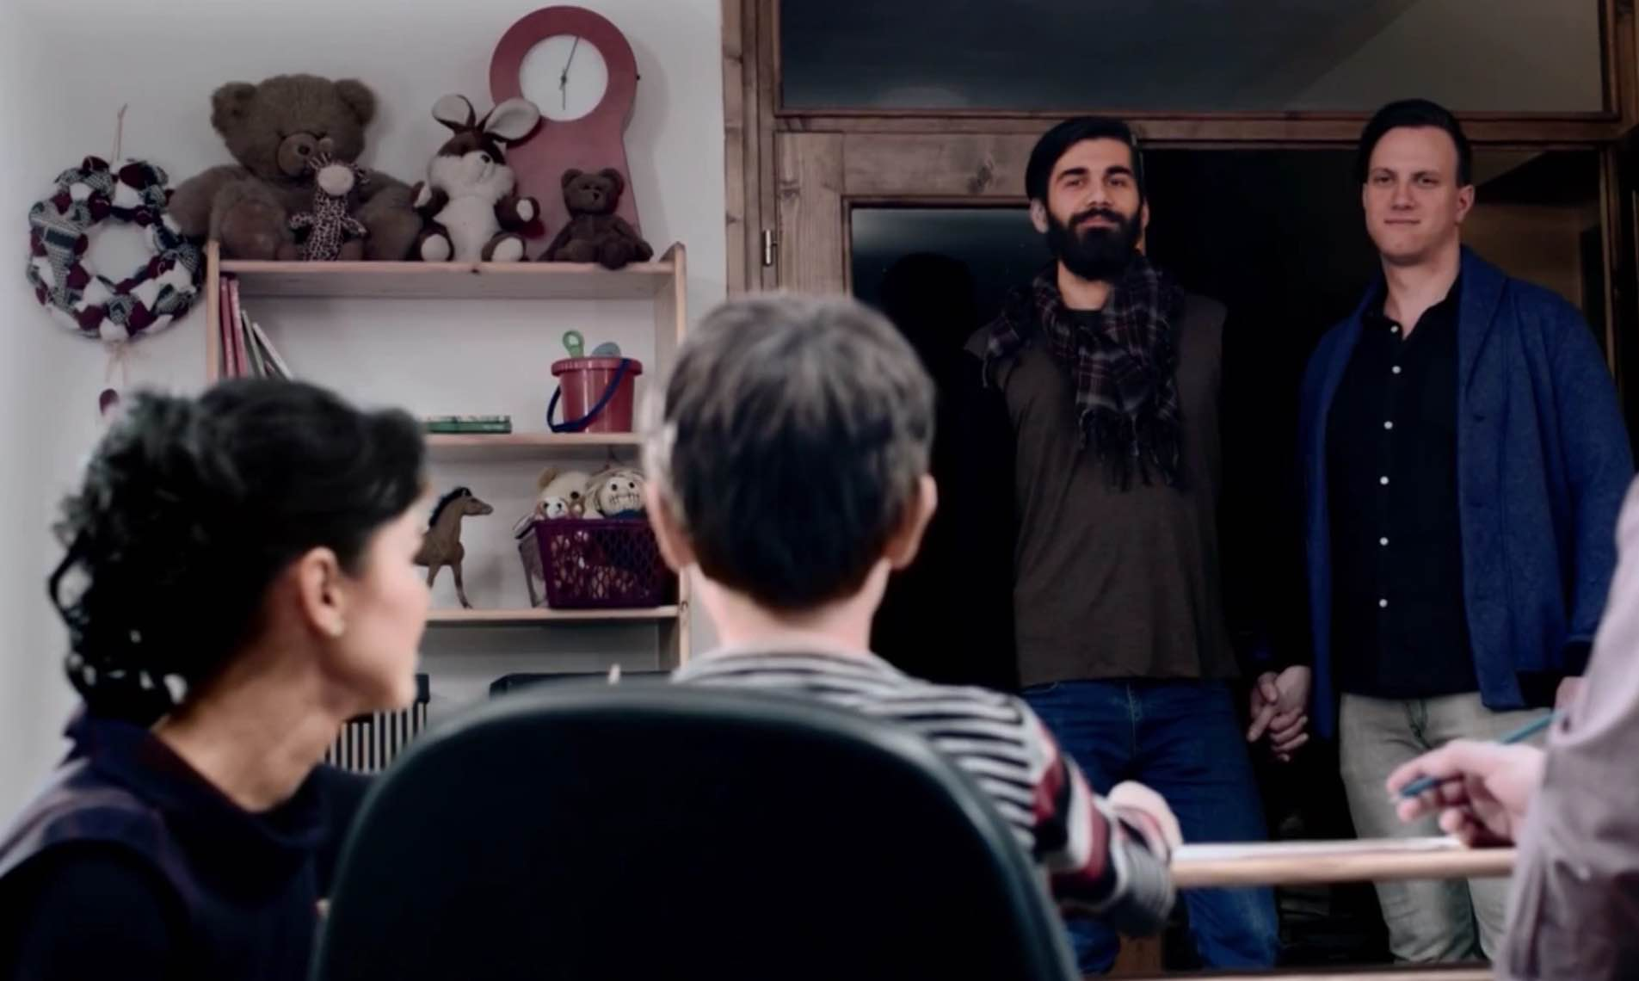
Referendum 2015

Slide 52


Referendum 2015

Slide 53
Referendum 2015
Most political parties remained fairly silent
A fear from losing Catholic voters?
Expressed views:
  KDH and SNS favored the referendum
  SaS rejected the idea and asked people to ignore it
SMER, SDKU only advised people to participate without holding a side

Slide 54
Referendum 2015
 |  | Votes | %
 | Total | 944 674 | 21,41
Only man – woman marriage | Yes | 892 719 | 94,50
 | No | 39 088 | 4,13
No adoptions for homosexuals | Yes | 873 224 | 92,43
 | No | 52 389 | 5,54
Parents` say in education | Yes | 853 241 | 90,32
 | No | 69 349 | 7,34

Slide 55
Referendum 2015
Initiator:
  Alliance for the Family
Motives:
  Official – Protection of family
  Real – Mostly banning rights of homosexuals
  Official = real?
Results:
  Referendum was not valid

Slide 56
Referendums in Slovakia
 | Year | Topic | Turnout | Result
1 | 1994 | Privatization | 19,96 | Not valid
2 | 1997 | NATO / President | 9,53 | Not valid / marred
3 | 1998 | Strategic companies | 44,25 | Not valid
4 | 2000 | Early elections | 20,03 | Not valid
5 | 2003 | EU | 52,15 | Valid – yes
6 | 2004 | Early elections | 35,86 | Not valid
7 | 2010 | Various | 22,84 | Not valid
8 | 2015 | Family | 21,41 | Not valid

Slide 57
Referendums that did not happen
Only several unsuccessful efforts to call for a referendum
1993 – petition of HZDS:
  Not enough signatures
1999 – petition of HZDS and SNS:
  Minority languages and strategic privatization
  Against the Constitution

Slide 58
Initiators
In almost all cases referendums were initiated by political parties
Usage of both possible channels:
  Petitions
  Resolution of parliament
Exceptions:
  2004 – Trade unions
  2015 – Alliance for the Family

Slide 59
Motives
Two types of referendums:
About issues:
  1994 – reveal of property gained by privatization
  1997 – presidential elections and NATO
  1998 – ban of privatization of strategic companies
  2010 – various topics – immunity, price of cars etc.
  2015 – homosexual marriages, adoptions, education
Without material issues:
  2000 – early elections
  2004 – early elections

Slide 60
Referendums with issues
Official motive only of secondary value (or not relevant at all)
Primary concern aimed at different motives
1994, 1998, 2010 – increasing chances of initiating parties (ZRS, HZDS, SaS) in parliamentary elections
1997 – blocking the initiative of political opponents
2015 – exception from this trend

Slide 61
Referendums without issues
The official motive equals the real motive
An openly expressed aim of initiators to end the term of government and call for early elections
Secondary aim to mobilize supporters (even in case the referendum is not valid)

Slide 62
Results
7 out of 8 referendums were not valid
Main reason – inability to reach the 50 % turnout
One referendum was marred
One referendum was valid yet – integration to the EU

Slide 63
Legacy for the future
Based on experience the referendum in Slovakia may be used as a mobilizing tool:
  Quite easy to initiate it
  Cheap campaign (for the initiator)
  Low turnout may be explained by the stance of political opponents who advised their voters to stay at home
  Referendum may have a sense for its initiator even if it is not valid → official vs. real motives

