Slide 1
Democratic Inequality
Lesson 8

Slide 2
Today’s questions
Do some citizens have more influence than others?
Does this influence matter?
Is the media responsible?

Slide 3
Do governments listen to the rich more than the poor?

Slide 4
Affluence and influence
Look at all policy preference questions from American surveys
  For example, “Do you support or oppose an increase in the retirement age to 67?”
  “Do you support or oppose legalizing gay marriage?”
Disaggregate responses by income, education
Was policy adopted within 4 years?
>1700 survey questions

Slide 5
Strong link between support and adoption

Slide 6
Why so little difference between rich and poor?
Appears that both rich and poor have reasonable influence
Why?
Most of the time, rich and poor have similar preferences
  For 1/3 of questions, rich and poor differ by < 8%
Note also that even very strong support among rich or poor only leads to 40-50% of adoption
  Most changes don’t get adopted

Slide 7
How much do spending preferences differ?
Repeated survey question on government:
  Should the government spend more, less, or the same on these policy areas?
How do opinions differ by income, education, and party identification?

Slide 8
Spending preferences, foreign affairs

Slide 9
Spending preferences, social policy

Slide 10
Small differences across income and education
Similar trends for most policies
  Differences between rich and poor about 3-4%
  Slightly larger for education
  Even larger for party ID
Welfare an exception: much stronger support for increased spending among poor

Slide 11
Focus on questions where preferences diverge

Slide 12
Is this a causal effect?
Could there be endogeneity: does government affect preferences?
  But opinion like a thermostat: left-wing policy => right-wing opinions
  Few citizens have any information about what their representatives want
  Correspondence greatest when president has average popularity, not when most popular
  Government should have most effect on preferences of poor, most manipuable

Slide 13
Mechanisms of influence
Money: rich more likely to contribute and contribute higher amounts
Turnout: rich more likely to vote
Coincidence: politicians mostly rich and share similar beliefs

Slide 14
Problems
Distinguish between means and ends
  If poor say: “I want tariffs” and “I want prosperity”, is it bad if politicians deliver prosperity but not tariffs?
Many people vote retrospectively over outcomes rather than inputs
Maybe wealthier voters more informed about which policies will produce good outcomes
Do we want governments to listen more to the poor and less-educated?

Slide 15
What about the superrich?

Slide 16
Most studies focus only on ordinary rich
Hard to find evidence on the political opinions and influence of superrich
But they may be the most influential
Very hard to contact
  No listed phone numbers
  Even their gatekeepers have gatekeepers
Most do not announce their views in the media

Slide 17
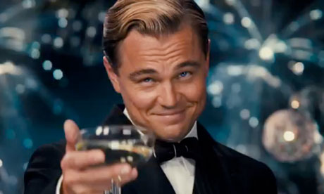
What do the super-rich believe?
Scholars in US contacting those with average wealth greater than $10 million
Findings
  Very interested and active in politics
  Frequent contact with elected politicians and government officials – more than 50% have personal contact with senators
Conservative economic beliefs
  Worried about budget, more willing to cut social programs, maintain low taxes, reduce regulation
But liberal social beliefs – gays, minorities
How much more influential on politics?

Slide 18
Webscraping on billionaires
Look through news sources for statement by billionaires
Most are silent – only political activity is campaign contributions: stealth politics
  Of 23 studied, only 3 take public positions on most issues (Gates, Buffett, Bloomberg)
  Another five make vague statements (Koch, Adelson, Icahn, Soros)
Most try to avoid offense to consumers
  Those who speak the most don’t depend on consumers

Slide 19
What about the poor?
Exclusion bias: Are people who don’t answer or answer “don’t know” different than others?
Poor subject to value conflicts on issues of redistribution: freedom and individualism versus fairness and equality
Poor have fewer resources and time to gather and process information to resolve conflict
More likely to answer “Don’t know” to questions on welfare state
Are we underestimating support for welfare state?

Slide 20
Does influence matter?

Slide 21
Income growth and government

Slide 22
Does it apply elsewhere?

Slide 23
Is media bias the problem?

Slide 24
What is bias?
Can media help solve these problems or is it the cause?
Can we say what biased reporting looks like?
  Even pure sequence of facts not necessarily unbiased
  Arrangement creates story, emotion, argument
Maybe at best we can say that bias = reporting similar to other ideological actors
  Uses same words, emphases, sources as political actors

Slide 25
Rise of objectivity norm
In past most news is partisan – produced by parties
Non-partisan reporting emerges as commercial product
High fixed costs to producing news (early 20th c.)
  Need to attract more readers
  Therefore stop presenting partisan news
  Also, rise of mass advertising: advertisers prefer to negotiate with one newspaper not five
But politicians can manipulate this standard
  “He said, she said” – can supply false information

Slide 26
Where does bias come from?
Desires of ownership (typically families or government)
  May sacrifice profits for ideology
  But “need to reach in order to teach”
  Do journalists want to follow political line?
Need to make a profit
  Who is your audience? What do they want?
  Who buys products from advertisers?
What do viewers want?
  Study of coverage of human rights violations in US less common for allies
  Desires of audience or government interference?

Slide 27
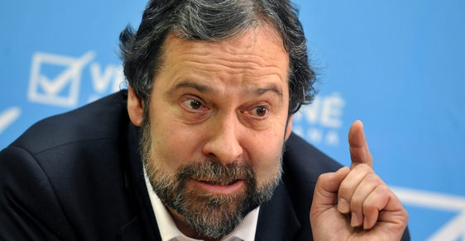
Political views of journalists
Many studies of political beliefs, vote choices, and campaign contributions of journalists
  In US and Western Europe, typically find that leftist – socially liberal
Why?
  Typical of educated, urban professionals
What are political beliefs of Czech journalists?
Does it matter?

Slide 28
Some attempts to measure bias (slant)
Which words/phrases most associated with left and right-wing politicians?
  To what extent do newspapers use the same words/phrases?
  Typical US newspaper close to moderate Democrat
  This is same as ideology of typical reader
Amount of coverage devoted to particular issues
  But what is the right amount?

Slide 31


Can public broadcasting improve knowledge?
Private media subject to market forces
  Focus on entertaining, exciting, sexy
Public broadcasters may be immune to market
  Can focus on politically important information
But does it do so?

Slide 32
“Auntie knows best”
Comparison of knowledge of citizens who watch public and private broadcasting
Viewers of public broadcasting are better informed
But only where public broadcaster
  Receives generous funding – immune from market
  With no strings attached – immune from political influence
But direction of causality?
  Knowledgeable people watch public broadcasting

Slide 33
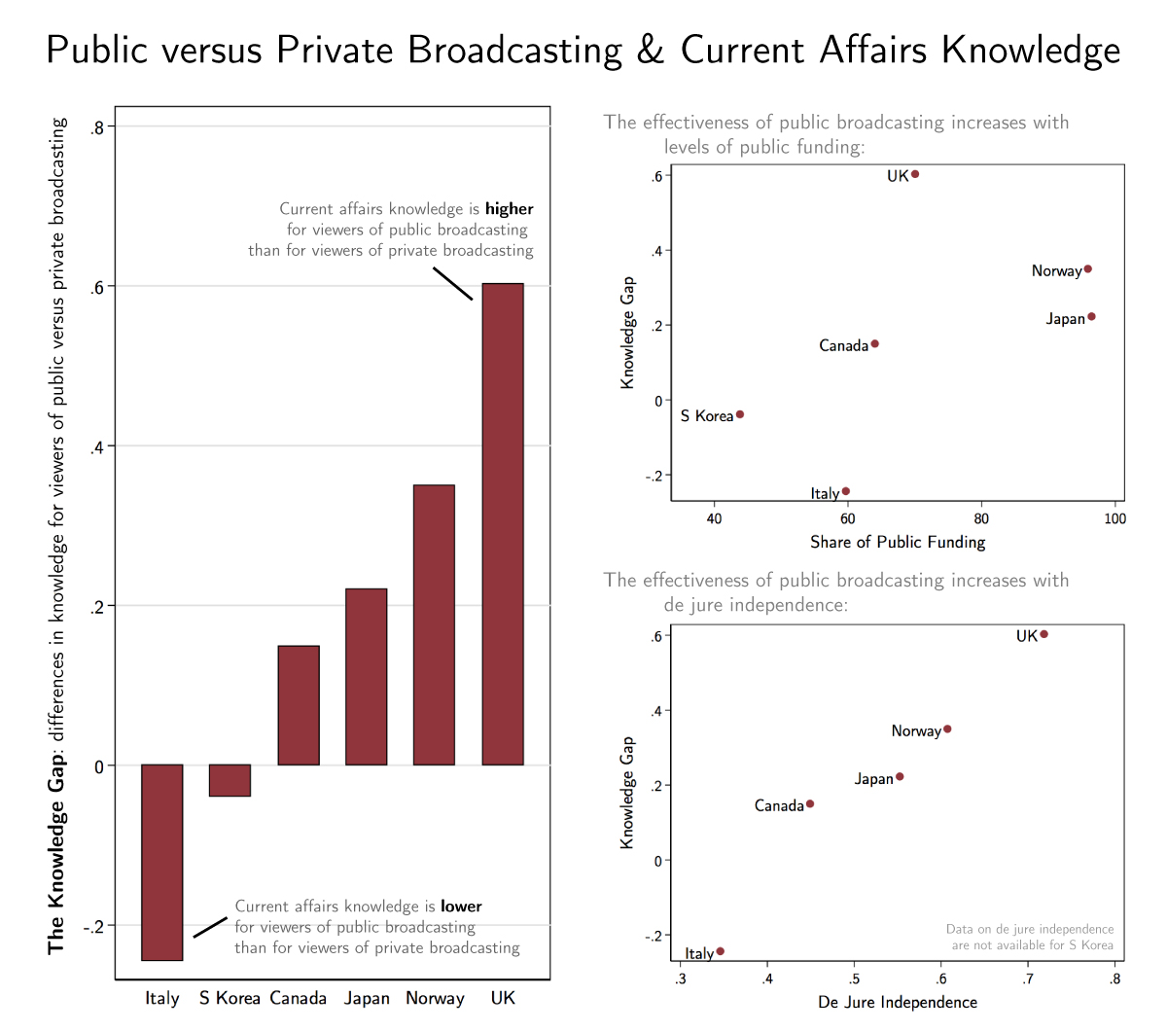

Slide 34
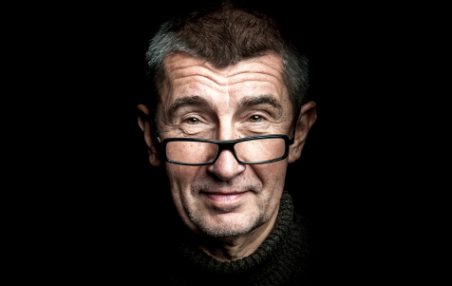
Who owns the media?
Typically families and government (little broad ownership)
Around world, government owns 27% of newspapers and 60% of TV
  More common in poor and authoritarian countries
  Especially high in Africa and Middle East
Government ownership correlated with:
  Journalists in prison, corruption
  Lack of citizen rights, lack of government effectiveness
  Worse education, apathy
Newspapers more important than TV
Be careful of direction of causality

