Slide 1
Rationality & Deliberation
Lecture 6

Slide 2
Citizen rule and citizens
If democracy quality = citizen rule, then a lot depends on citizens
What do citizens want?
Do they want anything?
Are their preferences stable?
Are their preferences reasonable?
Can they be manipulated?
Can they be improved?

Slide 3
1. The Bad News

Slide 4
Rational ignorance
Large costs to becoming informed about politics
  Reading newspapers and magazines
  Studying expert opinion
  Attending meetings
Few benefits to being well-informed
  Respect of peers?
  Ability to influence elections? Policy?

Slide 5
Public has very little knowledge of basic facts
Institutions and processes
People and players in politics
  People know PM/President, but not much else
Domestic and foreign politics
General political knowledge

Slide 6
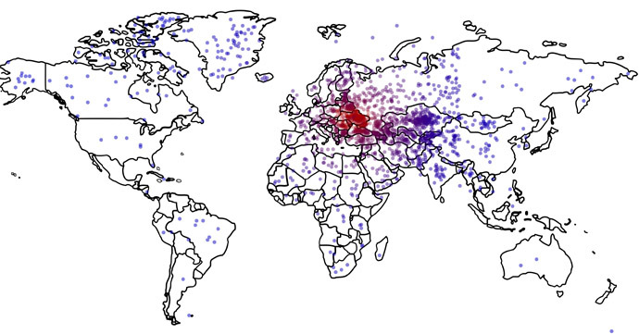
Where is Ukraine?
Only 16% locate correctly
Those who don’t know where it is are more likely to support military intervention

Slide 7
A summary of research on knowledge in US
Average American is poorly informed but not uninformed
  About 50% correct on one test of 16 questions
Levels of political knowledge relatively stable over last 50 years
Americans slightly less informed about politics than citizens of other nations
Average levels of knowledge mask important differences between groups
Knowledge is tied to many aspects of good citizenship
  More tolerance, more participation, more stable views

Slide 8
2. The will of the people

Slide 9
Does will of the people exist?
Individual level beliefs not very stable
  Little correlation over time
Most people are not very ideological
  Individual beliefs don’t cohere very well
Most people do not have strong political opinions
Most people take cues from parties and political leaders
  Adopt positions favored by preferred parties/politicians

Slide 10
Will of people depends on institutions
Will of people looks different under majoritarian and proportional institutions
Will of people looks different if presidential versus parliamentary, unicameral versus bicameral

Slide 11
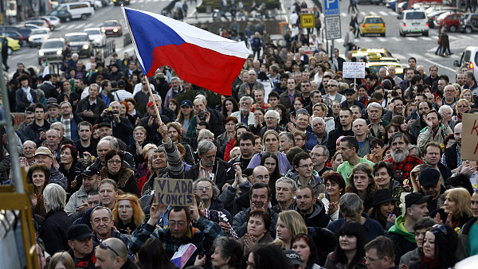
Problems in assessing the will of the people
Strong biases due to friends, colleagues, neighborhood, media
  1998: “I don’t know anyone who approves of Clinton”
  2006: “I don’t know anyone who approves of Bush”
Very hard to make accurate estimates
  Old method of public opinion: size and enthusiasm of crowds
We tend to think we know more than we do

Slide 12
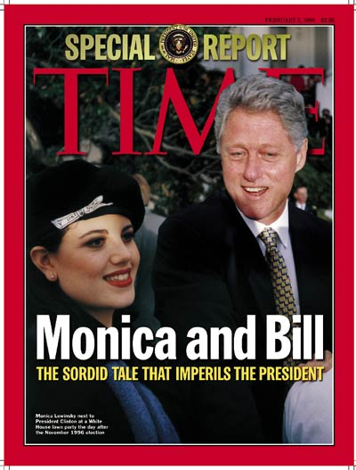
Monica Lewinsky’s contribution to political science
Clinton’s approval ratings go up after scandal
How is this possible?
  People usually don’t think about president
  Scandal causes them to think more about his accomplishments
  They distinguish his personal life from politics
  They realize that he does a good job as president
A revised view
  Media and elites not so powerful
  People influenced by fundamentals (eg, economy)

Slide 13
3. Good news

Slide 14
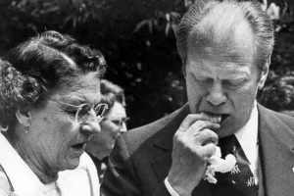
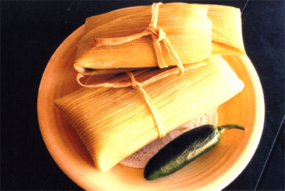
Heuristics - shortcuts
Are there easy ways to learn about politics?
Authority: what do others you respect think
  Endorsements of politicians, newspapers
Party or ideology
On-line processing
  Keep a running tally in your head for each party
    Positive information = +1 for party
    Negative information = -1 for party
  All you need to remember is total, not each piece of information

Slide 15
Condorcet’s jury theorem
If each voter has independent p>50% of choosing right policy (eg, 51%) and we use majority rule…
Then, probability of picking right policy => 100% as number of voters increases
  Actually increases very quickly: with 10,000 voters and p=51%, close to 100%
But
  Is p of being right >50%?
  Are all voters independent of each other?

Slide 16
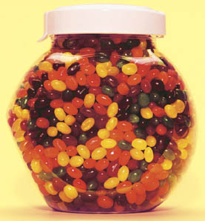

Wisdom of crowds
Groups can produce better predictions than individuals
  Eg, How much I weigh? How many jellybeans?
But only certain kinds of groups
  Opinions are independent
  Group is diverse
  Decentralization: People can specialize and draw on local knowledge
  Some means of aggregating individual views
Chcete být Milionářem?
  Most of the time the audience is right
  Much better than calling a friend

Slide 17
Miracle of aggregation
From individual ignorance to collective wisdom
  Voters not very well informed, but their errors are random
  Therefore, in a large sample their errors cancel out
Aggregate opinion is thus (i) more stable and (ii) more rational

Slide 18
The rational public
Look at changes in aggregate opinion over time on identical questions
  Eg, “Do you support or oppose same-sex marriage?”
  Does opinion change?
  How much does it change?
Results
  Most of the time opinion is stable
  Changes are mostly <5%
  Few fluctuations: up and down and up

Slide 19
Stability

Slide 20
Change, but explicable

Slide 21
How about the Czech Republic?
What would you expect?
New democracy, new issues, changing politics, changing economy => instability?
Or stability as in US?
Answer
  Mostly stable
  Exceptions: gay rights, joining the Euro

Slide 22
Support for EU membership

Slide 23
Opposition to anti-missile radar

Slide 24
Deliberation

Slide 25
Ideal deliberative setting
Everyone can speak
Everyone can introduce or question any assertion
No physical or psychological coercion
Evaluate arguments based on reason and evidence
Does this exist? Can we create it?

Slide 26
Cross-cutting discussions
Level of disagreement in interpersonal networks
Relatively rare, especially in US
  Most people not engaged in cross-cutting talk
  Norms against disagreement – talking about politics, religion
Less common in certain situations
  Family, close friends, voluntary associations
More common in others
  Workplace, lower income

Slide 27
Effects of cross-cutting talk
Increases tolerance
  Learn about other POVs
  Doubts about own POV
Decreases participation
  More ambivalence
  More likely to avoid conflict
Thus need both homogeneous groups to promote participation and heterogeneous groups to promote tolerance

Slide 28
Fishkin’s deliberative polling
Random selection of citizens invited to gather at a single place for a weekend in order to discuss issue.
Carefully balanced briefing materials are sent to the participants and are also made publicly available.
The participants engage in dialogue with competing experts and political leaders based on questions they develop in small group discussions with trained moderators.
Parts of the weekend events are broadcast on television, either live or in taped and edited form.
After the deliberations, the sample is again asked the original questions.

Slide 29
Europolis: A Deliberative Polity-Making Process
European Union (June 2009)
 | Before Deliberation % | After Deliberation % | Difference %
Agree that:
"We should do everything possible to combat climate change even if that hurts the economy" | 49 | 61 | +12
"I am enthusiastic about energy efficiency" | 75 | 84 | +9
"Immigration is an important problem" | 44 | 64 | +20
"Illegal immigrants should be eligible for national health care" | 63 | 71 | +8

Slide 30
Problems
Only a small number of public involved
  But they are more representative
  Can we use their opinions instead of elections?
  Cf., ancient Athens – election by lottery
How much time and effort will people commit?
Are the new opinions better?

