Slide 1
Misinformation and biases
Lecture 7

Slide 2
Today
Is problem that citizens are uninformed?
Or that citizens are misinformed?
  Systematic biases
  People confident in mistaken beliefs
Problems with political reasoning
Voting biases
Can we do better than democracy?
How can we make citizens better?
How can we make ourselves better?

Slide 3
Which is worse: lack of information or misinformation?
Misperceptions common about political issues (eg, vaccines)
Not always responsive to information (eg, Obama is a Muslim)
Source of misinformation is both politicians and grassroots
Knowledgeable people are not better off: better information but also stronger filters

Slide 4
1. Problems with political reasoning

Slide 5
Motivated reasoning
People believe what they want to believe
  Selective exposure: people seek out information consistent with their world view and avoid contradictory information
  Confirmation bias: people accept claims that reinforce their world view and reject claims that undermine their world view
These biases stronger among more sophisticated
Eg, Subjects watch a football match and are asked to assess decisions of referee
  More likely to think decisions against their team are bad

Slide 6
Partisan differences in viewing economy
Supporters of government parties see economy as better, supporters of opposition see as worse

Slide 7
Is internet the problem: Ideological segregation
Do people only view/read sources they agree with?
  Worry that with expansion of TV channels & internet people will segregate themselves
Isolation index: average conservative’s exposure – average liberal’s exposure
  Ranges from 0 (both sides read same thing) to 100 (each side reads something different)
  TV news best, internet okay, ordinary life the worst
Why?
  Still many popular, moderate sources versus small market for extremes
  People prefer news that is timely, well-written, and entertaining – takes a lot of resources to produce and thus tries to appeal to wide audience
  People browse, gather news from multiple sources
Compare real-life: do you have friends with very political different views

Slide 9
Conspiracy theories
Conspiracy theory = false theory or belief which ascribes excess malevolent intentionality and exaggerated power
  Past examples: Elders of Zion, Freemasons, Pope, UFOs
  Present examples: vaccines, 9/11
Why?
  We tend to anthropomorphize – see human intent readily
  Fundamental attribution error – attribute outcome to personality rather than context
Who believes them?
  Those with lack of trust, insecure employment, anomie
Can media stop them?

Slide 10
Systematic biases according to Caplan
Anti-market bias: people underestimate benefits of market
  Adam Smith on invisible hand
  Profits perceived as gifts rather than incentives
Anti-foreign bias: people underestimate benefits of interactions with foreigners
  Trade seen as zero-sum rather than positive-sum
Make-work bias: people underestimate benefits of conserving labor
  Worries about downsizing and technology; but they increase productivity
Pessimistic bias: people overestimate problems and underestimate future

Slide 11
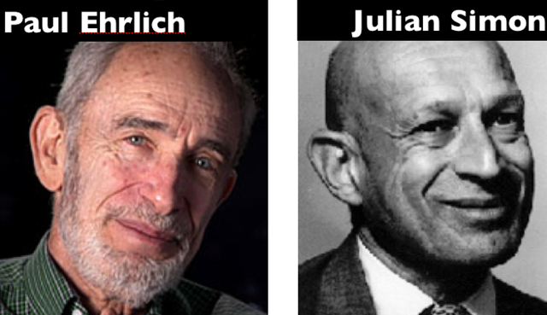
The bet: Julian Simon and Paul Ehrlich
Ehrlich published The Population Bomb in 1968, predicts that the world is running out of resources => starvation
In 1980 bets with Julian Simon that price of five metals (copper, chromium, nickel, tin, tungsten) will increase from 1980 to 1990
  If metals are becoming scarce, then price should increase
Simon wins the bet: the price of all five declines

Slide 12
2. Problems with voting

Slide 13
Extreme myopia
Retrospective economic voting should give politicians an incentive to produce better economy
But what economy do voters care about
  Mainly last year of electoral term or even last 3 months!
Politicians should thus only worry about economy at end of term
  Recall political business cycle

Slide 14
Duration neglect
Voters forget the length of good times and bad times
  Churchill in 1945: Wasn’t saving you from the Nazis enough?
  Answer: No
In short, what have you done for me lately
Or:
  I don’t know what the parties are doing now, but I know the Communists were bad.

Slide 15
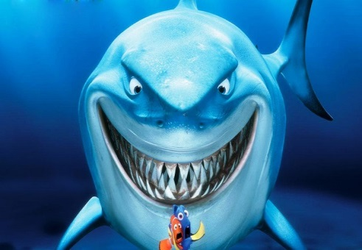
Blind retrospection
Voters will punish governments for shark attacks, droughts, flu, sports losses!
  God punishes society for sin?
When voters in pain, they kick the government
Even if it is not government’s fault!
Also, reward for good events outside of control
  Eg, oil price rises in oil-producing areas

Slide 16
Shark attacks!

Slide 17
What policies should politicians chose?
Voters reward politicians for disaster relief spending but not for disaster prevention

Slide 18
What has happened in the Great Recession?
Crisis of financial capitalism
Expect voters to turn to the left
  Punish capitalists
  Increase welfare
But right does slightly better (though only small effect)
Biggest effect = punishment of incumbents

Slide 20
In short
Whoever is in office at time of crisis loses and loses badly
Voters aren’t trying to choose best policies
Voters aren’t able to attribute blame
  Which parties were responsible for crisis?
  Who did the best job fighting against it?

Slide 21
If not rational, then what?
Group or identity thinking
  Emotional attachments that transcend thinking
People adopt opinions of group they belong to – family, school, occupation, race, ethnicity, party
  Thus, I draw policy preferences from the party I like
  I don’t choose party based on its policies

Slide 22
3. Can we do better than democracy?

Slide 23
How to do better than democracy?
Leave economic policy to economists
  Economists have systematically different beliefs than public
  Less prone to biases
More power, more votes for educated
Less government, more markets?

Slide 24
Are elites always more informed?
Consider foreign policy views in US
Public very multilateralist
  Supports UN, peacekeeping, Kyoto, International Criminal Court
  Opposes unilateral use of force
Elites disagree 73% of time: more unilateral
  Support use of force, oppose multilateralism
Who is objectively correct here?

Slide 25
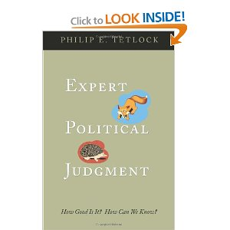
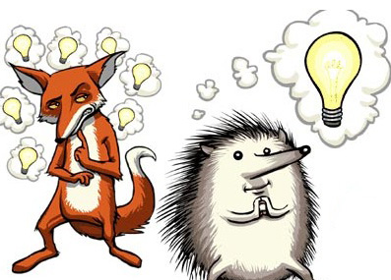
Can experts predict the future?
Tetlock asks 284 experts to make predictions on world affairs
  82,000 forecasts over 20 years
  3 possible futures – probability of each
Experts do very poorly – not much better than chance
Do far worse than simple extrapolation of past trends
Only difference is between hedgehogs and foxes
  Hedgehogs know 1 big thing
  Foxes know many little things

Slide 26
Making experts better
Force them to make clear predictions and monitor their performance
More bets between scholars
  If you are not willing to bet, does that mean that you don’t believe what you are saying
Prediction markets
Harness wisdom of crowds
  Good Judgment Project: teams compete at making predictions

Slide 27
4. Making citizens better

Slide 28
A better media?
Should media provide more informative reporting
  More: positions of parties, events in parliament, effects of policies
  Less: horse-race (who is winning)
But who wants to read it?
Is problem the lack of available information or lack of interest?
Can political scientists help?
  Can we provide useful information to journalists?
  How to make it interesting?

Slide 29
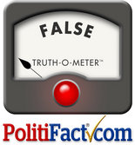
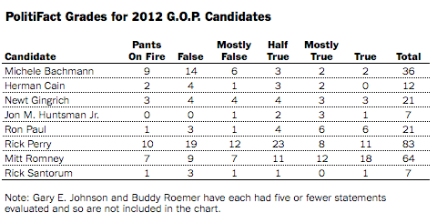
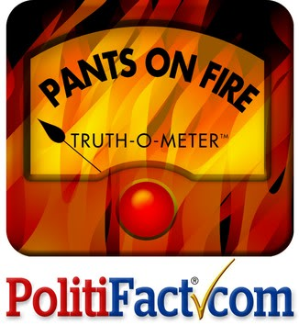
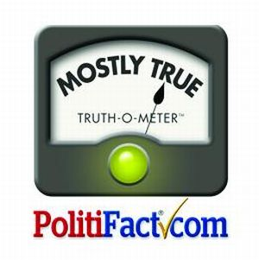
Ad watch/Fact check
Non-partisan attempts to check the facts on political advertisements and claims of politicians

Slide 30
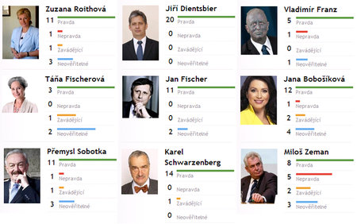
Demagog.cz

Slide 31
Does it work?
Are judgments of falsity correct?
Misperceptions hard to change
Need to be careful:
  Don’t repeat false claims (illusion of truth from familiarity)
  Don’t just state negation (Zeman is not a criminal)
  Need credible experts or on same side of those with misperception
  Need alternative causal story (if X=>Y is wrong, then what does cause Y)
  Graphics help

Slide 32
Maybe it affects politicians more than politicians
Recent experiment: send letters to politicians telling them that they will be fact-checked (other politicians don’t get this letter)
Those who receive letters are less likely to tell falsehoods

Slide 33
5. Making yourself better

Slide 34
How to avoid irrationality
Are you becoming angry during political discussion?
Do you have strong opinions about a subject before acquiring relevant evidence?
Do your opinions NOT change as you gather evidence?
Do you seek information only from sources you agree with?
Do you think people who disagree with you must be evil?

Slide 35

Danger of stories
Our brains are programmed to like stories
But stories are biased
  Narratives are too simple
  Emphasize intentions, but world often unintentional
  A little knowledge often worse than no knowledge
  People who tell stories are trying to manipulate you
What are typical narratives about Czech politics
  Battle against communism/communists
  Czechs versus foreigners (Germans, Austrians, EU)
  Ordinary people versus rich and powerful
  Honest people versus corrupt politicians

