Slide 1
Gender Perspectives in Social Work Practice
Coming out
And
Homophobia
Gyeongran Kim
Magdaléna Popovičová
Nikos Stamou

Slide 2
Ⅰ Definition
Ⅳ Social work
Ⅱ Cycle of
Oppression
Ⅴ Conclusion
Ⅵ References
Ⅲ Cultural differences

Slide 3
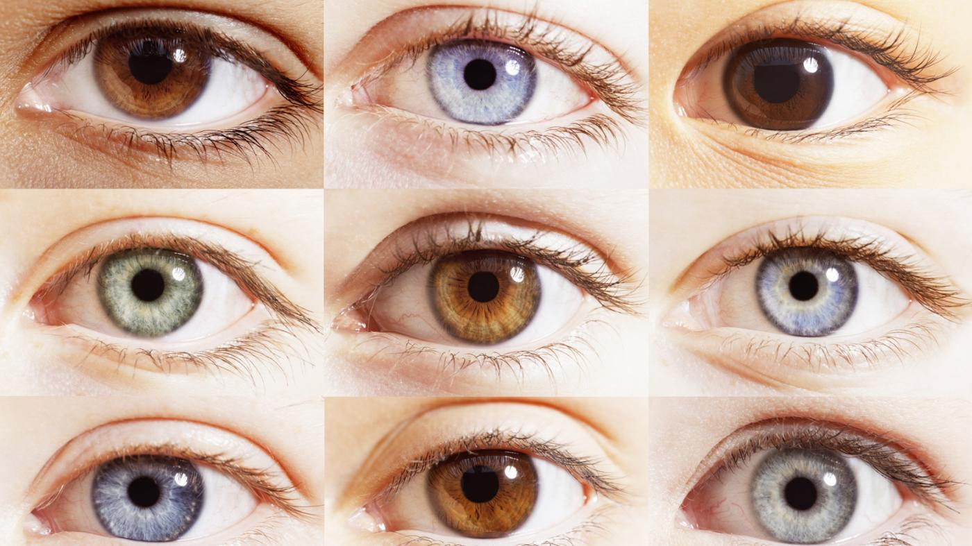
Ⅰ Definition
Diversity in general
Height
Eye color
Favorite food

Slide 4
Ⅰ Definition
Diversity in social work
: Diversity which is important to society and makes a difference in people's lives.
BASIC & SECONDARY DIMENSIONS OF DIVERSITY (Loden & Rosener, 1991)
Basic dimensions
Changeable
Invisible
Secondary dimensions
Unchangeable
Visible (except sexual orientation)
Notes:
. The diversity that employs social workers is one that is important to society and make a difference in people's lives.
BASIC & SECONDARY DIMENSIONS OF DIVERSITY (Loden & Rosener, 1991) 1. Basic dimensions are elements that have some ability to change. We can also choose whether to reveal or hide these features.
2. Secondary dimensions are aspects of ourselves that we can not change. Things that others know about us before we even open our mouths, because it is visible (except sexual orientation).

Slide 5
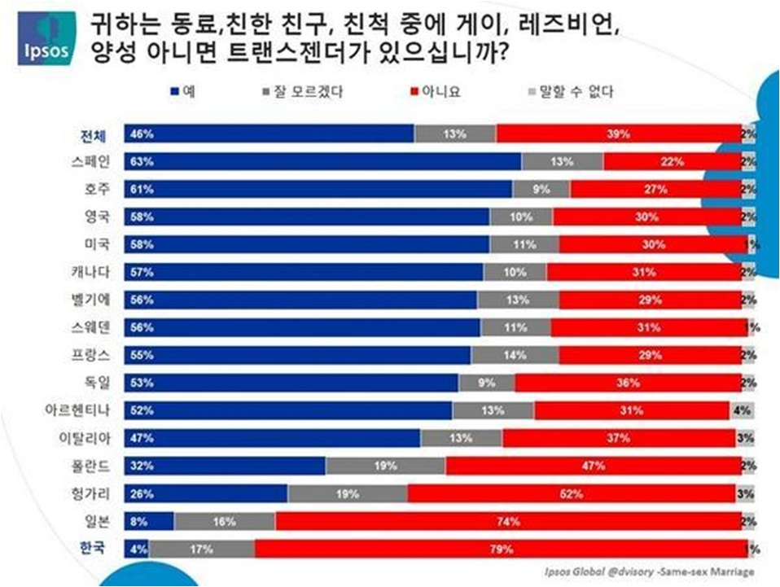
Ⅰ Definition
Gender Identity (Healy, 2014)
reflects a deeply felt and experienced sense of one’s own gender
consistent with the sex assigned to them at birth
Transgender People
Inconsistency between
their sense of their gender and the sex they were assigned at birth.
Often their characteristic may conflict with society’s expectations of gender-normative behavior
Transvestite (In dictionary Miriam Webster-online)
A person who wears clothes designed for the opposite sex
Usually they are identified as straight people
Notes:
reflects a deeply felt and experienced sense of one’s own gender
connsistent with the sex assigned to them at birth
Trasgender people
For trasgender people is an inconsistency between their sense of their own gender and the sex they were assigned at birth and offten their characteristic may conflict with society’s expectations of gender-normative behaviour.
Tranvestite (in dictionary Miriam Webster - online)
a person who wears clothes designed for the opposite sex
he do not usually identify as transgender—most identify as straight men Laura Erickson-Schroth

Slide 6
Ⅰ Definition
Sexual Orientation (Healy, 2014)
A person’s physical, romantic or emotional attraction toward other people
Integral to a person’s identity
Heterosexual
are attracted to individuals of a different sex from themselves
Homosexual
are attracted to individuals of the same sex from themselves
Notes:
refers to a person’s physical, romantic or emotional attraction towards other people
everyone has a sexual orientation, which is integral to a person’s identity
Homosexual
are attracted to individuals of the same sex as themselves
Heterosexual (sometimes known as ‘straight’)
are attracted to individuals of a different sex from themselves
Bisexual
may be attracted to individuals of the same or different sex
=> Sexual orientation is not related to gender identity

Slide 7
Ⅰ Definition
Sexual Orientation
Bisexual
are attracted to individuals of the same or different sex from themselves
Queer
attracted atoms and two sexes and / or transgendered (transgendered) atoms
Asexual
Does not feel sexual attraction
Notes:
Queer: attracted atoms and two sexes and / or transgendered (transgendered) atoms Asexuall: does not feel sexual attraction

Slide 8
Ⅱ Cycle of Oppression
Stereotype
Pre-
judgment
Discrimination
Oppression
Internalized
Oppression

Slide 9
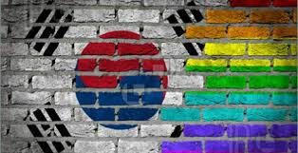
Ⅲ Cultural differences-Korea
“Big wall to break”

Slide 10
Ⅲ Cultural differences-Korea
Do you have any acquaintances who are LGBT? (%)
Most of Korean LGBT
are afraid of coming-out
(Ipsos global;2015)

Slide 11
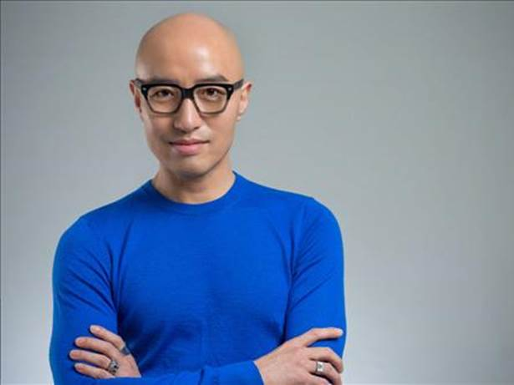
Ⅲ Cultural differences-Korea
Hong Seok-cheon
An actor and famous celebrity in Korea
After he revealed his homosexuality
Fired from his TV programs and advertisements
No longer landed any major acting roles
Faced massive stigma
Still he is the first and the last celebrity who did coming out in Korea
Notes:
Hong Seok-cheon is an actor and tv star in Korea.
In 2000, Hong was asked a question regarding his sexuality on a variety show,
and he chose to answer honestly that he was gay.
After Hong revealed his homosexuality, he was fired from his network television programs and advertisements amidst public uproar, and no longer landed any major acting roles.
He faced massive stigma after becoming the country's first openly gay celebrity,
and later said he experienced shunning, verbal abuse and discrimination that he rarely stepped out of his social circle
Nowadays he appears regulary on the TV show again and loved by Korean with a nickname of "Korean top gay".
Still he is the first and last celebrity who did "coming out" in Korea.

Slide 12
Ⅲ Cultural differences-Greece
“Existent but dormant”
a) indifference on the part of non concerned parties
b) deception and lack of trust on the part of parties
directly concerned (LGBTs and their organizations).
Notes:
existent but dormant.
One may observe
a) indifference on the part of non concerned parties and
b) deception and lack of trust on the part of parties directly concerned (LGBTs and their organisations).
This tacit acquiescence to homophobia is nurtured by a number of factors which are peculiar within Greek society. At least six factors may be pointed out:
6 factors which made the tacit acquiescence to homophobia
a) the main role of the Greek Orthodox Church in Greek society and its influence in the homophobic stance
b) the homophobic stance of the majority of politicians.
c) the negative imagery Thematic study Greece 6 put forward by the media,
d) the role of the police,
e) the absence of sexual education in schools and
f) the unwillingness of all the governments to pay attention to substantiated LGBT claims and to legislate in accordance. (Vasilis Hatazopoulos, 2010)
put forward by the media,

Slide 13
Ⅲ Cultural differences-Greece
6 factors which made the tacit acquiescence
The main role of the Greek Orthodox Church in Greek society and its influence in the homophobic stance
The homophobic stance of the majority of politicians
The negative imagery Thematic put forward by the media
The role of the police
The absence of sexual education in schools
The unwillingness of all the governments to pay attention to substantiated LGBT claims and to legislate in accordance.
(Vasilis Hatazopoulos, 2010)
Notes:
existent but dormant.
One may observe
a) indifference on the part of non concerned parties and
b) deception and lack of trust on the part of parties directly concerned (LGBTs and their organisations).
This tacit acquiescence to homophobia is nurtured by a number of factors which are peculiar within Greek society. At least six factors may be pointed out:
6 factors which made the tacit acquiescence to homophobia
a) the main role of the Greek Orthodox Church in Greek society and its influence in the homophobic stance
b) the homophobic stance of the majority of politicians.
c) the negative imagery Thematic study Greece 6 put forward by the media,
d) the role of the police,
e) the absence of sexual education in schools and
f) the unwillingness of all the governments to pay attention to substantiated LGBT claims and to legislate in accordance. (Vasilis Hatazopoulos, 2010)

Slide 14
Ⅲ Cultural differences-Czech
From 1990 according to the law (Act 175/1990 Sb) homosexuality was made equal to heterosexuality
From 2006 was adopted the law (Act 115/2006 Sb)
about registered patnership
(Procházka, Gaupner 2005)
Notes:
from 1990 according to the law (Act 175/1990 Sb) homosexuality was made equal to heterosexuality (Procházka, Gaupner 2005)
from 2006 was adopted the law (Act 115/2006 Sb) about registered patnership

Slide 15
Ⅲ Cultural differences-Czech
The perception of homosexuality
by Center for Public Opinion Research 2016 (Czech CVVM)
Proponent of homosexuality is mostly from people
in the ages 15-44 years with education
(especially absolvents from college)
opponents are usually people over 60 year, retiree, low-waged education and by Roman Catholic religion
Since 2008 - 2009 these groups are quite balanced and tolerant of their presence (for example in the neighborhood) since 2008 has increased
Notes:
The perception of homosexuality by Center for Public Opinion Research 2016 (Czech CVVM) are:
promotion of homosexuality is the most from people in the ages 15-44 years with education (especially absolvents from college)
opponents are usually people over 60 year, retiree, low education and by Roman Catholic religion
Since 2008 - 2009 these groups are quite balanced and tolerance of their presence (for example in the neighborhood) since 2008 has increased

Slide 16
https://www.youtube.com/watch?v=h4u4gqRgAag

Slide 17
Ⅳ Social work
What tools should social workers use ?
Participation
Intersectionality
to understand a social situation
of those people
Support
in struggle to society like stereotypes, prejudices and discrimination in gender view
Notes:
Social workers should be use a
tools like a participation and
a view of intersectionality
to understand a social situation those people
and also to support them in struggle to society like stereotypes, prejudices and discrimination in gender view too.
For example:
In the Czech is a non-profit organization called Stud*, which supported all people who fall under LGBT (lesbian, gay, bisexual and transgender) in their rights and equalization. In social work we can see it like a community work, which empowers this group to gain their cohesion, solidarity based on the civil rights.
In Corea ?
In Greece?
*link here: http://www.stud.cz/o-nas.html

Slide 18
Ⅴ Conclusion
Our suggestion
Non-profit organization which support all people who fall under LGBT in their rights and equalization.
Empower this kind of group
to gain their cohesion, solidarity
Based on their civil rights.
Notes:
Social workers should be use a
tools like a participation and
a view of intersectionality
to understand a social situation those people
and also to support them in struggle to society like stereotypes, prejudices and discrimination in gender view too.
For example:
In the Czech is a non-profit organization called Stud*, which supported all people who fall under LGBT (lesbian, gay, bisexual and transgender) in their rights and equalization. In social work we can see it like a community work, which empowers this group to gain their cohesion, solidarity based on the civil rights.
*link here: http://www.stud.cz/o-nas.html

Slide 19
Ⅵ References
Healey, J. (2014). Sexual Orientation and Gender Identity. Thirroul, N.S.W.: Spinney Press. link here: http://eds.a.ebscohost.com/eds/ebookviewer/ebook/bmxlYmtfXzgxODI1N19fQU41?sid=4a0728b5-6f1d-479b-aca6-10d2361d044f@sessionmgr4007&vid=1&format=EB&rid=3 00378. ISBN 9781922084569
PROCHÁZKA, I., GRAUPNER, H. 2005. Historie právních postojů k homosexualitě.[online] Praha: Econnect. Dostupné z: <http://www.ecn.cz/PRIVATE/logos/pravhist.htm>.
Zákon č. 115/2006 Sb. o registrovaném partnerství a o změně některých souvis. zákonů. [online] Praha: Ministerstvo vnitra. [cit.06. 04. 2017]. Dostupné z: <http://portal.gov.cz/wps/portal/_s.155/701/.cmd/ad/.c/313/.ce/10821/.p/8411/_s.155/701?PC_8411_l=115/2006&PC_8411_ps=10#10821>.
Center for Public Opinion Research. 2016. public attitudes to the rights of homosexuals.(online).[cit.06. 04. 2017].link here: http://cvvm.soc.cas.cz/media/com_form2content/documents/c1/a7579/f3/ov160725.pdf
“tranvestity” Merriam Webster - dictionary [online].link here: https://www.merriam-webster.com/dictionary/transvestite . [cit.06. 04. 2017].
Legal Study on Homophobia and Discrimination on Grounds of Sexual Orientation and Gender Identity,Hatzopoulos,V.(2010)file:///C:/Users/N%CE%99%CE%9A%CE%9F%CE%9B%CE%91%CE%9F%CE%A3/Downloads/1352-LGBT-2010_thematic-study_EL.pdf

Slide 20
https://www.youtube.com/watch?v=fmaHOui33SE

Slide 21
Q&A

Slide 22
Thank you

