Slide 1
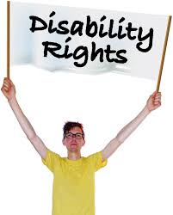
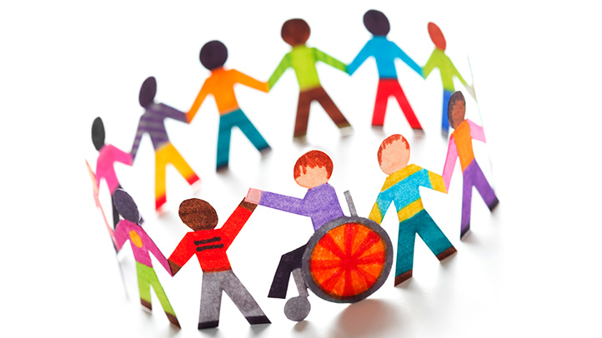
DISABILITY
Aneta Mácová, Michaela Sošková, Julie Dvořáková

Slide 2
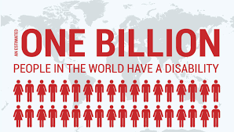
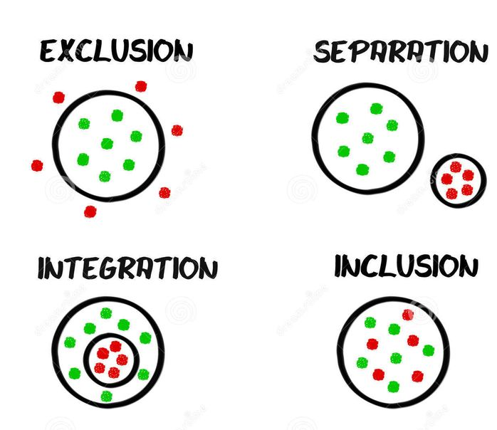
Content
Disability
Models of disability
Categories
Stereotypes, prejudicies
Intersection
Media
What come to your mind when you hear this word? What do you think that comes into mind of others people?

Slide 3
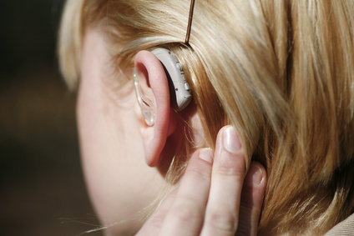
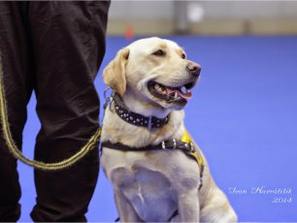
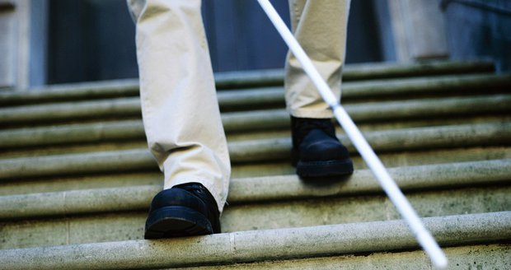
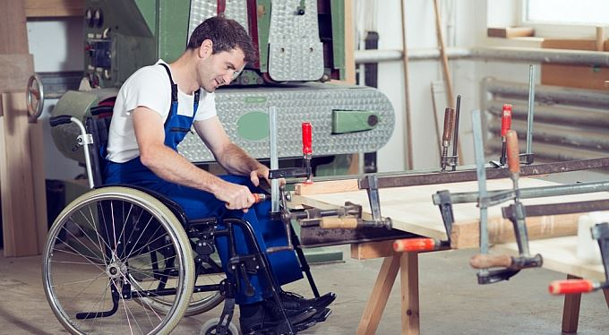
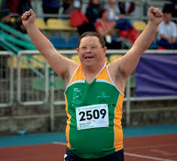

Slide 4
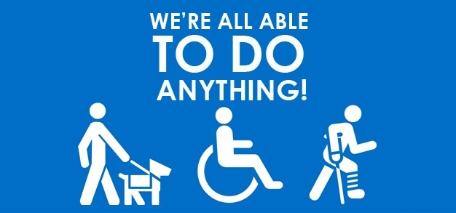
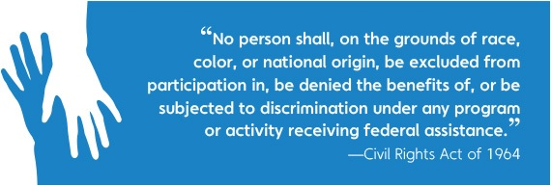
Disability is understood as the consequence of social conditions (society, culture and politic phenomen) which counts with the social environment
Earlier was the deficnition oriented about the handicap and the people with the impariment, primaryly for defects as the problem of the person. Nowdays the concepts focused more for the barriers which are caused by the environment.
Disability as a studying field is trying
to describe the phenomen thanks to the people with self life experience for creating the space which is without bariers - social exclusion and prejudicies
The experience of disability is nontransferable, and for people without a personal experience is difficult to understand the context of daily life
In everyday life the existence of people with some disorder is perceived as a non normal phenomenon, although is natural and normal and has been a part of the world since ever

Slide 5
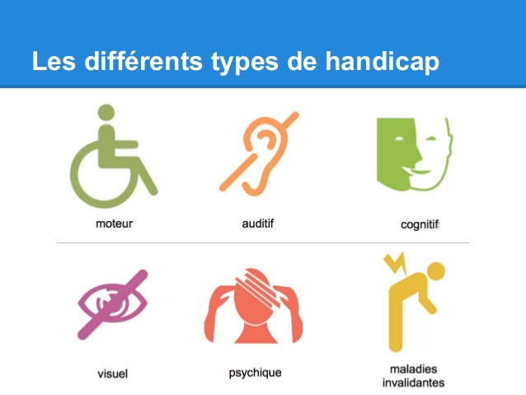
If we asked about the impairment/handicap we should asked why we need to know that
Disabled people are often talked about as though they form one group, but every disabled person faces different challenges and health conditions.
Care for people with disability therefore varies greatly, and finding the right solution for each person will need careful assessment and review of available resources.
Disability might be :
Physical
Sensory
Mental
--> or some combination of these
-->It substantially affects a person's life activities and
may be present from birth or occur during a person's lifetime.
The levels of disability → Long term adverse effect:
NONE
MILD → I. 35% - 49%
MODERATE → II. 50% - 69%
SEVERE → 70%
TOTAL

Slide 6
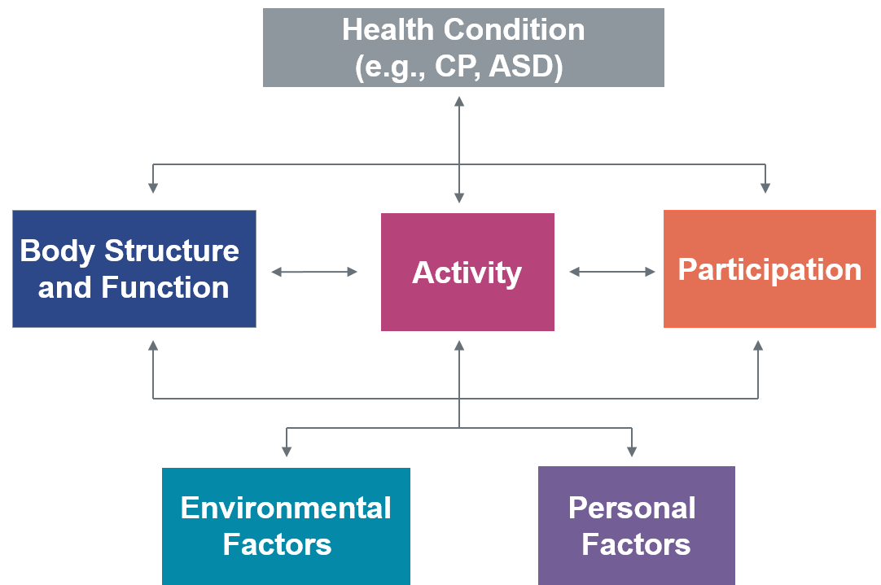
The International Classification of Functioning, Disability and Health (ICF), produced by the WHO, distinguishes between body functions and body structures and made a lists broad domains of functioning which can be affected:
Learning and applying knowledge
General tasks and demands
Communication
Basic physical mobility, Domestic life, and Self-care (for example, activities of daily living)
Interpersonal interactions and relationships
Community, social and civic life, including employment
Other major life areas

Slide 7
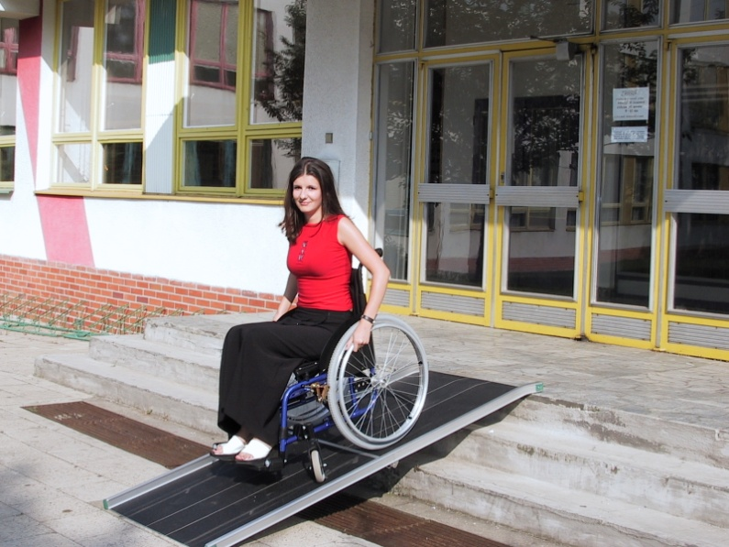
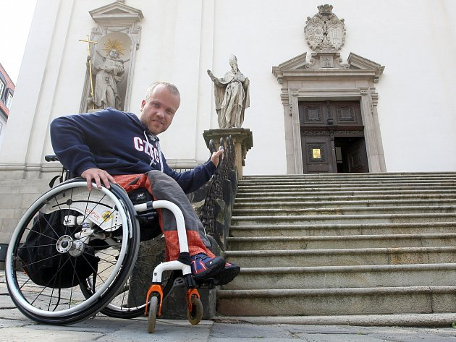
Models of Disability
The medical model views disability as a problem of the person, directly caused by disease, trauma, or other health conditions which therefore requires sustained medical care.
The social model of disability sees "disability" as a socially created problem and a matter of the full integration of individuals into society.
The management of the problem requires social action It is the collective responsibility of society to create a society in which limitations for people with disabilities are minimal.

Slide 8
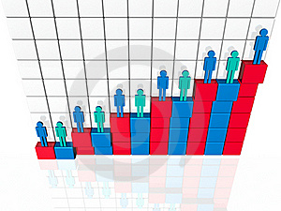
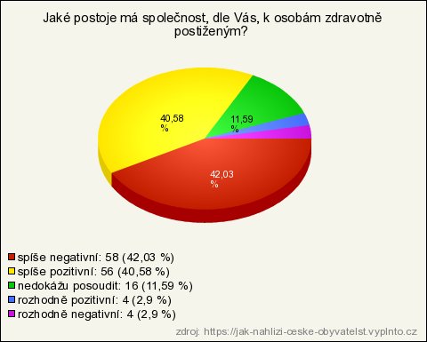
Social construction
https://www.youtube.com/watch?v=sBeXA-Rh85g
The social construction of disability is the idea that disability is constructed by social expectations and institutions rather than biological differences.
Social construction of disability would argue that the medical model of disability's view that a disability as an impairment, restriction, or limitation is wrong. Instead what is seen as a disability is just a difference in the individual from what is considered "normal" in society.

Slide 9
If we „gave space“ for people with handicap to have their rights in maximum, its not giving an benefits to them, its normal and its not diskrimination
Based on the bariers of environment or society the people with handicaps with long term problems, can make harder their inclusion in every day life
The prohibition of discrimination is given by law in every country – the most importnat is nowdays contained in the Convention on the Rights of Persons with Disabilitie
If you try to find out that the discrimination might occure in some situation is good to ask a question: "Would it be different in this situation with a person without a disability?"
The discrimination can have different types: direct/non direct
The right of access or accessibility is the key right of people with disabilities. Persons with disabilities must have access in particular to transport, information and communication, including in- formation and communication technologies and systems, and to other facilities and services available or provided to the public.
The most effective legal remedy for protection against discrimination is legal action. Anti-discrimination disputes are, however, complex and with uncertain prospect of success. To manage them successfully, it is advisable for people with disabilities to use the services of a lawyer.
A universal place to help victims of discrimination in the Czech Republic is the Public Defender of Rights - the Ombudsman, who can be contacted for assistance in cases of discrimination.
Anti-discrimination law is the last means of defense against discrimination. Often it helps negotiation, mediation and dispute resolution by non-legal means.

Slide 10
Identity
In contexts where their differences are visible, persons with disabilities often face stigma.
People frequently react to disabled presence with fear, pity, patronization, intrusive gazes, revulsion, or disregard.
These reactions can, and often do, exclude persons with disabilities from accessing social spaces along with the benefits and resources these spaces provide.
“Going out in public so often takes courage. How many of us find that we can't dredge up the strength to do it day after day, week after week, year after year, a lifetime of rejection and revulsion? It is not only physical limitations that restrict us to our homes and those whom we know. It is the knowledge that each entry into the public world will be dominated by stares, by condescension, by pity and by hostility.”
(Jenny Morris with personal experience with disability )
Facing stigma can cause harm to psycho-emotional well-being of the person being stigmatized.
→ It can lead to feeling that they are weak, crazy, worthless, or any number of other negative attributes that may be associated with their conditions.

Slide 11
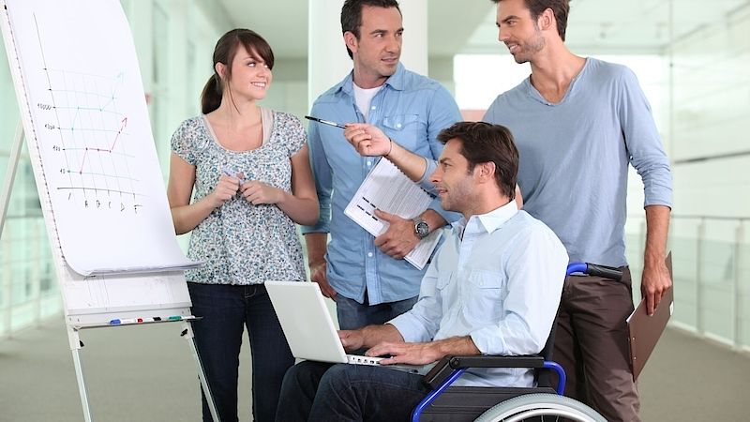
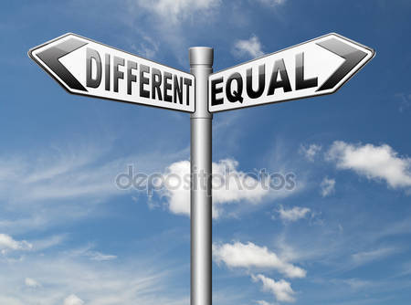
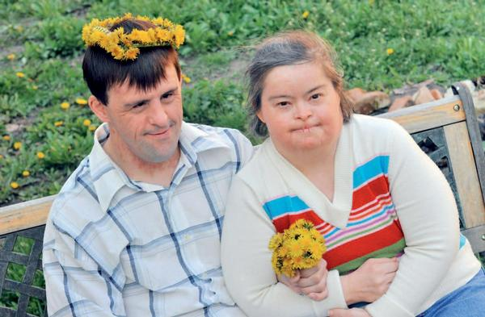
Stereotypes
Little people are Surreal – film – The Eyes of Laura Mars
Single Episode Disability
Disability Superpower
The object of pity
Sinister or evil – anti-hero
Eternal innocence – paired with people with intellectual disabillities ( Forest Gump, I am Sam, Rainman
Asexual, undesirable, or incapable of sexual or romantic interactions examples – adolescent coming-of-age storzlines and teen sick-lit such as The Fault in our Stars
https://www.youtube.com/watch?v=S6sLI7-Ulh8
https://www.youtube.com/watch?v=MmWtSF0lWPM

Slide 12
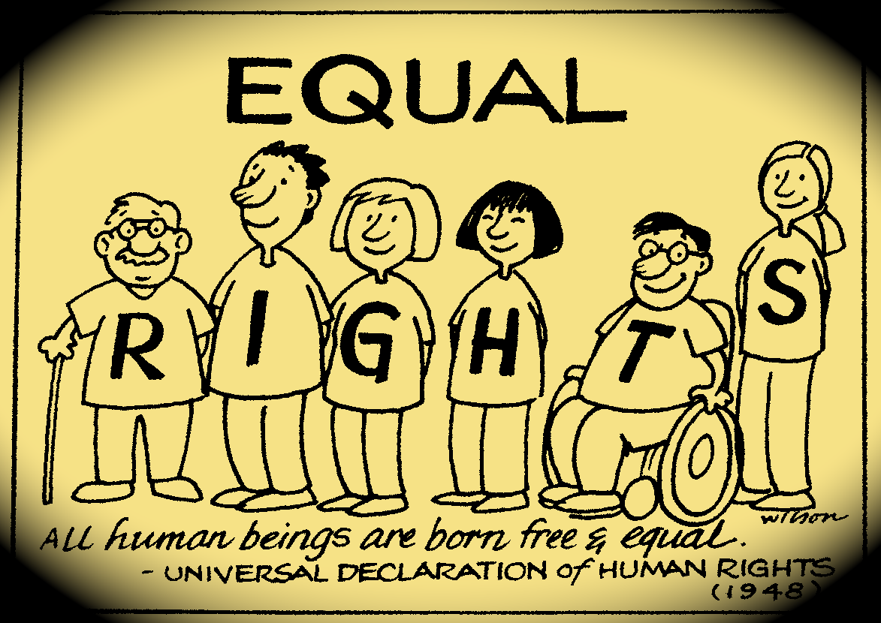
Predjudicies
Persons with disabilities have not sexual desire, and they are not able to engage in sexual relations.
can not have “reale“ sex.
can not have romantic partners.
is not the target of sexual assaults.
are not able to grow up a childrens.
have increased (or reduced) sexual instincts.
are still a children, if he will be taught in the part of sexual life, the sexual instinctes can woke up.
are not be educate.
The stay of mentally handicapped children and healthy children in one class adversely affects their development.
The healthy children are not ready to acept disabled children as a friend.
With retardacion have lower job performance.
Need to be protected before a failure.
To place a worker with mental retardation in the workplace are necessary the increased cost of the employer.
Person with disability can not work alone.
are not able to live alone, and take care about himself without help.
the best felling, when they are with people like they are.
is inadequate, he does not decide for himself, he has no identity card.

Slide 13
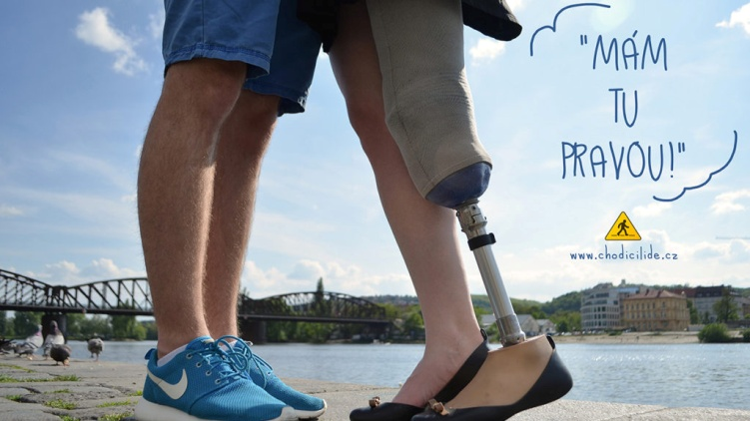
Media
The media play a significant role in creating and reinforcing stigma associated with disability.
Media coverage that is "negative", "unrealistic", or displays a preference for the "pitiful" and "sensationalistic" over the "everyday and human side of disability" are identified at the root of the dissatisfaction.
https://youtu.be/kian33iQf_o
„Many people with disabilities believe mainstream journalists are incapable of accurately covering stories about them. Generally, journalists either portray us as pitiful cripples, super achievers, or insane mental patients. These erroneous media stereotypes of people with disabilities are perpetuated because journalists consistently fail to understand or learn about people with disabilities and the issues that are important to us. „
Journalist Leye Jeannette Chrzanowski, who uses a wheelchair

Slide 14
References
Mallon, Ron (2014-01-01). Zalta, Edward N., ed. Naturalistic Approaches to Social Construction (Winter 2014 ed.).
Weiner, B.; Perry, R. P. & Magnusson, J. (1988). "An attributional analysis of reactions to stigmas". Journal of Personality and Social Psychology.
Shakespeare T (2001). "The social model of disability: An outdated ideology?". Research in Social Science and Disability. 2: 9–28.
"International Classification of Functioning, Disability and Health". WHO. Retrieved 15 November 2011.

Slide 15
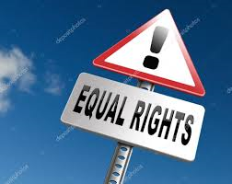
Thank you for your attention!

